Slide 1
Generate a Physics Experiment with Python
import numpy as np
import matplotlib.pyplot as plt
testrand = np.random.rand(42000)
Base = 110 + 30* np.random.rand(42000)
index = (1.0 - 0.5* (Base-110)/30) > testrand
gauss = 2 * np.random.randn(300) +126
Sloping = Base[index]
NarrowGauss = 0.5 * np.random.randn(300) +126
total = np.concatenate((Sloping, gauss))
NarrowTotal = np.concatenate((Sloping, NarrowGauss))

Slide 2
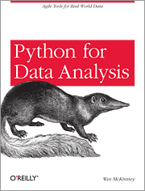
Python Resources
http://www.enthought.com/products/epdgetstart.php Python distribution including NumPy and SciPy with plot package matplotlib
Also pandas and iPython
Python for Data Analysis Agile Tools for Real World Data By Wes McKinney
Publisher: O'Reilly Media
Released: October 2012
Pages: 472

Slide 3
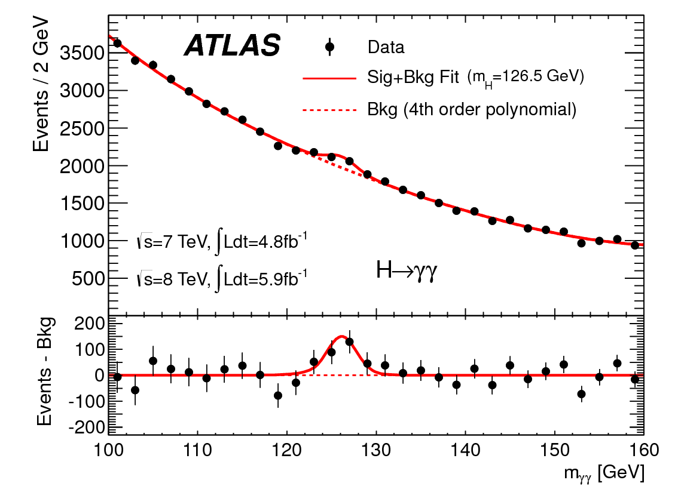
http://www.quantumdiaries.org/2012/09/07/why-particle-detectors-need-a-trigger/atlasmgg/
Model

