Slide 1

Python Resources
http://www.enthought.com/products/epdgetstart.php Python distribution including NumPy and SciPy with plot package matplotlib
Also pandas and iPython
Python for Data Analysis Agile Tools for Real World Data By Wes McKinney
Publisher: O'Reilly Media
Released: October 2012
Pages: 472

Slide 2
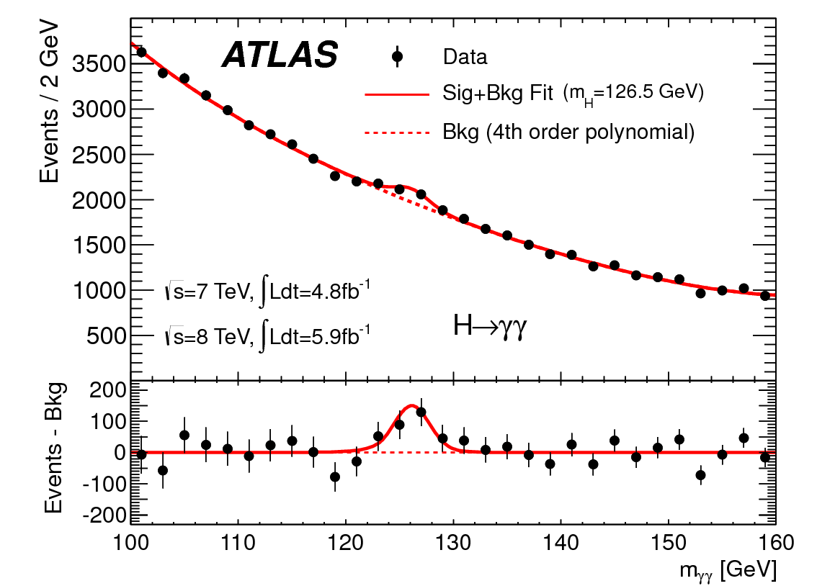
http://www.quantumdiaries.org/2012/09/07/why-particle-detectors-need-a-trigger/atlasmgg/
Model

Slide 3
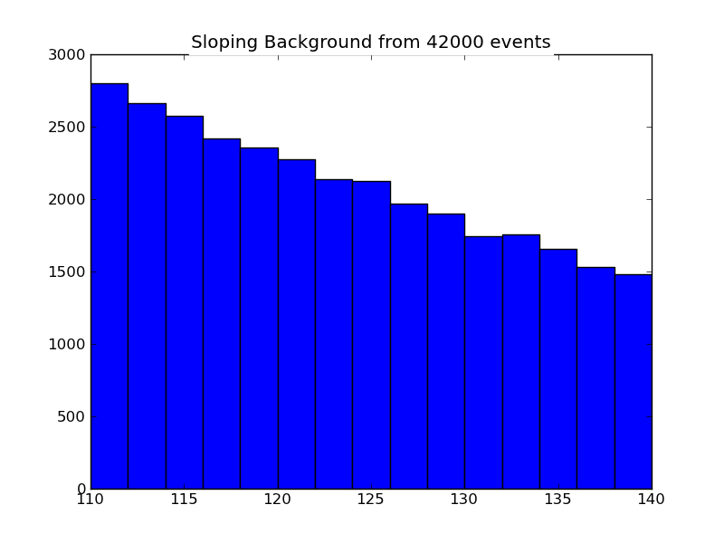
Sloping

Slide 4
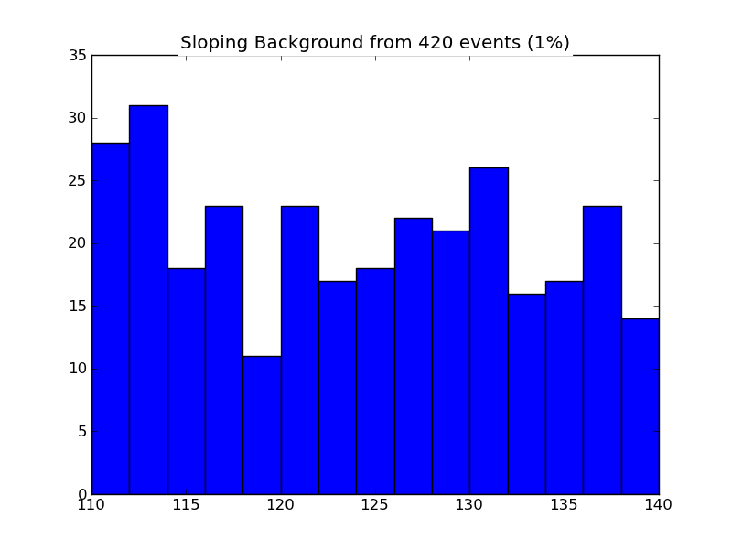
Sloping 1% Data

Slide 5
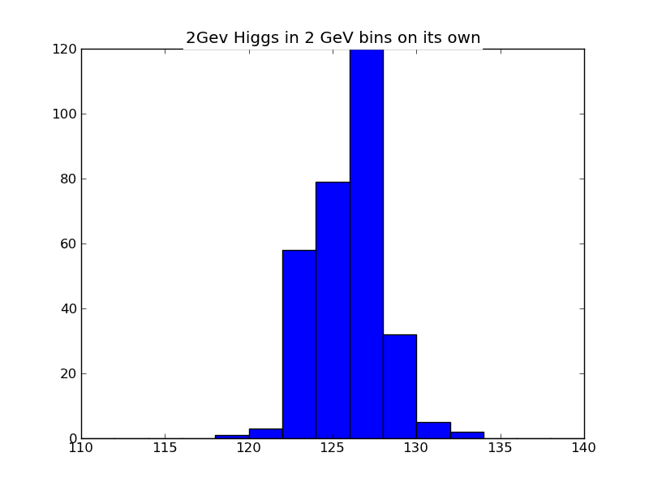
Higgs on its own

Slide 6
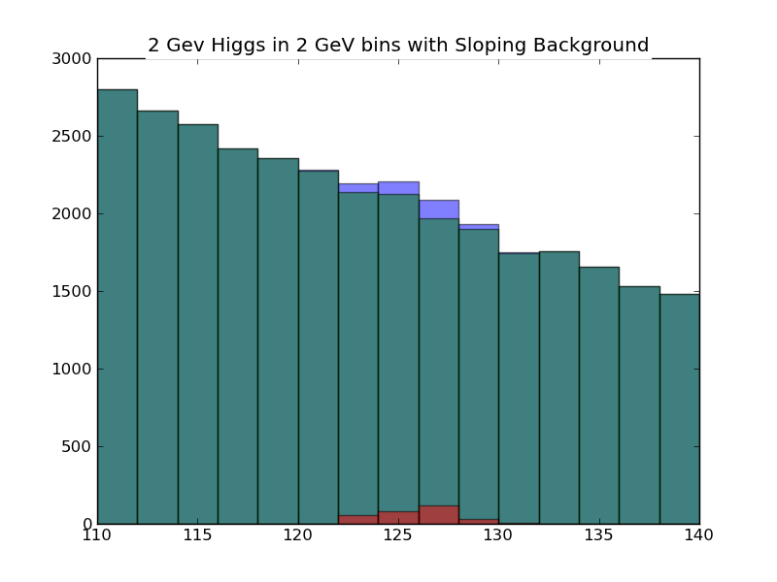
Actual Wide Higgs plus Sloping Background

Slide 7

Actual Wide Higgs plus Sloping Background with errors

Slide 8
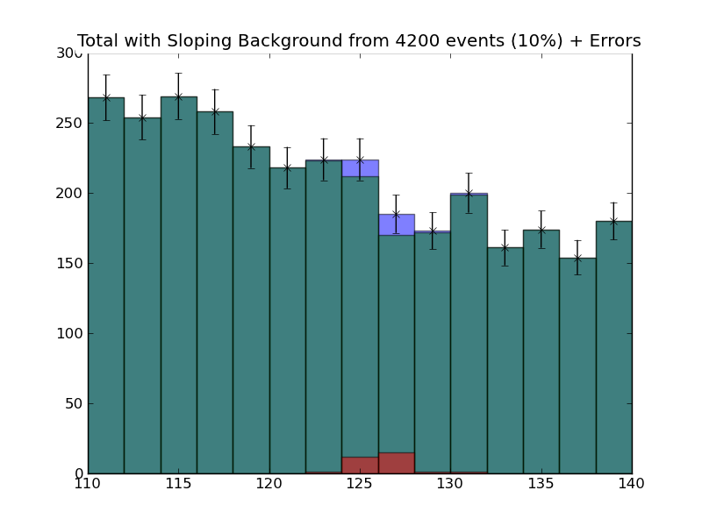
Actual Wide Higgs plus Sloping Background Data Size divided by 10

Slide 9
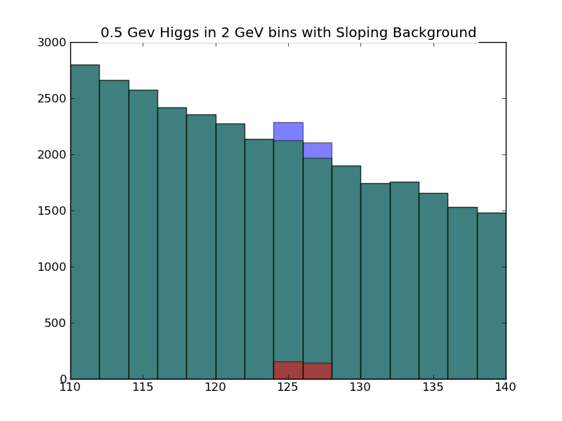
Narrow Higgs plus Sloping Background 2 GeV Bins

Slide 10
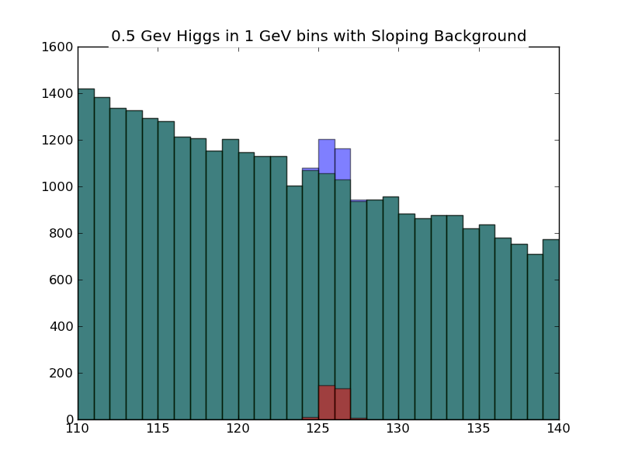
Narrow Higgs plus Sloping Background 1 GeV Bins

Slide 11

Narrow Higgs plus Sloping Background 0.5 GeV Bins

