Slide 1
Atlas Data Analysis
The detector generates unmanageably large amounts of raw data: about 25 megabytes per event (raw; zero suppression reduces this to 1.6 MB), multiplied by 40 million beam crossings per second in the center of the detector. This produces a total of 1 petabyte of raw data per second.
The trigger system uses simple information to identify, in real time, the most interesting events to retain for detailed analysis. There are three trigger levels. The first is based in electronics on the detector while the other two run primarily on a large computer cluster near the detector. The first-level trigger selects about 100,000 events per second.
Raw Data: After the third-level trigger has been applied, a few hundred events remain to be stored for further analysis. This amount of data still requires over 100 megabytes of disk space per second — at least a petabyte each year.
Information: Offline event reconstruction is performed on all permanently stored events, turning the pattern of signals from the detector into physics objects, such as jets (collections of particles), photons, and leptons.
Grid computing is being extensively used for event reconstruction, allowing the parallel use of university and laboratory computer networks throughout the world for the CPU-intensive task of reducing large quantities of raw data into a form suitable for physics analysis. The software for these tasks has been under development for many years, and will continue to be refined even now that the experiment is collecting data.
Knowledge: Individuals and groups within the collaboration are writing their own code to perform further analysis of these objects, searching the patterns of detected particles for particular physical models or hypothetical particles.

Slide 2
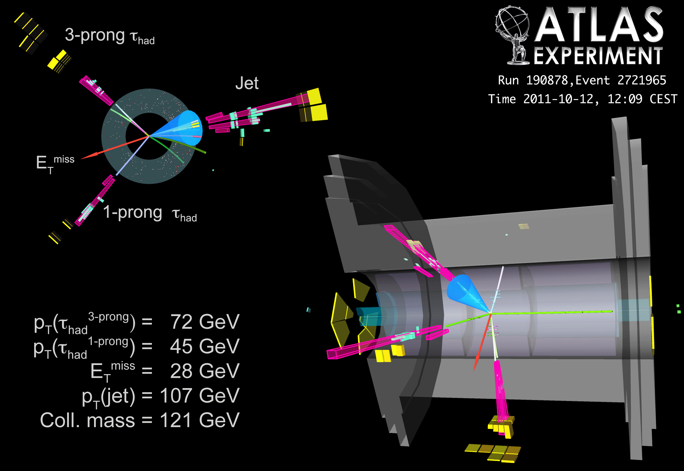

Slide 3
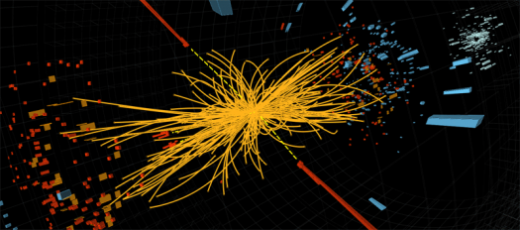
A proton-proton collision event in the CMS experiment produces two high-energy photons (the red towers). This is what physicists would expect to see from the decay of a Higgs boson, but it is also consistent with background Standard Model physics processes.
Orange tracks are charged (they bend) and are mainly forward and back.
The photons are sent off transversely indicative of an extreme event

Slide 4
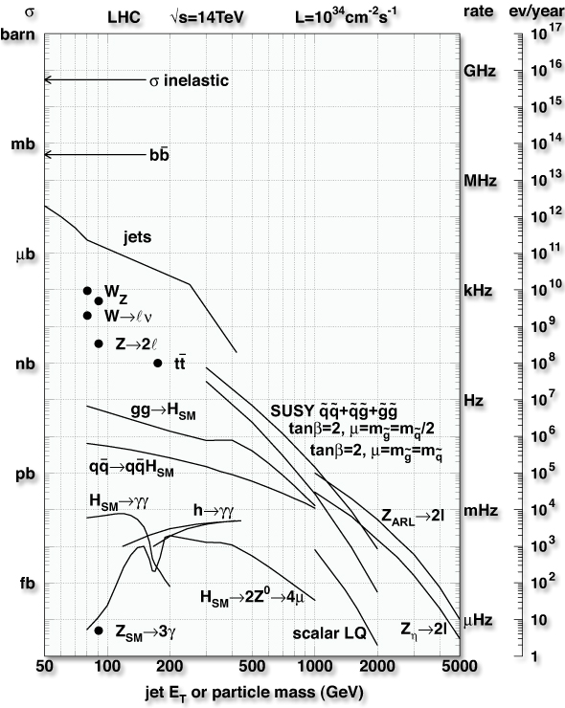
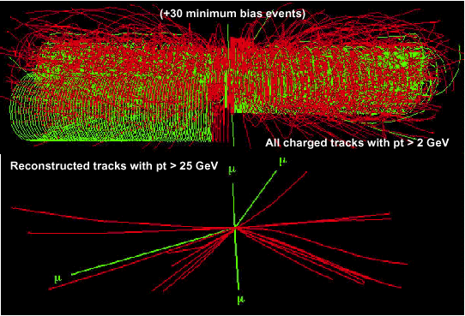
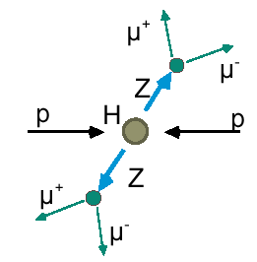
Final States at the LHC
Event rate
~ 30% is diffractive
Level-1
Pedestal Effect
On tape
Discovery
“Golden Channel”

Slide 5
Statistics: IID
There are two simple ways of doing formal statistics of Physics analysis
Poisson Distribution
Binomial distribution
Both give the same answer for case here where the events are very very unlikely
First we note a key assumption/property
Each (physics) event is independent of previous ones
Thus events form independent identically distributed (IID) random variables
Most cases in big data either have this property or it approximately true

