Slide 1
Statistics: Law of Large Numbers
Suppose a single valued random variable X has mean μ and standard deviation σ
μ is average value of X
σ² is average value of (X - μ)²
Then let X_{i} (i= 1 .. N) be N IID random variables distributed in same way that X is
Let Observable O = ∑_{i=1}^{N} X_{i} be sum of the N X_{i}
Alternatively can use average of observations ∑_{i=1}^{N} X_{i} /N
Then O has expected value N μ and
O has standard deviation (error) √N σ
Note error/mean ∝ 1/√N
Note amount of “effort” ∝ N and so it takes 4 times the effort to reduce error by a factor of 2

Slide 2
Event/Counting Data
This basically covers all surveys as well as physics case
If you measure N responses to a question – that is similar to counting N events in a histogram – make each question a bin of histogram
Then error is √N and N is distributed with a Normal distribution which allows one to estimate chance that measurement significant
Lets look at this in Python with a survey that has 40,000 answers – each equally likely
First take case 25 is expected number of events in bin and of course √25 = 5

Slide 3
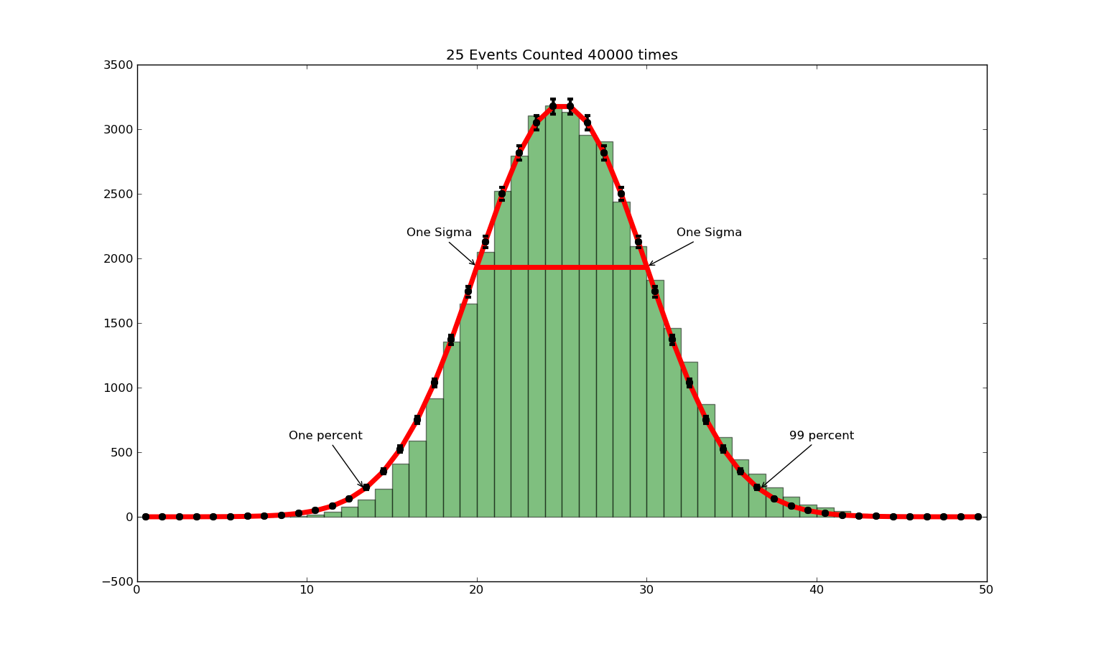

Slide 4
Looking at Error bars in detail

Slide 5
This Corresponds to
Asking a million people a question with 40,000 answers where each answer equally likely
Measuring a million physics events – each with one of 40,000 outcomes – each equally likely
Note bins from 22(start)-28(end) have 2789(22-23), 3060(23-24), 3132(24-25), 3179(25-26), 3111(26-27), 2793(27-28) events in them
The red curve is naïve expected number of events in each bin – Normal distribution
Good but not perfect as actual data shifted to larger values (green tends to be above red if bin start > 25, red tends to be above green if start < 25)
It predicts 3176 events in bins 24-25 and 25-26 with error √3176 = 56

Slide 6

Normal or Gaussian Distribution
Python: def Normal(x, mu, sigma): return exp(- (x-mu)**2/(2*sigma**2))/(sigma*sqrt(2*pi))
See also built in scipy.stats.norm
http://en.wikipedia.org/wiki/Normal_distribution

Slide 7
Generating Events
Events25 = np.random.rand(1000000)
Counters25 = np.zeros(40000)
for value in Events25: Place = int(40000 * value)
Counters25[Place] +=1
# Place assigns to each of one million events, a random category out of 40000

