Slide 1
Plotting the 40,000 trials
figure("Count 25 Events 40000 times")
Numcounts25, binedges25, patches = hist(Counters25, bins = 50, range = (0,50), color = "green", alpha = 0.5)
centers25 = 0.5*(binedges25[1:] + binedges25[:-1])
y25 = 40000 * Normal(centers25, 25, sqrt(25))
xbar25 = np.zeros(2)
ybar25 = np.zeros(2)
xbar25[0] = 25 - sqrt(25)
xbar25[1] = 25 + sqrt(25)
ybar25 = 40000*Normal(xbar25, 25, sqrt(25))
plot(xbar25, ybar25, color= "red", alpha = 1.0, lw =5)
plot(centers25, y25, alpha = 1.0, color = "red", lw =5)

Slide 2
Adding Annotations
from scipy.special import ndtri
prob1percent25 = 25 + sqrt(25) * ndtri(0.01)
prob99percent25 = 25 + sqrt(25) * ndtri(0.99)
y1percent25 = 40000*Normal(prob1percent25, 25, sqrt(25))
y99percent25 = 40000*Normal(prob99percent25, 25, sqrt(25))
annotate('One percent', xycoords="data", textcoords='offset points', arrowprops=dict(facecolor='black', arrowstyle="->"), xytext =(-75,50), xy = (prob1percent25, y1percent25))
annotate('99 percent', xycoords="data", textcoords='offset points', arrowprops=dict(facecolor='black', arrowstyle="->"), xytext =(30,50), xy = (prob99percent25, y99percent25))
annotate('One Sigma', xycoords="data", textcoords='offset points', xy = (20,ybar25[0]), xytext = (-70,30), arrowprops=dict(facecolor='black', arrowstyle="->"))
annotate('One Sigma', xycoords="data", textcoords='offset points', xy = (30,ybar25[1]), xytext = (30,30), arrowprops=dict(facecolor='black', arrowstyle="->"))

Slide 3
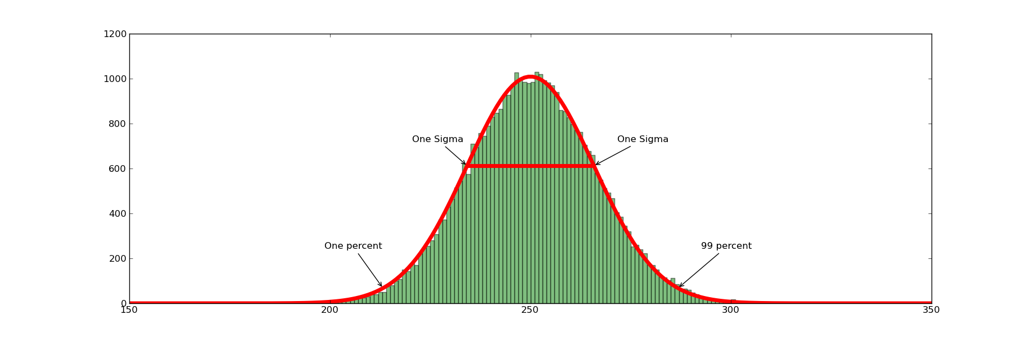
40000 Total Counts of 250

Slide 4
A larger set of Events
Note if you had a total of ten million events but still 40,000 categories, then the red curve is nearer the green curve and 250 is expected number of events with an error of √250 ≈ 16
The one sigma line runs from 250- √250 to 250 + √250
The plots get rough if reduce number of events from 40000 to 400 or 4000
Use larger bin size (1 becomes 5) if number of events small

Slide 5
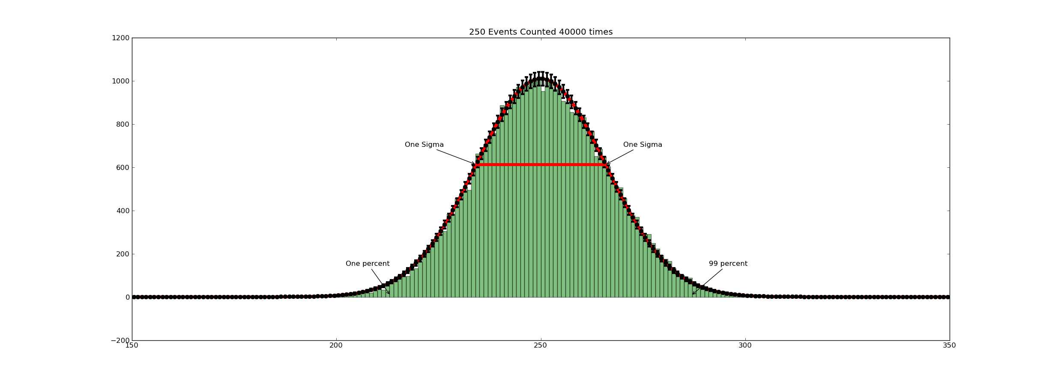

Slide 6
Looking at Error bars in detail

Slide 7
Looking at Error bars in detail

Slide 8
Making Error Bars √ Law for y axis
Numcounts25, binedges25, patches = hist(Counters25, bins = 50, range = (0,50), color = "green", alpha = 0.5)
centers25 = 0.5*(binedges25[1:] + binedges25[:-1])
y25 = 40000 * Normal(centers25, 25, sqrt(25))
errors25 = sqrt(y25)
errorbar(centers25, y25, yerr = errors25, linestyle='None', linewidth = 3.0, markeredgewidth = 3.0, marker ='o', color = 'black', markersize= 5.0 )
Note the √ law governs the width of distribution (x-axis) and counts in each bin (y axis)

Slide 9
Making One Sigma Line √ Law for x axis
xbar25 = np.zeros(2)
ybar25 = np.zeros(2)
xbar25[0] = 25 - sqrt(25)
xbar25[1] = 25 + sqrt(25)
ybar25 = 40000*Normal(xbar25, 25, sqrt(25))
plot(xbar25, ybar25, color= "red", alpha = 1.0, lw =5)

