Slide 1
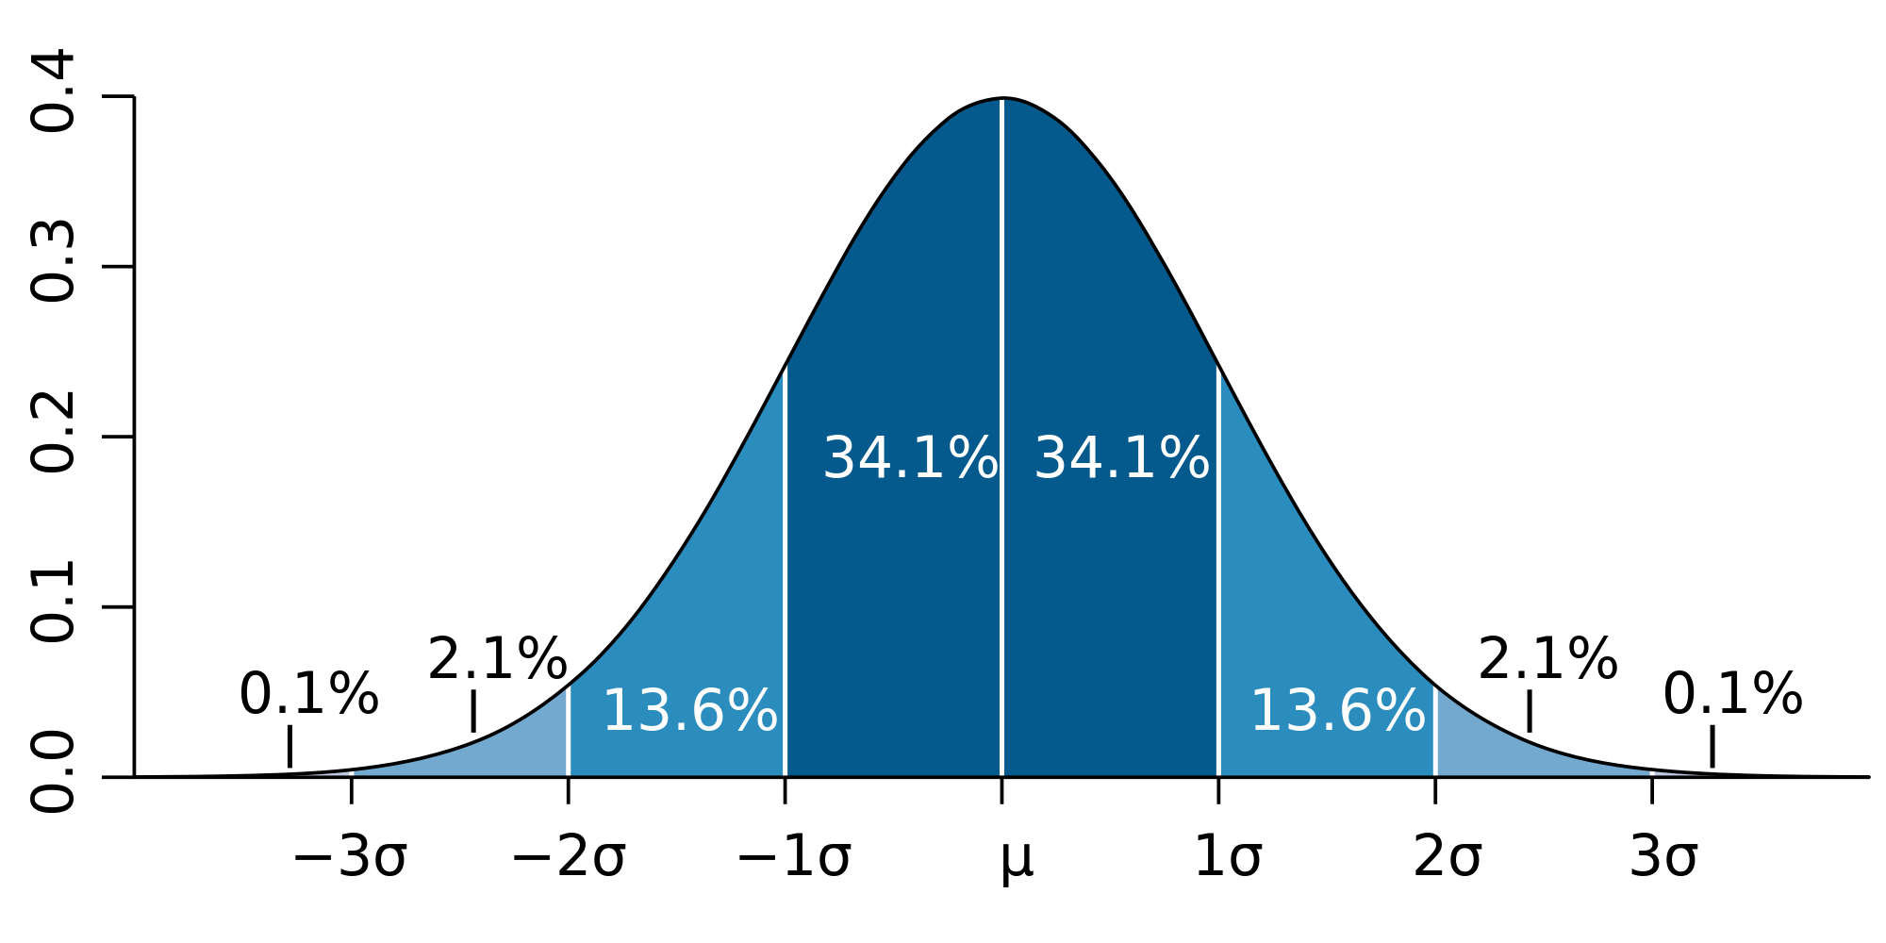
Meaning of a Standard Deviation (one sigma)
From Wikipedia
68% of the time, you will be within one sigma of mean for a normal distribution

Slide 2
Is this stuff Right?
There are two types of corrections to “rule of thumb” that “everything pretty large” is distributed according to Gaussian distribution and for N events, the error is √N
a) There are “mathematical” corrections as rule of thumb only correct “asymptotically”
See results for 40000 counters of 25 – the observed counts are larger than prediction of Gaussian when you are in tail above mean
Easy to correct as exact distributions known. Not very important
b) Biases. If you counted results of a survey on Indiana politics based on people in Bloomington, this is not representative of state and your results will be biased (i.e. wrong)

Slide 3
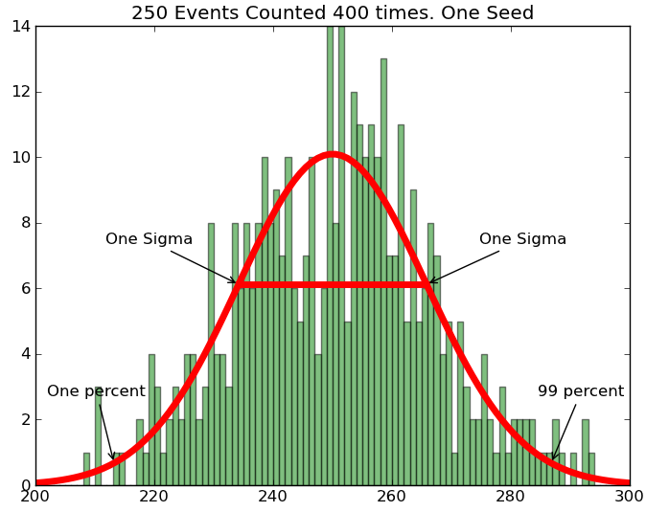
Pretty Raggedy √10 ≈ 3

Slide 4
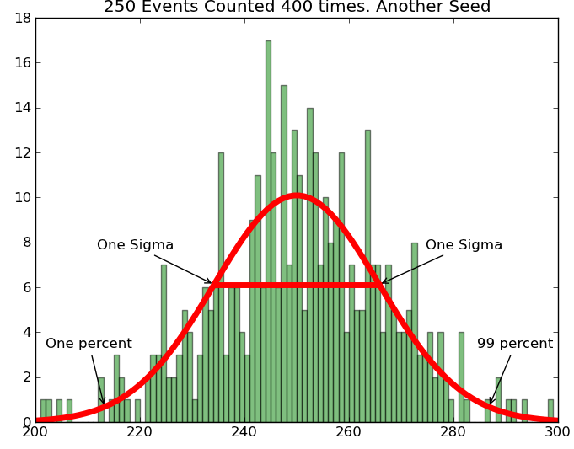
Looks different
Numpy gives
“new random numbers”
each time unless fix seed

Slide 5
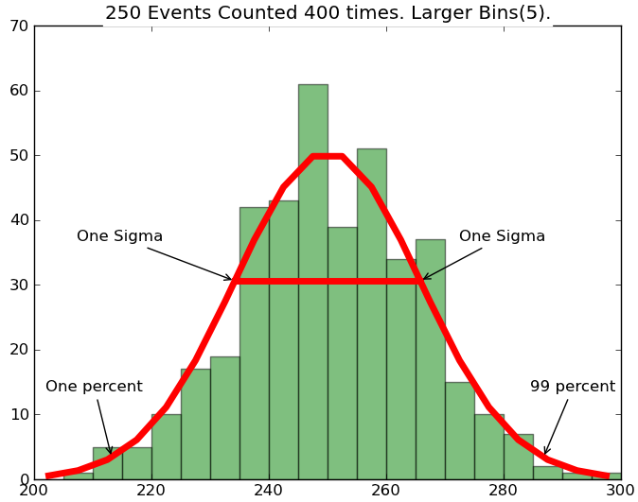
Increase bin size
if too few events
√50 ≈ 7

Slide 6
