Slide 1
Random Numbers II
Sometimes its good to get random numbers but always have the same e.g. if you are debugging something
Use random.seed(seed=some integer) to guarantee same start
random.seed(seed=1234567)
figure("On Top of Each Other")
Base = 110 + 30* np.random.rand(42000)
plt.hist(Base, bins=15, range =(110,140), alpha = 0.5, color="blue")
#
random.seed(seed=1234567)
Base2 = 110 + 30* np.random.rand(42000)
plt.hist(Base2, bins=15, range =(110,140), alpha = 0.5, color="yellow")
plt.title("Two histograms on top of each other as identical random numbers")

Slide 2
More on Seeds
figure("Different")
#
random.seed(seed=1234567)
Base4 = 110 + 30* np.random.rand(42000)
plt.hist(Base4, bins=15, range =(110,140), alpha = 0.5, color="blue")
Base1 = 110 + 30* np.random.rand(42000)
# Note Base1 starts where Base4 ends so is a different set of random numbers
plt.hist(Base1, bins=15, range =(110,140), alpha = 0.5, color="green")
#
random.seed(seed=7654321)
Base3 = 110 + 30* np.random.rand(42000)
plt.hist(Base3, bins=15, range =(110,140), alpha = 0.5, color="red")

Slide 3
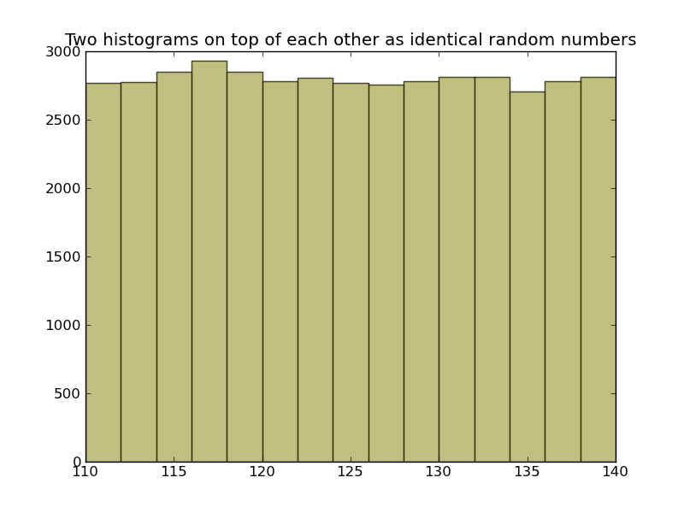

Slide 4
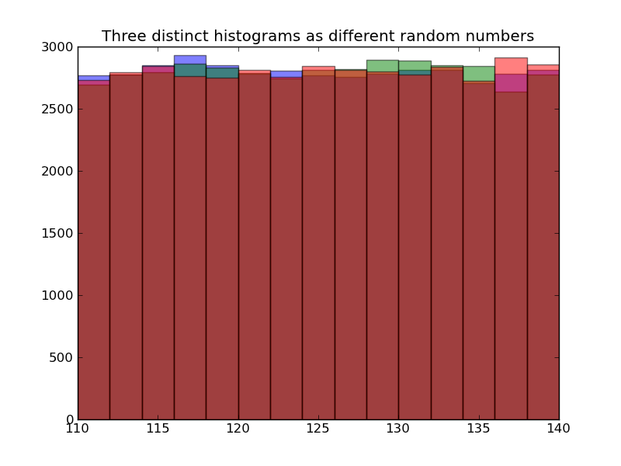

Slide 5
Look at Numbers
random.seed(seed=1234567)
Base = 110 + 30* np.random.rand(42000)
array([ 117.11087505, 110.22945122, 110.59490925, ..., 117.34085492,
138.72156377, 117.25522386])
random.seed(seed=1234567)
Base2 = 110 + 30* np.random.rand(42000)
array([ 117.11087505, 110.22945122, 110.59490925, ..., 117.34085492,
138.72156377, 117.25522386])
Base1 = 110 + 30* np.random.rand(42000)
array([ 133.51704792, 132.87435972, 128.95204036, ..., 115.25271937,
130.21388378, 112.55649254])
random.seed(seed=7654321)
Base3 = 110 + 30* np.random.rand(42000)
array([ 111.05068005, 112.63158568, 124.30148179, ..., 120.35946227,
112.44901602, 133.75223691])

Slide 6
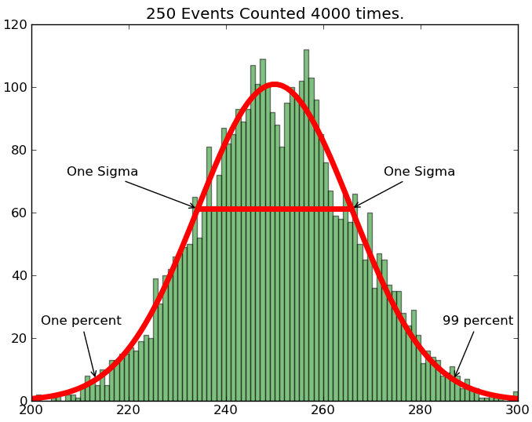
√100 = 10
Funny dip in middle

Slide 7
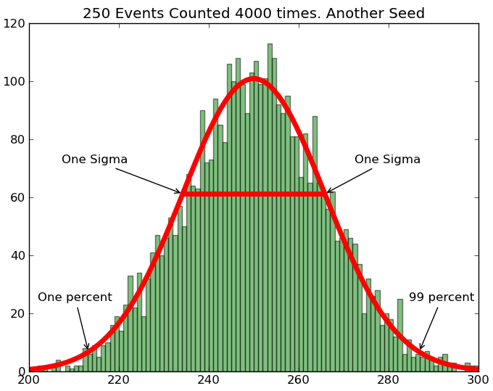
Looks better but just luck

