Slide 1
Counting and Binomial Distribution I
Suppose random variable X = 1 (event in a particular bin of histogram) and X=0 (event not in bin)
Let μ be probability that a particular event lies in a bin
This is coin tossing problem with μ probability of heads
If a random variable takes just two values with probability μ (for 1) and 1-μ (for 0), then
Average of X = {0. (1-μ) + 1. μ}/{(1-μ) + μ} = μ
Average of (X-μ)² = {(-μ)². (1-μ) + (1-μ)² . μ} = (1-μ) μ

Slide 2
Counting and Binomial Distribution II
Now in our application μ is tiny
So Average of X = Average of (X-μ)² = μ
i.e. standard deviation of X is square root of mean
If we have a sum of random variables with a binomial distribution
O = ∑_{i=1}^{N} X_{i}
Then O has mean Nμ and standard deviation = √N √μ = √mean

Slide 3
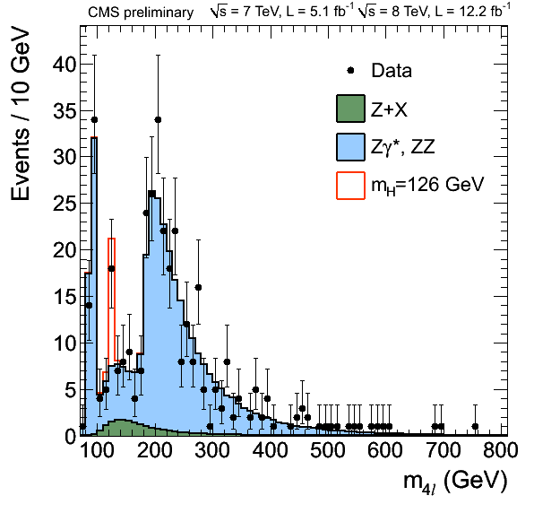
Here is a histogram with 140 bins. We have a random variable for each bin. There is an excess of events in bin from 125 to 130 GeV

Slide 4
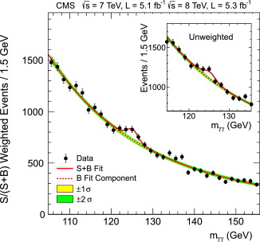

Slide 5
Comments
Note some measurements have a small signal but a small background
Others have a larger signal but also a larger background
If you have signal N_{S} and background N_{B,} then statistical error is √(N_{S} + N_{B}) and one needs
√(N_{S} + N_{B}) much smaller than N_{S} which is harder than √N_{S} much smaller than N_{S}
Typically one quotes “systematic errors” as well. These reflect model-based uncertainties in analysis and will not decrease like sqrt of total event sample

