Slide 1
Poisson Distribution
The Poisson distribution is what you get when you take binomial distribution and let μ get small but keep product μN fixed.
This is actually what I used in discussing histograms
The Poisson distribution describes exactly nuclear decays and can be defined as distribution of events at time T where in small time interval δt, the probability of an event arriving is λδt
Probability (k events) = (λT)^{k} exp(-λT)/ k!
(Written in Wikipedia for case T=1 and varies λ not fixing λ and varying T)
For Poisson: Mean = σ² = λT

Slide 2
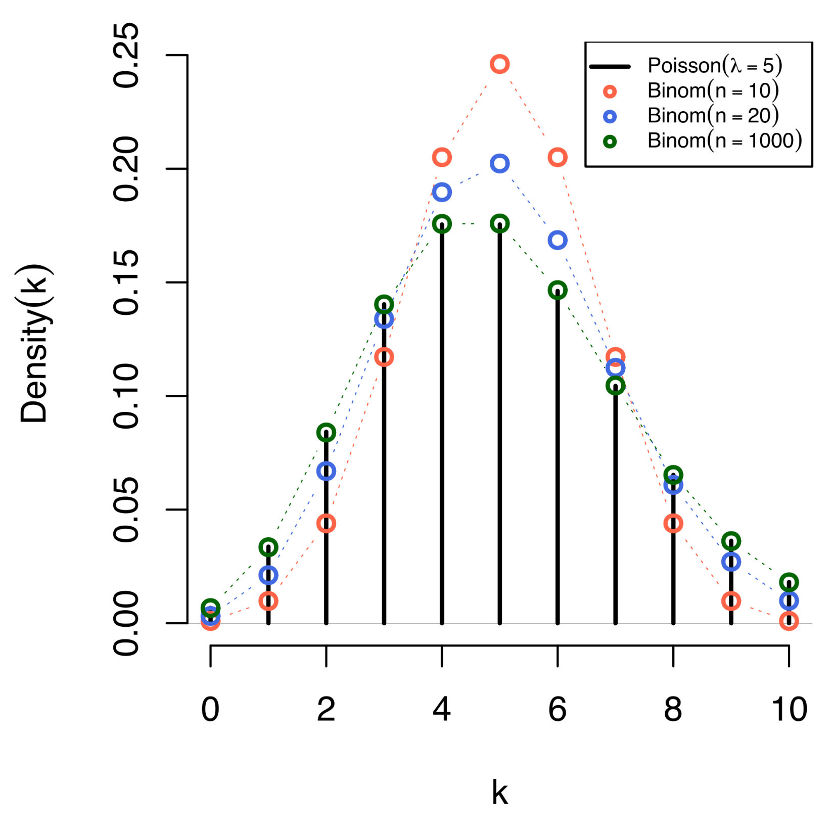
Comparison of the Poisson distribution (black lines) and thebinomial distribution with n=10 (red circles), n=20 (blue circles), n=1000 (green circles). All distributions have a mean of 5. The horizontal axis shows the number of events k. Notice that as n gets larger, the Poisson distribution becomes an increasingly better approximation for the binomial distribution with the same mean. (Wikipedia)

Slide 3
Poisson Examples I (Wikipedia)
Applications of the Poisson distribution can be found in many fields related to counting:
Electrical system example: telephone calls arriving in a system.
Astronomy example: photons arriving at a telescope.
Biology example: the number of mutations on a strand of DNA per unit length.
Management example: customers arriving at a counter or call centre.
Civil engineering example: cars arriving at a traffic light.
Finance and insurance example: Number of Losses/Claims occurring in a given period of Time.
Earthquake seismology example: An asymptotic Poisson model of seismic risk for large earthquakes.

Slide 4
Poisson Examples II (Wikipedia)
The Poisson distribution arises in connection with Poisson processes. It applies to various phenomena of discrete properties (that is, those that may happen 0, 1, 2, 3, ... times during a given period of time or in a given area) whenever the probability of the phenomenon happening is constant in time or space. Examples of events that may be modelled as a Poisson distribution include:
The number of soldiers killed by horse-kicks each year in each corps in the Prussian cavalry. This example was made famous by a book of Ladislaus Josephovich Bortkiewicz (1868–1931).
The number of yeast cells used when brewing Guinness beer. This example was made famous by William Sealy Gosset (1876–1937).
The number of phone calls arriving at a call centre per minute.
The number of goals in sports involving two competing teams.
The number of deaths per year in a given age group.
The number of jumps in a stock price in a given time interval.
Under an assumption of homogeneity, the number of times a web server is accessed per minute.
The number of mutations in a given stretch of DNA after a certain amount of radiation.
The proportion of cells that will be infected at a given multiplicity of infection.
The targeting of V-1 rockets on London during World War II.
These are often called “birth processes”

Slide 5
Central Limit Theorem
The large of large numbers (which is usually most important operationally) tells you about the mean and standard deviation (error) of the sum of many IID random variables
The Central Limit Theorem extends this to tell you about shape of probability distribution and says that for well behaved cases, the shape is that of Gaussian or normal distribution WHATEVER original distribution of X was
i.e. probability of values far from mean fall off exponentially
Pr(O = k) ∝ exp{ - (k- <O>)² / 2<O>}
Where O (sum off IID’s) has mean <O>

Slide 6
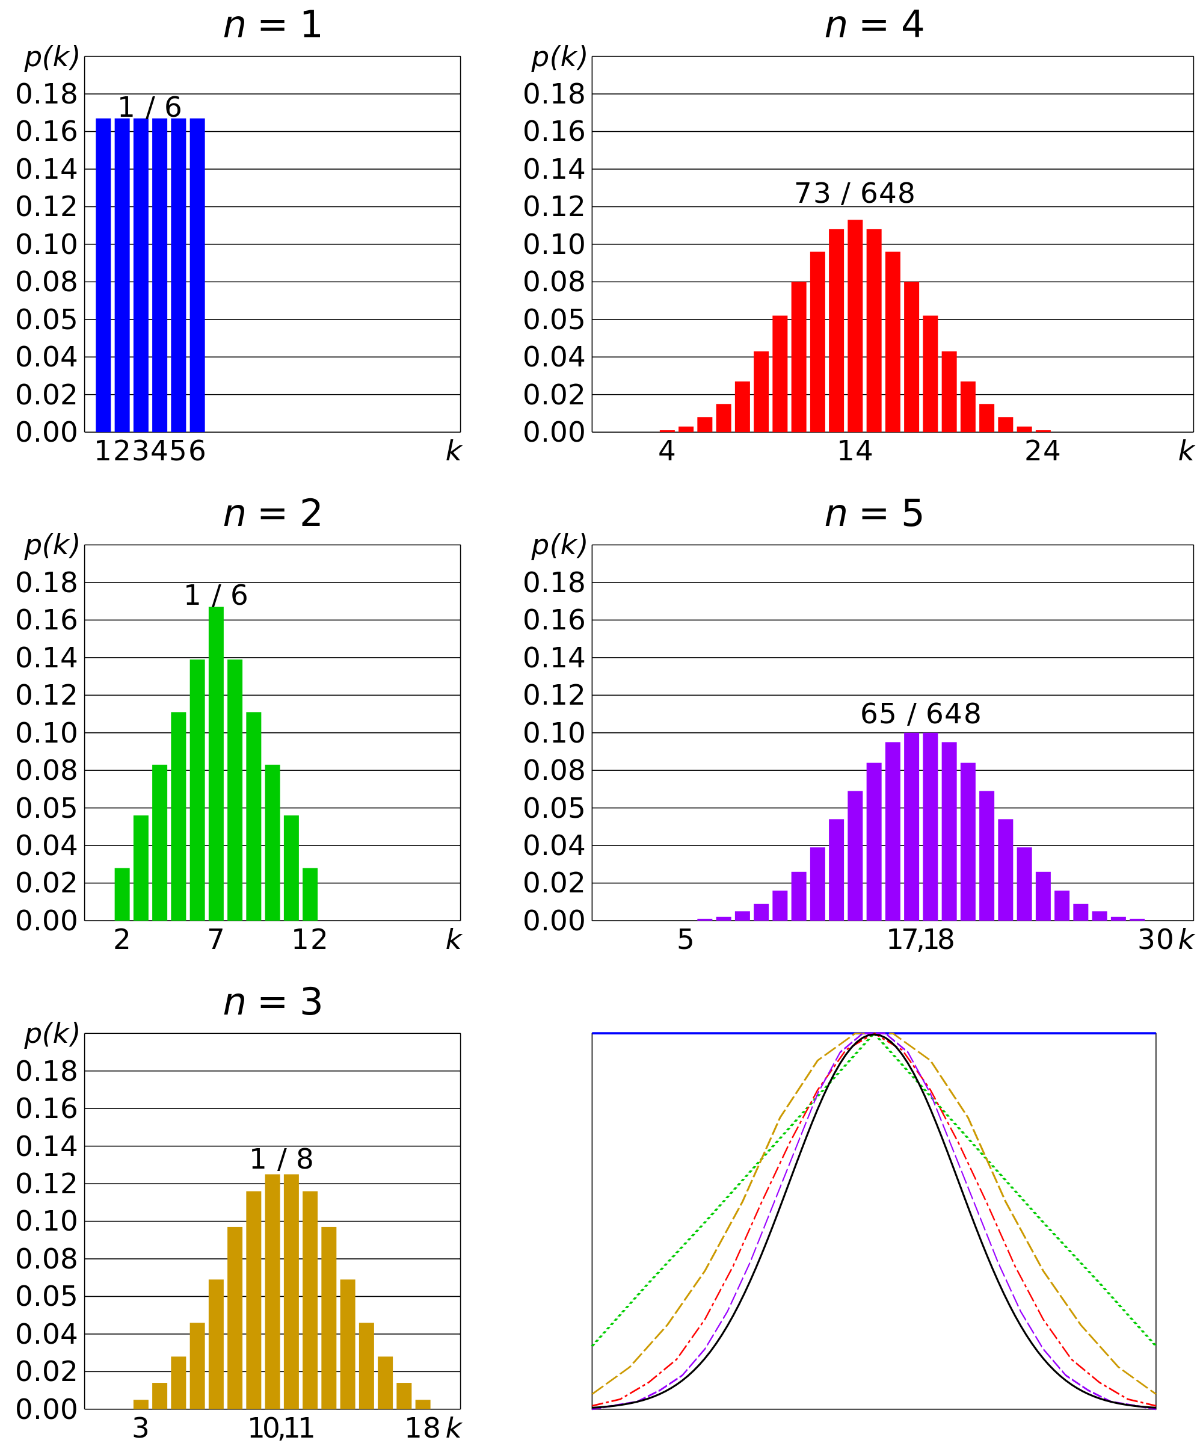
Comparison of probability density functions, p(k) for the sum of n fair 6-sided dice to show their convergence to a normal distribution with increasing n, in accordance to the central limit theorem. In the bottom-right graph, smoothed profiles of the previous graphs are rescaled, superimposed and compared with a normal distribution (black curve).

Slide 7
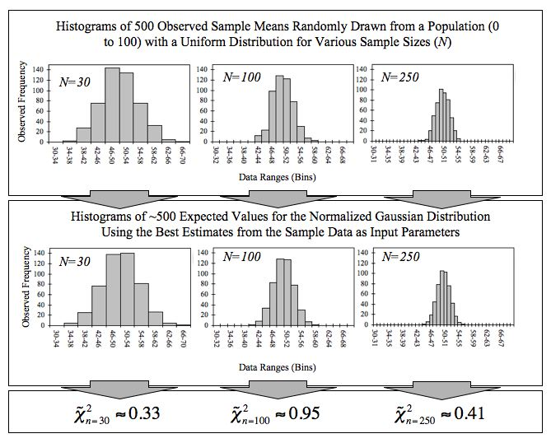
This figure demonstrates the central limit theorem. The sample means are generated using a random number generator, which draws numbers between 1 and 100 from a uniform probability distribution. It illustrates that increasing sample sizes result in the 500 measured sample means being more closely distributed about the population mean (50 in this case).
It also compares the observed distributions with the distributions that would be expected for a Gaussian distribution, and shows the chi-squared values that quantify the goodness of the fit

