Slide 1



Problem domain
Recommendation systems (RS) help to match users with items
Ease information overload
Sales assistance (guidance, advisory, persuasion,…)
RS are software agents that elicit the interests and preferences of individual consumers […] and make recommendations accordingly.
They have the potential to support and improve the quality of the decisions consumers make while searching for and selecting products online.
(Xiao & Benbasat 2007¹)
Different system designs / paradigms
Based on availability of exploitable data
Implicit and explicit user feedback
Domain characteristics
(1) Xiao and Benbasat, E-commerce product recommendation agents: Use, characteristics, and impact, MIS Quarterly 31 (2007), no. 1, 137–209
See Netflix example later
http://recommenderbook.net/teaching-material/slides Chapter 1

Slide 2
Purpose and success criteria (1)
Different perspectives/aspects
Depends on domain and purpose
No holistic evaluation scenario exists
Retrieval perspective
Reduce search costs
Provide "correct" proposals
Users know in advance what they want
Recommendation perspective
Serendipity – identify items from the Long Tail
Users did not know about existence
Money is often essentially criterion
This is goal of site owner but in long term this requires that
User maximizes happiness or knowledge
http://recommenderbook.net/teaching-material/slides Chapter 1
Notes:
Could a RS be a persuasive technology? In fact depending on the application area RS are deployed to:

Slide 3
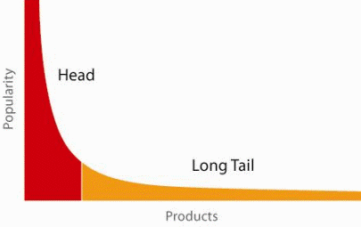
When does a RS do its job well?
90-10 or 80-20 “rule” broadly applicable
"Recommend widely unknown items that users might actually like!"
20% of items accumulate 74% of all positive ratings
Positive means items rated > 3 in MovieLens 100K dataset (ratings 0 to 5)
Recommend items from the long tail
http://recommenderbook.net/teaching-material/slides Chapter 1

Slide 4
Purpose and success criteria (2)
Prediction perspective
Predict to what degree users like an item
Most popular evaluation scenario in research
Interaction perspective
Give users a "good feeling"
Educate users about the product domain
Convince/persuade users - explain
Finally, conversion perspective
Commercial situations
Increase "hit", "clickthrough", "lookers to bookers" rates
Optimize sales margins and profit
Money!
http://recommenderbook.net/teaching-material/slides Chapter 1

Slide 5
Recommender systems
RS seen as a function
Given:
User model (e.g. ratings, preferences, demographics, situational context)
Items (with or without description of item characteristics)
Find:
Relevance score. Used for ranking.
Relation to Information Retrieval:
IR is finding material [..] of an unstructured nature [..] that satisfies an information need from within large collections [..].
(Manning et al. 2008¹)
(1) Manning, Raghavan, and Schütze, Introduction to information retrieval, Cambridge University Press, 2008
Advanced IR does use essentially
recommender system to order results
Recommend links that satisfy search query
http://recommenderbook.net/teaching-material/slides Chapter 1

Slide 6
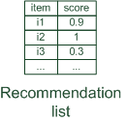
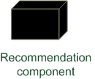
Paradigms of recommender systems
Recommender systems reduce information overload by estimating relevance
http://recommenderbook.net/teaching-material/slides Chapter 1

Slide 7


Paradigms of recommender systems
Personalized recommendations
http://recommenderbook.net/teaching-material/slides Chapter 1

Slide 8

Paradigms of recommender systems
Collaborative: "Tell me what's popular among my peers"
http://recommenderbook.net/teaching-material/slides Chapter 1

Slide 9

Paradigms of recommender systems
Content-based: "Show me more of the same what I've liked"
http://recommenderbook.net/teaching-material/slides Chapter 1

Slide 10


Paradigms of recommender systems
Knowledge-based: "Tell me what fits based on my needs"
http://recommenderbook.net/teaching-material/slides Chapter 1

Slide 11
Paradigms of recommender systems
Hybrid: combinations of various inputs and/or composition of different mechanism
http://recommenderbook.net/teaching-material/slides Chapter 1

