Slide 1
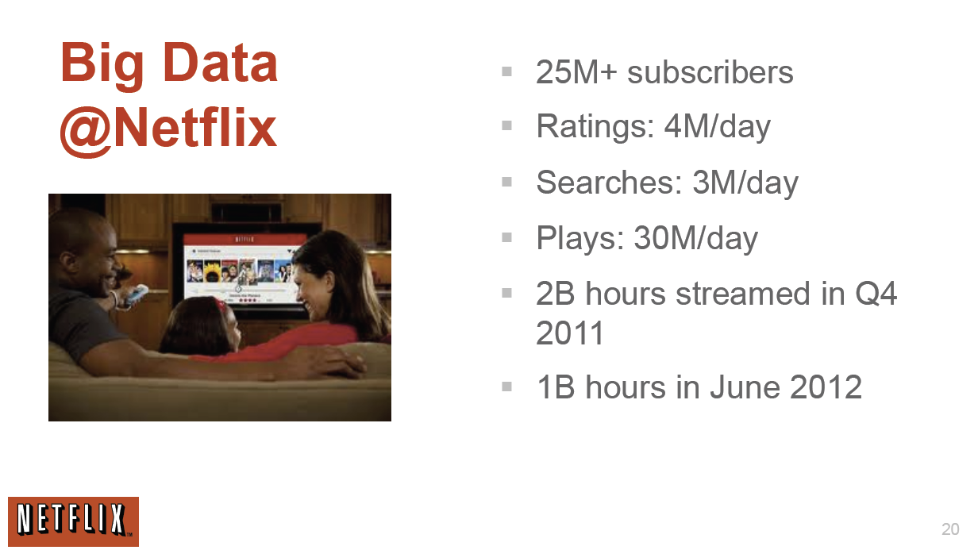
http://www.slideshare.net/xamat/building-largescale-realworld-recommender-systems-recsys2012-tutorial
April 2013: The last two quarters have each brought more than 2 million new streaming subscriber signups. That gives Netflix a current total of nearly 29.2 million subscribers

Slide 2
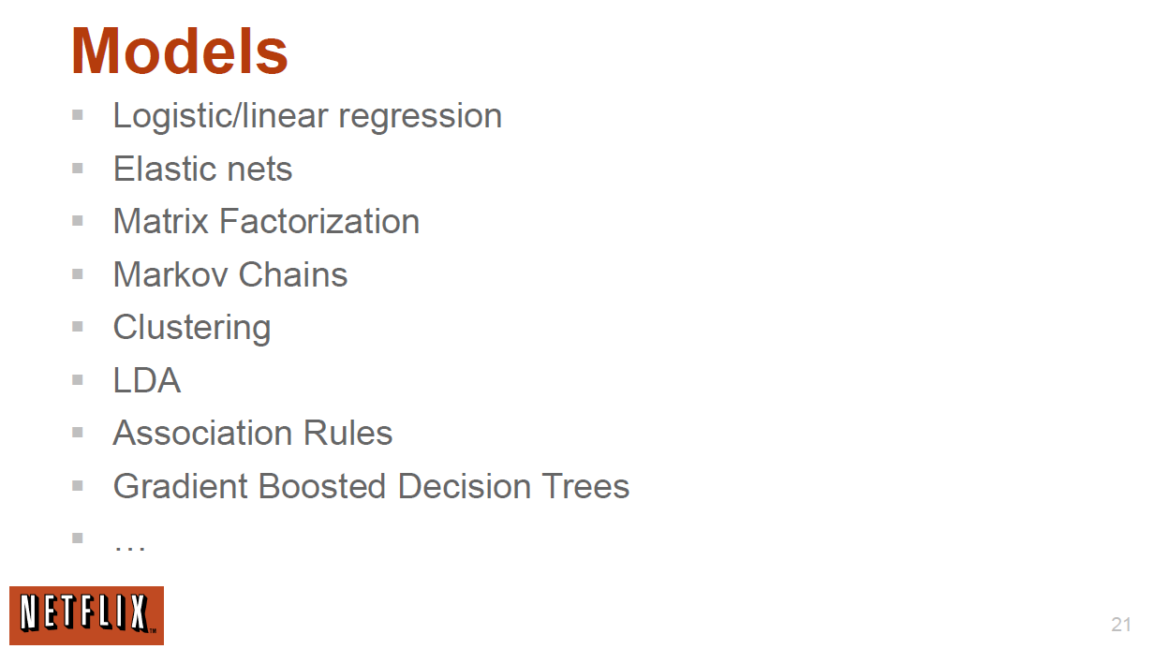
http://www.slideshare.net/xamat/building-largescale-realworld-recommender-systems-recsys2012-tutorial
Latent Dirichlet Allocation

Slide 3
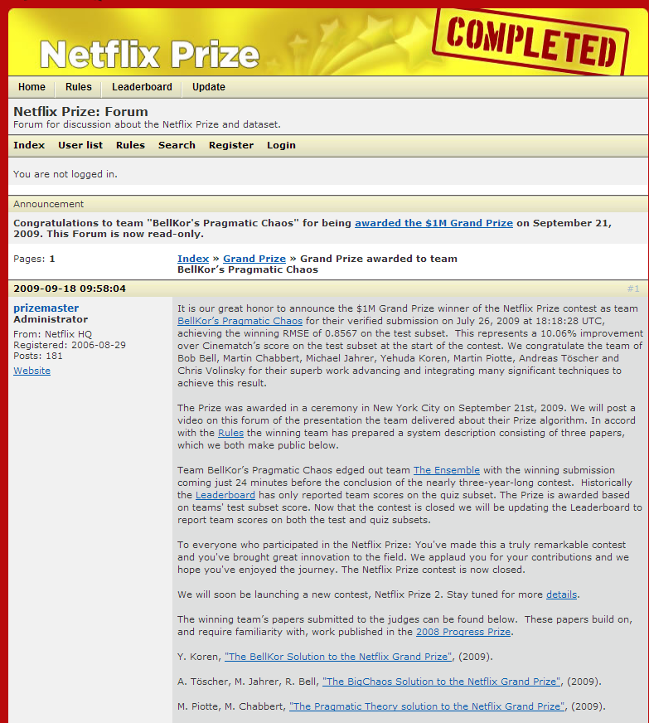
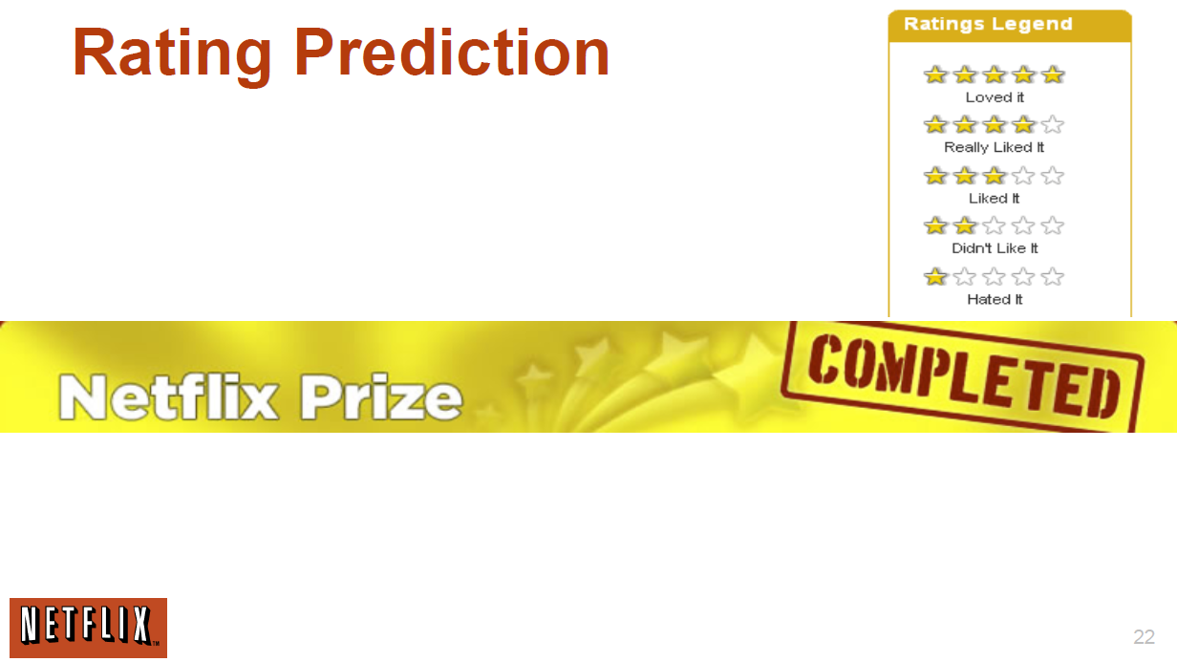
http://www.slideshare.net/xamat/building-largescale-realworld-recommender-systems-recsys2012-tutorial
$1M Prize

Slide 4
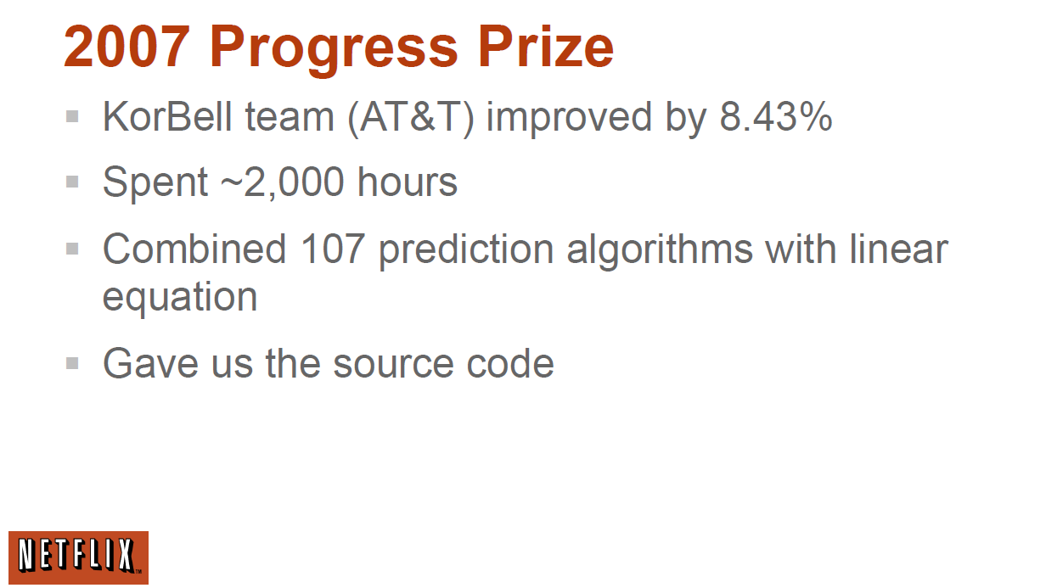
http://www.slideshare.net/xamat/building-largescale-realworld-recommender-systems-recsys2012-tutorial

Slide 5
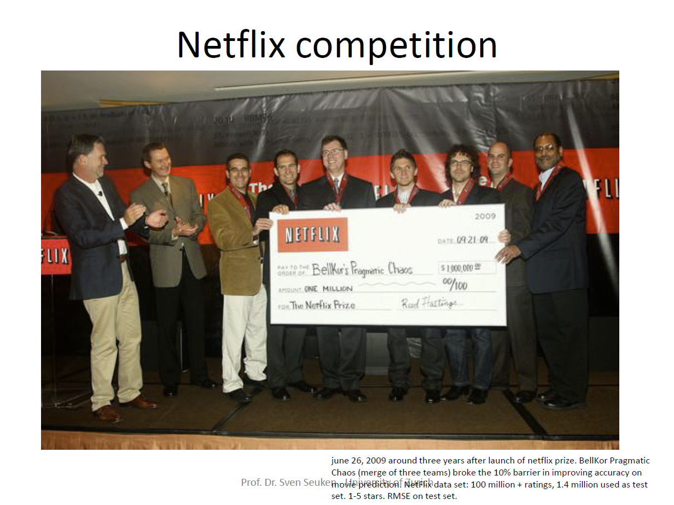
http://www.ifi.uzh.ch/ce/teaching/spring2012/16-Recommender-Systems_Slides.pdf

Slide 6

More data usually beats better algorithms
Here's how the competition works. Netflix has provided a large data set that tells you how nearly half a million people have rated about 18,000 movies. Based on these ratings, you are asked to predict the ratings of these users for movies in the set that they have not rated. The first team to beat the accuracy of Netflix's proprietary algorithm by a certain margin wins a prize of $1 million!
Different student teams in my class adopted different approaches to the problem, using both published algorithms and novel ideas. Of these, the results from two of the teams illustrate a broader point. Team A came up with a very sophisticated algorithm using the Netflix data. Team B used a very simple algorithm, but they added in additional data beyond the Netflix set: information about movie genres from the Internet Movie Database(IMDB). Guess which team did better?
Anand Rajaraman is Senior Vice President at Walmart Global eCommerce, where he heads up the newly created @WalmartLabs,
http://anand.typepad.com/datawocky/2008/03/more-data-usual.html
20120117berkeley1.pdf Jeff Hammerbacher

Slide 7
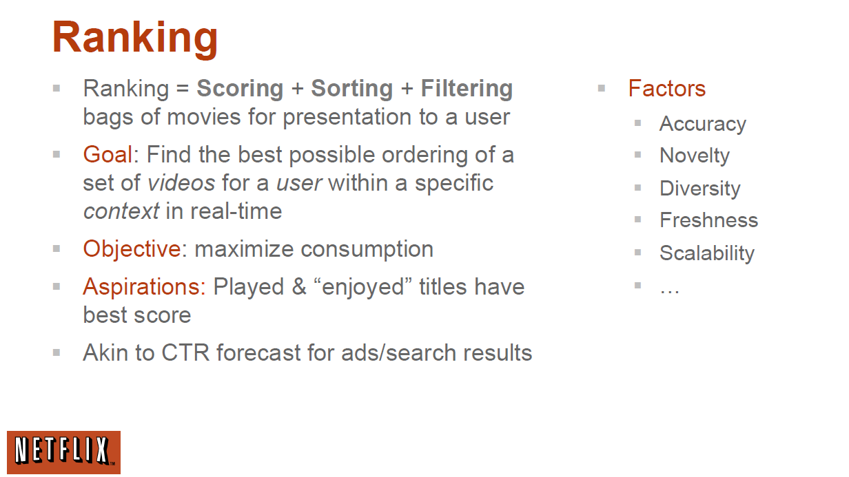
http://www.slideshare.net/xamat/building-largescale-realworld-recommender-systems-recsys2012-tutorial
CTR = Click-through rate

