Slide 1
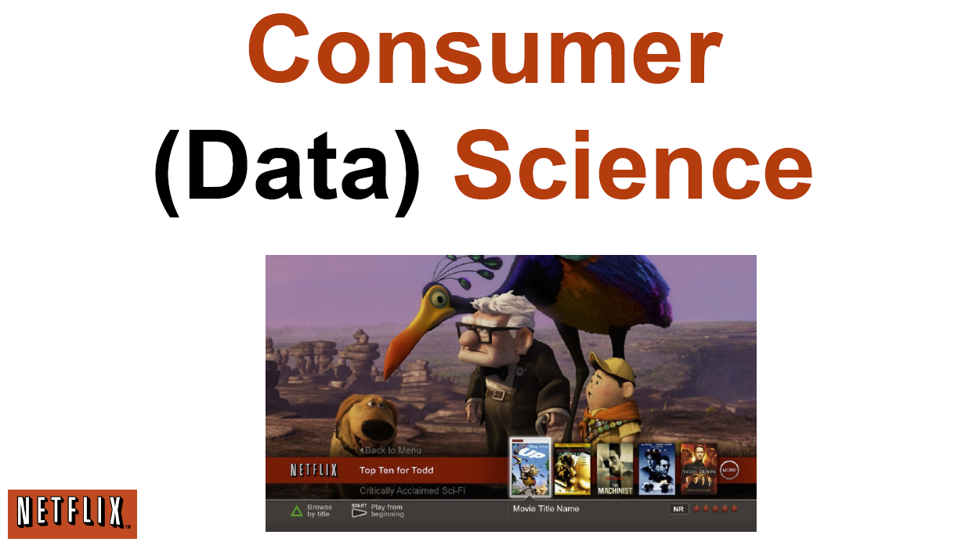
http://www.slideshare.net/xamat/building-largescale-realworld-recommender-systems-recsys2012-tutorial
Consumer OR
Life Style
Informatics

Slide 2
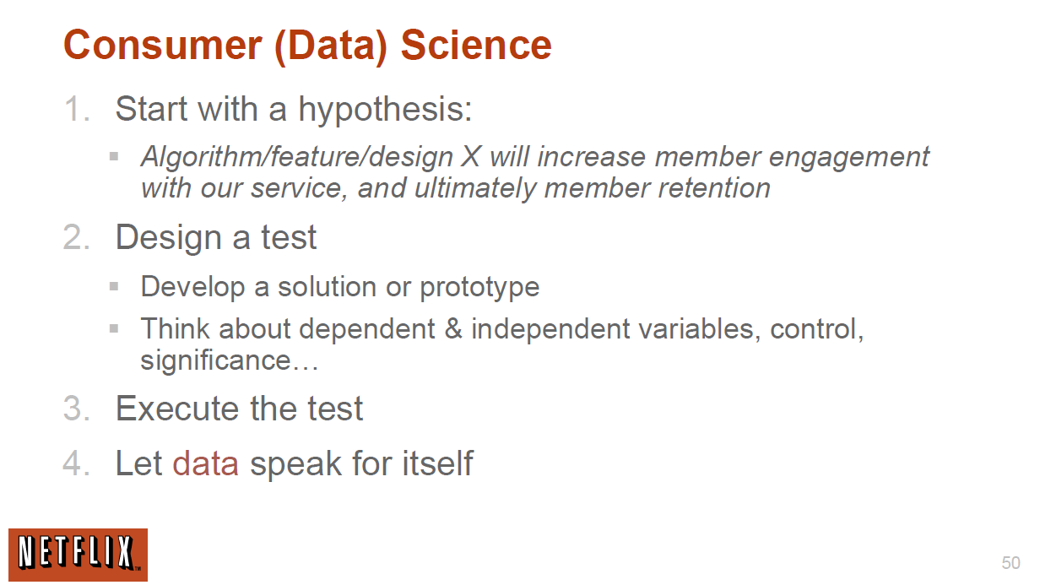
http://www.slideshare.net/xamat/building-largescale-realworld-recommender-systems-recsys2012-tutorial

Slide 3


Netflix foretells ‘House of Cards’ success with Cassandra big data engine
House of Cards, starring Kevin Spacey, is the first major TV show to completely bypass the usual television ecosystem of networks and cable operators and premiere on the streaming service Netflix.
It may seem like Netflix took a big risk buying in unproven content rather than licensing content that was already successful. In reality, however, Netflix knew that the series would be a hit, based on data about the viewing habits of its 33 million users.
Using the NoSQL database Apache Cassandra, Netflix was able to gather real-time data about the programs its customers were watching, their demographics and viewing patterns, and build up an authoritative picture of the kind of content that would be well received.
http://news.techworld.com/applications/3437514/netflix-foretells-house-of-cards-success-with-cassandra-big-data-engine/

Slide 4
A/B Testing from Wikipedia
In web development and marketing, A/B testing or split testing is an experimental approach to web design (especially user experience design), which aims to identify changes to web pages that increase or maximize an outcome of interest (e.g., click-through rate for a banner advertisement).
As the name implies, two versions (A and B) are compared, which are identical except for one variation that might impact a user's behavior. Version A might be the currently used version, while Version B is modified in some respect.
For instance, on an e-commerce website the purchase funnel is typically a good candidate for A/B testing, as even marginal improvements in drop-off rates can represent a significant gain in sales.
Multivariate testing or bucket testing is similar to A/B testing, but tests more than two different versions at the same time.

Slide 5
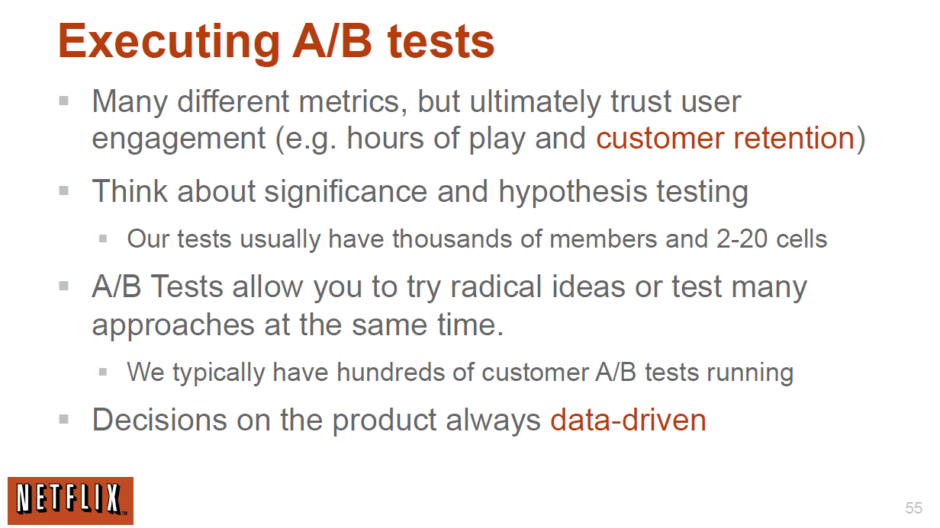
http://www.slideshare.net/xamat/building-largescale-realworld-recommender-systems-recsys2012-tutorial

Slide 6
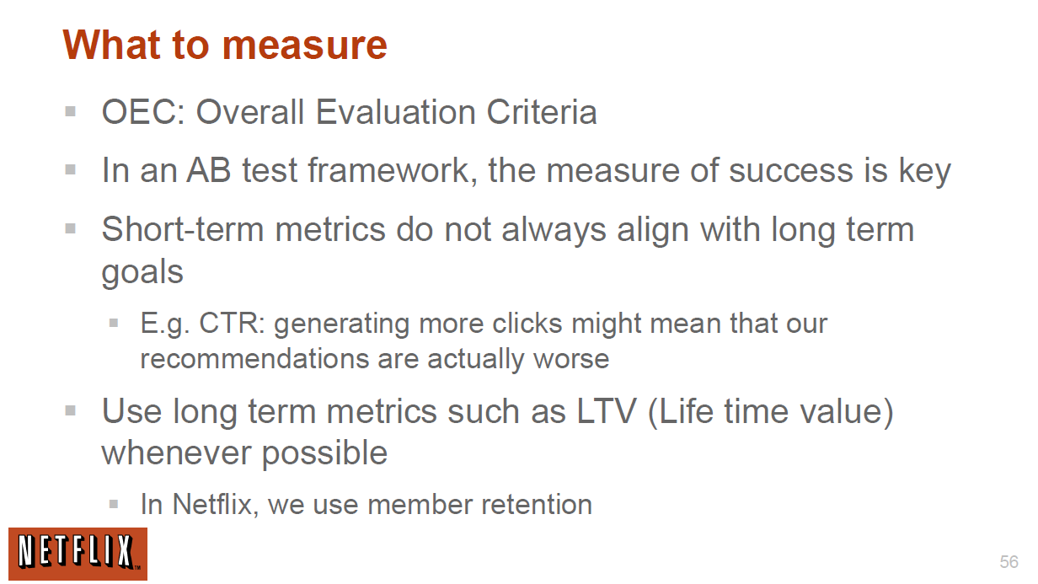
http://www.slideshare.net/xamat/building-largescale-realworld-recommender-systems-recsys2012-tutorial

Slide 7
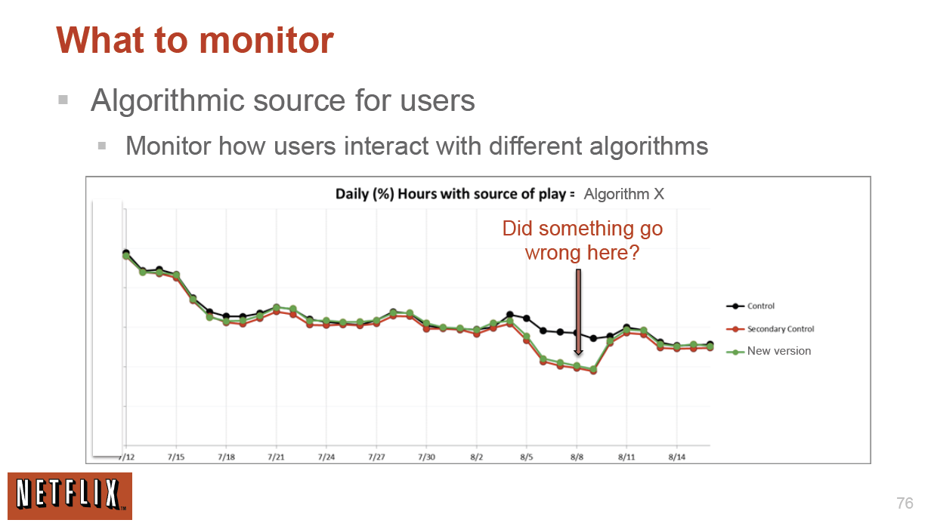
http://www.slideshare.net/xamat/building-largescale-realworld-recommender-systems-recsys2012-tutorial

Slide 8
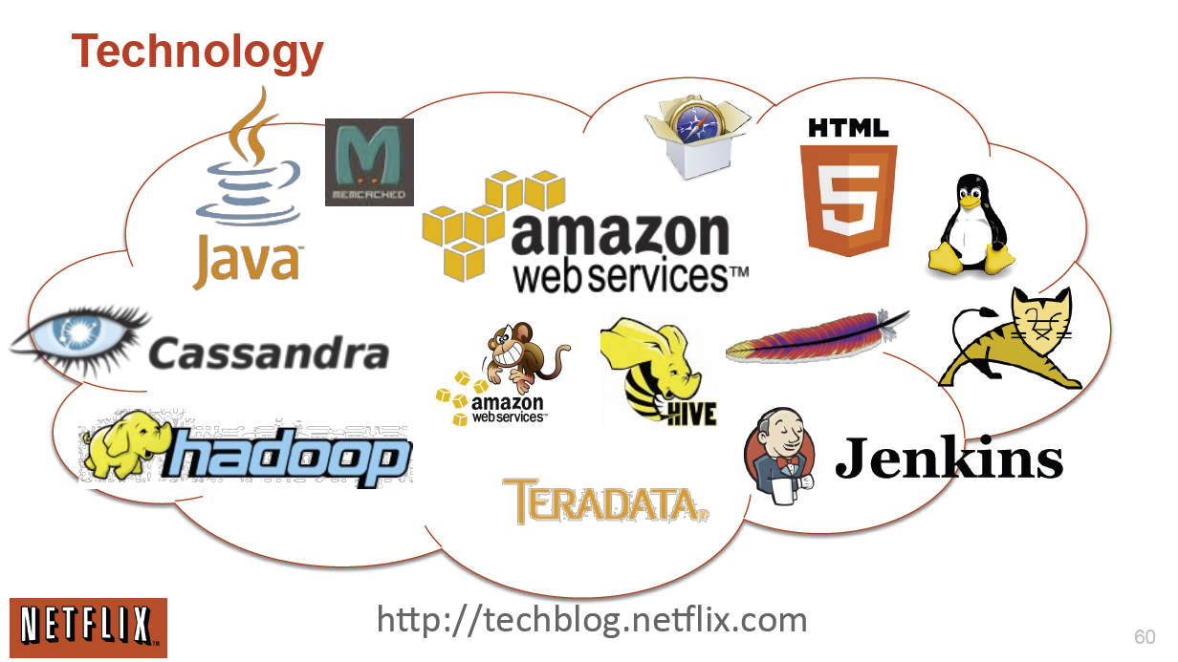
http://www.slideshare.net/xamat/building-largescale-realworld-recommender-systems-recsys2012-tutorial

Slide 9
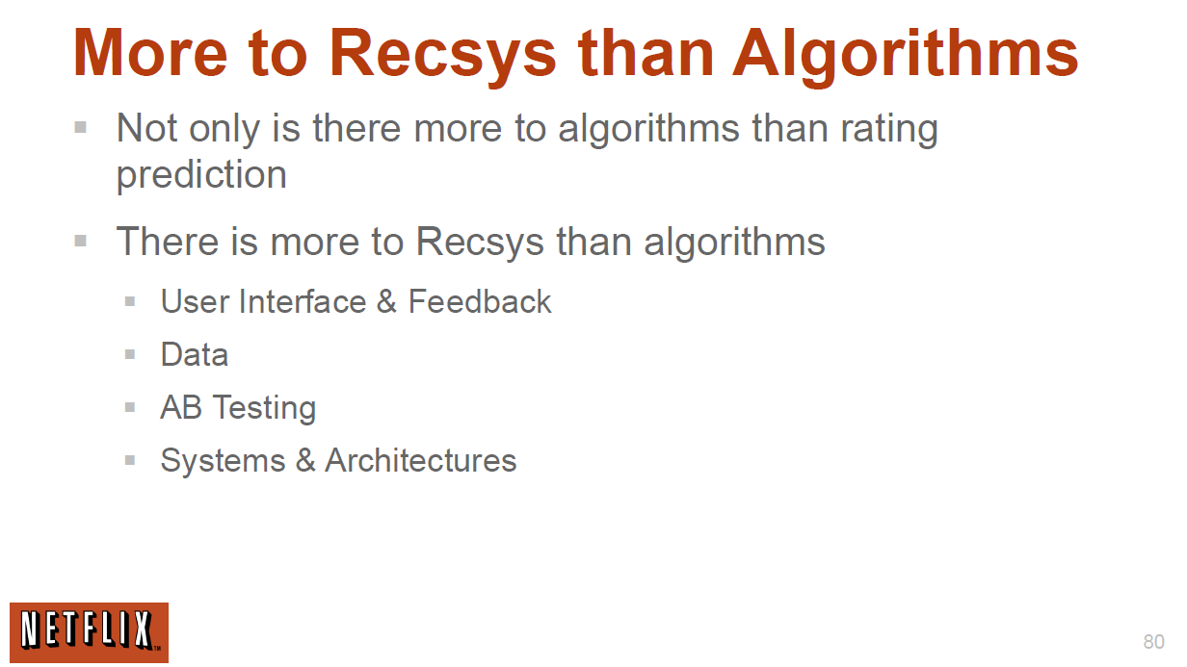
http://www.slideshare.net/xamat/building-largescale-realworld-recommender-systems-recsys2012-tutorial

Slide 10
Interesting Unanswered Question from Student
What is impact of users representing say a family e.g. father and daughter and so ratings are blended (if represent of interest to one family member) or inconsistent (if a given class of item sometimes rated by one and then other family member)

