Slide 1
Modern Recommendation Systems
Goal
  Serve the right item to a user in a given context to optimize long-term business objectives
A scientific discipline that involves
  Large scale Machine Learning & Statistics
    Offline Models (capture global & stable characteristics)
    Online Models (incorporates dynamic components)
    Explore/Exploit (active and adaptive experimentation)
  Multi-Objective Optimization
    Click-rates (CTR), Engagement, advertising revenue, diversity, etc
  Inferring user interest
    Constructing User Profiles
  Natural Language Processing to understand content
    Topics, “aboutness”, entities, follow-up of something, breaking news,…
http://pages.cs.wisc.edu/~beechung/icml11-tutorial/

Slide 2
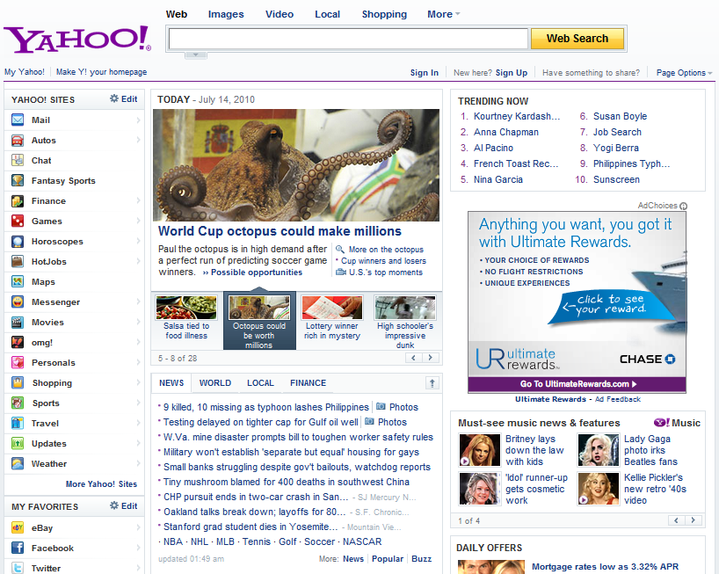
Recommend search queries
Recommend packages:
Image
Title, summary
Links to other pages
Pick 4 out of a pool of K
K = 20 ~ 40
Dynamic
Routes traffic other pages
Recommend applications
Recommend news article
http://pages.cs.wisc.edu/~beechung/icml11-tutorial/

Slide 3
Some examples from content optimization
Simple version
  I have a content module on my page, content inventory is obtained from a third party source which is further refined through editorial oversight. Can I algorithmically recommend content on this module? I want to improve overall click-rate (CTR) on this module
More advanced
  I got X% lift in CTR. But I have additional information on other downstream utilities (e.g. advertising revenue). Can I increase downstream utility without losing too many clicks?
Highly advanced
  There are multiple modules running on my webpage. How do I perform a simultaneous optimization?
http://pages.cs.wisc.edu/~beechung/icml11-tutorial/

Slide 4
Problems in this example
Optimize CTR on multiple modules
  Today Module, Trending Now, Personal Assistant, News
  Simple solution: Treat modules as independent, optimize separately. May not be the best when there are strong correlations.
For any single module
  Optimize some combination of CTR, downstream engagement, and perhaps advertising revenue.
http://pages.cs.wisc.edu/~beechung/icml11-tutorial/

Slide 5
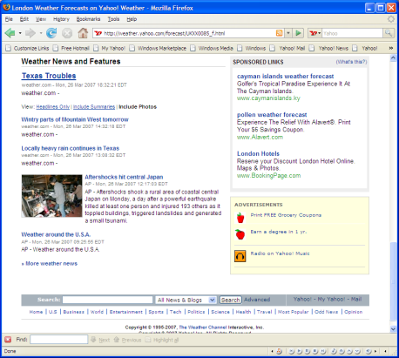


Online Advertising
Response rates
(click, conversion, ad-view)
Bids
conversion
ML /Statistical
model
Auction
Select argmax f(bid,response rates)
Click
Advertisers
Ads
Recommend
Best ad(s)
Page
Ad Network
User
Examples:
Yahoo, Google, MSN, …
Ad exchanges (RightMedia, DoubleClick, …)
Publisher
http://pages.cs.wisc.edu/~beechung/icml11-tutorial/
Notes:
This only shows one scenario; that of content match. Let’s add Sponsored Search (Replace Content with Query) and
Have a new slide for display advertising. This also does not provide info for the revenue model (shall we add it here or later).

