Slide 1
Predicting user-item interaction rates
Feature construction
Content: IR, clustering, taxonomy, entity,..
User profiles: clicks, views, social, community,..
Online
(Finer resolution
Corrections)
(item, user level)
(Quick updates)
Offline
( Captures stable characteristics
at coarse resolutions)
(Logistic, Boosting,….)
Initialize
Explore/Exploit
(Adaptive sampling)
(helps rapid convergence
to best choices)
http://pages.cs.wisc.edu/~beechung/icml11-tutorial/

Slide 2


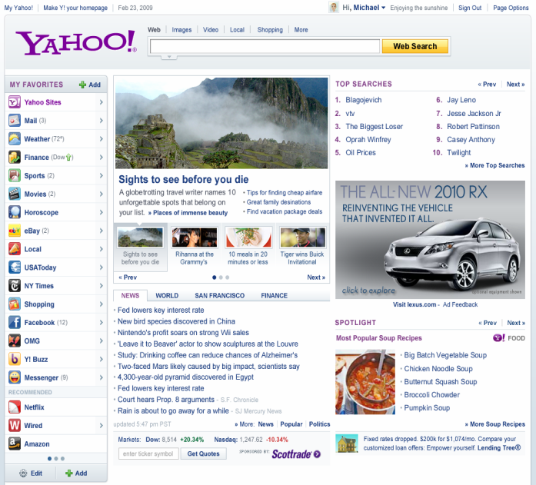



Post-click: An example in Content Optimization
Recommender
EDITORIAL
AD SERVER
DISPLAY ADVERTISING Revenue
Clicks on FP links influence downstream supply distribution
content
Downstream engagement
(Time spent)
http://pages.cs.wisc.edu/~beechung/icml11-tutorial/

Slide 3
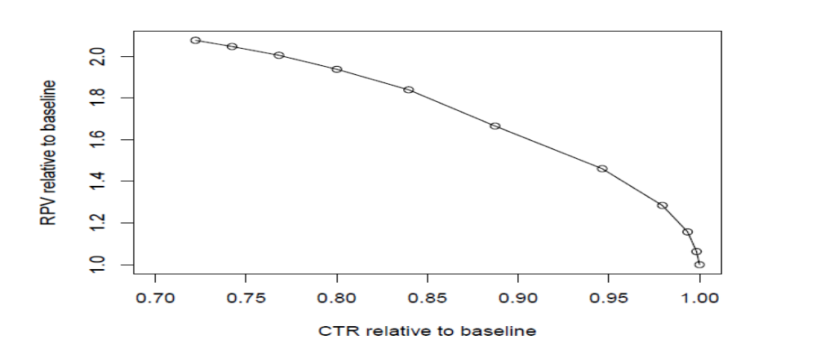
Serving Content on Front Page: Click Shaping
What do we want to optimize?
Current: Maximize clicks (maximize downstream supply from FP)
But consider the following
  Article 1: CTR=5%, utility per click = 5
  Article 2: CTR=4.9%, utility per click=10
    By promoting 2, we lose 1 click/100 visits, gain 5 utils
If we do this for a large number of visits --- lose some clicks but obtain significant gains in utility?
  E.g. lose 5% relative CTR, gain 40% in utility (revenue, engagement, etc)
http://pages.cs.wisc.edu/~beechung/icml11-tutorial/

Slide 4
Example Application:
Today Module on Yahoo! Homepage
Currently in production, powered by some methods discussed in this tutorial
http://pages.cs.wisc.edu/~beechung/icml11-tutorial/

Slide 5
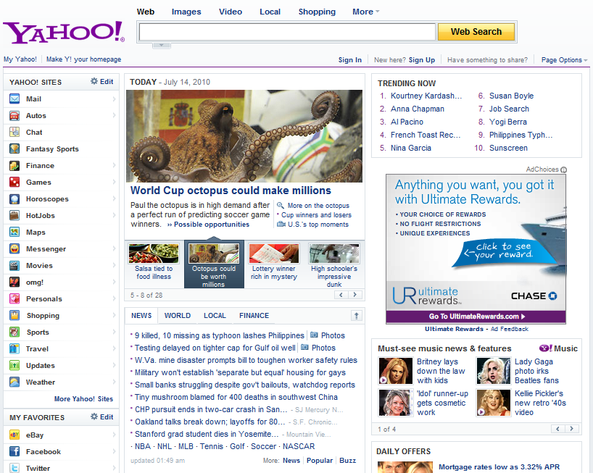
Recommend packages:
Image
Title, summary
Links to other pages
Pick 4 out of a pool of K
K = 20 ~ 40
Dynamic
Routes traffic other pages
1
2
3
4
http://pages.cs.wisc.edu/~beechung/icml11-tutorial/

Slide 6
Problem definition
Display “best” articles for each user visit
Best - Maximize User Satisfaction, Engagement
  BUT Hard to obtain quick feedback to measure these
Approximation
  Maximize utility based on immediate feedback (click rate) subject to constraints (relevance, freshness, diversity)
Inventory of articles?
  Created by human editors
  Small pool (30-50 articles) but refreshes periodically
http://pages.cs.wisc.edu/~beechung/icml11-tutorial/

Slide 7
Where are we today?
Before this research
  Articles created and selected for display by editors
After this research
  Article placement done through statistical models
How successful ?
"Just look at our homepage, for example. Since we began pairing our content optimization technology with editorial expertise, we've seen click-through rates in the Today module more than double. ----- Carol Bartz, CEO Yahoo! Inc (Q4, 2009)
http://pages.cs.wisc.edu/~beechung/icml11-tutorial/

Slide 8
Main Goals
Methods to select most popular articles
  This was done by editors before
Provide personalized article selection
  Based on user covariates
  Based on per user behavior
Scalability: Methods to generalize in small traffic scenarios
  Today module part of most Y! portals around the world
  Also syndicated to sources like Y! Mail, Y! IM etc
http://pages.cs.wisc.edu/~beechung/icml11-tutorial/

