Slide 1
Distances in Funny Spaces I
In user-based collaborative filtering, we can think of users in a space of dimension N where there are N items and M users.
Let i run over items and u over users
Then each user is represented as a vector U_{i}(u) in “item-space” where ratings are vector components. We are looking for users u u’ that are near each other in this space as measured by some distance between U_{i}(u) and U_{i}(u’)
If u and u’ rate all items then these are “real” vectors but almost always they each only rates a small fraction of items and the number in common is even smaller
The “Pearson coefficient” is just one distance measure that can be used
Only sum over items rated by u and u’

Slide 2
Distances in Funny Spaces II
In item-based collaborative filtering, we can think of items in a space of dimension M where there are N items and M users.
Let i run over items and u over users
Then each item is represented as a vector R_{u}(i) in “user-space” where ratings are vector components. We are looking for items i i’ that are near each other in this space as measured by some distance between R_{u}(i) and R_{u}(i’)
If i and i’ rated by all users then these are “real” vectors but almost always they are each only rated by a small fraction of users and the number in common is even smaller
The “Cosine measure” is just one distance measure that can be used
Only sum over users rating both i and i’

Slide 3
Do we need “real” spaces?
Much of (eCommerce/LifeStyle) Informatics involves “points”
Events in LHC analysis
Users (people) or items (books, jobs, music, other people)
These points can be thought of being in a “space”
Set of all books
Set of all physics reactions
Set of all Internet users
However as in recommender systems where a given user only rates some items, we don’t know “full position”
However we can nearly always define a useful distance d(a,b) between points
Always d(a,b) >= 0
Usually d(a,b) = d(b,a)
Rarely d(a,b) + d(b,c) >= d(a,c) Triangle Inequality

Slide 4
Using Distances
The simplest way to use distances is “nearest neighbor algorithms” – given one point, find a set of points near it – cut off by number of identified nearby points and/or distance to initial point
Here point is either user or item
Another approach is divide space into regions (topics, latent factors) consisting of nearby points
– This is clustering described in following slide
Also other algorithms like Gaussian mixture models or Latent Semantic Analysis or Latent Dirichlet Allocation which use a more sophisticated model

Slide 5
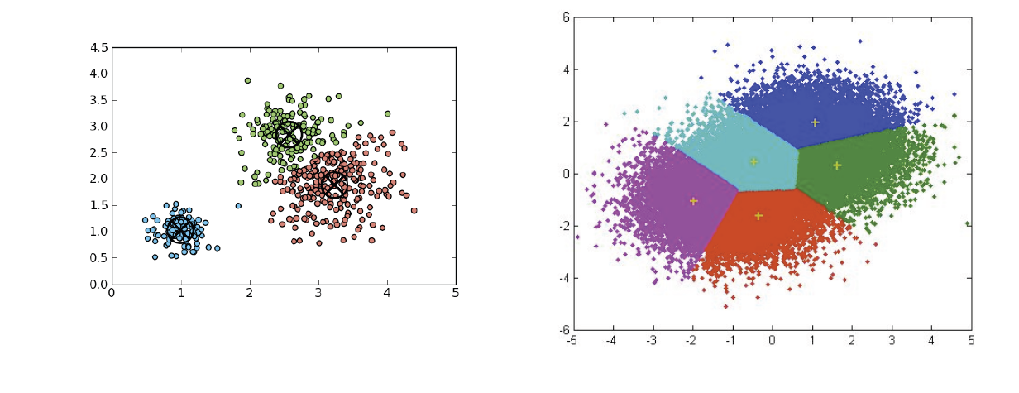
Clustering
One can think of users and/or items as points in a space and try to find clusters
Either clear clusters (as in left) or divisions of space into points close to each other (right picture)
All entities in the same cluster are assigned the same recommendations which can dramatically speed up real time computation
i.e. all users in same cluster are assigned same recommendations for a given item
See 2003 Amazon article (http://www.cs.umd.edu/~samir/498/Amazon-Recommendations.pdf) for comments on need to respond in real time
Clustering discussed later

