Slide 1
Collaborative Filtering (CF)
The most prominent approach to generate recommendations
used by large, commercial e-commerce sites
well-understood, various algorithms and variations exist
applicable in many domains (book, movies, DVDs, ..)
Approach
use the "wisdom of the crowd" to recommend items
Basic assumption and idea
Users give ratings to catalog items (implicitly or explicitly)
Customers who had similar tastes in the past, will have similar tastes in the future

Slide 2
Pure CF Approaches
Input
Only a matrix of given user–item ratings
Output types
A (numerical) prediction indicating to what degree the current user will like or dislike a certain item
A top-N list of recommended items

Slide 3
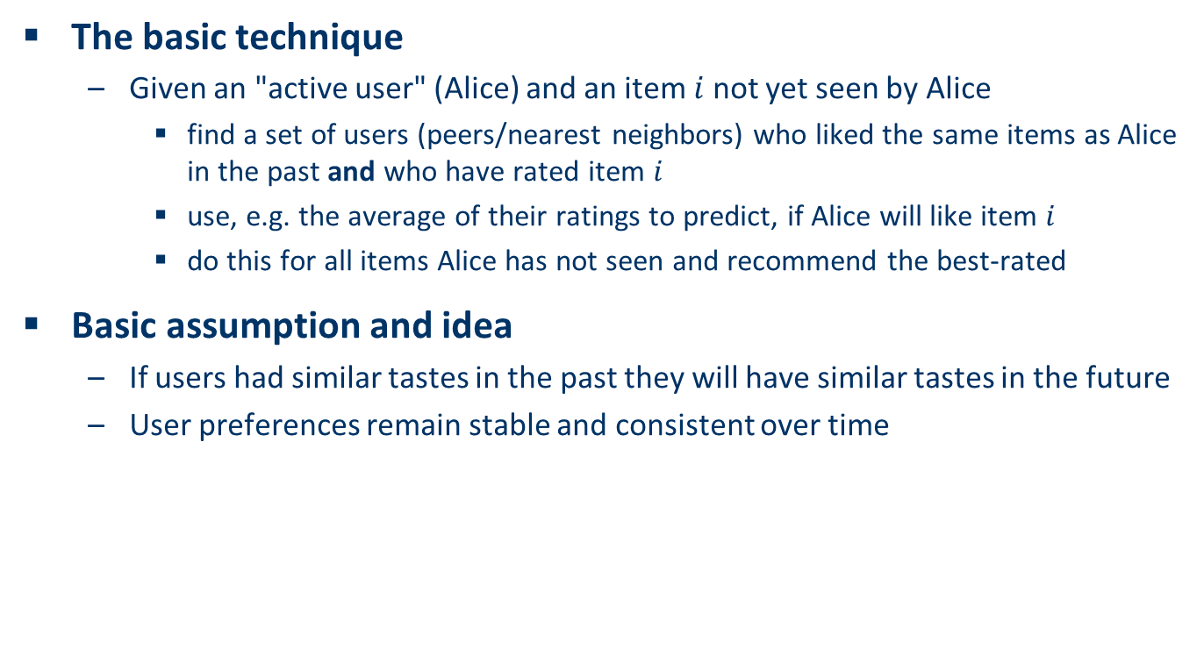
User-based nearest-neighbor collaborative filtering (1)
The basic technique
Given an "active user" (Alice) and an item $i$ not yet seen by Alice
find a set of users (peers/nearest neighbors) who liked the same items as Alice in the past and who have rated item $i$
use, e.g. the average of their ratings to predict, if Alice will like item $i$
do this for all items Alice has not seen and recommend the best-rated
Basic assumption and idea
If users had similar tastes in the past they will have similar tastes in the future
User preferences remain stable and consistent over time

