Slide 1
User-based nearest-neighbor collaborative filtering (2)
Example
A database of ratings of the current user, Alice, and some other users is given:
Determine whether Alice will like or dislike Item5, which Alice has not yet rated or seen
 | Item1 | Item2 | Item3 | Item4 | Item5
Alice | 5 | 3 | 4 | 4 | ?
User1 | 3 | 1 | 2 | 3 | 3
User2 | 4 | 3 | 4 | 3 | 5
User3 | 3 | 3 | 1 | 5 | 4
User4 | 1 | 5 | 5 | 2 | 1

Slide 2

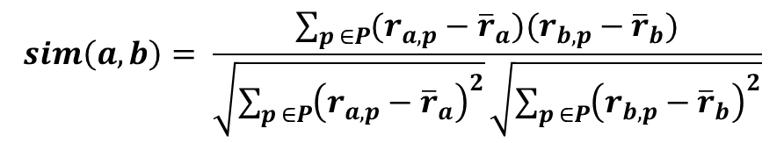
Measuring user similarity (1)
A popular similarity measure in user-based CF: Pearson correlation
$a$, $b$ : users
$r_{a,p}$ : rating of user $a$ for item $p$
$P$ : set of items, rated both by $a$ and $b$
Possible similarity values between $−1$ and $1$
$$sim\left(a,b\right)= \frac{\sum_{p ∈P}{(r_{a,p}−{\overline{r}}_{a})(r_{b,p}−{\overline{r}}_{b})}}{\sqrt{\sum_{p ∈P}{{\left(r_{a,p}−{\overline{r}}_{a}\right)}^{2}}}\sqrt{\sum_{p ∈P}{{\left(r_{b,p}−{\overline{r}}_{b}\right)}^{2}}}}$$

Slide 3
Measuring user similarity (2)
A popular similarity measure in user-based CF: Pearson correlation
$a$, $b$ : users
$r_{a,p}$ : rating of user $a$ for item $p$
$P$ : set of items, rated both by $a$ and $b$
Possible similarity values between $−1$ and $1$
 | Item1 | Item2 | Item3 | Item4 | Item5
Alice | 5 | 3 | 4 | 4 | ?
User1 | 3 | 1 | 2 | 3 | 3
User2 | 4 | 3 | 4 | 3 | 5
User3 | 3 | 3 | 1 | 5 | 4
User4 | 1 | 5 | 5 | 2 | 1
sim = 0,85
sim = 0,00
sim = 0,70
sim = -0,79

Slide 4
Pearson correlation
Takes differences in rating behavior into account
Works well in usual domains, compared with alternative measures
such as cosine similarity

Slide 5
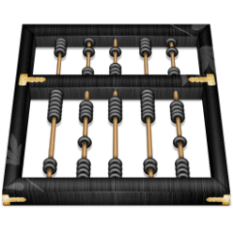
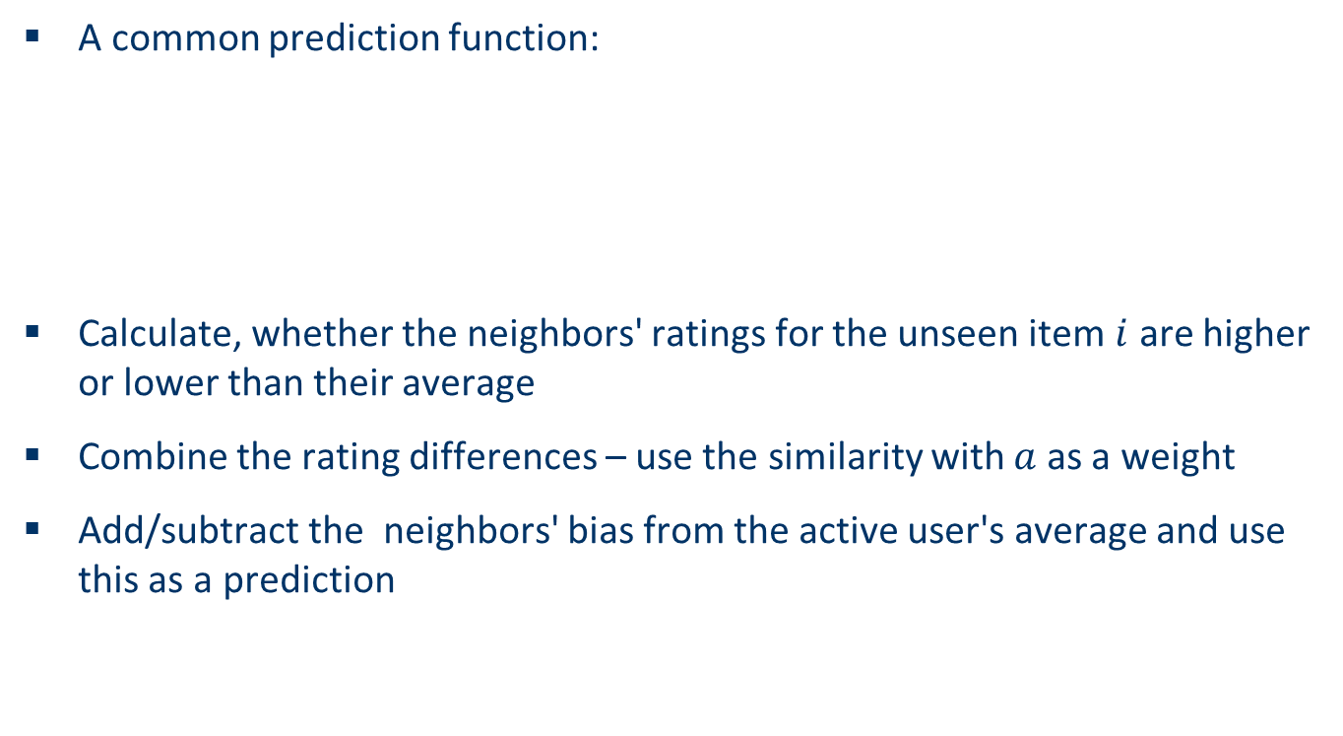
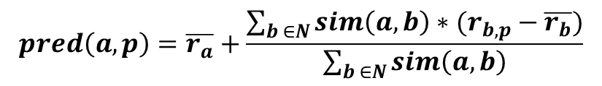
Making predictions
A common prediction function:
Calculate, whether the neighbors' ratings for the unseen item $i$ are higher or lower than their average
Combine the rating differences – use the similarity with $a$ as a weight
Add/subtract the neighbors' bias from the active user's average and use this as a prediction
$$pred\left(a,p\right)=\overline{r_{a}}+\frac{\sum_{b ∈N}{sim\left(a,b\right)∗(r_{b,p}−\overline{r_{b}})}}{\sum_{b ∈N}{sim\left(a,b\right)}}$$

Slide 6
Improving the metrics / prediction function
Not all neighbor ratings might be equally "valuable"
Agreement on commonly liked items is not so informative as agreement on controversial items
Possible solution: Give more weight to items that have a higher variance
Value of number of co-rated items
Use "significance weighting", by e.g., linearly reducing the weight when the number of co-rated items is low
Case amplification
Intuition: Give more weight to "very similar" neighbors, i.e., where the similarity value is close to 1.
Neighborhood selection
Use similarity threshold or fixed number of neighbors

