Slide 1
X-Informatics Case Study: e-Commerce and Life Style Informatics: Recommender Systems IV: k’th Nearest Neighbor Algorithms
February 11 2013
Geoffrey Fox
gcf@indiana.edu
http://www.infomall.org/X-InformaticsSpring2013/index.html
Associate Dean for Research and Graduate Studies, School of Informatics and Computing
Indiana University Bloomington
2013

Slide 2
Big Data Ecosystem in One Sentence
Use Clouds running Data Analytics Collaboratively processing Big Data to solve problems in X-Informatics ( or e-X)
X = Astronomy, Biology, Biomedicine, Business, Chemistry, Climate, Crisis, Earth Science, Energy, Environment, Finance, Health, Intelligence, Lifestyle, Marketing, Medicine, Pathology, Policy, Radar, Security, Sensor, Social, Sustainability, Wealth and Wellness with more fields (physics) defined implicitly
Spans Industry and Science (research)
Education: Data Science see recent New York Times articles
http://datascience101.wordpress.com/2013/04/13/new-york-times-data-science-articles/

Slide 3

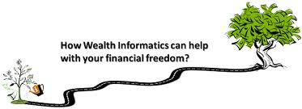

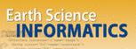


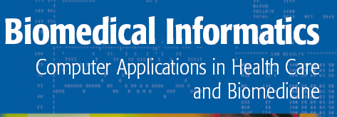


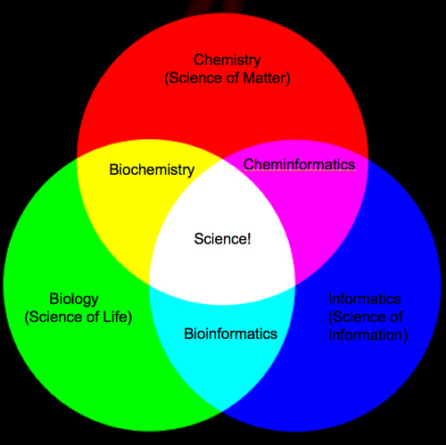
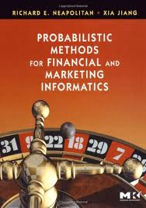
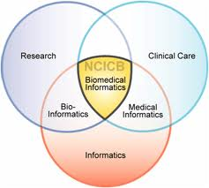
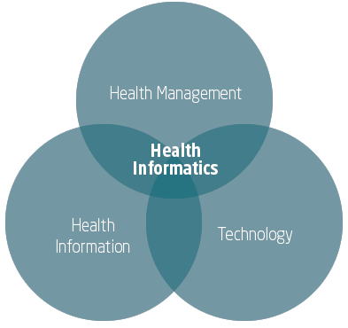


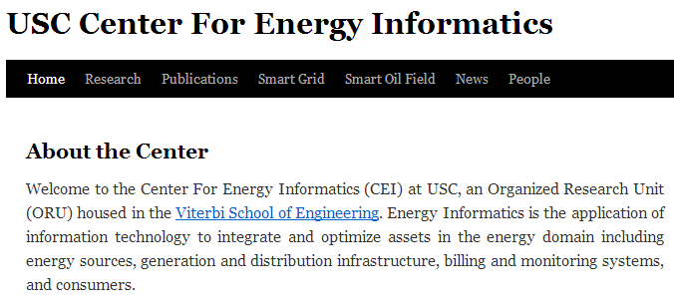
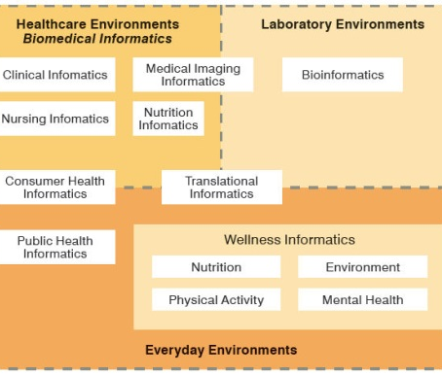
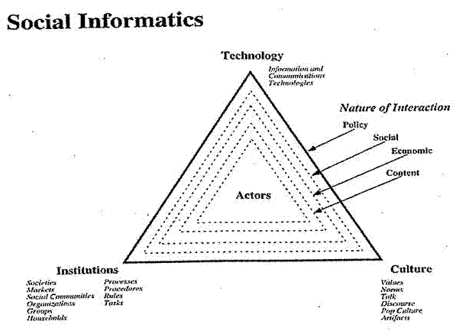


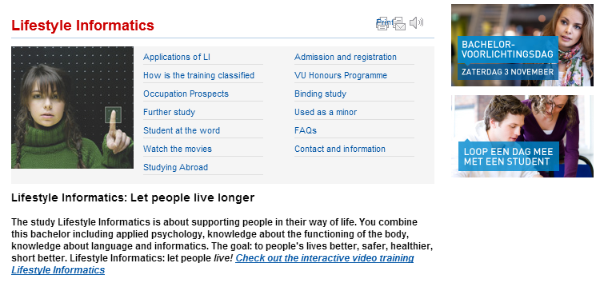


Social Informatics

Slide 4
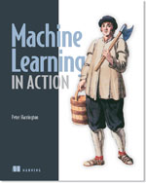
Python Example
Machine Learning in Action Peter Harrington April, 2012 | 384 pages ISBN: 9781617290183
http://www.manning.com/pharrington/MLiA_SourceCode.zip
Chapter 2
We will use software from this book with minor enhancements to write out file in format for 3D plotting program

Slide 5
Files Used in Recommender Engine Python
datingTestSet2.txt # A dataset of 1000 points
ConvertToPviz.py # Python driver to convert dataset to a format readable by PlotViz program (3D point plotter)
DatingRatingforPviz.txt # Result of converting 1000 point file
DatingRating-OriginalLabels.pviz The previous file saved by Plotviz with same data but some formatting additions
kNN.py # Code from book to implement k’th nearest neighbor and various utilities
kNNDriver.py # Driver to invoke kNN.py and produce results discussed

Slide 6
Create Dataset of 2D and 3D Values and Rating (Labels)
Two “artificial” examples
Start with a simple example: 4 2D vectors with Labels
Then move onto 1000 3D Labels
# Set up a dataset of 4 (2D vector) items -- each of which has one of two labels
def createDataSet():
group = array([[1.0,1.1],[1.0,1.0],[0,0],[0,0.1]])
labels = ['A','A','B','B']
return group, labels

Slide 7
Python Example I: Four 2D Vectors
# Set Directory
%cd d:\\Python\RecommenderCh02
import kNN
FigDating = figure() # This figure will have 3 parts (subplots)
# Set up 4 points and associate color to two groups
group,labels = kNN.createDataSet()
colormap1 = { 'A':'red', 'B':'blue'}
ColoredGroupLabels = []
for things in labels:
ColoredGroupLabels.append(colormap1[things])
# Plot four points
ax1 = FigDating.add_subplot(311, xlim=(-0.1,1.1), ylim=(-.05,1.15))
ax1.scatter(group[:,0], group[:,1], s= 20, c= ColoredGroupLabels, marker = 'o' )

Slide 8
Python Example I: Four 2D vectors Contd.
# Here we classify and plot 3 points
# Original points circles and test points crosses
# Original points re two clusters – each of two points – red or blue
# Color of test points indicates classification
testvector = [.2, .2]
answer = kNN.classify0(testvector,group, labels, 3)
# type answer to see result or we will plot
ax1.scatter(testvector[0], testvector[1], s= 20, c= colormap1[answer], marker = 'x' )
testvector = [.5, .5]
answer = kNN.classify0(testvector,group, labels, 3)
ax1.scatter(testvector[0], testvector[1], s= 20, c= colormap1[answer], marker = 'x' )
testvector = [.75, .75]
answer = kNN.classify0(testvector, group, labels, 3)
ax1.scatter(testvector[0], testvector[1], s= 20, c= colormap1[answer], marker = 'x' )

Slide 9
Finding Nearest Neighbors
testvector = [.75, .75]
answer = kNN.classify0(testvector, group, labels, 3)
ax1.scatter(testvector[0], testvector[1], s= 20, c= colormap1[answer], marker = 'x' )
# kNN.classify0 implements k nearest neighbor algorithm
# It takes testvector and finds its Euclidean distance to all the points in group
# Then its sorts distances and finds the k (=3 in this case) smallest distances
# It returns label that appears most often in set of k points whose label is specified in labels
# We will look at code in detail later on

Slide 10
Python Example II: 1000 3D vectors
# Read in 1000 points in file and assign colors
datingDataMat,datingLabels = kNN.file2matrix('datingTestSet2.txt')
datingLabelArray = array(datingLabels)
colormap2 = { 1:'red', 2:'blue', 3:'green' }
ColoredDatingLabel = []
for things in datingLabelArray:
ColoredDatingLabel.append(colormap2[things])

