Slide 1
Python Example II: 1000 3D vectors Contd.
# Plot unnormalized results
ax2 = FigDating.add_subplot(312, xlim=(0,100000), ylim=(0,25))
ax2.scatter(datingDataMat[:,0], datingDataMat[:,1], s= 20, c= ColoredDatingLabel, marker = 'o' )
# Normalize and Plot normalized results
normMat, ranges, minVals = kNN.autoNorm(datingDataMat)
ax3 = FigDating.add_subplot(313, xlim=(0,1), ylim=(0,1))
ax3.scatter(normMat[:,0], normMat[:,1], s = 20, c= ColoredDatingLabel, marker = 'o' )
# One typically normalizes in some way – one approach is to make mean 0 and standard deviation 1 in each coordinate direction
# autoNorm makes minimum value 0 and maximum 1 in each coordinate
show() # Plot complete

Slide 2
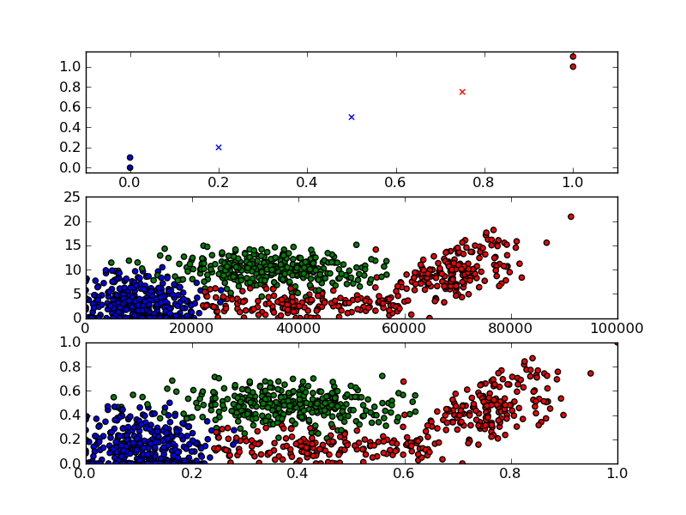

Slide 3
PlotViz
Now we look at PlotViz as a 3D viewer available at http://salsahpc.indiana.edu/pviz3/
We will demonstrate now with first some snapshots and then interactive rotation
The cluster separation varies according to view taken

Slide 4
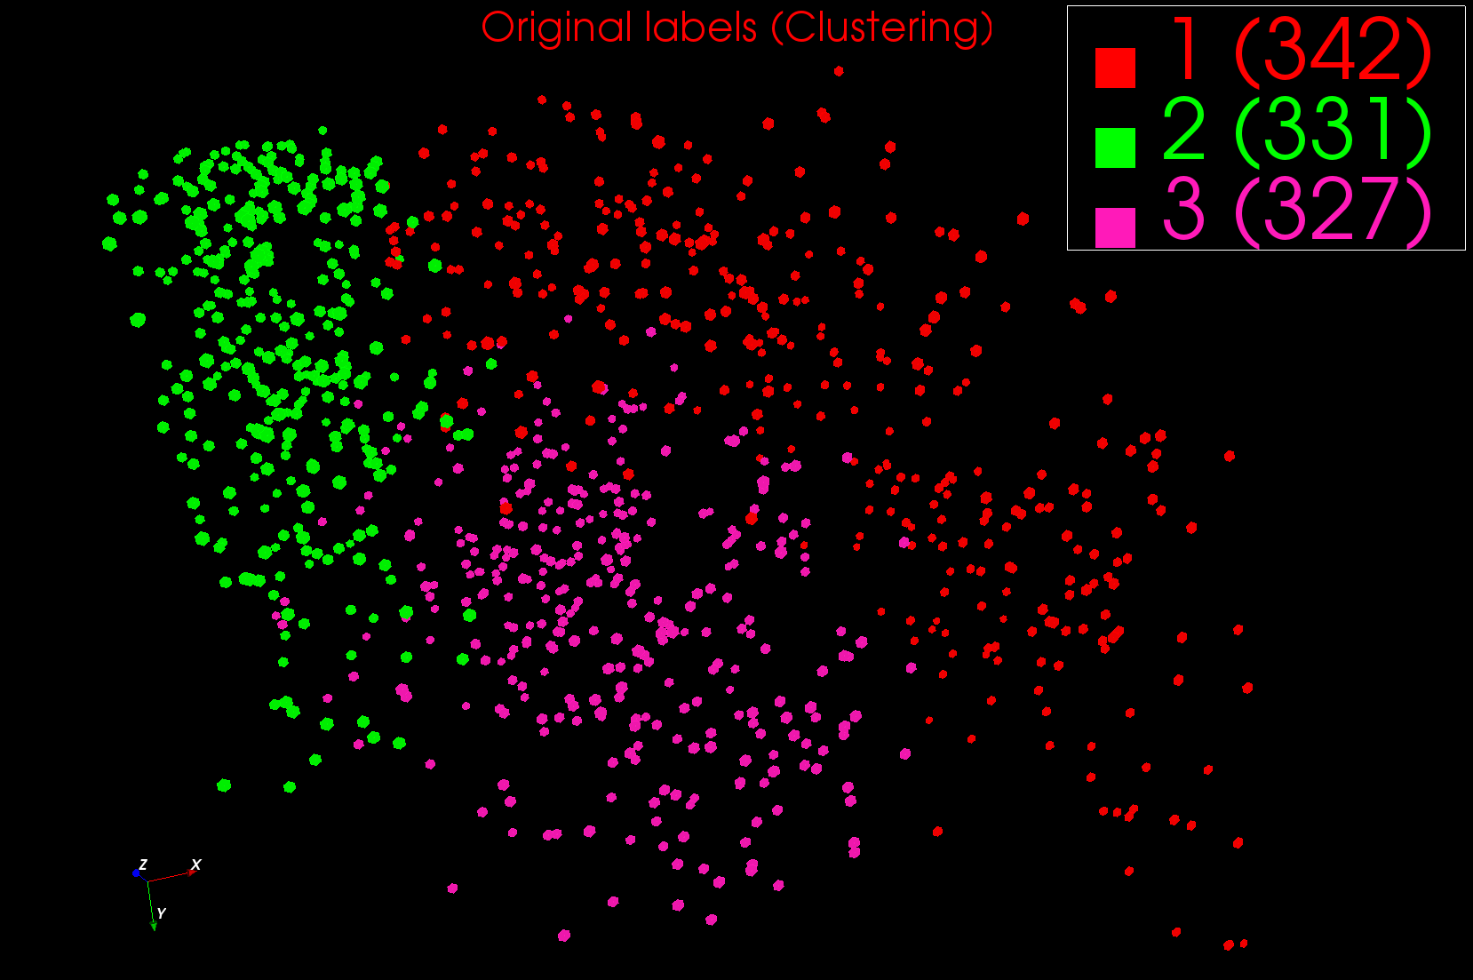
One of 3D Rotated 2D Views of Clusters

Slide 5
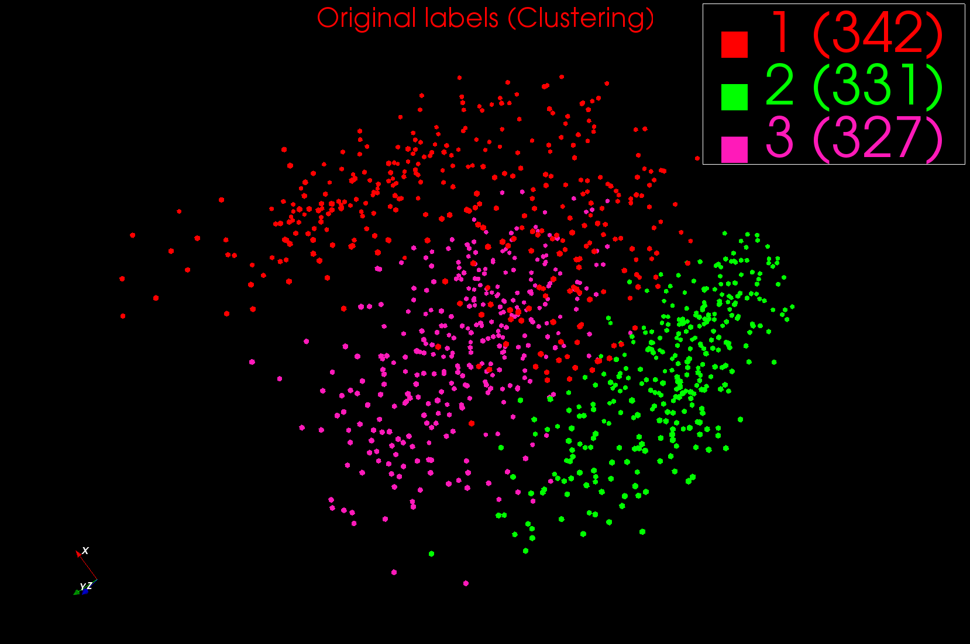
One of 3D Rotated 2D Views of Clusters

Slide 6
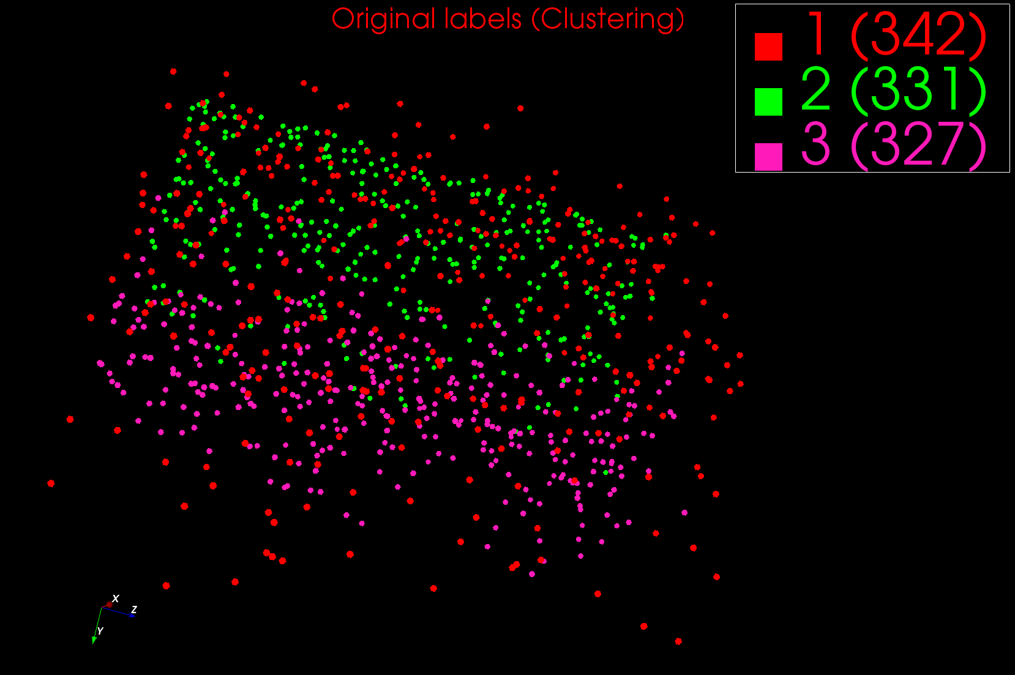
One of 3D Rotated 2D Views of Clusters

