Slide 1
Technology for Informatics Kmeans
June 19 2013
Geoffrey Fox
gcf@indiana.edu
http://www.infomall.org/
Associate Dean for Research, School of Informatics and Computing
Indiana University Bloomington
2013

Slide 2
Big Data Ecosystem in One Sentence
Use Clouds running Data Analytics Collaboratively processing Big Data to solve problems in X-Informatics ( or e-X)
X = Astronomy, Biology, Biomedicine, Business, Chemistry, Climate, Crisis, Earth Science, Energy, Environment, Finance, Health, Intelligence, Lifestyle, Marketing, Medicine, Pathology, Policy, Radar, Security, Sensor, Social, Sustainability, Wealth and Wellness with more fields (physics) defined implicitly
Spans Industry and Science (research)
Education: Data Science see recent New York Times articles
http://datascience101.wordpress.com/2013/04/13/new-york-times-data-science-articles/

Slide 3

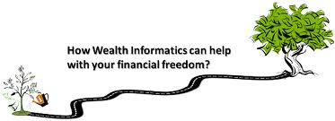

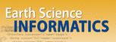


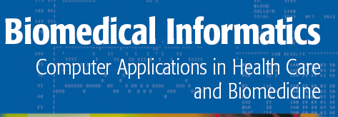

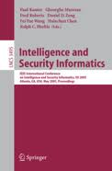
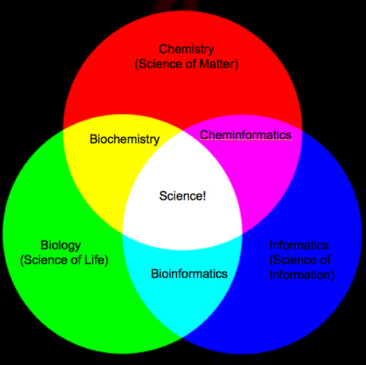
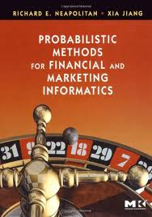
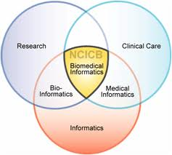
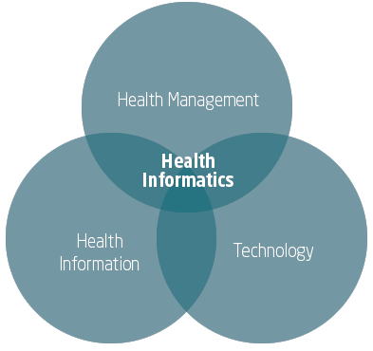
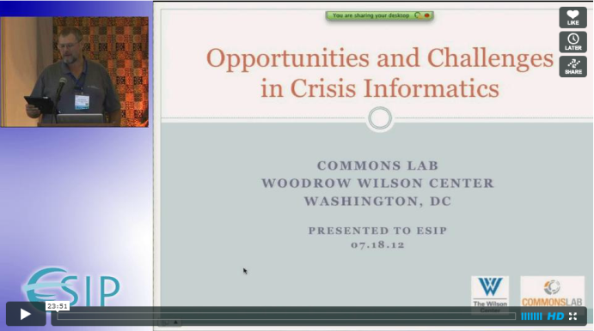

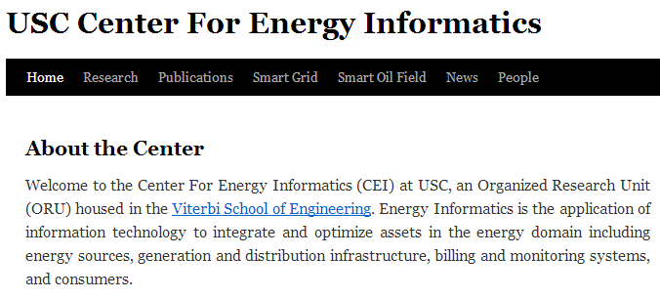
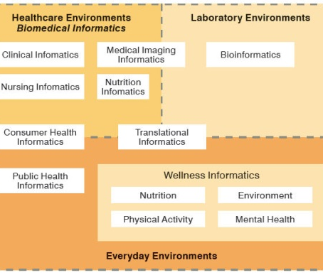
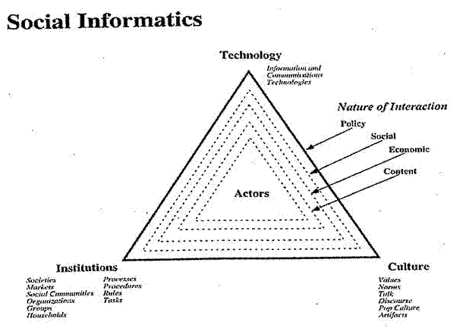

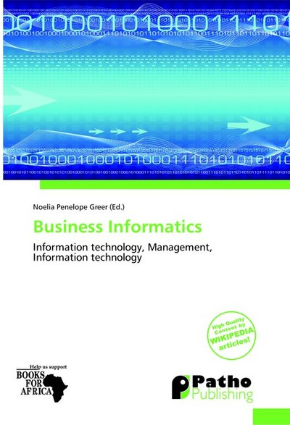
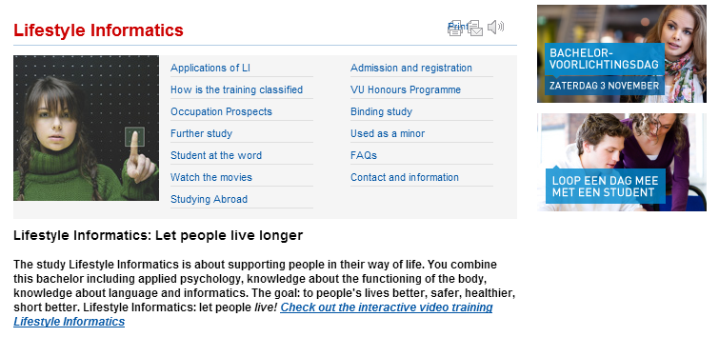


Social Informatics

Slide 4
Kmeans in Python

Slide 5
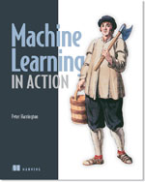
Kmeans Resources
Machine Learning in Action Peter Harrington April, 2012 | 384 pages ISBN: 9781617290183
http://www.manning.com/pharrington/MLiA_SourceCode.zip
Chapter 10 discusses Kmeans but we will NOT use this software but rather the built in support of Kmeans in SciPy
This SciPy software will be modified for some of experimentation reported here

Slide 6
Resources Used
SciPy Software https://github.com/scipy/scipy/blob/master/scipy/cluster/vq.py has both kmeans code and a “utility vq to associate points with clusters
http://docs.scipy.org/doc/scipy/reference/cluster.vq.html describes software
File KmeansExtra.py has drivers to invoke SciPy code to calculate 6 different scenarios based on “fake” data corresponding to 4 actual clusters of three different sizes “small” “large” “very large”
File ParallelKmeans.py has modified Kmeans code invoking same vq Utility. Modification supports MapReduce Parallelism (see later) and different goodness measure. Gives 8 plots (adds K=6 and 8) and will be used in lecture
xmean.py uses Python built in Kmeans to read data from CSV file
sample.csv Sample height/weight data from http://www.kosbie.net/cmu/fall-10/15-110/
http://www.kosbie.net/cmu/fall-10/15-110/handouts/notes-clustering/tshirts-GHIJ-nooutliers.csv

Slide 7
Simple T-Shirt Example
Cluster 85 T-shirt records in sample.csv into a number of categories set by number of clusters set in xmean.py file
2 clusters is default
We try 2 3 4 5 Clusters
Note Kmeans allows more clusters but plot only works up to 5

Slide 8
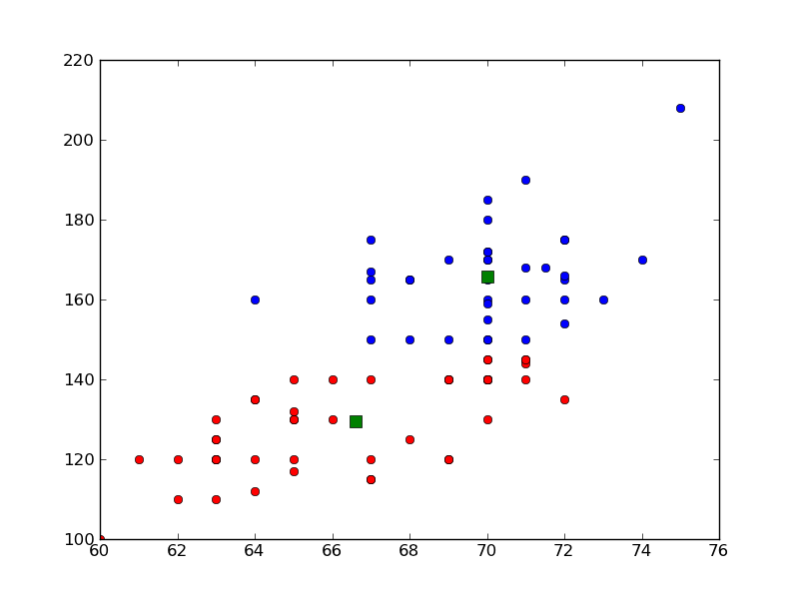
Weight (y) versus Height(x)
2 T-Shirt Sizes
Kmeans K=2 on data from a file

Slide 9
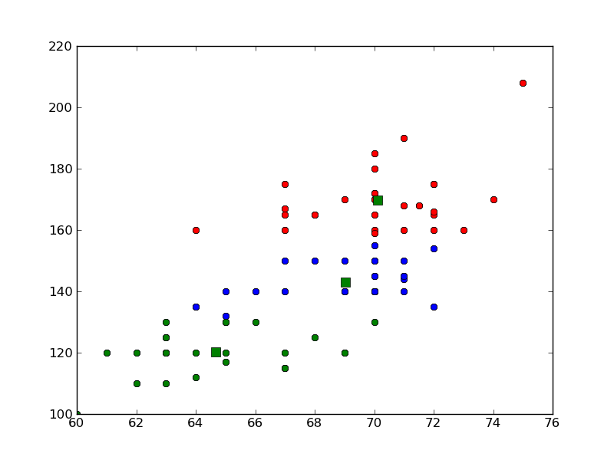
Weight (y) versus Height(x)
3 T-Shirt Sizes

Slide 10
Clusters Generated
There are 4 clusters each with 250 points generated as Gaussians (remember discussion of Physics Higgs particle) with given centers and radii (standard deviations)
Center (0, 0) Radius 0.375
Center (3, 3) Radius 0.55
Center (0, 3) Radius 0.6
Center (3, 0) Radius 0.25
Note largest clusters are those with y=3 (on top)
These are “large” clusters
“small” clusters have radii = 0.25 these retaining ratio given above
“very large” clusters have radii = 1.5 these

