Slide 1
Kmeans
Have a set N of Points – find a specified number K of clusters
Choose a “random” starting point e.g. randomly choose K points to be centers
Iterate until converged
Associate points with cluster whose center they are nearest
Calculate new center positions as centroid (average) of points associated with center
Note Python has a Kmeans code which we use
As source available we modify to illustrate parallel computing and change goodness criterion

Slide 2
Sequential version of Kmeans
Overall iteration over starting positions
Initialize Centroids
Iterate until converged
Find association of points and centers
Calculate distortion (Point-Center distance)
Find centroids as mean of point vectors
Delete zero size clusters
Check convergence
Return best solution based on Goodness criterion which for SciPy version is average distortion
Later tweak algorithm to put in MapReduce form

Slide 3
Kmeans on 4 “Artificial” Clusters
Fixed Center positions at
(0,0) radius 0.375
(3,3) radius 0.55
(0,3) radius 0.6
(3,0) radius 0.25
These are “large clusters”
“Small Clusters” have radius multiplied by 0.25
“Very Large Clusters” radius multiplied by 1.5
Each clusters has 250 points generated in normal (Gaussian) distribution with standard deviation 1
We used Kmeans with 2, 4 and just for fun 6 or 8 clusters (i.e. more than “real number” of clusters

Slide 4
Comments
As random data and random starting points, get different answers each time
Can fix seeds for reproducible results
Generally get “correct” answers
Reduce number of iterations (20 default in Python) of independent runs to increase “interesting” results with non optimal solutions

Slide 5
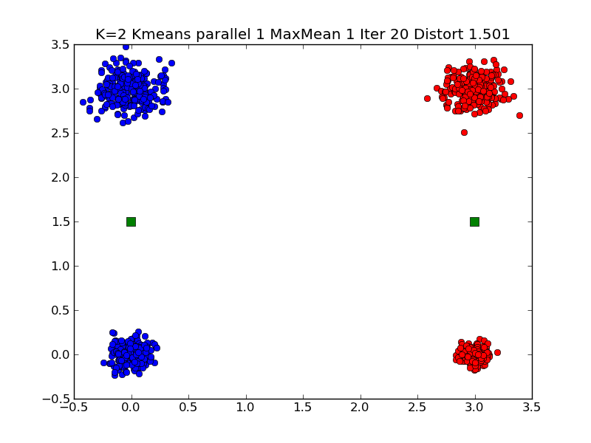
Typical K=2 Small Clustering Note distortion ~1.5

Slide 6
In Graph Title
K is number of clusters looked for K = 2…8
Parallelism is level of (pseudo) parallelism. Used for illustrating MapReduce
MaxMean = 1 Judge quality by mean distortion
Distortion is distance from point to its center
MaxMean = 2 Judge quality by max distortion
Iter is number of totally independent Kmeans iterations to run; return highest quality
Minimizing distortion measure controlled by MaxMean is quality measure

Slide 7
kmeans_gcf(data, Numclusters, NumIterations, Thresh, Parallelism, MaxMean)
data is points to be clustered
Numclusters (2 4 6 8 here) is number of clusters to find
NumIterations is number of independent iterations to perform returning solution with minimum “distortion” as described earlier
Thresh controls each iteration of Kmeans; stop when change in distortion < Thresh. Note this can still be a non optimal solution
Parallelism = 1 here. Later lecture runs a simple MapReduce parallel version with Parallelism = 2
MaxMean = 1 is usual Python Kmeans. MaxMean = 2 is alternative quality measure described earlier

