Slide 1
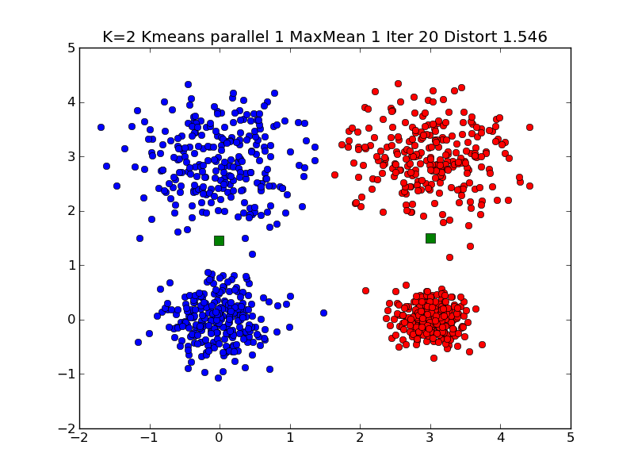
Typical K=2 Large Clustering

Slide 2
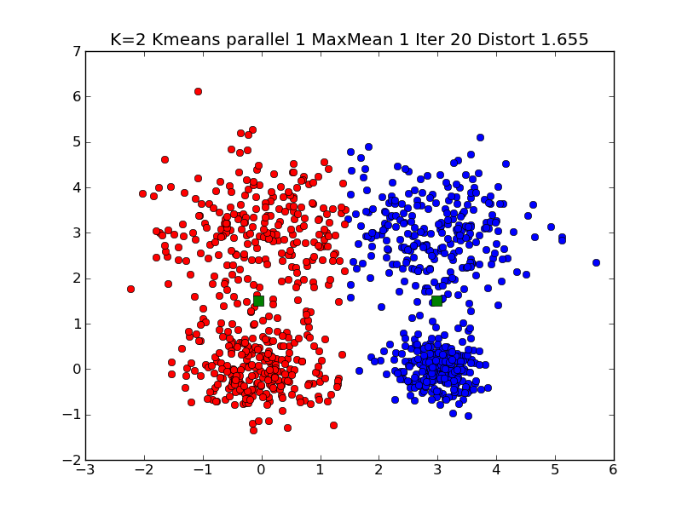
Typical K=2 Very Large Clustering

Slide 3
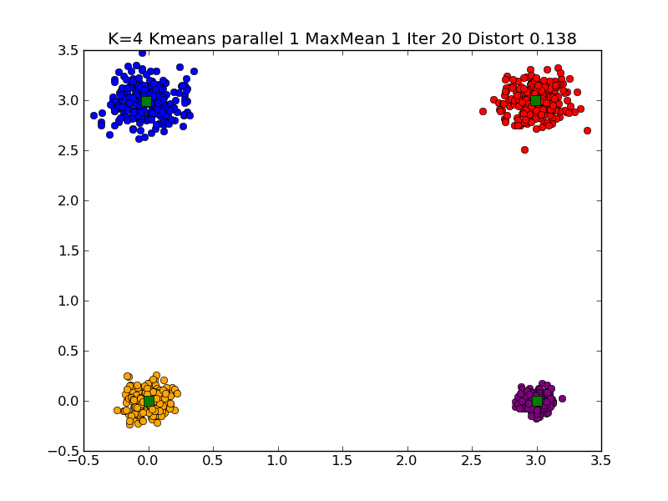
Typical K=4 Small Clustering

Slide 4
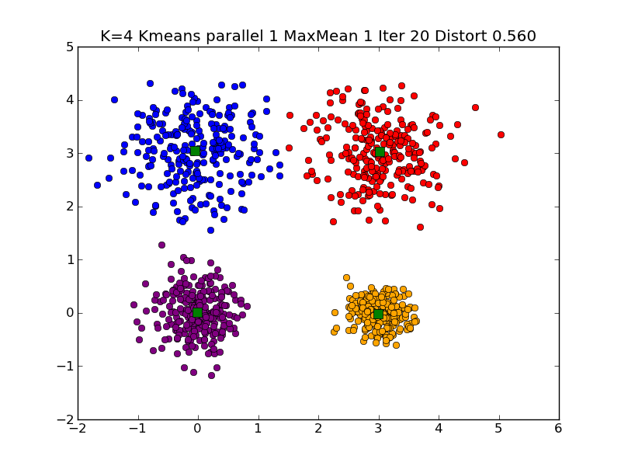
Typical K=4 Large Clustering

Slide 5
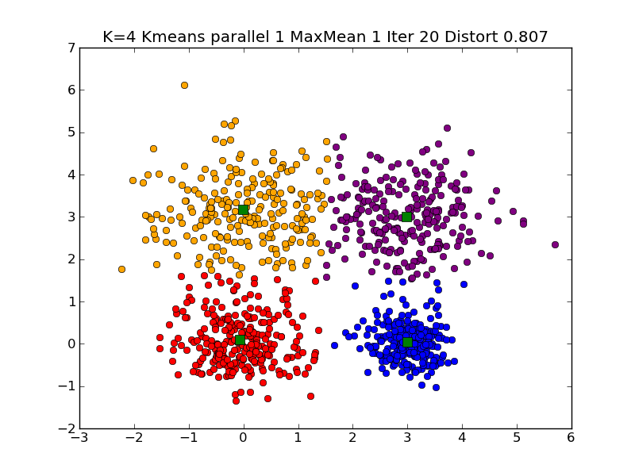
Typical K=4 Very Large Clustering

Slide 6
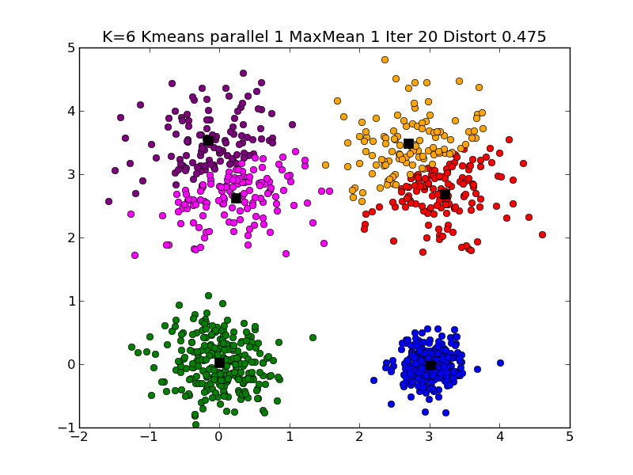
Typical K=6 Large Clustering

Slide 7
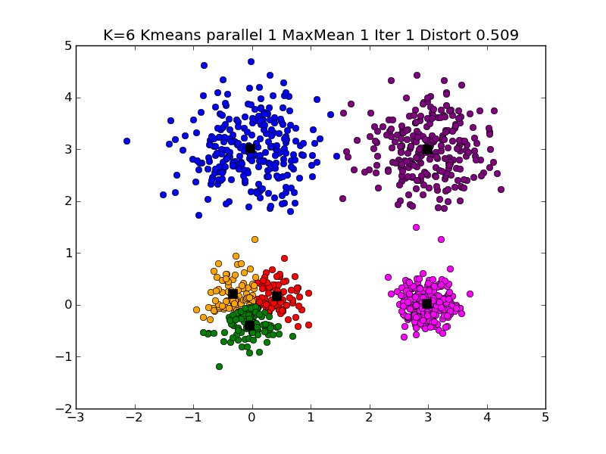
Different K=6 Large Clustering

Slide 8
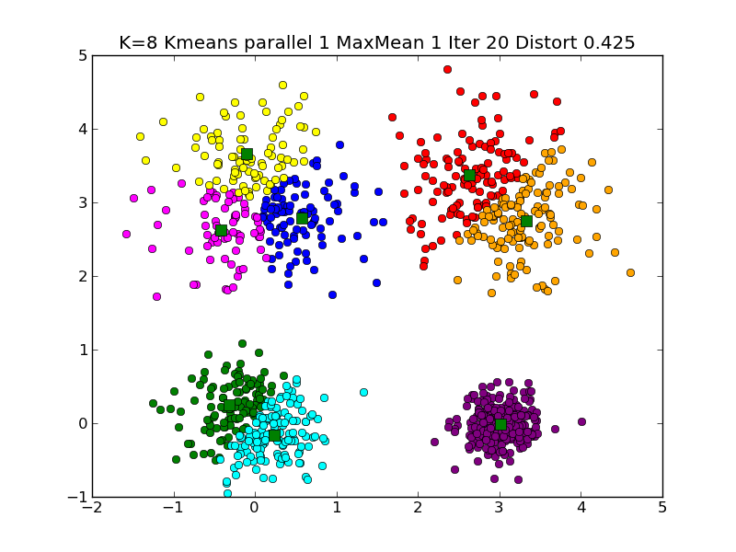
Typical K=8 Large Clustering

Slide 9
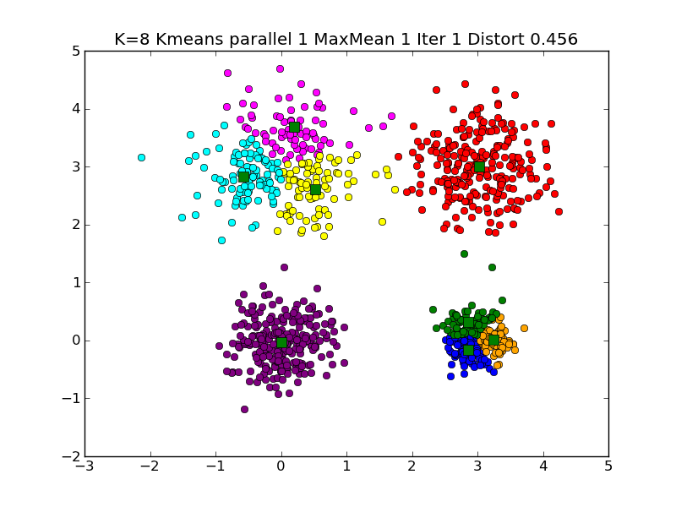
Another K=8 Large Clustering

Slide 10
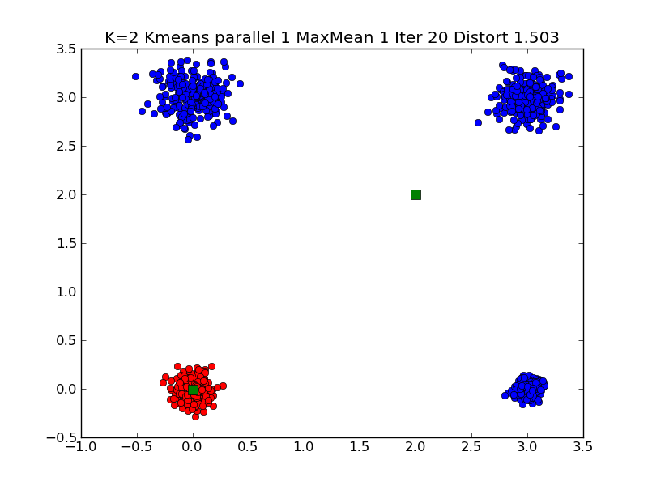
A different solution of K=2 Small Clustering

Slide 11
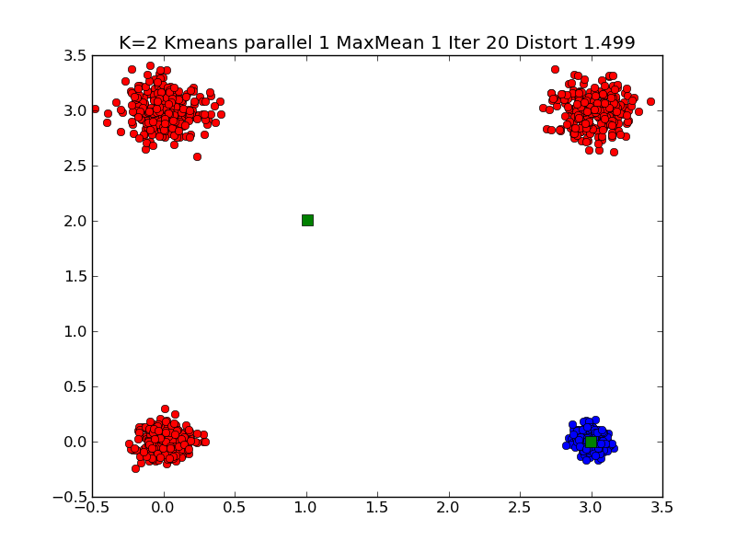
Note Symmetry related solutions
A second look at a different solution of K=2 Small Clustering

Slide 12
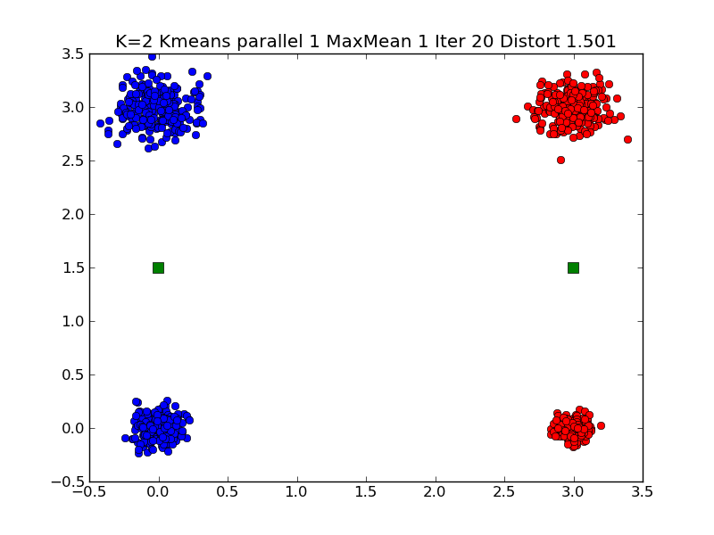
Typical K=2 Small Clustering

