Slide 1
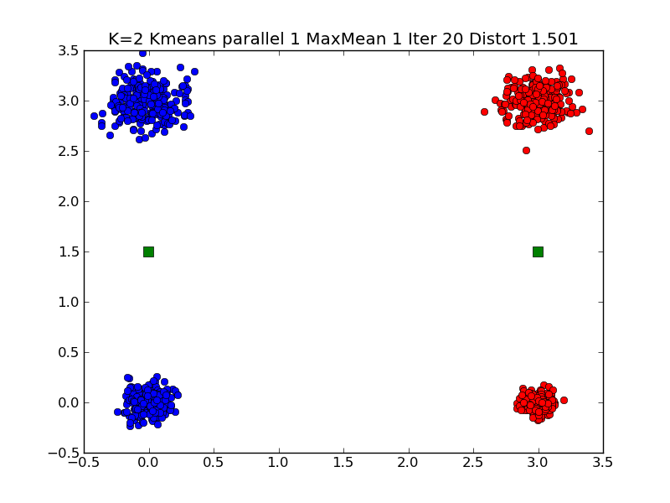
Typical K=2 Small Clustering

Slide 2
Note 4 Small Cluster Case is Ambiguous
There are two solutions for K =2 which have similar measures of goodness
2 Clusters each of 2 real clusters
1 Cluster is 1 real cluster, the other is three real clusters
Current measure of goodness is “Average distance between point and its cluster”. This roughly 1.5 for both solutions
Details of starting point determines which solution you find
Also sensitive to “random clusters” i.e. solutions are so near that they can change with choice of Gaussianly distributed points
Typical function with two widely separated minima
Goodness of Fit
Cluster positions (4 parameters for K=2)

Slide 3
Ambiguous Solutions
The Python code runs Kmeans 20 times and chooses best solution out of this 20.
The 4 small cluster case has such similar goodness values for two cases that results vary from run to run
The 2 real cluster case has goodness ~ 3 (distance between generated centers)/2 = 1.5
In other solution a typical case is centers at (0,0) and (2,2) with goodness = (2√5 + √2 + 0)/4 = 1.47
Exact for very small size clusters
Changing goodness to Maximum not mean distance of points to centers will lead to unique solution with each cluster having two real clusters
Max values is 1.5 which is much less than √5 = 2.24

Slide 4
Note the Hill between Solutions
There are 2 symmetry related solutions with 2 real clusters per Kmeans solution
There are 4 symmetry related solutions with 3+1 real clusters per Kmeans solution
These 6 solutions are separated by hills and are local minima
They are stable on small perturbations
Need big change to get from one to another
Very common feature seen in change of leadership in both democratic and non democratic societies
Perhaps in play in battle IoS v Android v Blackberry v Windows 8 in smart phones
Blackberry messed up enough to let Android/IoS take over
To change state, it is insufficient to be better
You need to be so much better that can jump hill

Slide 5
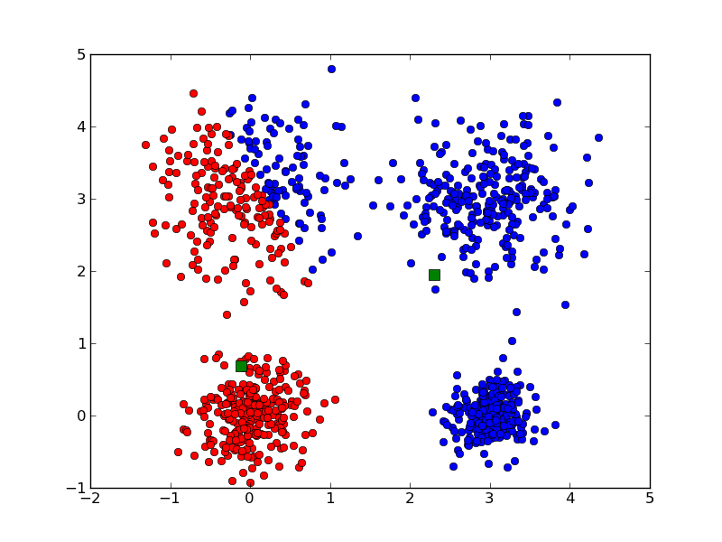
Messy K=2 large Clustering

Slide 6
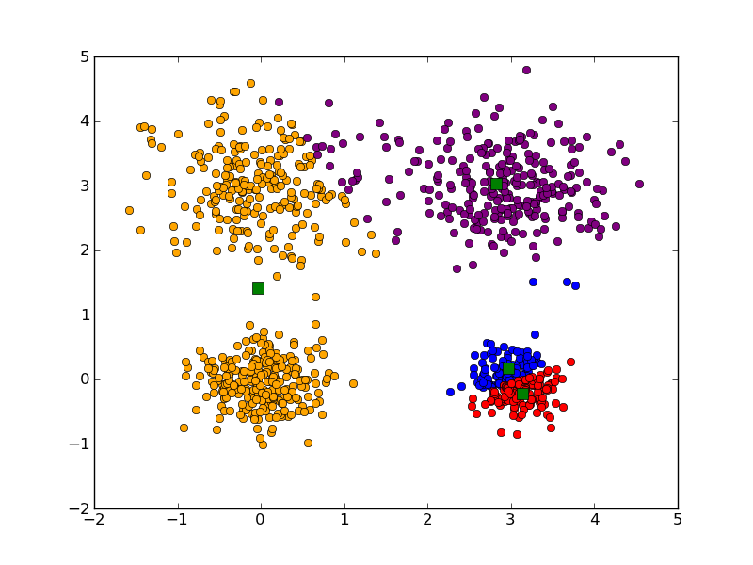
Messy K=4 large Clustering

Slide 7
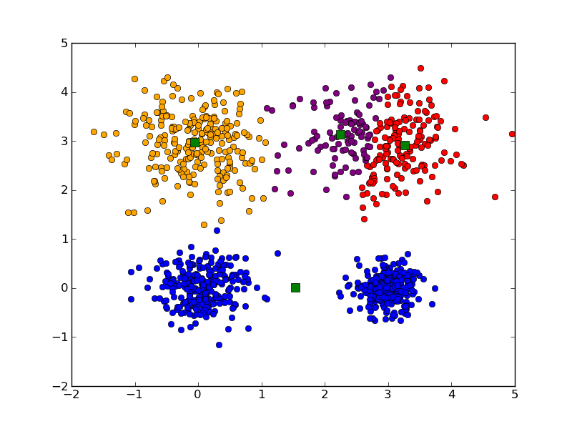
Messy K=4 large Clustering

Slide 8
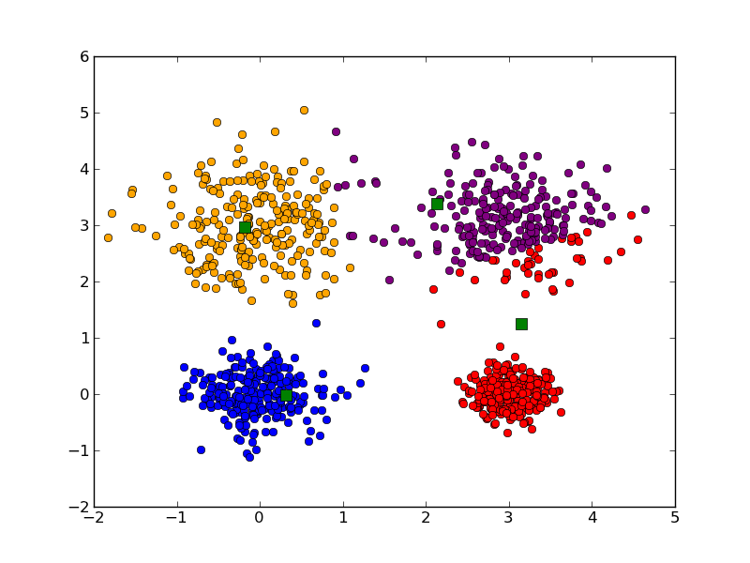
Messy K=4 large Clustering

Slide 9
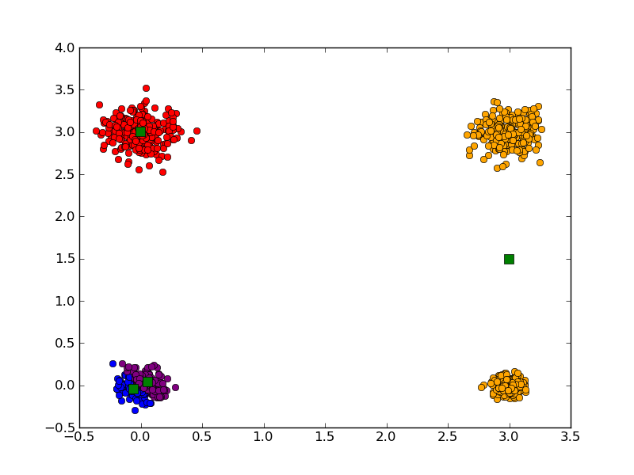
Messy K=4 Small Clustering

Slide 10
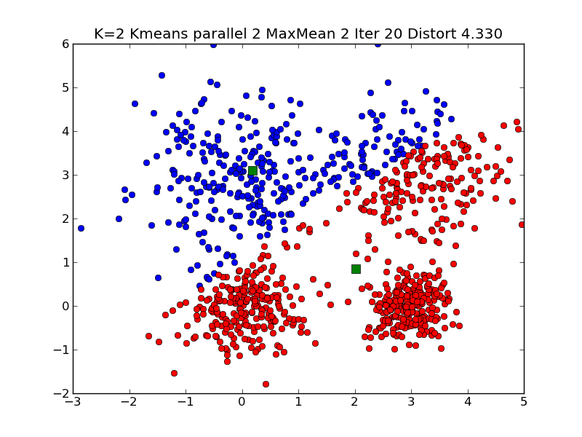
Messy K=2 Very large Clustering

Slide 11
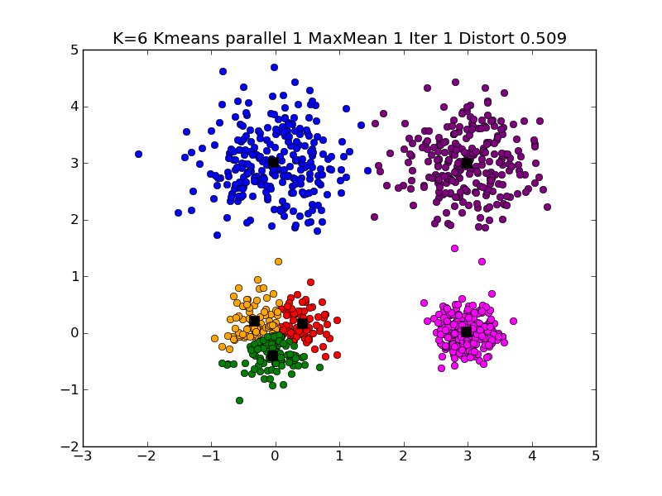
Different K=6 Large Clustering

Slide 12
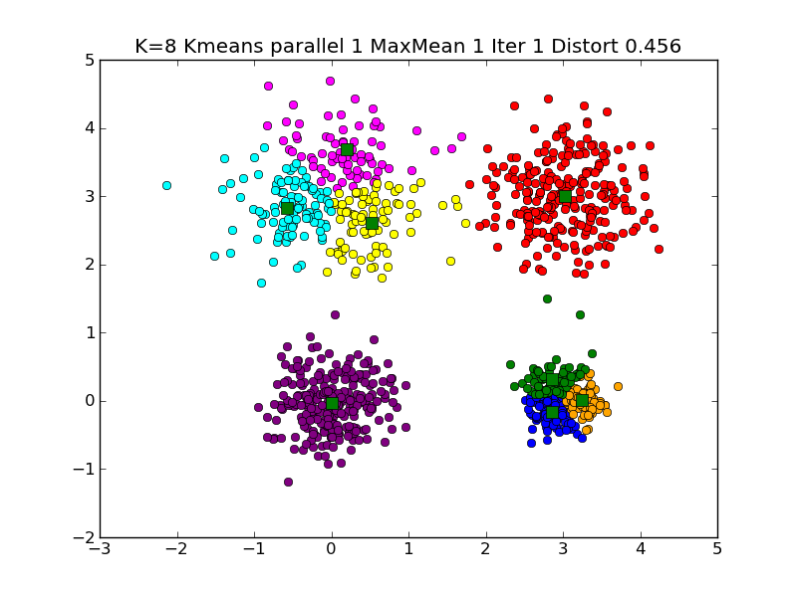
Another K=8 Large Clustering

