Slide 1
X-Informatics MapReduce
June 19 2013
Geoffrey Fox
gcf@indiana.edu
http://www.infomall.org/X-InformaticsSpring2013/index.html
Associate Dean for Research, School of Informatics and Computing
Indiana University Bloomington
2013

Slide 2
Big Data Ecosystem in One Sentence
Use Clouds running Data Analytics Collaboratively processing Big Data to solve problems in X-Informatics ( or e-X)
X = Astronomy, Biology, Biomedicine, Business, Chemistry, Climate, Crisis, Earth Science, Energy, Environment, Finance, Health, Intelligence, Lifestyle, Marketing, Medicine, Pathology, Policy, Radar, Security, Sensor, Social, Sustainability, Wealth and Wellness with more fields (physics) defined implicitly
Spans Industry and Science (research)
Education: Data Science see recent New York Times articles
http://datascience101.wordpress.com/2013/04/13/new-york-times-data-science-articles/

Slide 3









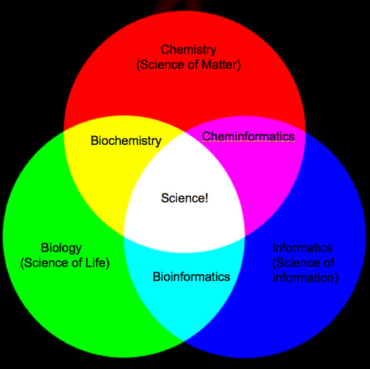
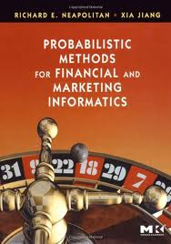
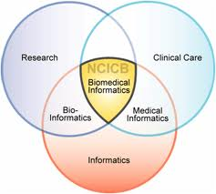
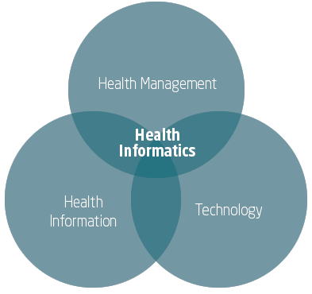


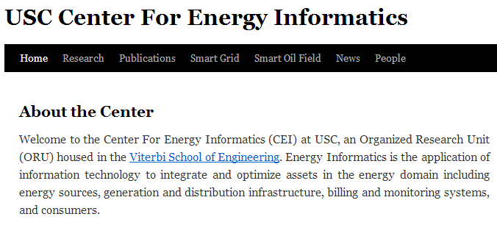
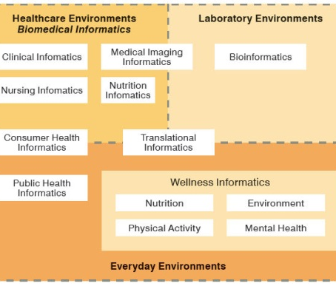
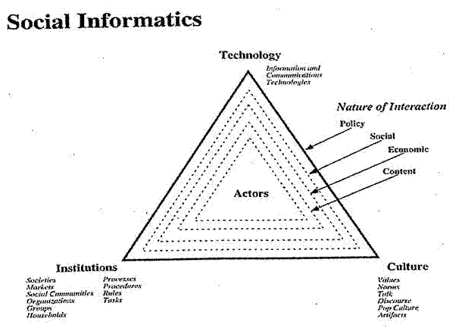


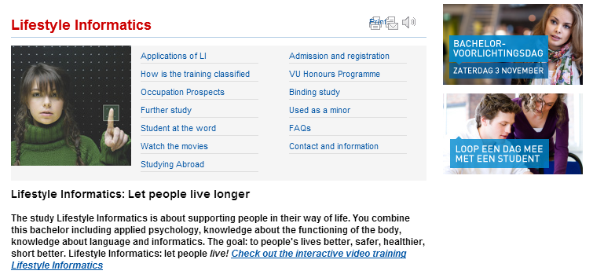


Social Informatics

Slide 4
MapReduce

Slide 5
MapReduce
A parallel Runtime coming from Information Retrieval
Data Partitions
Map(Key, Value)
A hash function maps the results of the map tasks to r reduce tasks
Reduce(Key, List<Value>)
Reduce Outputs
Implementations support:
Splitting of data
Passing the output of map functions to reduce functions
Sorting the inputs to the reduce function based on the intermediate keys
Quality of services

Slide 6

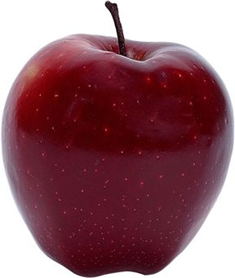

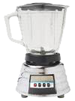


Sam’s Problem
Sam thought of “drinking” the apple
He used a to cut the
and a to make .

Slide 7
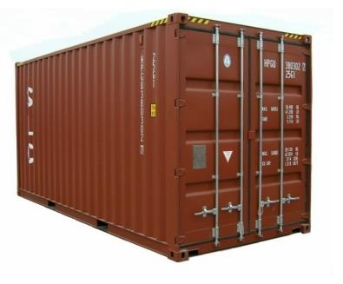
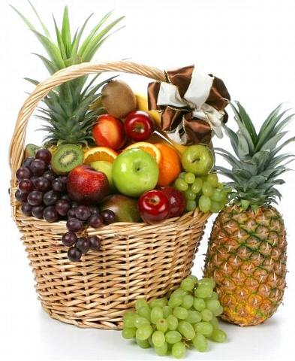
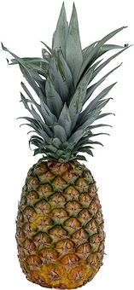
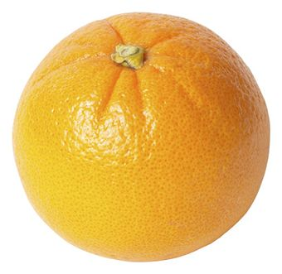



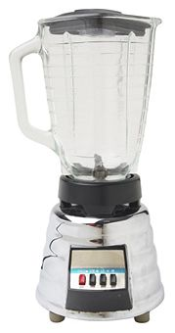
Creative Sam
Implemented a parallel version of his innovation
Fruits
Each input to a map is a list of <key, value> pairs
(<a, > , <o, > , <p, > , …)
Each output of slice is a list of <key, value> pairs
(<a’, > , <o’, > , <p’, > )
Grouped by key
The idea of Map Reduce in Data Intensive Computing
Each input to a reduce is a <key, value-list> (possibly a list of these, depending on the grouping/hashing mechanism)
e.g. <ao, ( …)>
Reduced into a list of values
A list of <key, value> pairs mapped into another list of <key, value> pairs which gets grouped by the key and reduced into a list of values

