Slide 1
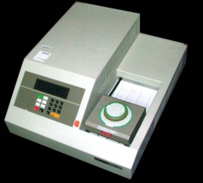
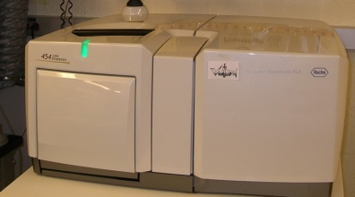
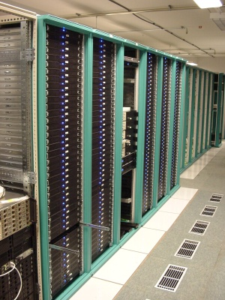
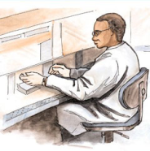


MapReduce “File/Data Repository” Parallelism
Map = (data parallel) computation reading and writing data
Reduce = Collective/Consolidation phase e.g. forming multiple global sums as in histogram
Instruments
MPI and Iterative MapReduce
Map Map Map Map
Reduce Reduce Reduce
Communication
Reduce
Portals /Users
Disks
Map₁
Map₂
Map₃

Slide 2
4 Forms of MapReduce
(a) Map Only
(b) Classic MapReduce
(c) Iterative MapReduce
(d) Loosely Synchronous
Input
Input
Iterations
Input
map
map
map
P_{ij}
reduce
reduce
Output
BLAST Analysis
Parametric sweep
Pleasingly Parallel
High Energy Physics (HEP) Histograms
Distributed search
Expectation maximization Clustering e.g. Kmeans
Linear Algebra, Page Rank
Classic MPI
PDE Solvers and particle dynamics
Domain of MapReduce and Iterative Extensions
Science Clouds
MPI
Exascale
MPI is Map followed by Point to Point Communication – as in style d)

Slide 3
Map Collective Model (Judy Qiu)
Combine MPI and MapReduce ideas
Implement collectives optimally on Infiniband, Azure, Amazon ……
Applies for general data; not necessarily key-value pairs
Iterate
Input
map
Initial Collective Step
Generalized Reduce
Final Collective Step

Slide 4
Twister for Data Intensive Iterative Applications
Generalize to arbitrary Collective
Broadcast
Compute
Communication
Reduce/ barrier
New Iteration
Smaller Loop-Variant Data
Larger Loop-Invariant Data
(Iterative) MapReduce structure with Map-Collective is framework
Twister runs on Linux or Azure
Twister4Azure is built on top of Azure tables, queues, storage
Qiu, Gunarathne
Notes:
Most of these applications consists of iterative computation and communication steps where single iterations can easily be specified as MapReduce computations.
Large input data sizes which are loop-invariant and can be reused across iterations.
Loop-variant results.. Orders of magnitude smaller…
While these can be performed using traditional MapReduce frameworks, Traditional is not efficient for these types of computations. MR leaves lot of room for improvements in terms of iterative applications.

