Slide 1
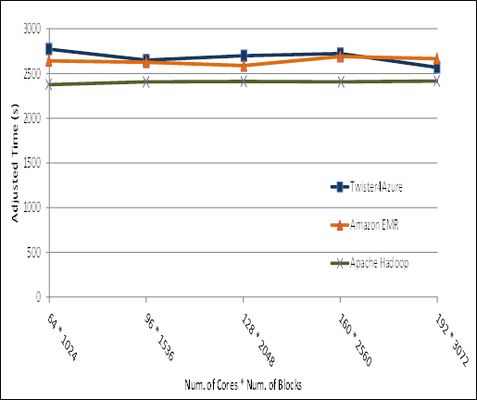
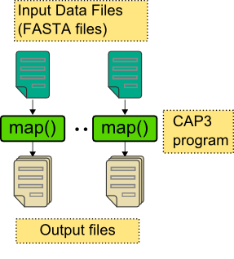
Pleasingly Parallel Performance Comparisons
Smith Waterman
Sequence Alignment
BLAST Sequence Search
Cap3 Sequence Assembly

Slide 2
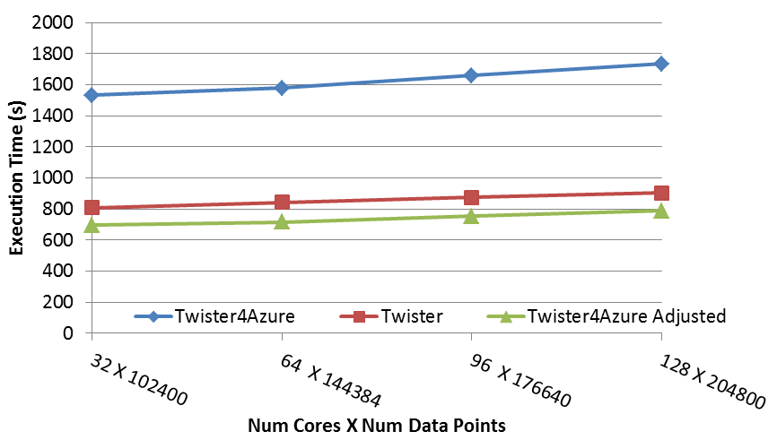
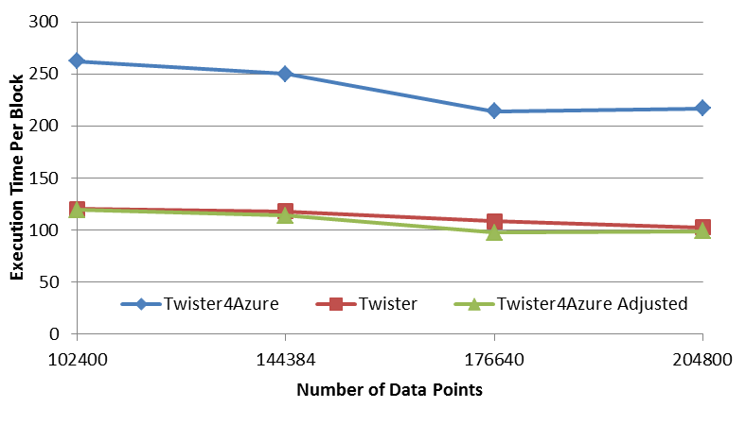
Multi Dimensional Scaling
BC: Calculate BX
X: Calculate invV (BX)
Calculate Stress
Map
Reduce
Merge
Map
Reduce
Merge
Map
Reduce
Merge
New Iteration
Performance adjusted for sequential performance difference
Weak Scaling
Data Size Scaling
Scalable Parallel Scientific Computing Using Twister4Azure. Thilina Gunarathne, BingJing Zang, Tak-Lon Wu and Judy Qiu. Submitted to Journal of Future Generation Computer Systems. (Invited as one of the best 6 papers of UCC 2011)
Notes:
The Java HPC Twister experiment was performed in a dedicated large-memory cluster of Intel(R) Xeon(R) CPU E5620 (2.4GHz) x 8 cores with 192GB memory per compute node and with Gigabit Ethernet on Linux. Java HPC Twister results do not include the initial data distribution time.
Azure large instances with 4 workers per instances is used. Memory mapped based caching and AllGather primitive are used.
Left: Weak scaling where workload per core is ~constant. Ideal is a straight horizontal line. X axis is
Right: Data size scaling with 128 Azure small instances/cores, 20 iterations.
The Twister4Azure adjusted (t_{a}) depicts the performance of Twister4Azure normalized according to the sequential MDS BC calculation and Stress calculation performance ratio between the Azure(t_{sa}) and Cluster(t_{sc}) environments used for Java HPC Twister. It is calculated using t_{a} x (t_{sc}/t_{sa}). This estimation however does not account for the overheads that remain constant irrespective of the computation time. Hence Twister4Azure seems to perform better, but in reality when the task execution times become smaller, twister4Azure overheads will become relatively larger and the performance would not be as good as shown in the adjusted curve.

Slide 3
Kmeans
Investigating Improved communication (collective) routines
Hadoop adjusted for Azure: implies Hadoop KMeans run time adjusted for the performance difference of iDataplex vs Azure

Slide 4
Kmeans Strong Scaling (with Hadoop Adjusted)
128 Million data points. 500 Centroids (clusters). 20 Dimensions. 10 iterations
Parallel efficiency relative to the 32 core run time.
Note Hadoop slower by factor of 2
Relative Efficiency = Time(32 cores)/Time(N cores) . 32/N

