Slide 1
Technology for Informatics Kmeans and MapReduce Parallelism
June 19 2013
Geoffrey Fox
gcf@indiana.edu
http://www.infomall.org/
Associate Dean for Research, School of Informatics and Computing
Indiana University Bloomington
2013

Slide 2
Big Data Ecosystem in One Sentence
Use Clouds running Data Analytics Collaboratively processing Big Data to solve problems in X-Informatics ( or e-X)
X = Astronomy, Biology, Biomedicine, Business, Chemistry, Climate, Crisis, Earth Science, Energy, Environment, Finance, Health, Intelligence, Lifestyle, Marketing, Medicine, Pathology, Policy, Radar, Security, Sensor, Social, Sustainability, Wealth and Wellness with more fields (physics) defined implicitly
Spans Industry and Science (research)
Education: Data Science see recent New York Times articles
http://datascience101.wordpress.com/2013/04/13/new-york-times-data-science-articles/

Slide 3



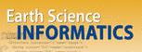

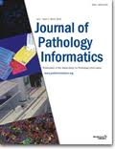
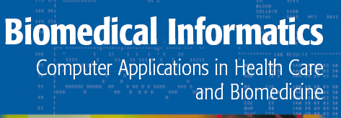


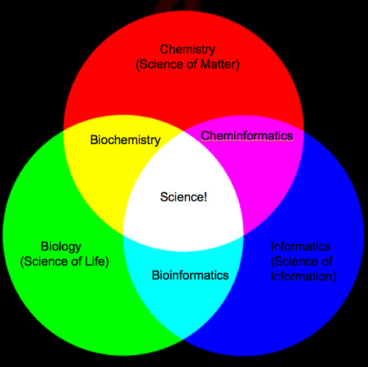
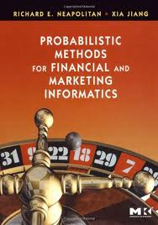
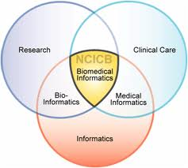
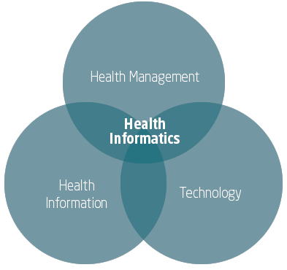


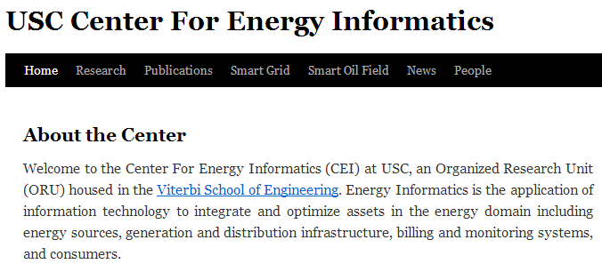
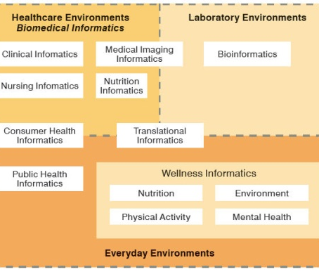
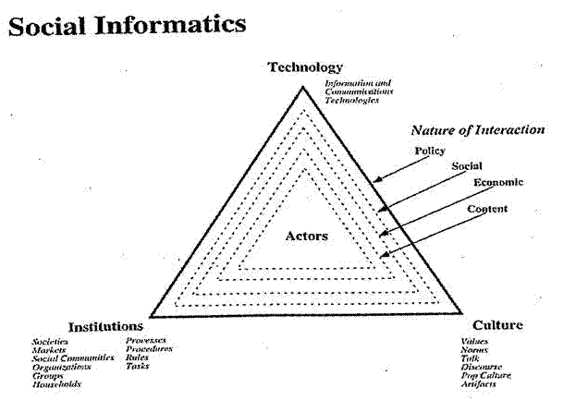


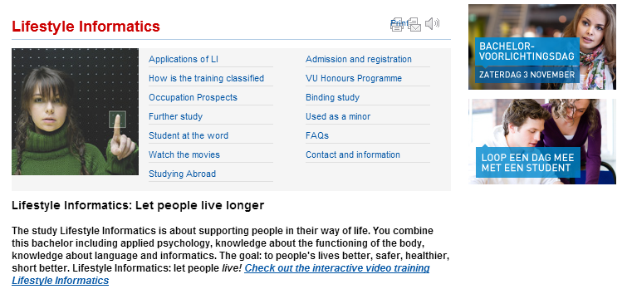
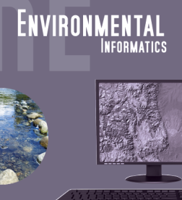

Social Informatics

Slide 4
MapReduce Kmeans in Python

Slide 5
Slightly Changed Sequential version
We change to allow MapReduce implementation
Overall iteration over starting positions
Initialize Centroids
Iterate until converged
Call map to find association and do first step in find centroids as sum over point vectors and distortion
Reduce step: Divide summed centers by points in center to get centroid
Do other book keeping
Delete zero size clusters
Check convergence
Return best solution based on Quality criterion

Slide 6
Parallel MapReduce Version
Iseven = np.empty([tot], dtype=bool)
for i in arange(tot):
Iseven[i] = (i%2 == 0);
obs1 = compress(Iseven, obs, 0)
obs2 = compress(logical_not(Iseven), obs, 0)
avg_dist = []
diff = thresh+1.
while diff > thresh:
#
if Parallelism == 1:
code_book, NumPointsinClusters, distortsum, distortmax, NumPoints = Kmeans_map(obs, code_book)
if Parallelism == 2:
# Can be Parallel Map Operations
code_book1, NumPointsinClusters1, distortsum1, distortmax1, NumPoints1 = Kmeans_map(obs1, code_book)
code_book2, NumPointsinClusters2, distortsum2, distortmax2, NumPoints2 = Kmeans_map(obs2, code_book)
#
# Following are 4 Reduction Operations
# Note maps include local reductions
code_book = np.add( code_book1, code_book2)
NumPointsinClusters = np.add( NumPointsinClusters1, NumPointsinClusters2)
distortsum = distortsum1 + distortsum2
distortmax = np.maximum(distortmax1, distortmax2)
NumPoints = NumPoints1 + NumPoints2
#
code_book = compress(np.greater(NumPointsinClusters, 0), code_book, 0)
# remove code_books that didn't have any members
#
j = 0
nc = code_book.shape[0]
for i in arange(nc):
if NumPointsinClusters[i] > 0:
code_book[j,:] = code_book[j,:] / NumPointsinClusters[i]
j = j + 1
Map
Reduce

Slide 7
Map for Kmeans
def Kmeans_map(obs, code_book):
No = obs.shape[0]
nc = code_book.shape[0]
# nc is current number of clusters (may decrease if zero clusters last iteration)
#
#compute membership and distances between obs and code_book
obs_code, distort = vq(obs, code_book)
distortsum = np.sum(distort)
distortmax = np.amax(distort)
#
# vq returns an indexing array obs_code mapping rows of obs (the points) to code_book (the centroids)
# distort is an array of length No that has difference between observation and chosen centroid
# vq stands for vector quantization and is provided in SciPy
#
VectorDimension = obs.shape[1]
NewCode_Book = np.zeros([nc, VectorDimension])
NumPointsinClusters = np.zeros([nc])
for i in arange(nc):
# Loop over clusters labelled with i
cell_members = compress(equal(obs_code, i), obs, 0)
NumPointsinClusters[i] = cell_members.shape[0]
# Extract Points in this Cluster; extract points whose quantization label is i
#
NewCode_Book[i] = np.sum(cell_members, 0)
# Calculate centroid of i'th cluster
return NewCode_Book, NumPointsinClusters, distortsum, distortmax, No
This routine takes Points in obs and Centroids in code_book and associates each point with nearest centroid
It calculates Non normalized centroids (sum over vectors in cluster), Number of points in each cluster and convergence measures (mean and max of distance between points and centers)

