Slide 1
X-Informatics Case Study: e-Commerce and Life Style Informatics: Recommender Systems III: Item-based Collaborative Filtering
June 18 2013
Geoffrey Fox
gcf@indiana.edu
http://www.infomall.org/X-InformaticsSpring2013/index.html
Associate Dean for Research, School of Informatics and Computing
Indiana University Bloomington
2013

Slide 2
Big Data Ecosystem in One Sentence
Use Clouds running Data Analytics Collaboratively processing Big Data to solve problems in X-Informatics ( or e-X)
X = Astronomy, Biology, Biomedicine, Business, Chemistry, Climate, Crisis, Earth Science, Energy, Environment, Finance, Health, Intelligence, Lifestyle, Marketing, Medicine, Pathology, Policy, Radar, Security, Sensor, Social, Sustainability, Wealth and Wellness with more fields (physics) defined implicitly
Spans Industry and Science (research)
Education: Data Science see recent New York Times articles
http://datascience101.wordpress.com/2013/04/13/new-york-times-data-science-articles/

Slide 3









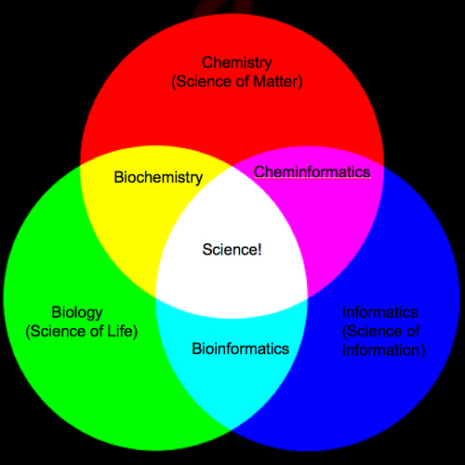
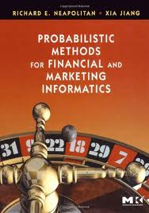
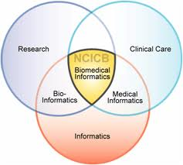
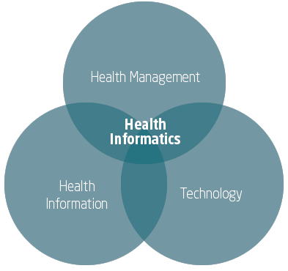


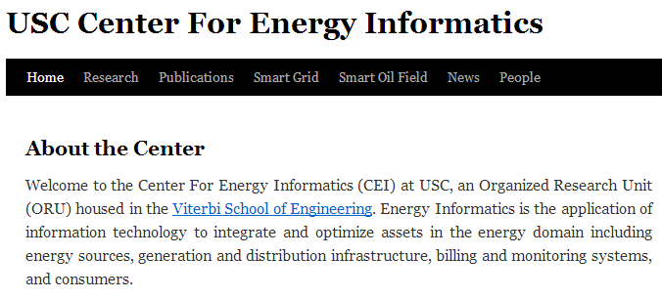
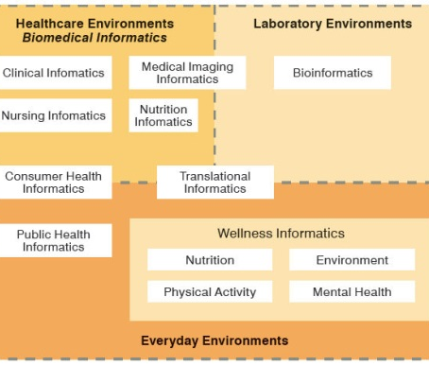
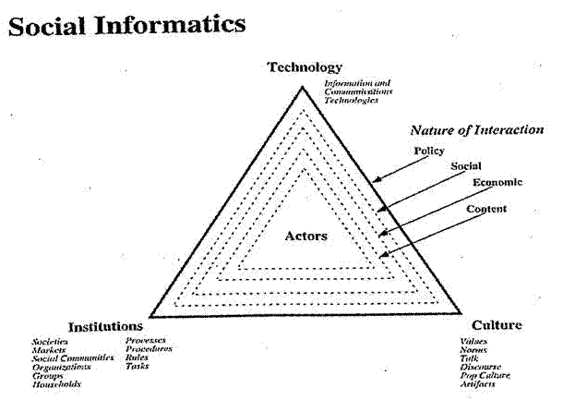


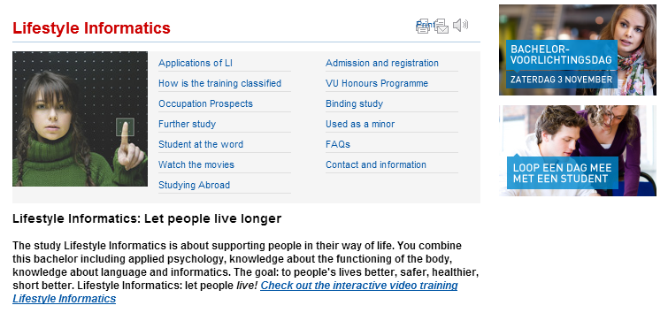


Social Informatics

Slide 4
Memory-based and model-based approaches
User-based CF is said to be "memory-based“ (Real-Time)
the rating matrix is directly used to find neighbors / make predictions
does not scale for most real-world scenarios
large e-commerce sites have tens of millions of customers and millions of items
Model-based approaches (Batch or Off Line)
based on an offline pre-processing or "model-learning" phase
at run-time, only the learned model is used to make predictions
models are updated / re-trained periodically
large variety of techniques used
model-building and updating can be computationally expensive
item-based CF is an example for model-based approaches
http://recommenderbook.net/teaching-material/slides Chapter 2

Slide 5
Item-based collaborative filtering
Basic idea:
Use the similarity between items (and not users) to make predictions
Example:
Look for items that are similar to Item5
Take Alice's ratings for these items to predict the rating for Item5
 | Item1 | Item2 | Item3 | Item4 | Item5
Alice | 5 | 3 | 4 | 4 | ?
User1 | 3 | 1 | 2 | 3 | 3
User2 | 4 | 3 | 4 | 3 | 5
User3 | 3 | 3 | 1 | 5 | 4
User4 | 1 | 5 | 5 | 2 | 1

Slide 6

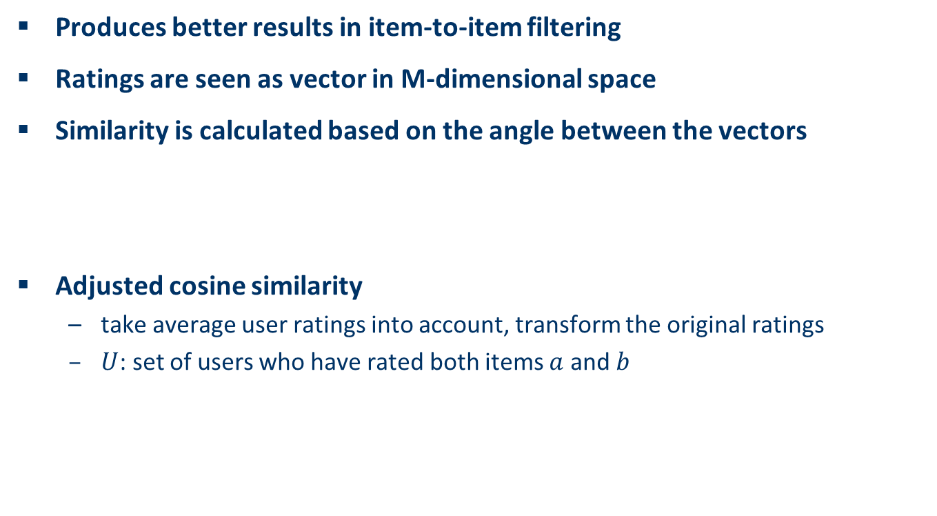
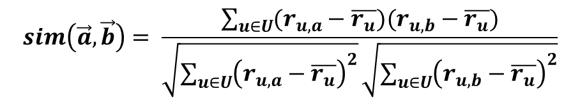

The cosine similarity measure
Item based collaborative filtering
Produces better results in item-to-item filtering
Ratings are seen as vector in M-dimensional space
Similarity is calculated based on the angle between the vectors
Adjusted cosine similarity
take average user ratings into account, transform the original ratings
$U$: set of users who have rated both items $a$ and $b$
M is number of users
$$sim\left(\vec{a},\vec{b}\right)=\frac{\vec{a}∙\vec{b}}{\left|\vec{a}\right|∗|\vec{b}|}$$
$$sim\left(\vec{a},\vec{b}\right)= \frac{\sum_{u∈U}{(r_{u,a}−\overline{r_{u}})(r_{u,b}−\overline{r_{u}})}}{\sqrt{\sum_{u∈U}{{\left(r_{u,a}−\overline{r_{u}}\right)}^{2}}}\sqrt{\sum_{u∈U}{{\left(r_{u,b}−\overline{r_{u}}\right)}^{2}}}}$$
http://recommenderbook.net/teaching-material/slides Chapter 2

Slide 7
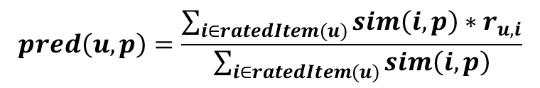
Making predictions
Item based collaborative filtering
A common prediction function:
Neighborhood size is typically also limited to a specific size
Not all neighbors are taken into account for the prediction
An analysis of the MovieLens dataset indicates that "in most real-world situations, a neighborhood of 20 to 50 neighbors seems reasonable" (Herlocker et al. 2002)
$$pred\left(u,p\right)=\frac{\sum_{i∈ratedItem(u)}{sim\left(i,p\right)∗r_{u,i}}}{\sum_{i∈ratedItem(u)}{sim\left(i,p\right)}}$$

