Slide 1
k Nearest Neighbors
The basic user and item based recommendation systems built around k Nearest Neighbor method
Set k = 3…20 and find the k nearest neighbors
If k too small then sensitive to error (maybe one of the k is somehow screwed up)
The algorithm can be trivial
Calculate all the distances (user i – Alice) where all users including Alice have rated some cutoff number of identical items
Sort distances lowest to highest
Take the lowest k
See Python code

Slide 2
Some Issues
Users and Items each live in abstract spaces
Users in space of items with rankings as coefficients
Items in space of users with rankings as coefficient
OR in content-based, items live in space defined by their content
Words
Clusters or “latent factors” or “mixtures” or topics
Semantic information as in Music Genome
How do we easily find nearest neighbors?
Take user-based case
The trivial algorithm needs O(M) distance computations for M customers and then O( M_{real}(Alice)log{M_{real}(Alice)}) where M_{real}(Alice) users are considered as have rated enough items in common.
Sorting P numbers takes time P logP
If k small, complexity is k M_{real}(Alice)
Note M_{real}(Alice) << M

Slide 3
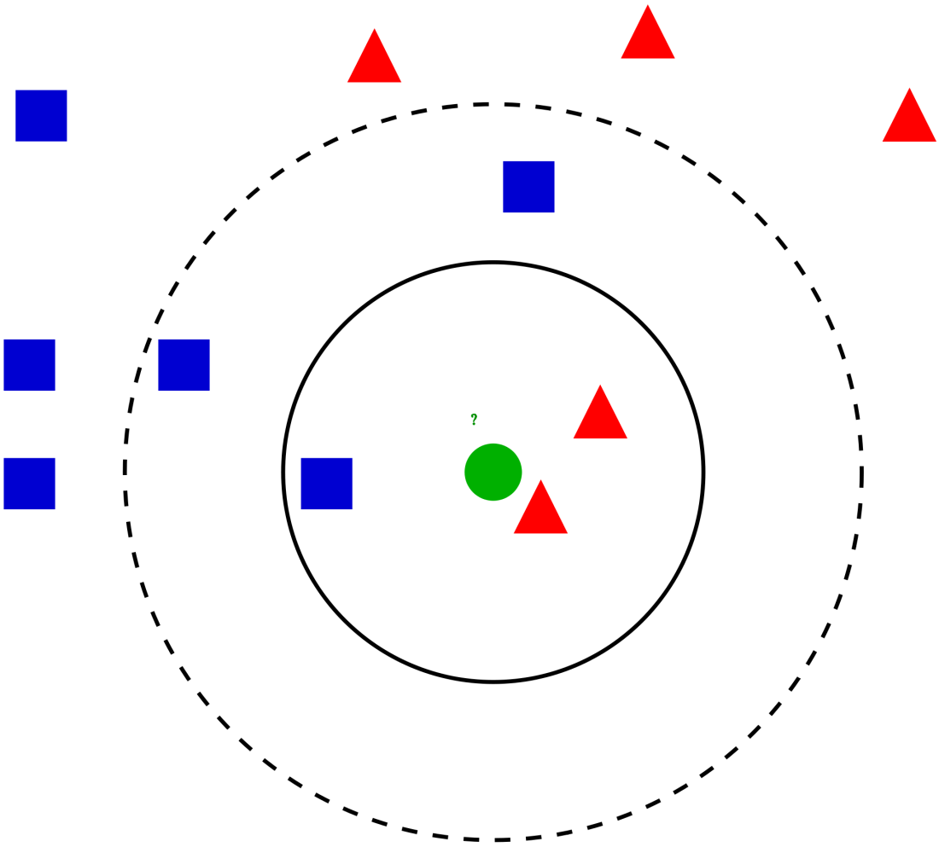
Wikipedia: Example of k-NN classification
The test sample (green circle) should be classified either to the first class of blue squares or to the second class of red triangles. If k = 3(solid line circle) it is assigned to the second class because there are 2 triangles and only 1 square inside the inner circle. If k = 5(dashed line circle) it is assigned to the first class (3 squares vs. 2 triangles inside the outer circle).

Slide 4
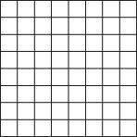
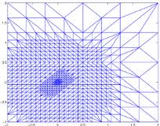
The Curse of Dimensionality
In a low dimension space it is very fast to find nearest neighbors
Divide space into a grid
Assign points to cells of grid
The mesh can be non uniform
Just look at same cell point is in or its neighbors to find k nearest neighbors
Doesn’t work for “abstract” or high dimension spaces as too many cells
Factor analysis or clustering or dimension reduction addresses this

Slide 5
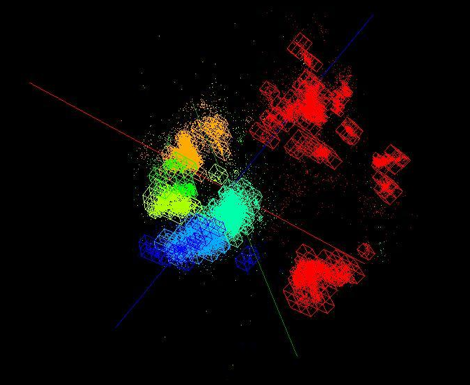
Genome Data projected to 3D and put in a mesh

