Slide 1
X-Informatics Case Study: e-Commerce and Life Style Informatics: Clustering
June 19 2013
Geoffrey Fox
gcf@indiana.edu
http://www.infomall.org/X-InformaticsSpring2013/index.html
Associate Dean for Research, School of Informatics and Computing
Indiana University Bloomington
2013

Slide 2
Big Data Ecosystem in One Sentence
Use Clouds running Data Analytics Collaboratively processing Big Data to solve problems in X-Informatics ( or e-X)
X = Astronomy, Biology, Biomedicine, Business, Chemistry, Climate, Crisis, Earth Science, Energy, Environment, Finance, Health, Intelligence, Lifestyle, Marketing, Medicine, Pathology, Policy, Radar, Security, Sensor, Social, Sustainability, Wealth and Wellness with more fields (physics) defined implicitly
Spans Industry and Science (research)
Education: Data Science see recent New York Times articles
http://datascience101.wordpress.com/2013/04/13/new-york-times-data-science-articles/

Slide 3






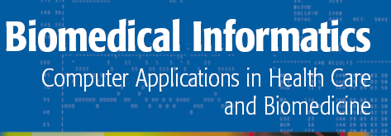


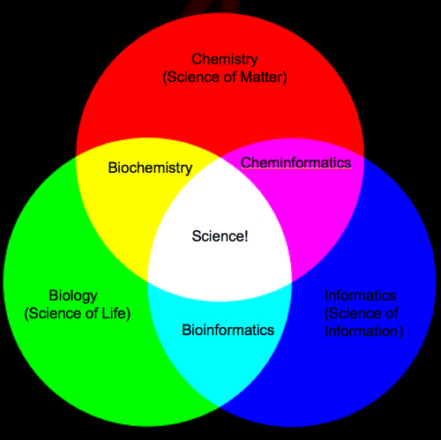
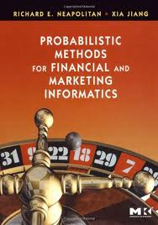
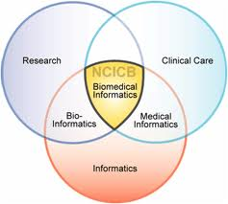
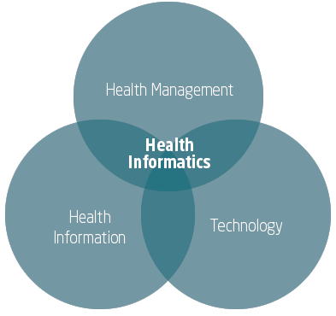
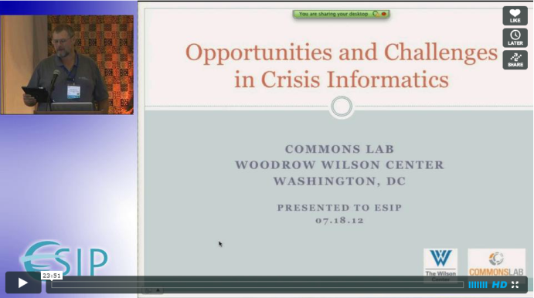

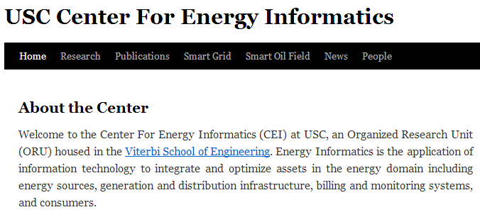
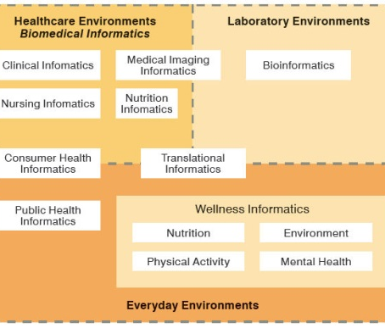
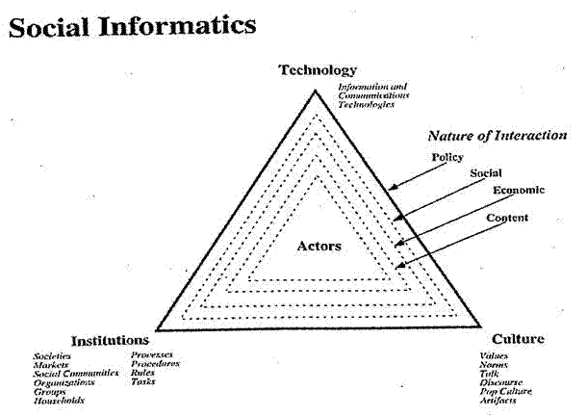


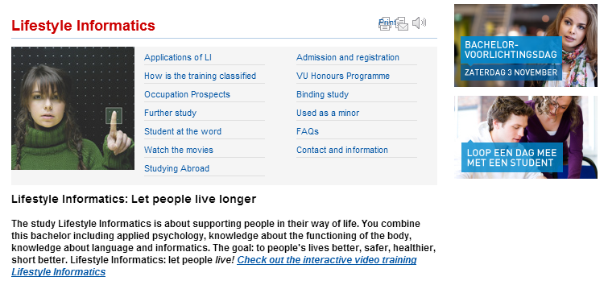


Social Informatics

Slide 4
Resources
See http://grids.ucs.indiana.edu/ptliupages/publications/Clusteringv1.pdf for advanced clustering method improving k means
This lesson has no code but we will use PlotViz program introduced earlier
And Wikipedia on k means
Files used are
clusterFinal-M3-C3Dating-ReClustered.pviz
clusterFinal-M30-C28.pviz
These were found by advanced clustering based on vector file DatingRatingforPviz.txt of 1000 points discussed earlier with PlotViz version DatingRating-OriginalLabels.pviz
fungi_LSU_3(15)_to_3(26)_zeroidx.pviz is used to demonstrate genomic clusters in PlotViz

Slide 5
k means Clustering
Choose k=2 to 10 million (or more) clusters according to some intuition
Initialize k cluster centers (this only works in real spaces)
Then Iterate
Assign each point to cluster whose center it is nearest to
Calculate new center position as centroid (average in each component) of points assigned to it
Converge when center positions change < cut
Lots of variants that are better but k means used as simple and fast
Also methods for when only some distances available and no vector space
Sometimes gets wrong answer – trapped in a local minima

Slide 6
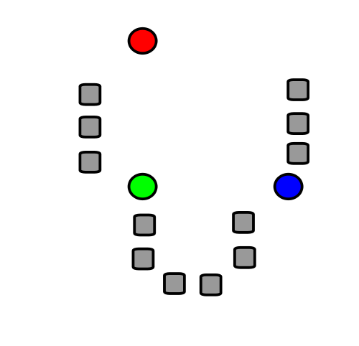
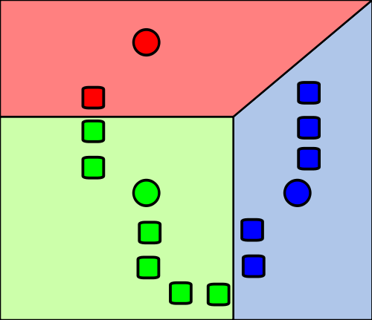
1) k initial "means" (in this case k=3) are randomly generated within the data domain (shown in color).
2) k clusters are created by associating every observation with the nearest mean. The partitions here represent the Voronoi diagram generated by the means.
Wikipedia

Slide 7
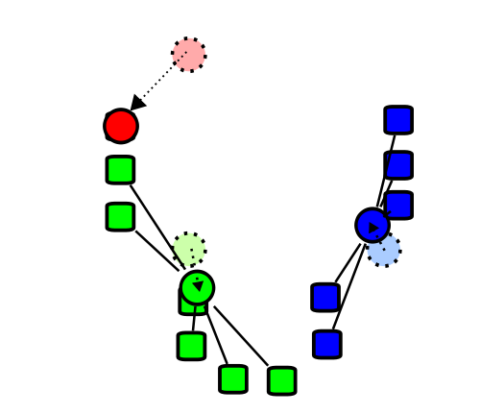
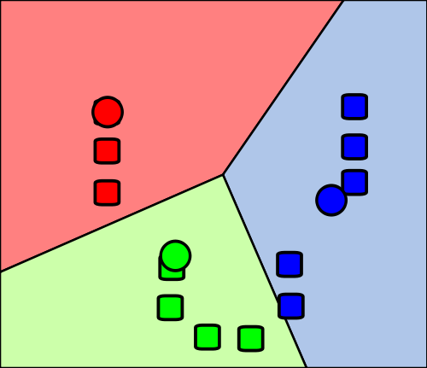
4) Steps 2 and 3 are repeated until convergence has been reached.
But red and green centers (circles) are clearly in wrong place!!! (stars added by me about right for centers)
3) The centroid of each of the k clusters becomes the new mean.
Wikipedia

