Slide 1
Next Set of Slides
Compares original labelling of points with a fresh clustering into 3 clusters (using deterministic annealing advanced method in paper but k means similar)
Fresh clustering has centers marked
The 1000 points are identically placed in side by side pictures

Slide 2
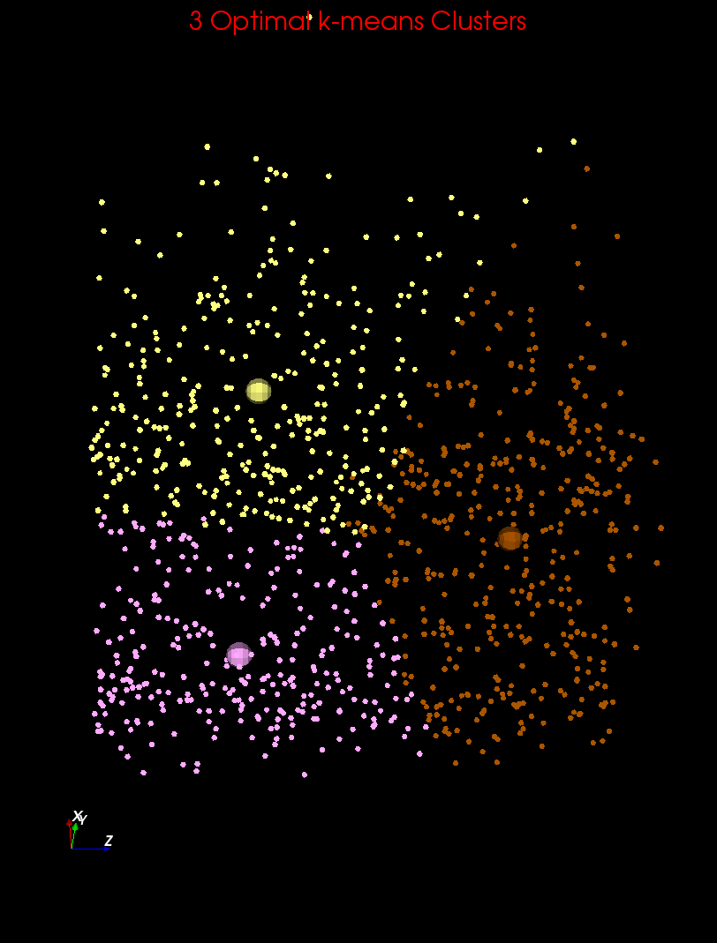
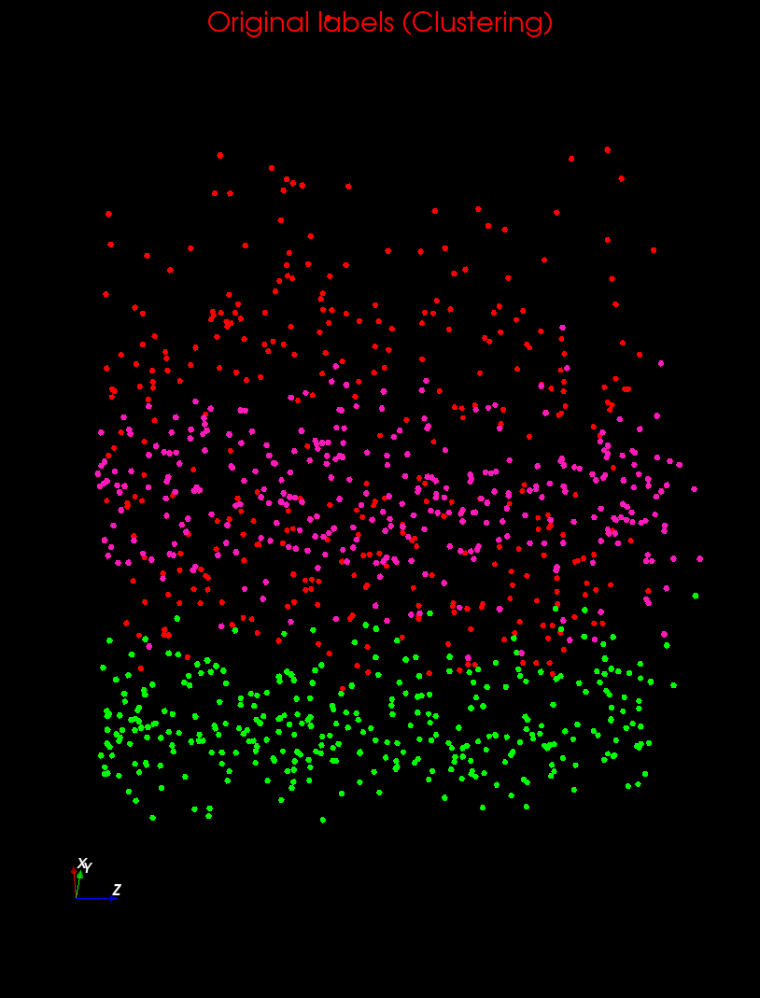
Clustering v User Rating I

Slide 3
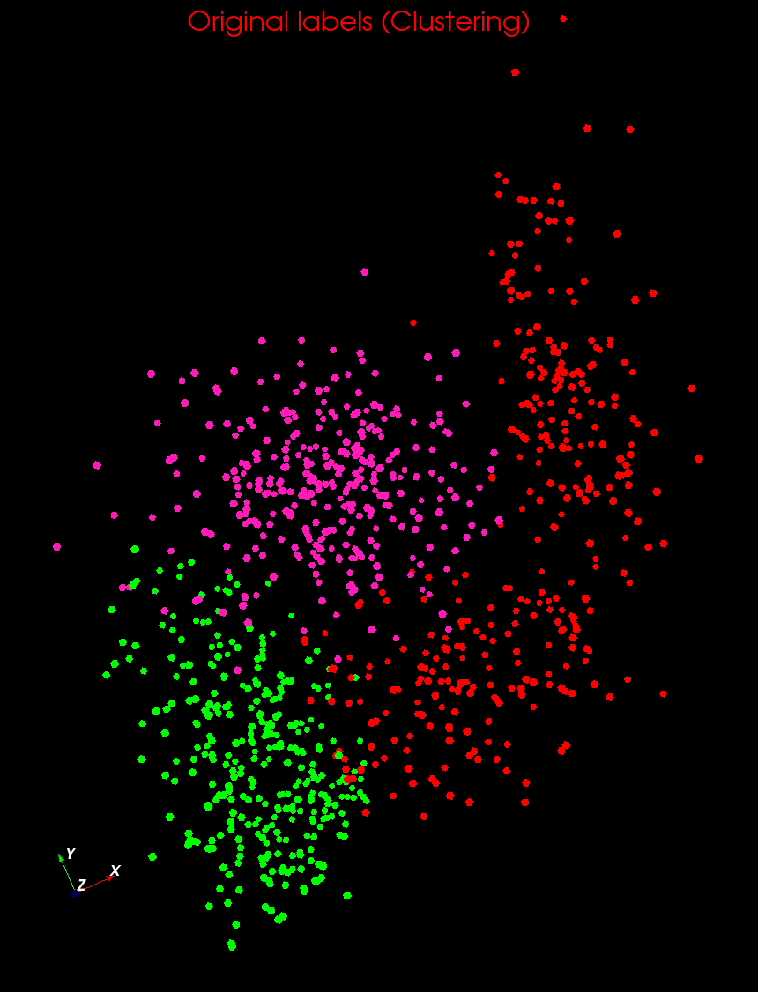
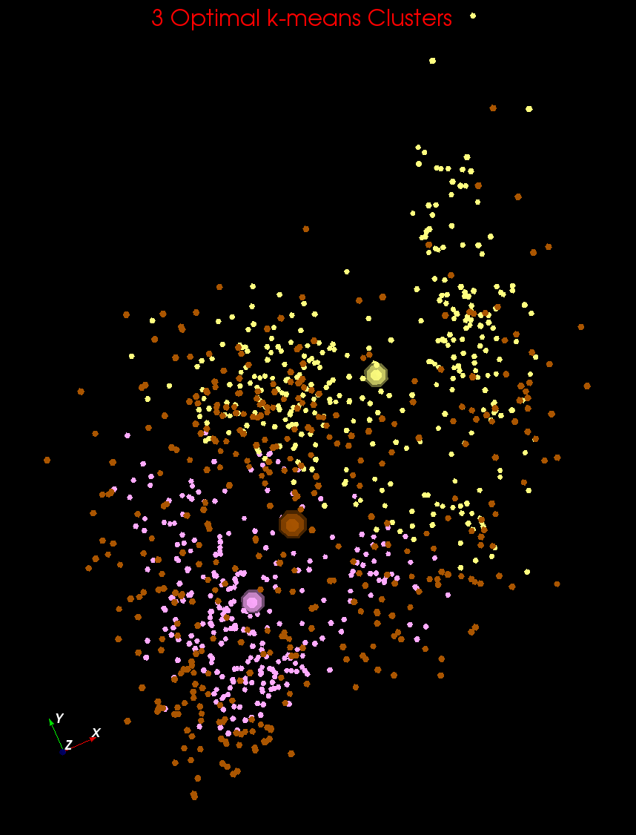
Clustering v User Rating II

Slide 4
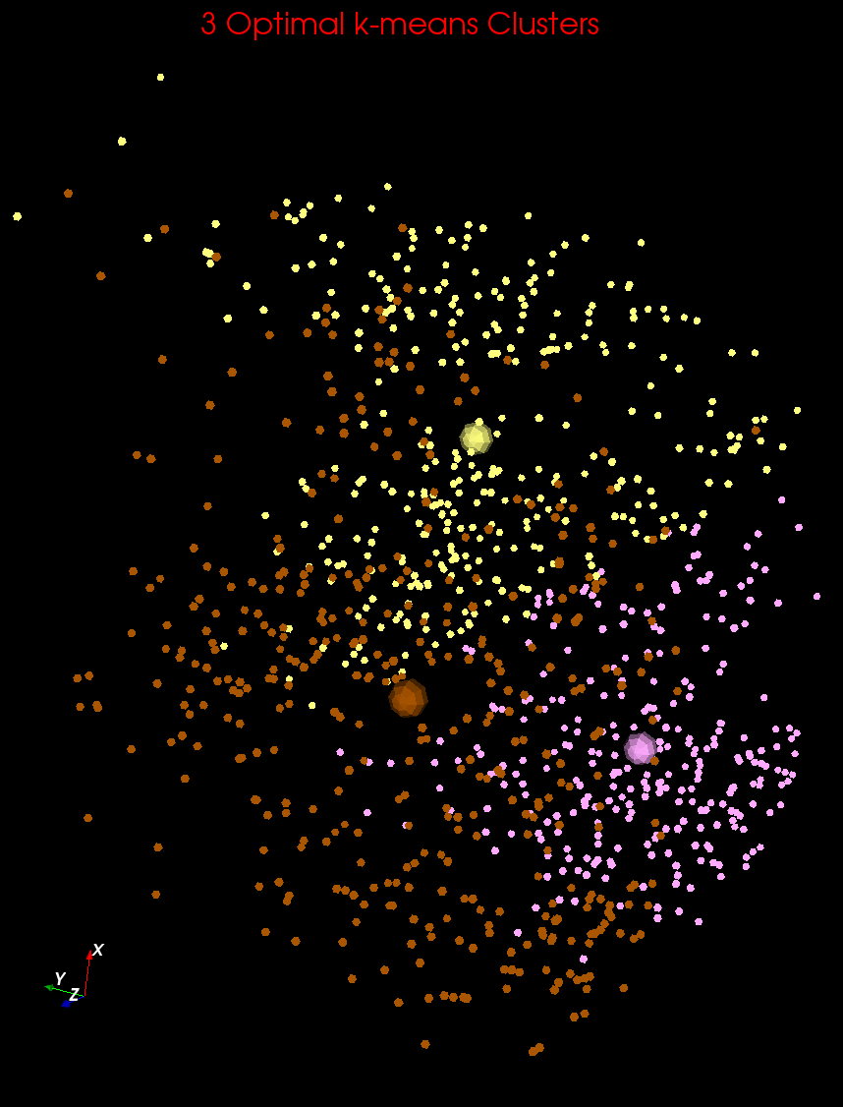
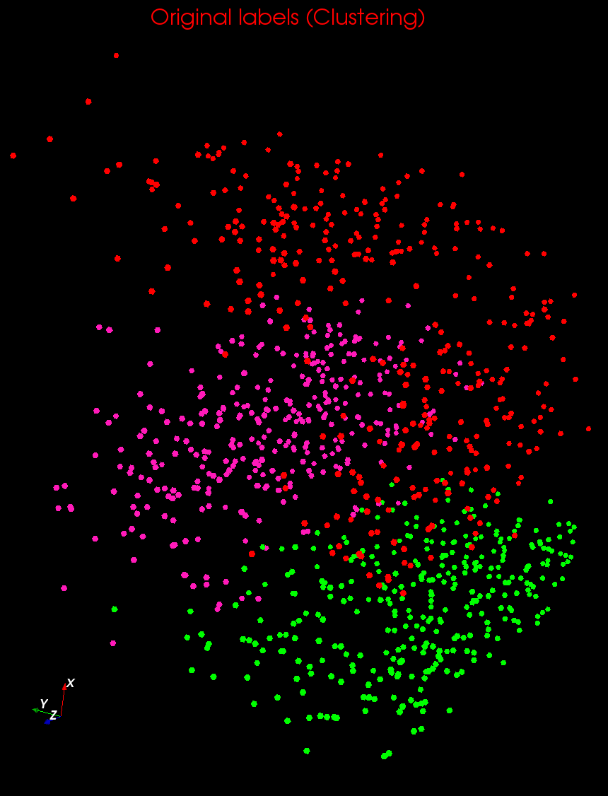
Clustering v User Rating III

