Slide 1
Next Set of Slides
Looks at fresh clusters into 3 or 28 clusters using deterministic annealing
We tried for 30 clusters in second case but program removes small clusters so it went down to 28
Note clustering divides full region into geometrically compact subregions

Slide 2
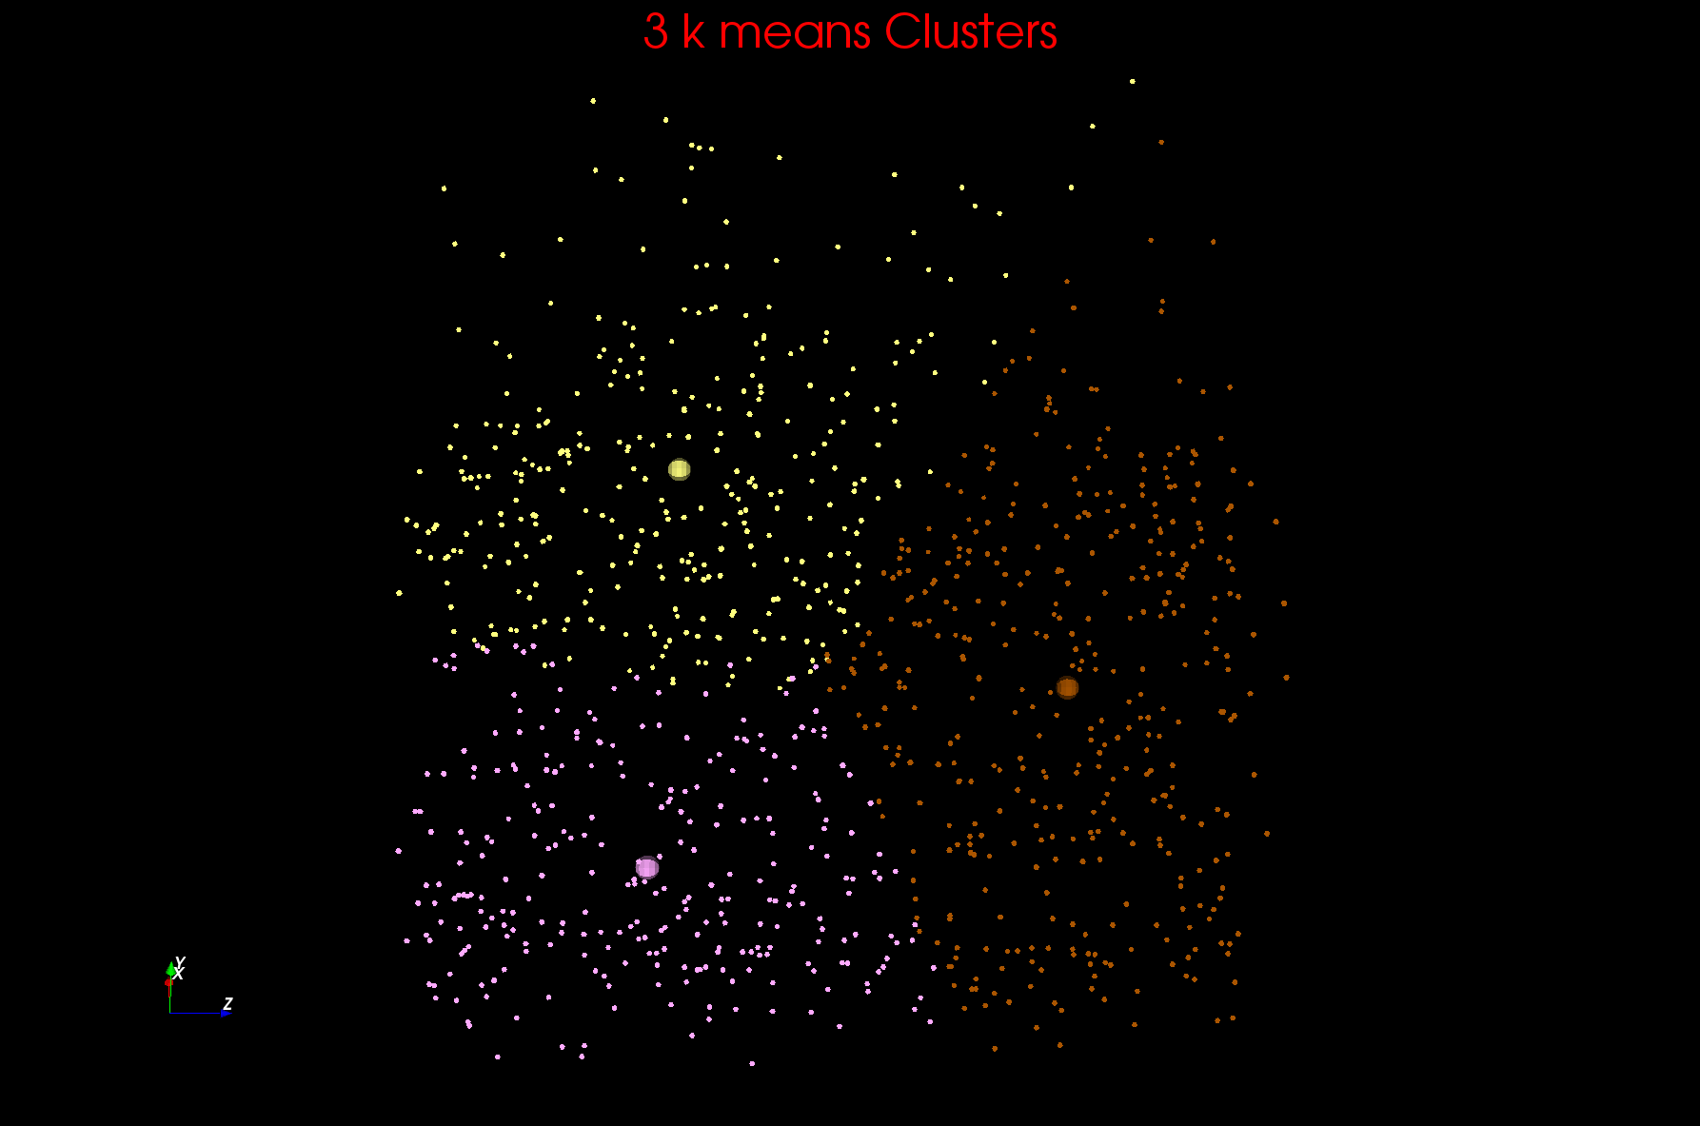
Two views of a 3D Clustering I

Slide 3
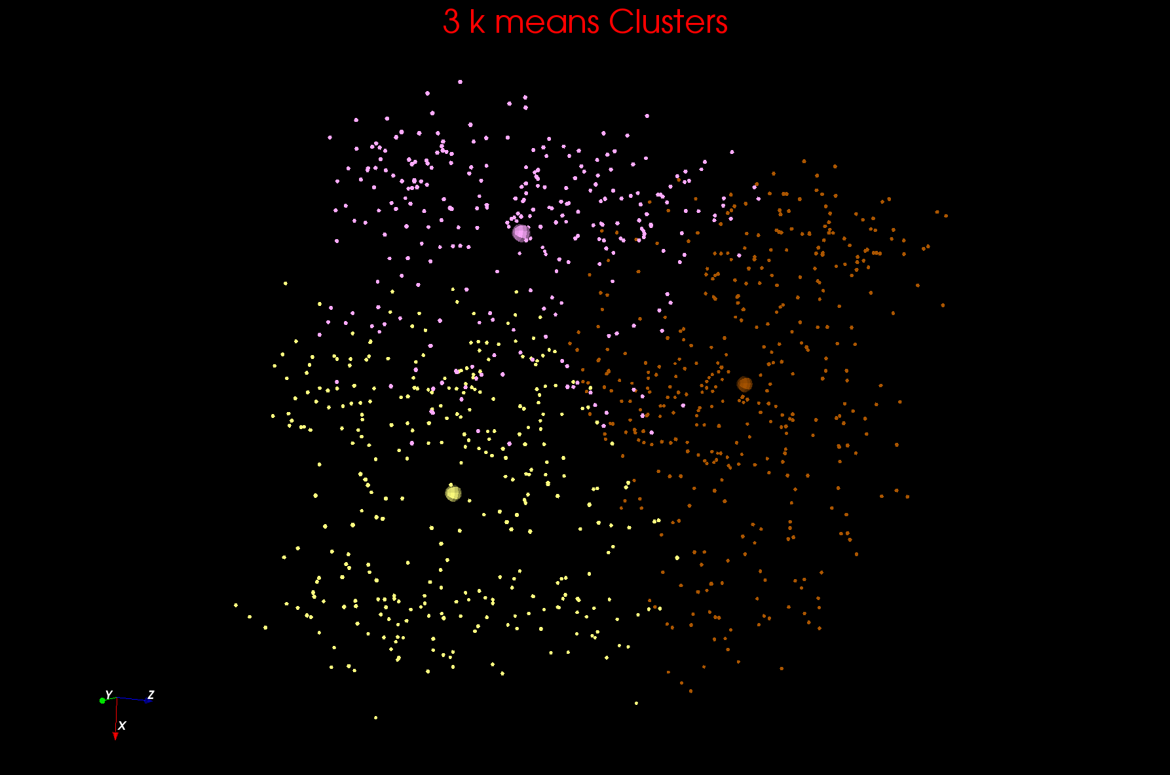
Two views of a 3D Clustering II

Slide 4
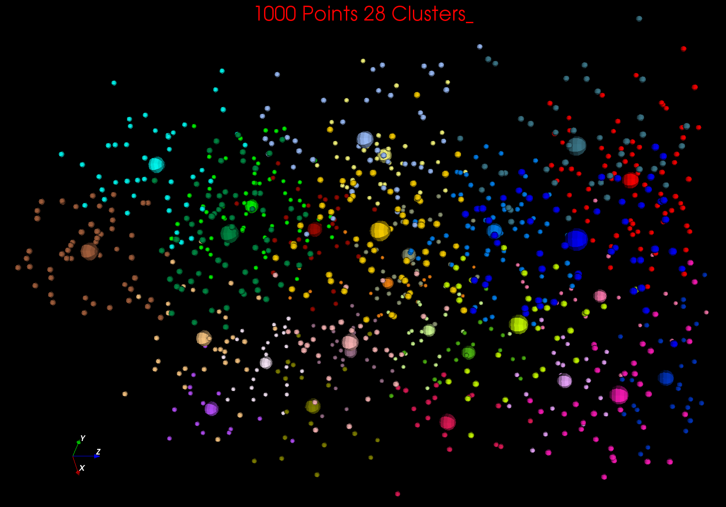

Slide 5
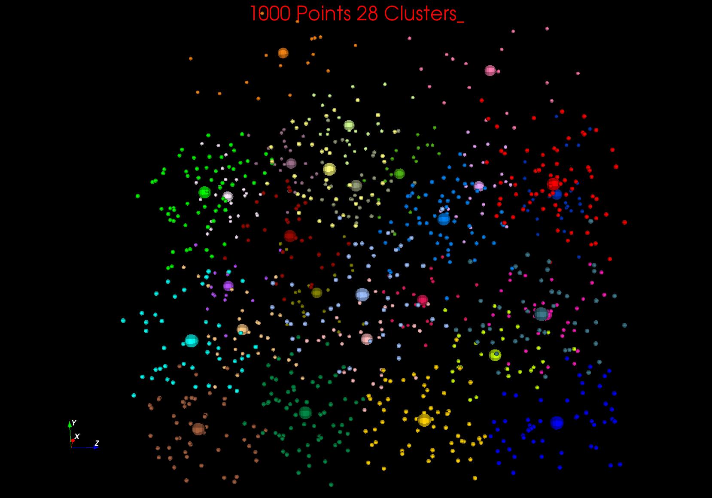
28 Clusters (Tried for 30 but 2 removed as too small) Note clusters not separated but they do divide region up which is needed in classifiers

