Slide 1
Getting the wrong answer
Remember all things in life – including clustering – are optimization problems
Lets say it’s a minimization (change sign if maximizing)
k means always ends at a minimum but maybe a local minimum out of which small changes are stable
We will see examples of false minima later in course in Kmeans with Python lesson
Initial Position
Unhappiness
Local Minimum Wrong Answer
Real Minimum
Center Positions

Slide 2

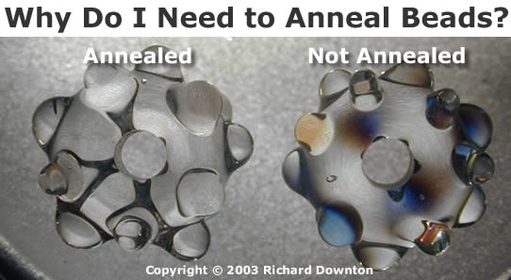
Annealing
Physics systems find true lowest energy state if you anneal i.e. you equilibrate at each temperature as you cool
Allow atoms to move around
If system cools too fast it finds a false minima
Corresponds to fuzzy algorithms

Slide 3
Annealing
Objective Function
Fixed Temperature – false minima
T3
Annealing -- correct minima
T3
T2
T2
T3 < T2 < T1
T1
T1
Configuration – Center Positions Y(k)

