Slide 1
Greedy Algorithms
Many algorithms like k Means are greedy
They consist of iterations
Each iterations makes the step that most obviously minimizes function
Set of short term optima; not always global optima
Same is true of life (politics, wall street)

Slide 2
Purpose of Clustering
This is used in several somewhat different ways
First is taking a set of points in a space and divide into distinct groups with (clear) separation
Second is dividing points into neighboring points but not groups that are separate
There are also latent factor and mixture models which use a different definition of cluster that adds probabilities
These are used to group “items” together in content based approaches
Further one has methods/applications that work in
Real vector spaces
Spaces in which there are no vectors but some or all of distances defined

Slide 3
Clustering Examples
We follow with examples in mass spectrometry peaks and genomics where there are real separated clusters
The mass spectrometry is in a 2D space
The genomic case is not a vector space and one clustered without using vectors
The pictures show results after projecting to 3 dimensions
We also have a PlotViz demo

Slide 4
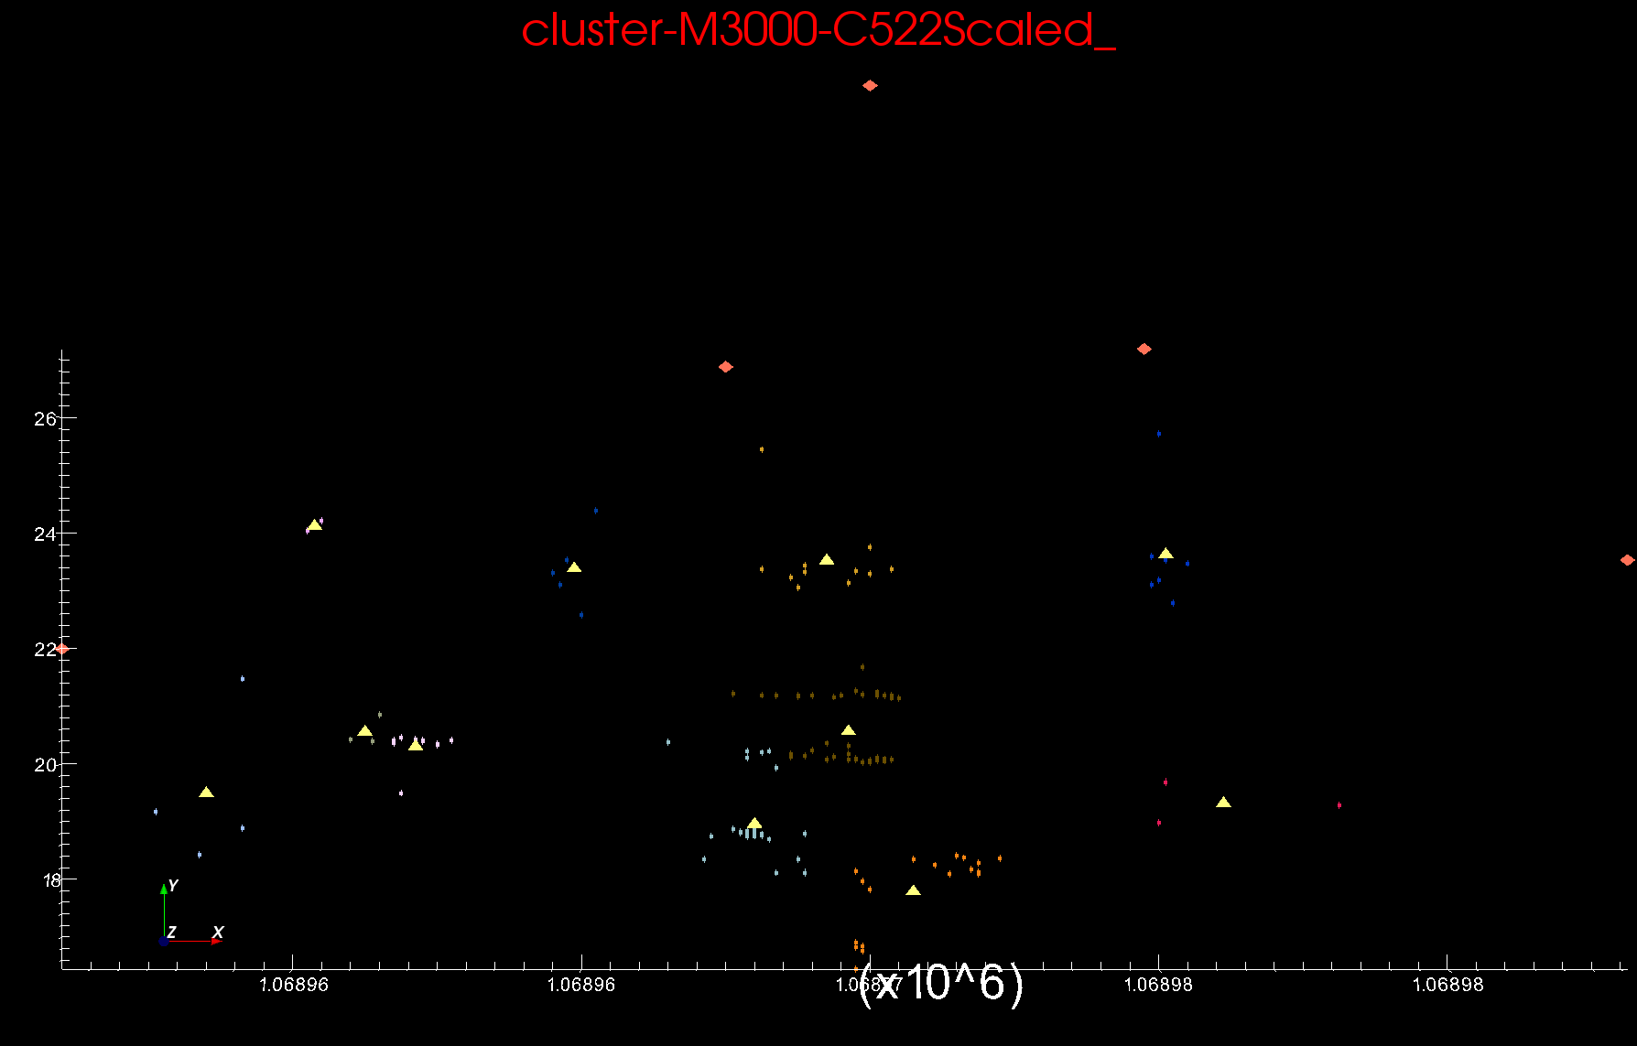
Proteomics 2D DA Clustering T=0.1 small sample of ~30,000 Clusters Count >=2
Sponge Peaks
Centers

