Slide 1

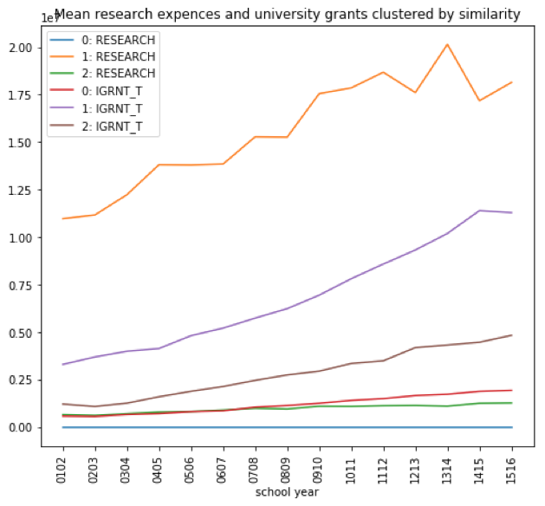
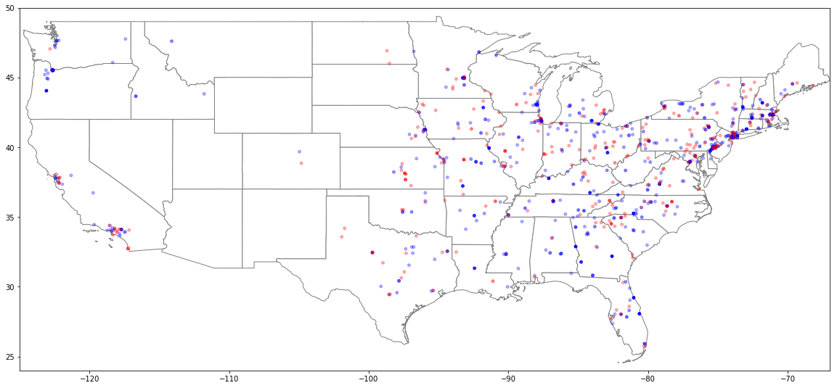
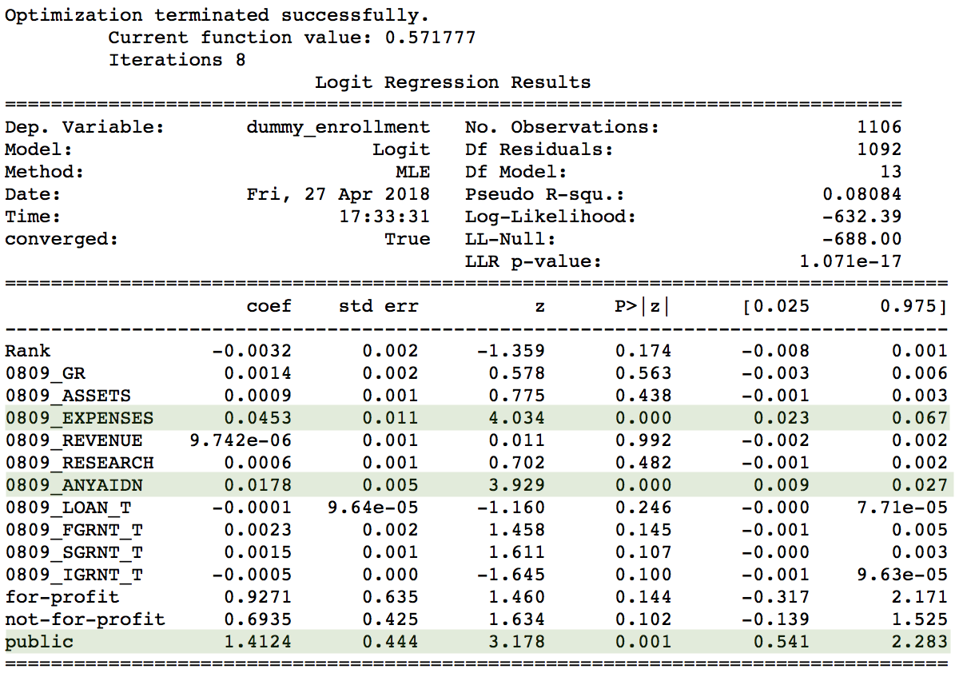
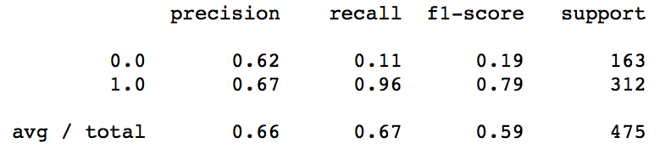
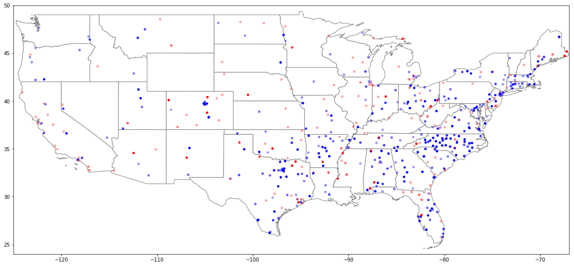
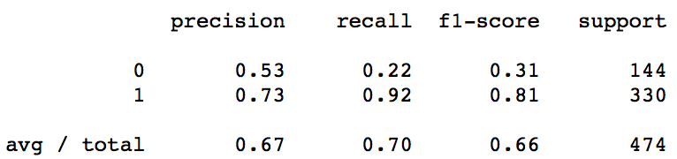
Impact of Economic Recessions on Higher-Level Educational Activity
Vincent Wahl
Chenyang Yu
Blake Stanford
Questions/Hypotheses
Our Data
Introduction
This project investigates how economic recessions impact educational activity. We determine this impact by looking at a school’s enrollment statistics, financial aid provided to students, and allocation to research. Due to the limited availability of education data during past recessions, we chose to focus our study primarily on the 2008 recession.
How do schools respond to an economic recession?
What schools respond similarly to recessions?
How do students respond to economic recessions?
We expected a decrease in educational activity during recessions. This would be seen by decreased enrollment, decreased financial aid, and decreased research spending across the board.
National Center for Education Statistics
Yahoo! Finance
Google’s Geocoder API
U.S News & World Report
The educational data required significant restructuring as many schools reported data inconsistently.
Cluster Analysis
Analysis Using GMM clustering of schools based on similarity of change in research spending and grants given during financial recession.
Geo-Location Analysis
Analysis Geographic plots of school, showing change in enrolment during 2008 between public and private schools.
Predictive Models
Analysis Effort to determine whether a school will see an increase or decrease in enrollment, using Logistic Regression (LR) and Artificial Neural Network (ANN) for Binary Classification.
Conclusion
How do schools respond to an economic recession?
Difficult to determine given that the 2009 stimuli package provided funds for expansion in the educational sector
Future studies should take into account the past recessions where such stimulus packages were not initiated.
What schools respond similarly to recessions?
Top ranked universities – in terms of change in research spending and grants
Schools of same type
Schools in same state
How do students respond to economic recessions?
Increase in grants to students
More students taking loans
Possible movement from private to public schools
LR Model
Private Universities
Public Universities
ANN Model
Observations Cluster 1 was made up primarily of highly ranked universities. For this cluster research spending is lower than expected for school year 08/09. However, during 09/10 it increases drastically.
This increase in educational activity during the recession was found to be due to the 2009 stimulus package issued by the Obama administration.
Blue indicates an increase in enrollment while red indicates a decrease.
Observations The LR model showed that the variables of highest significance in determining how a schools enrolment will change during recessional periods were change in number of students receiving financial aid, change in school expenses, and whether the school was public. The ANN further improved the classification model.
Observations We see an overall increase in enrollment in public universities while many private universities see a decrease in admissions. A possible explanation is a movement of students from expensive private universities to more affordable public universities.

