Slide 1
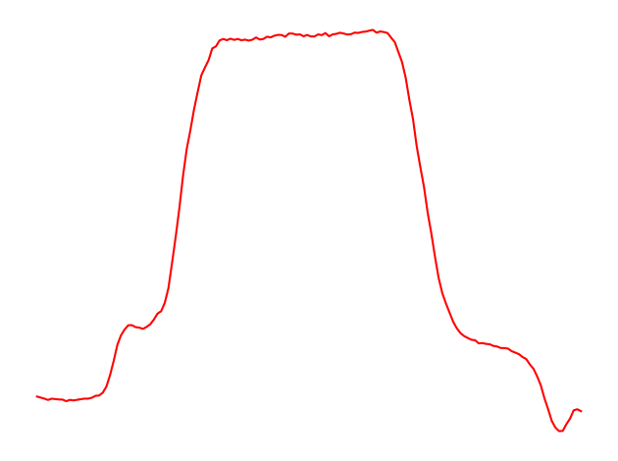
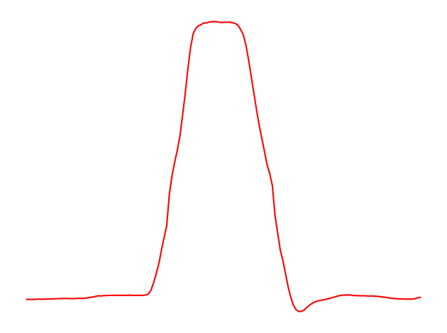
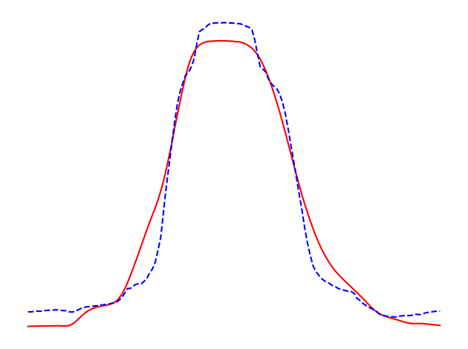
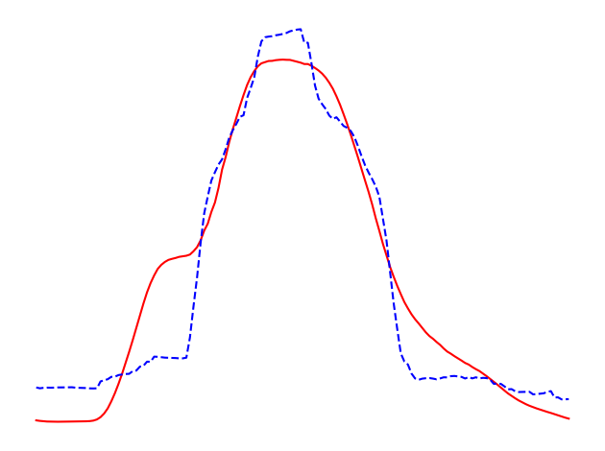
Shoulder level
Hand moving down to grasp the gun
Aiming
Pointing
Hand moving above the holster
Hand at rest
Hand at rest
Shoulder level
Aiming
Pointing
Hand moving down to grasp the gun
Hand moving above the holster
Hand at rest
Hand at rest

