Slide 1
A Melody Composer for both Tonal and Non-Tonal Languages
Coleman Yu, Raymond Chi-Wing Wong
The Hong Kong University of Science and Technology
cyuab@cse.ust.hk, raywong@cse.ust.hk
ICMC 2017 (16-10-2017)
Presented by Coleman
The paper and this slide can be found in http://www.cse.ust.hk/~raywong/.

Slide 2
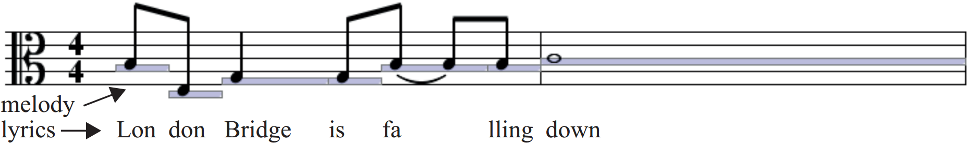
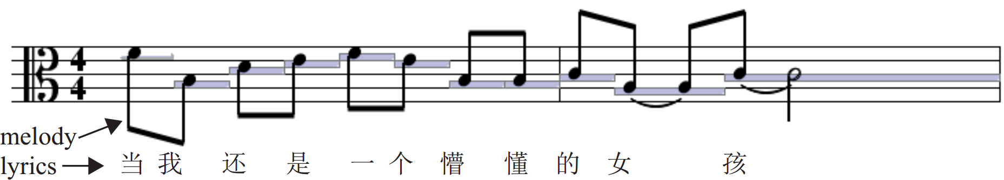
Introduction
Output
Input
Output
Input

Slide 3
Architecture
Mining Freq. Patterns (FPs)
Using FPs to compose melody for the lyrics
I am happy.
Songs
Songs
FPs
melody
Melody
lyrics
Lyrics
I want to own a song.

Slide 4
Outline
Lyrics is absent
1. Mining Frequent Patterns
Mining FPs from both songs and instrumental compositions
2. Composing Melody
Compose Melody for Tonal and Non-Tonal languages
Original
New
Original
New

Slide 5
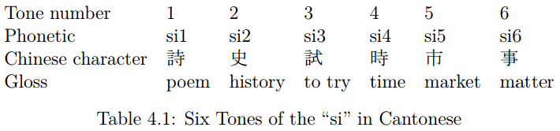
1. Tonal and Non-Tonal Languages
In non-tonal languages, using different tones to pronounce the same phonetic will not change their meanings.
E.g. men (men)
In tonal languages, opposite condition.
Pronounced at different tones will alter the meanings of “si”

Slide 6
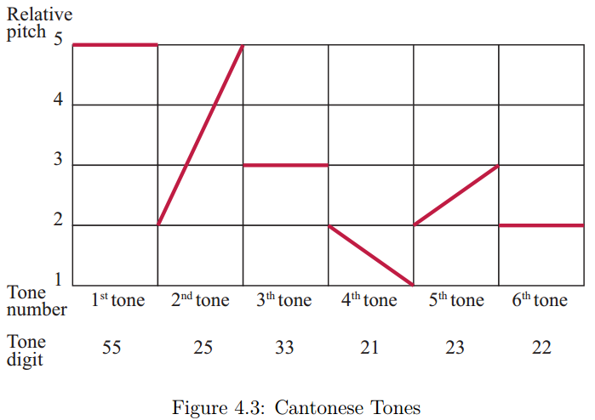
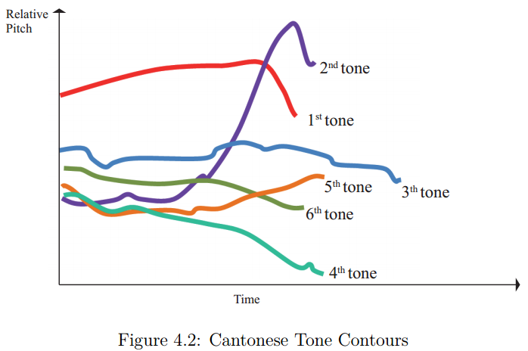
1. Tone Contour and Tone Digit

Slide 7
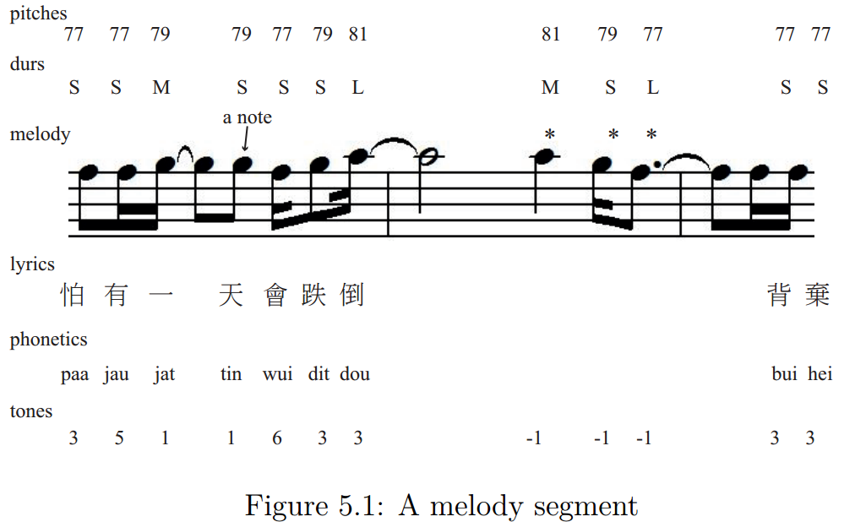
1. Representation
No lyrics are assigned to these notes

Slide 8


1. Absolute Seq. VS Trend
pitches, durs, tones
The absolute sequences are not useful for us.
Trend is more suitable because melody is more like a sequence of changing pitch differences but not a sequence of absolute pitches.
tone trend
tones
Pairwise differences
Similar procedure for computing the trends of pitches and durs

Slide 9
1. Frequent Pattern (FP)
We are interested in the correlations between melodies and lyrics.
These correlations can be represented by
“fps of the tone trend and pitch trend”
and
“fps of the tone trend and duration trend”.

Slide 10
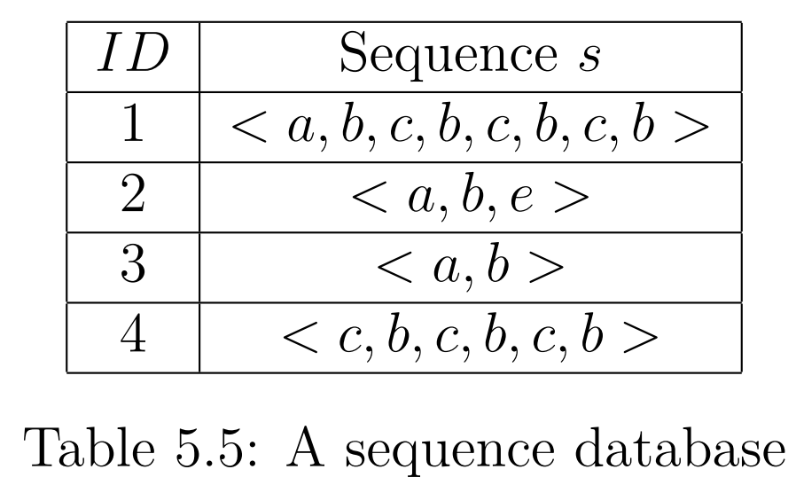
1. Specific Frequent Threshold
Specific Frequent Threshold is set to be 3
In song 1, the support of <c,b> is 3
<c,b> is specific frequent w.r.t. song 1
In song 4, the support of <c,b> is 3
<c,b> is specific frequent w.r.t. song 4

Slide 11
1. Overall Frequent Threshold
Specific Frequent Threshold is set to be 3
Overall Frequent Threshold is set to be 2
<c,b> is specific frequent w.r.t. song 1
<c,b> is specific frequent w.r.t. song 4
<c,b> is overall frequent w.r.t. the sequence database

Slide 12
1. Original Method: Mining FPs from songs
Mining FPs from songs
Songs
FPs
It cannot mine FPs from instrumental compositions.

Slide 13
1. New method: Mining FPs from plain music (Method 1)
Method emphasizing the original fps
A frequent pattern
FP database (General)
FP database (Style) is a subset of FP database (General)
Tone trend
Pitch trend
FP database (Style)
Frequent pitch trends (Style)
Plain music with style
Mine freq. pitch trends
A frequent pitch trend

Slide 14
1. New method: Mining FPs from plain music (Method 2)
Goal: Fill the tone trend for all the freq. pitch trends
Method emphasizing the newly mined frequent pitch trends
A frequent pattern with length = l
FP database (General)
Tone trend
Pitch trend
+
+
FP database (Style)
FPs with length << l
FPs with length < l
FPs with length = l
Even shorter FPs
Shorter FPs
Frequent pitch trends (Style)
Plain music with style
Mine freq. pitch trends
A new FP !
We fill the tone tread of by
We find that
=
+
+
We guess
=
+
+
A frequent pitch trend with length l

Slide 15
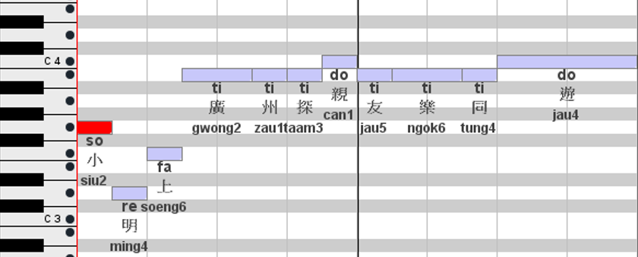
2. Construct Pitch Seq. from pitch trend
Obtained based on the tone trend of the input lyrics
Pitch trend = < − 3, 2, 3, 0, 0, 1, − 1, 0, 0, 1>
Generate from the ending note
Diff. in sofa name = 1
This melody is in C major.
Diff. in sofa name = 3
Diff. in sofa name = -3

Slide 16
2. Composing Melody using fps in Different Language
Goals: Use the fps mined from songs with lyrics in language L₁ to compose the melody with the user-input lyrics in language L₂.
Do a tone mapping of the tones from L₂ to L₁.
L₂ tone sequence L₁ tone sequence
Language of user-input lyrics
Language of songs
Example:
Thai
Cantonese

Slide 17
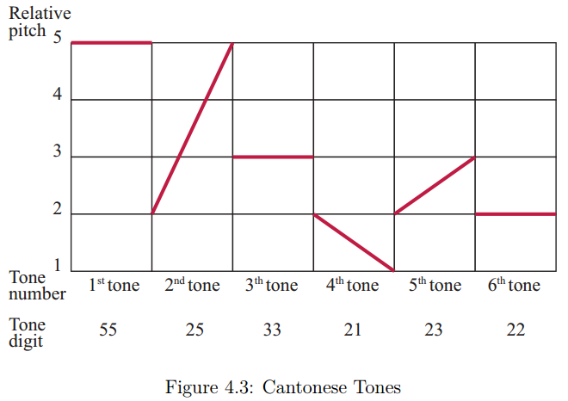
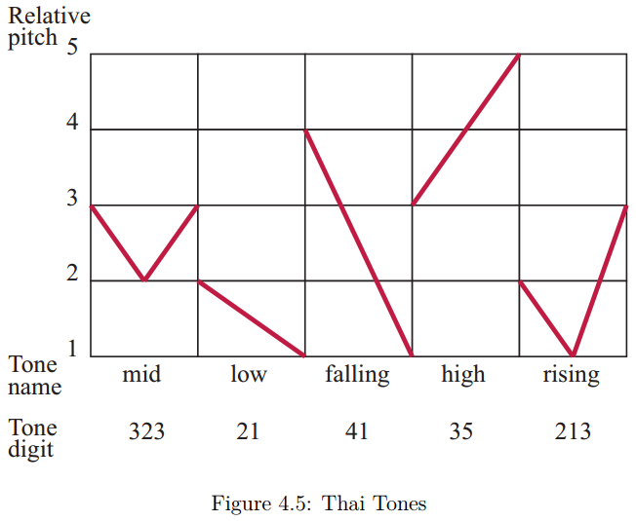
2. Cantonese Tones and Thai Tones
Use the greedy algorithm to find the similar pairs.

Slide 18
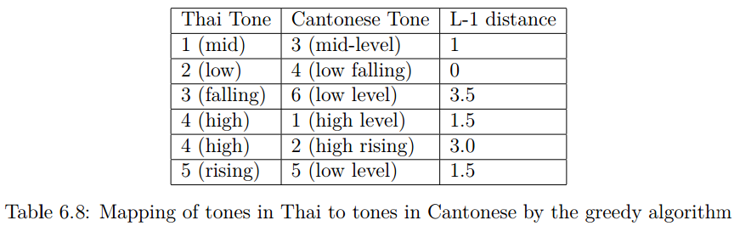
2. Map the Thai tones to the Cantonese tones
Between the tone digit of the Thai tones and that of the Cantonese tones
The 4th Thai tones is assigned to 2 Cantonese tones
With this mapping, we can transform the Thai tone sequence to the Cantonese tone sequence

Slide 19
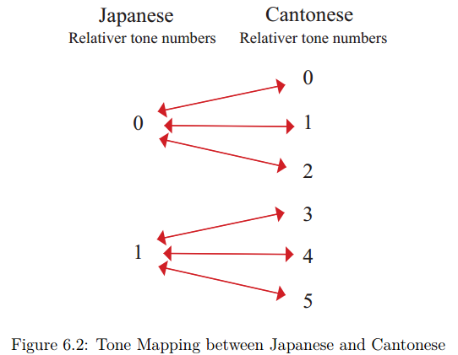
2. Map the Japanese tones to the Cantonese tones
lowest
l
Low pitch tone
h
High pitch tone
highest

Slide 20
2. Existing Method: Random mapping
Its tone trend <-4,3,-1,-3,4 > does not appear in the fp database
A possible Cantonese tone seq.
Japanese tone seq.
< 5, 1, 4, 3, 0, 4 >
< 1, 0, 1, 1, 0, 1 >
< 4, 2, 5, 3, 1, 5 >
Tone mapping
An other possible Cantonese tone seq.
Its tone trend <-2,3,-2,-2,4 > does appear in the fp database
Conclusion: We should map < 1, 0, 1, 1, 0, 1 > to < 4, 2, 5, 3, 1, 5 > !
Random mapping cannot do this for us!
There is a fp with tone tread = <-2,3,-2,-2,4 > in the fp database!

Slide 21
2. A lemma
Lemma 1: A Cantonese tone trend can be generated from at most 4 Japanese tone sequences, no matter how long the Cantonese tone trend is.
A Jap. tone seq.
A Cantonese tone seq.
A Jap. tone seq.
A Cantonese tone seq.
A Cantonese tone trend
A Jap. tone seq.
A Cantonese tone seq.
A Jap. tone seq.
A Cantonese tone seq.
Tone mapping
Pairwise diff.
Example
< l, l, l, l, l, l >
< 2, 1, 2, 2, 0, 1 >
< h, l, h, h, l, l >
< 3, 2, 3, 3, 1, 2 >
< − 1 , 1 , 0 , − 2 , 1>
< h, h, h, h, l, h >
< 4, 3, 4, 4, 2, 3 >
< h, h, h, h, h, h >
< 5, 4, 5, 5, 3, 4 >

Slide 22
2. New method: Optimal mapping
Size: 4X of FP database (Cantonese)
Generated from FP database
Japanese tone seqs.
A frequent pattern
FP database (Cantonese)
Cantonese Tone trend
Sofa trend
Input
Japanese tone seq.
Japanese lyrics
Find the at most 4 Japanese tone seqs. of each Cantonese tone trend
Japanese tone seq.

Slide 23
Conclusion
A demo video
https://vimeo.com/209610916
Thank You

