Slide 1
CS591 Project: Yelp Dataset Challenge
Christopher Yung

Slide 2
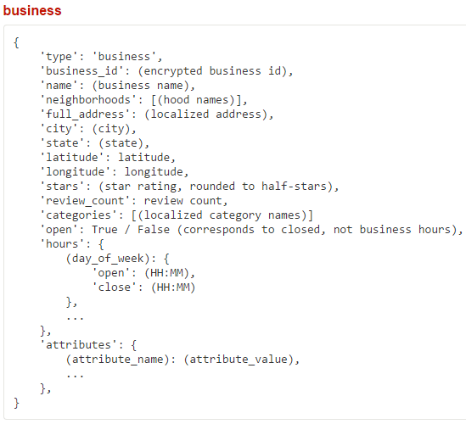
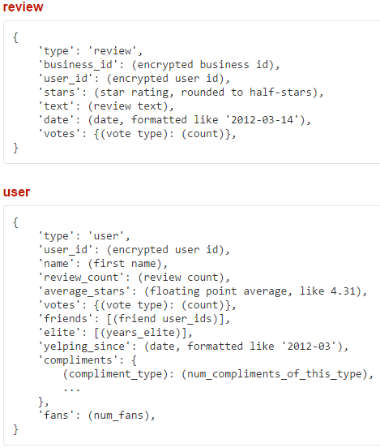
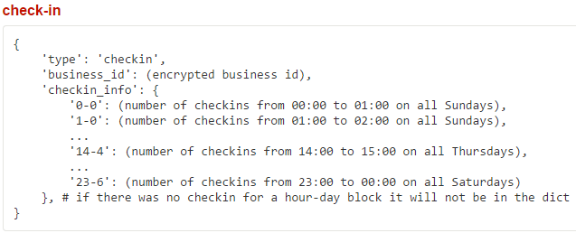
Data provided by Yelp

Slide 3
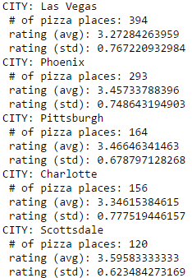
Hypothesis 1: Rating standard deviation and density in each city
My first hypothesis was that the standard deviation for ratings of a specific category in a given city was correlated to the density of that category.
In other words, a city with a higher number of pizza places would have a larger standard deviation in ratings due to a wider selection of choice.
Findings:

Slide 4
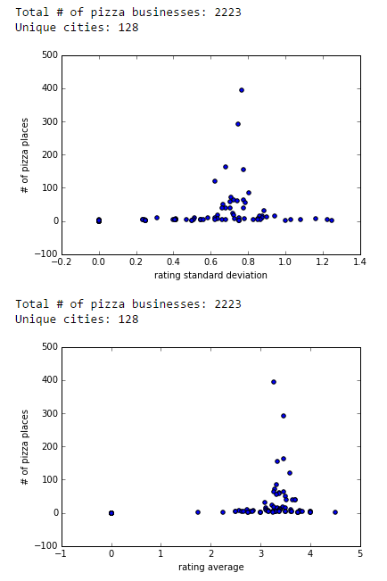
Conclusion 1
My hypothesis proved to be incorrect because there was no correlation between the two.
Reasoning: After analyzing the results further, it is clear that most users rate restaurants a 3 or higher, so the standard deviation will never be significant.

Slide 5
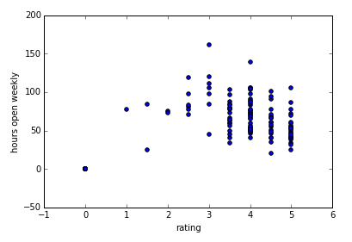
Hypothesis 2: Selective hours and ratings
My next hypothesis was that shops that are more selective with their hours tend to receive higher ratings. The theory was that specialized shops satisfy a certain niche and can afford to be more flexible with their times. Additionally, since niche shops have little to no competition, I assumed their rating would be higher.
Findings:

Slide 6
Conclusion 2
Once again, my hypothesis ended up not being true.
Reasoning: There are many factors that can affect the rating of a shop. Just because it is a niche shop with few hours does not mean that its ratings are guaranteed to be better.

Slide 7
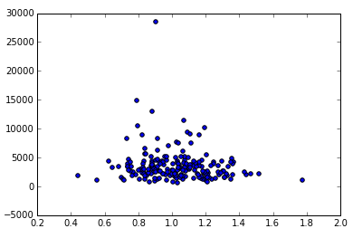
Hypothesis 3: Correlating user vocabulary with rating scale
My next hypothesis was that the larger a user’s vocabulary is, the larger his scale of rating is. This is done by comparing unique word count to standard deviation.
In other words, a user who has a large vocabulary is more likely to rate on a scale of 1 to 5 than on a scale of 3 to 5.
Findings:

Slide 8
Conclusion 3
Similarly, my hypothesis did not hold.
Reasoning: Personal bias can be attributed to more factors than just vocabulary. A person may be a good story teller, but still have a heavy bias when it comes to rating businesses.

Slide 9
Hypothesis 4: Predicting business category using check-ins
My last hypothesis was that a business’s category can be predicted solely by looking at its check-in information.
The check-in dataset provides the business ID along with 168 additional columns. Each of these columns specify the day of the week and the hour of that day. The value corresponds to the number of check-ins.

Slide 10
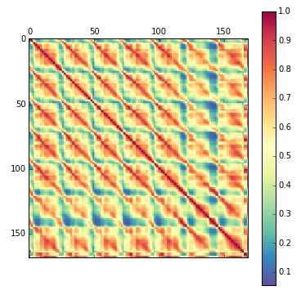
First look at the data
To examine the data, I chose to filter out the businesses with less than 200 check-ins. This resulted in somewhat dense data, so I did not need to use a metric like cosine distance. Instead, I chose the Pearson correlation coefficient.
To the right is the Pearson correlation matrix visualized.
You can clearly see the separation between the days. Interestingly, Saturday contains the most reviews.

Slide 11
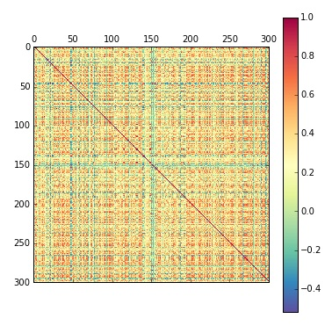
Building a classifier
Method: I used collaborative filtering to group businesses with similar check-in times.
From this, I built a pairwise matrix consisting the Pearson correlation coefficients between business i and business j.

Slide 12
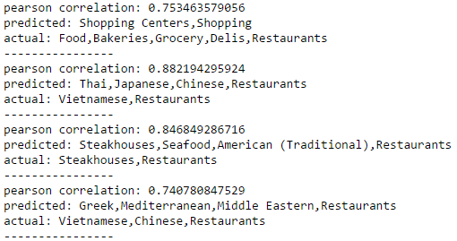
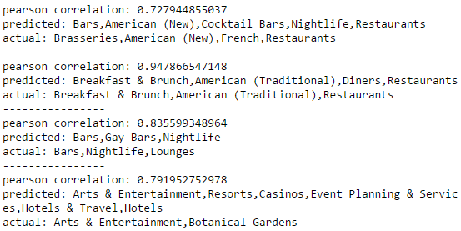
Conclusion 4
At last, we have a supported hypothesis and the classifier was able to identify the base category for a business based solely on its check-in information.
However, it was unable to classify different sub-categories like the difference between a Thai restaurant and a Hawaiian restaurant. This makes sense since check-in times have limitations and people generally eat at the same time regardless of food choice.

