Slide 2
環境建立(linux)
實驗環境
manjaro KDE 2023.1.2
CPU: 13th Gen intel® Core™ i9-13900K
GPU: a5000 cuda11.3
安裝requirement.txt
conda create --name myenv python=3.8
cd path/to/requirement.txt
pip install -r requirement.txt
進入與離開環境請下此指令:
conda activate name
conda deactivate
自行命名

Slide 3
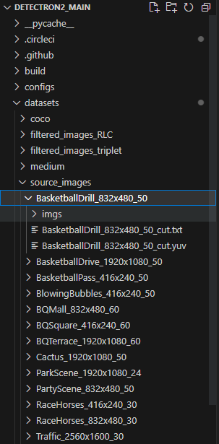
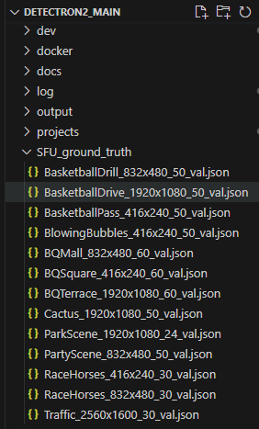
資料集路徑
依照以路徑儲存
img
/datasets/source_images/sequence name/imgs/…
e.g. /datasets/source_images/BasketballDrive_1920x1080_50/imgs/…
annotation
/SFU_ground_truth/

Slide 4
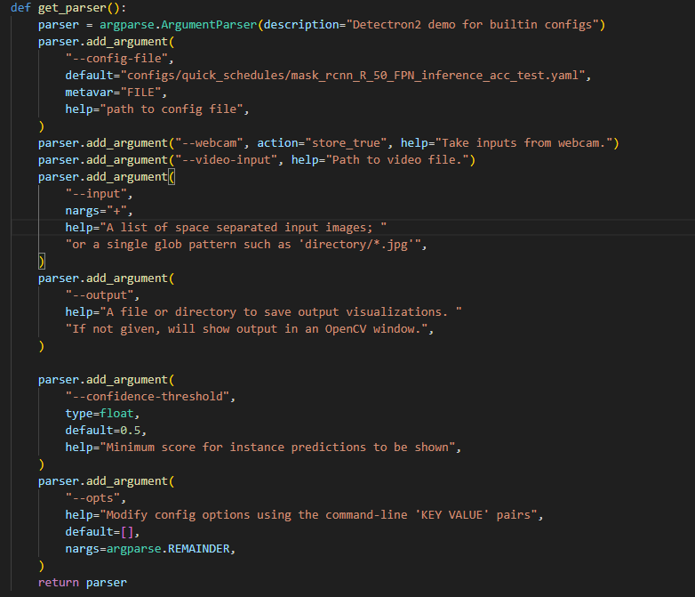
使用手冊
Parser
在終端機執行此命令，設定root
export PYTHONPATH="${PYTHONPATH}:/root to detectron2_main“
inference 1張照片
python demo.py --config-file configs/COCO-InstanceSegmentation/faster_rcnn_X_101_32x8d_FPN_3x.yaml --input input1.jpg --opts MODEL.WEIGHTS detectron2://COCO-InstanceSegmentation/faster_rcnn_X_101_32x8d_FPN_3x/137849600/model_final_68b088.pkl

Slide 5
生成不同bitrate應對的圖片資料夾
Entropy coding使用RLC->Huffman coding
python detectron2/test_all_QF_bitrate_RLC.py
Entropy coding使用triplet->Huffman coding
python detectron2/test_all_QF_bitrate_triplet.py
DCT
Filter
Quantize
triplets
Huffman coding
Huffman decoding
Sparse Matrices
Dequantize
IDCT
DCT
Filter
Quantize
Run Length Coding
Huffman coding
Huffman decoding
Run Length Decoding
Dequantize
IDCT

Slide 6
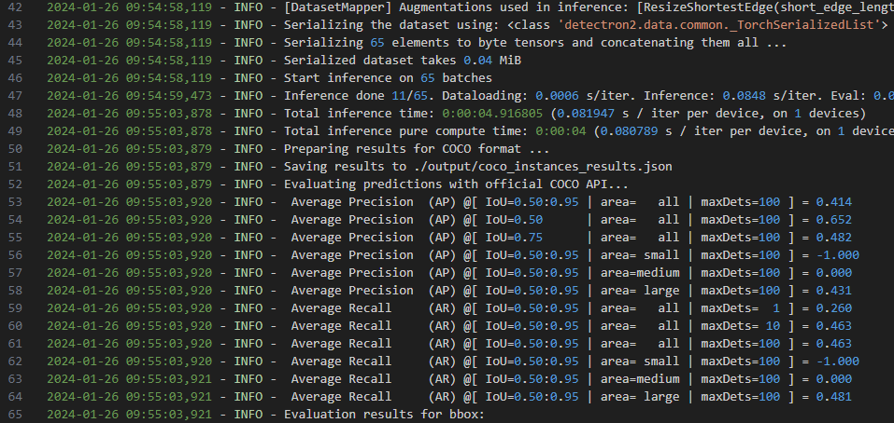

Test mAP
執行以下指令
python detectron2/run_mAP.py
輸出會儲存在log/logger.log

Slide 7
Draw ground truth
畫ground truth:
python detectron2/draw_GroundThruth.py

