Slide 1
頻域實驗

Slide 2
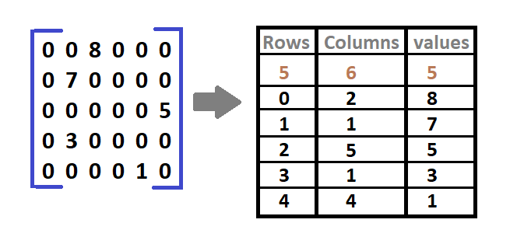
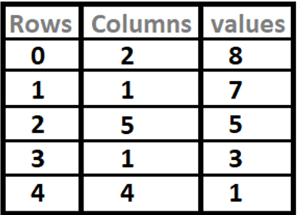
實驗設計
調整Quantize的QF參數，測量不同bitrate的mAP
DCT
Filter
Quantize
triplets
Huffman coding
Huffman decoding
Sparse Matrices
Dequantize
IDCT
Test mAP
DCT
Filter
Quantize
Run Length Coding
Huffman coding
Huffman decoding
Run Length Decoding
Dequantize
IDCT

Slide 3
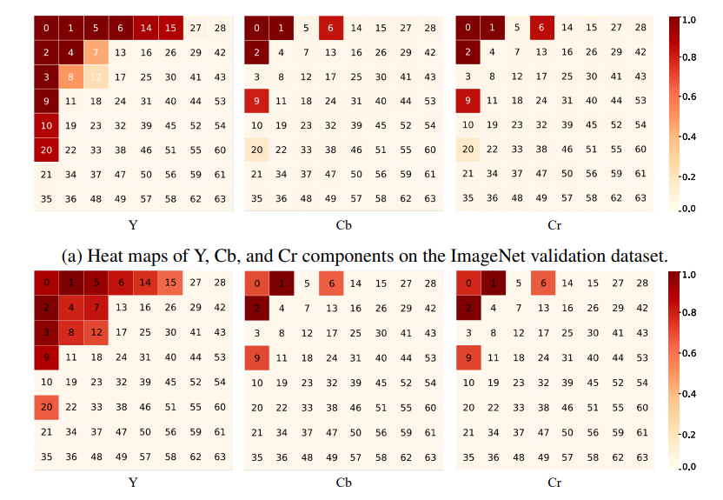
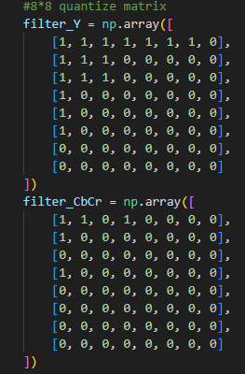
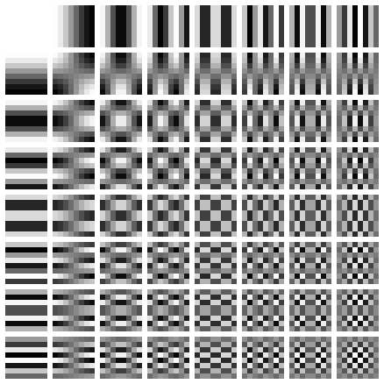
乘以量化矩陣
DCT
Filter
Quantize
Sparse Matrices
to triplets
Huffman coding
Huffman decoding
Triplets to Sparse Matrices
Dequantize
IDCT
除以量化矩陣並round
實作上將待編碼資料型態轉為string，以符號的格式送入Huffman coding

