Slide 1


A web application for mood check-ins, private reflection, AI-assisted conversation, and moderated peer connection
Notes:
Welcome. DayFeel brings mood check-ins, private journaling, an AI companion, and moderated community circles into one calm, warm application. This deck walks through the why, the what, and the how.

Slide 2



Feelings get scattered everywhere
People who want to understand their emotions often record them inconsistently, in disconnected notes, chats, and calendars.
Hard to look back
Changes over time are difficult to see when records live in different places.
Missing context
A difficult day is hard to connect to what actually happened around it.
Support feels exposed
Peer support raises privacy and moderation worries about journals and account details.
Notes:
The core issue: emotional records are scattered, they lack context, and seeking peer support can feel risky for privacy. Note that this is a design premise, not a clinical finding.

Slide 3






One gentle place for every need
Inconsistent tracking
Daily check-in on a five-emotion scale, with history, charts, and a monthly calendar
Mood scores lack context
Private journal entries to record experiences and the feelings behind them
Patterns are hard to notice
Historical glance of your check-ins
Wanting to talk and connect
An AI companion, plus member-only circle feeds and live chat
Privacy and harmful interactions
Ownership checks, aliases, membership, reporting, moderation, data controls
Notes:
Each problem maps to one part of the app: check-ins for consistency, journals for context, insights for patterns, companion and circles for connection, and layered safeguards for privacy.

Slide 4

Where the name comes from
They Feel
Day Feel
Everyone has feelings
Every day is different
And those feelings deserve to be recognized, without being dismissed or judged.
Daily check-ins invite you to pause, acknowledge how you feel, and record it.
Notes:
DayFeel is a wordplay on 'They Feel': everyone has feelings worth recognizing. Swapping 'They' for 'Day' ties that idea to the habit of daily check-ins.

Slide 5



Why yellow? Your “yellow person”
“
Emotional safety
Warmth
Someone in your life who brings emotional safety, warmth, optimism, and comfort.
Optimism
Comfort
That is the experience DayFeel hopes to offer: a welcoming place to check in, reflect, and feel heard.
Day Feel does not ask users to feel happy every day; it invites them to acknowledge whatever they are feeling.
Notes:
'Yellow person' is an informal expression for someone who makes you feel safe and warm. The soft yellow palette expresses that intent. It's an aspiration, not a promise that a color can guarantee emotional safety.

Slide 6

What DayFeel sets out to do
1
Make daily recording straightforward
A companion, not a clinic
2
Preserve a useful personal history
DayFeel supports wellbeing and self-reflection. It is not a diagnostic tool, treatment service, emergency service, or a replacement for professional care.
3
Support reflection without diagnostic claims
4
Provide moderated peer interaction
Need help now? Links to Find A Helpline
5
Give users control over AI preferences and data
Notes:
Five objectives guide the product. Equally important is what DayFeel is not: it complements trusted relationships and professional support. 'Need help now?' links to Find A Helpline, an external service DayFeel doesn't operate.

Slide 7



Three roles, clear responsibilities
Member
Moderator
Administrator
Manages a profile, records check-ins, writes journals, talks with the companion, joins circles, and reports posts or comments.
Reviews reported content in authorized circles; pauses posting, restricts or restores access, or removes content.
Accesses admin features such as creating circles, and can perform every moderator action.
Notes:
Members are the everyday users. Moderators keep circles safe within their authorized scope. Administrators set up circles and can also moderate.

Slide 8




What members can do today
Account & profile
Daily check-ins
Private journal
Sign-in, sessions, aliases, avatars
History, table, and monthly calendar
Create, edit, delete, paginated reading
Companion chat
Circles
Live circle chat
Saved chats, renaming, optional memory
Posts, comments, supportive reactions
Latest 50 messages, older on demand
Reporting
No self-reports; time-limited restrictions
Out of scope: clinical diagnosis, appointments, professional messaging, payments, and emergency dispatch.
Notes:
These are the implemented, user-facing capabilities. Journals and check-ins are separate records. The boundaries line clarifies what DayFeel intentionally does not provide.

Slide 9
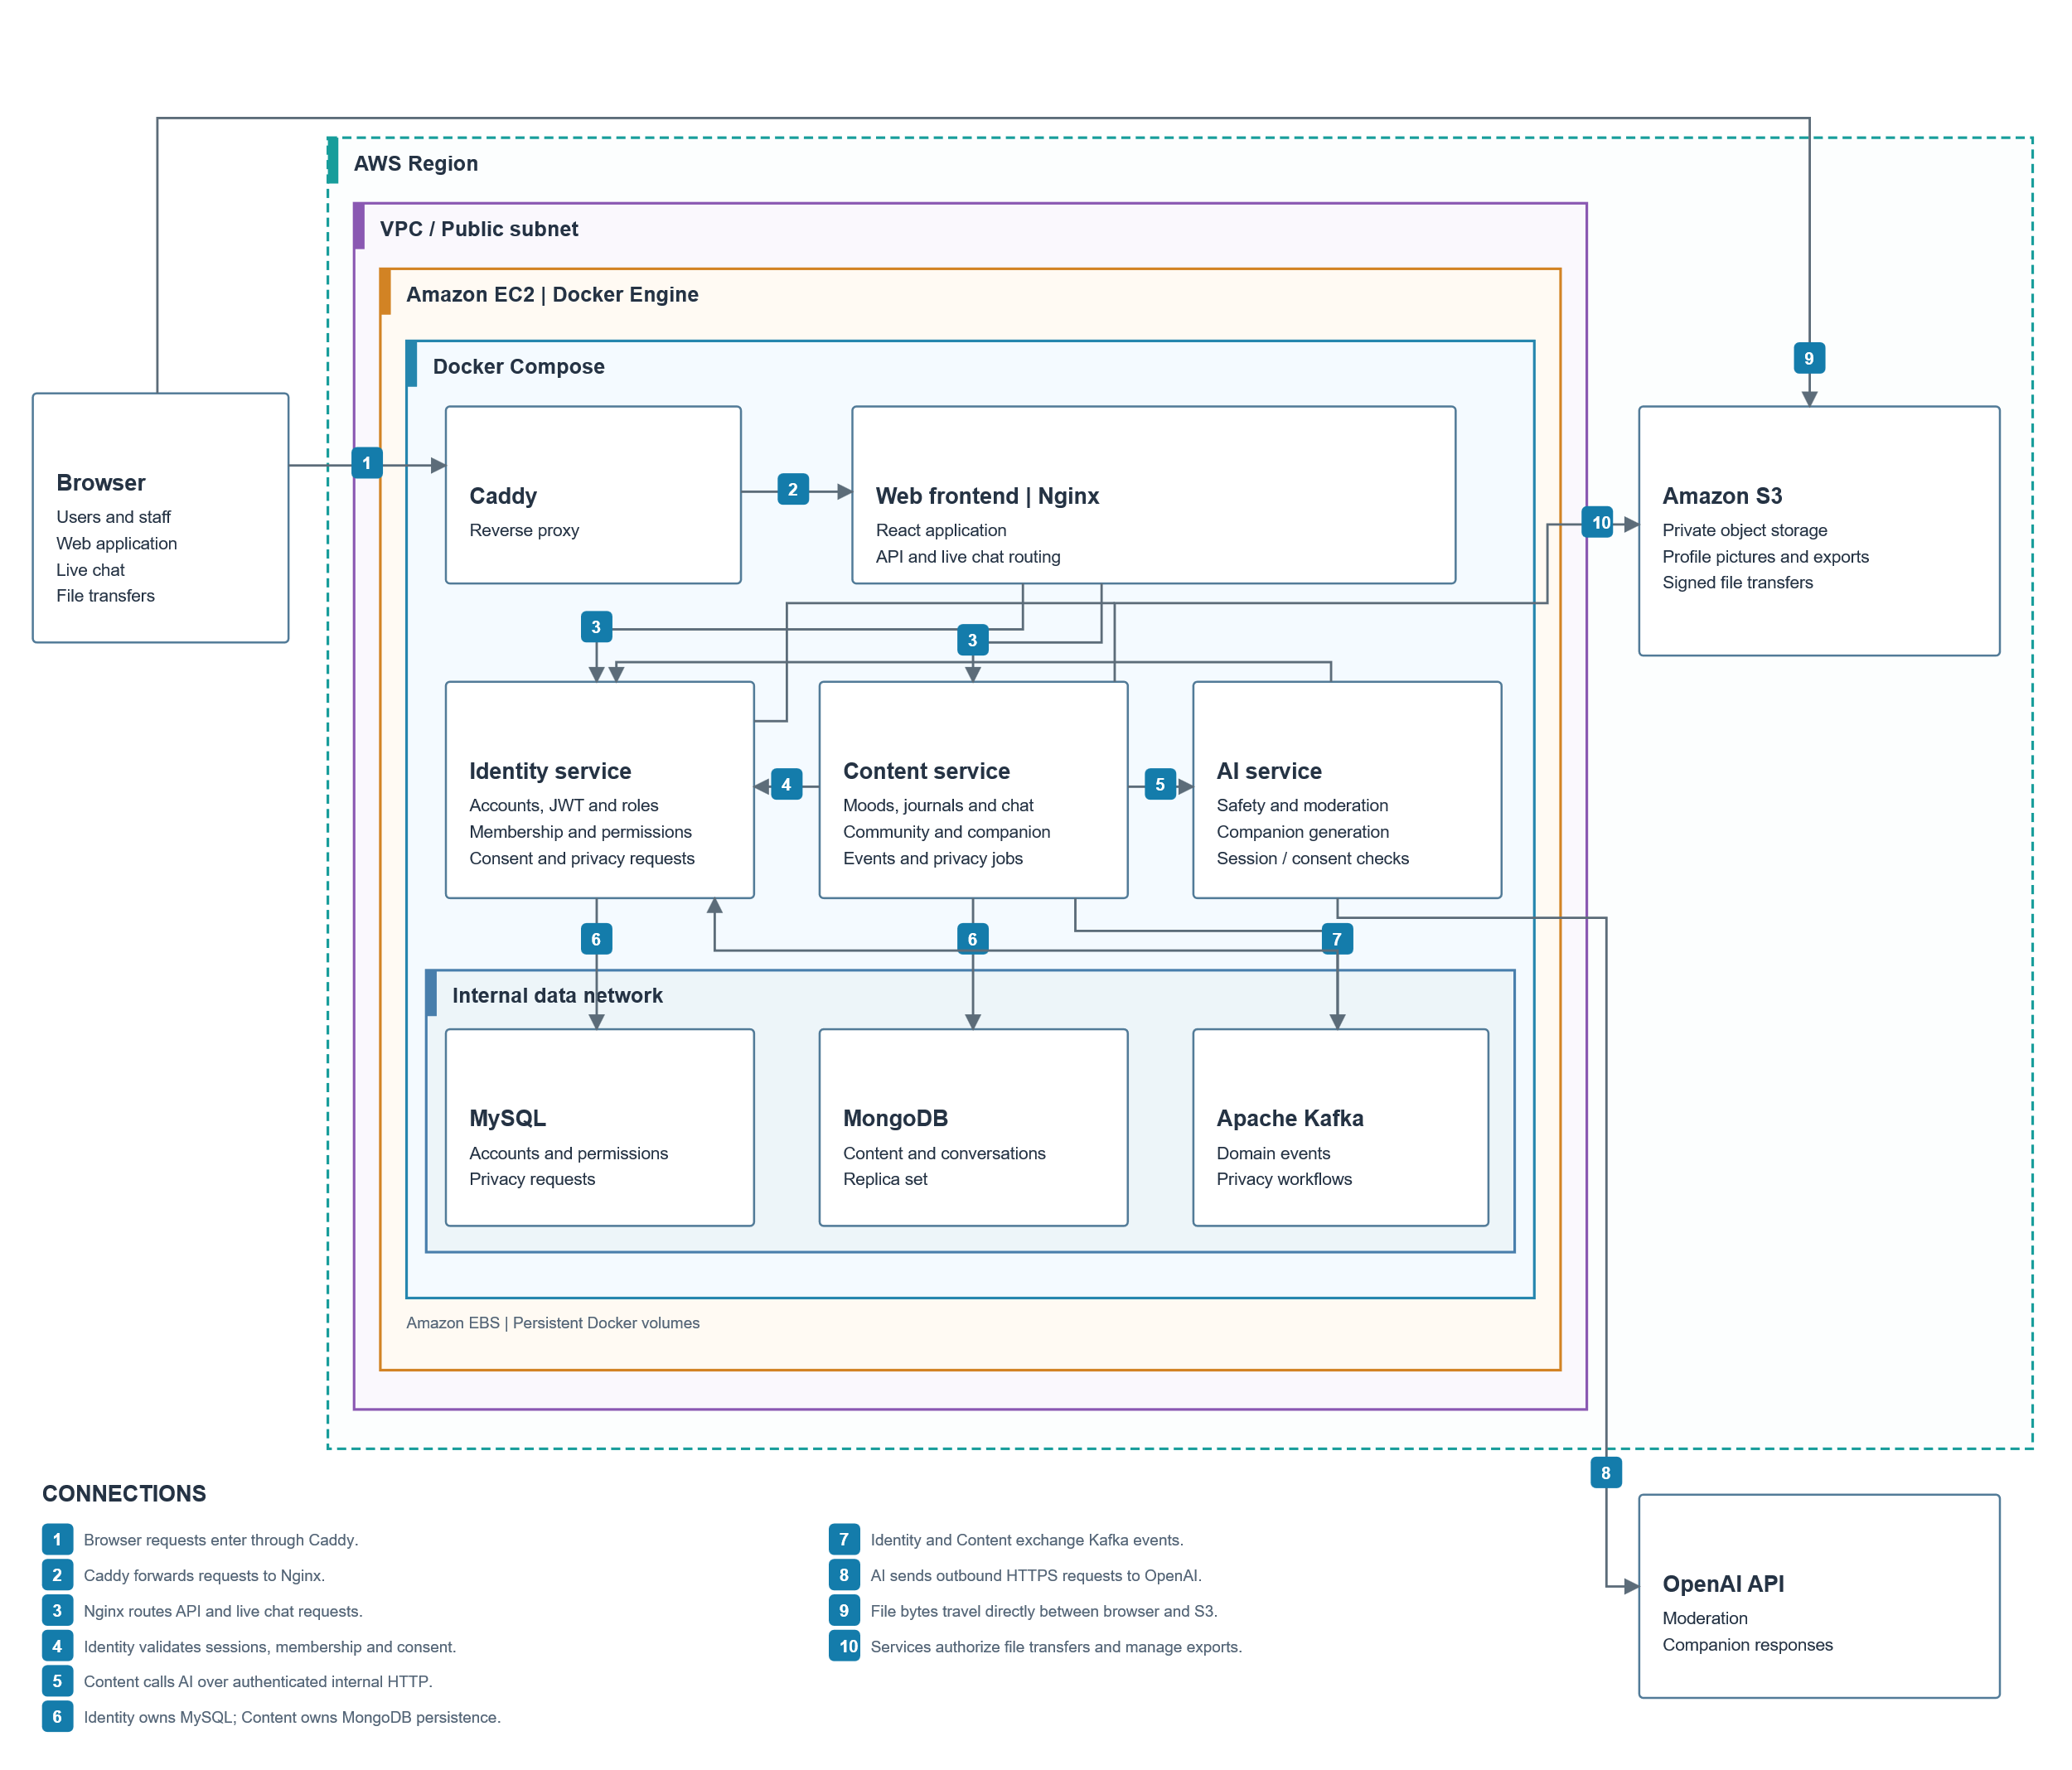
How the pieces fit together
1
Browser requests enter through Caddy, which forwards to Nginx
2
Nginx serves the React app and routes API and live-chat calls
3
Identity validates sessions, membership, and consent
4
Content calls AI, which reaches OpenAI over HTTPS
5
File bytes move directly between browser and S3
Notes:
This is the high-level diagram from the technical document. Requests flow browser to Caddy to Nginx, then to the three services. Identity and Content exchange Kafka events. AI reaches OpenAI, and files go straight between browser and S3 using signed URLs.

Slide 10


Three services, each owning its part
Identity
Content
AI
Spring Boot · MySQL
Node.js · MongoDB
FastAPI · OpenAI
Users, roles, sessions, aliases, AI consent, circles, reports, moderation, and privacy requests.
Journals, moods, companion history, posts, reactions, chat, and weekly insights. Checks ownership and asks Identity before protected actions.
Internal endpoints that generate companion replies. A stateless adapter to OpenAI.
Notes:
Responsibilities are split cleanly. Identity owns who you are and what you're allowed to do. Content owns what you write. AI is a stateless adapter. A transactional outbox in Identity publishes domain events to Kafka.

Slide 11





Deployed on a single AWS EC2 instance
Docker Compose on EC2
Amazon S3
Private file storage
Web access
Services
Data & events
Caddy + Nginx
Spring Boot · Node.js · FastAPI
MySQL · MongoDB · Kafka
Reverse proxy and React hosting
Auth, content, live chat, AI
Identity, content, messaging
OpenAI API
AI functionality
Notes:
Everything runs as Docker containers on one EC2 instance, managed by Docker Compose. Caddy and Nginx handle web access, three backend services do the work, and MySQL, MongoDB and Kafka handle data and events. S3 and OpenAI sit outside the instance.

Slide 12
Where data lives
MySQL · Identity
MongoDB · Content
Amazon S3
Users, roles, sessions, circles, memberships, reports, moderation actions, privacy requests, outbox events
Moods, journals, companion chats, posts, comments, reactions, circle chat, weekly insights, file metadata
Avatar files and generated data exports
Notes:
Identity data is relational in MySQL, content is document-oriented in MongoDB, and files live in S3. Because IDs cross databases without foreign keys, event consumers deduplicate and check state so deleted data isn't recreated.

Slide 13

Principal workflows
Sign-in
Daily check-in
Journal
Companion
Identity issues tokens; every service verifies them
One mood per local date; updates replace it
Private entry stored, screened, queued for analysis
Message saved, safety-checked, reply persisted
Community
Reporting
Privacy
Membership checked; one reaction per user
Members report unsafe content; moderators act
Use of alias for users
Notes:
Seven core workflows. Notable details: a day's check-in is updated rather than duplicated; companion memory is opt-in and disabling it doesn't delete history; self-reports are rejected; and a privacy request isn't 'done' until every service confirms completion. Automatic journal analysis still needs its worker to be complete.

Slide 14

What’s next for DayFeel
AI mood insights
Notifications
Account support
Chat retention
Additional Emotions
Weekly or monthly trends, focus points, and helpful habits
Check-in reminders, report alerts, new circle messages
Forgot password and admin user management
Rules for pre-join visibility, retention, and deletion
Provide more emotions in the daily check-in to acknowledge more user’s feelings.
Notes:
Proposed enhancements: AI-driven mood insights, a notifications module, account support tools, a defined chat retention policy (implemented only once product rules are agreed), and AI evaluation with cost controls.

Slide 15

Every feeling deserves to be recognized
DayFeel is a welcoming place to check in, reflect, and feel heard, complementing trusted relationships and professional support.
Notes:
Thank you. DayFeel doesn't ask anyone to feel happy every day; it simply invites them to acknowledge whatever they're feeling.

