Slide 1


Advanced Subsystems for
Martian Exploration
6 Innovative Engineering Concepts for Lander & Rover Survivability
Course: ENGR1000J
Instructor: Prof. Shen & Prof. Wei
Presenter: Group 5
Group Name: six gentlemen
SJTU Global College — Technical Communication Pitch
1
Notes:
Hello everyone, we are Group Five, the Six Gentlemen from SJTU Global College. Today, we are very excited to present our technical pitch, focusing on advanced engineering subsystems designed for Mars exploration missions. We will walk you through five innovative concepts aimed at improving the survivability and efficiency of planetary landers and rovers in hostile space environments. Let us begin.

Slide 2

Six Innovative Space Exploration Concepts
Overview: Five specialized subsystems engineered to address critical environmental challenges on Mars
01 | Deep Space Thermal Control System
04 | Adaptive Robotic Arm Gripper
Closed-loop PID loops maintaining internal instrumentation.
Soft-robotic claw conforming to irregular minerals.
02 | Self-Stabilizing Landing Platform
05 | Deployable Communication Relays
Active-leveling landing legs to prevent spacecraft tipping.
Micro launcher bridging signals over steep canyons.
03 | Quadrupedal Wheeled Mars Rover
06 | Electrostatic Solar Dust Remover
A wheeled quadruped robot that keeps its body level on any terrain.
Dynamic traveling electric fields clearing panel dust.
Group 5 | six gentlemen
2
Notes:
On this slide, you can see an overview of the five specialized subsystems we have developed. We will first discuss our self-stabilizing landing platform, which uses active suspension. Next, we will cover our adaptive robotic arm gripper for specimen collection. Then, we will look at high-precision deep space thermal control. After that, we will introduce deployable micro communication relays, and finally, we will present our electrostatic dust removal device for solar panels. Each system solves a critical threat to mission success.

Slide 3
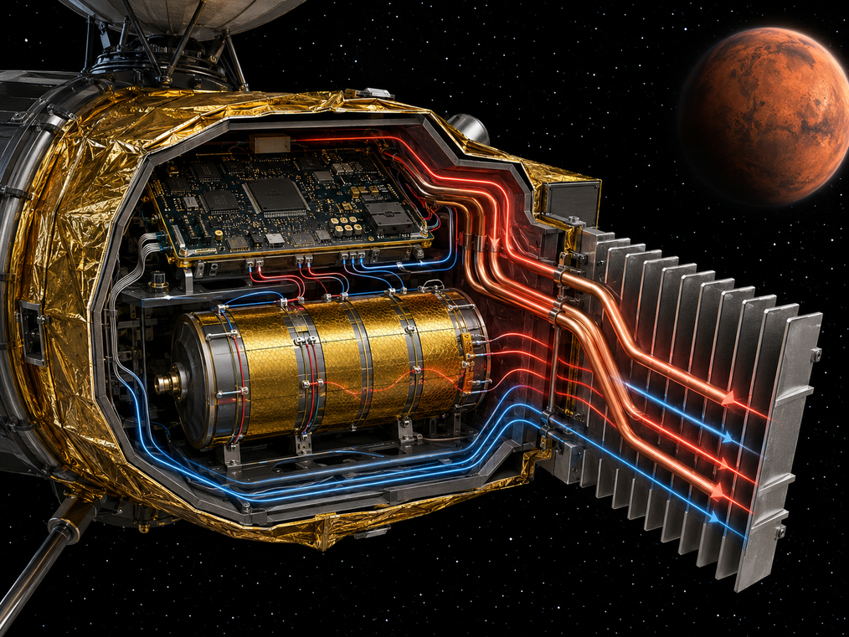
01 | Deep Space Thermal Control System
Problem:
Extreme temperatures in deep space alternate between direct solar heat and cryogenic shadows, destroying delicate electronics.
Need:
A closed-loop thermal regulation system with high-precision control to maintain a constant internal temperature for instrumentation.
Solution:
PID-controlled loops combining heater patches, heatsinks, heat pipes, and insulation layers, achieving +/- 1 degree Celsius stability.
Figure 1: High-precision thermal regulation system layout for deep space instrumentation cabinets.
Group 5 | six gentlemen
5
Notes:
Our third concept is the Deep Space Thermal Control System. Explorers experience severe temperature variations in vacuum, alternating between direct sunlight and cryogenic shadows. Sensitive electronics will break outside narrow thermal boundaries. We need closed-loop thermal regulation with high-precision feedback. Our solution utilizes heaters, heat pipes, and multilayer insulation blankets. Using PID control, the system maintains the electronics bay temperature within a strict range of plus or minus one degree Celsius.

Slide 4
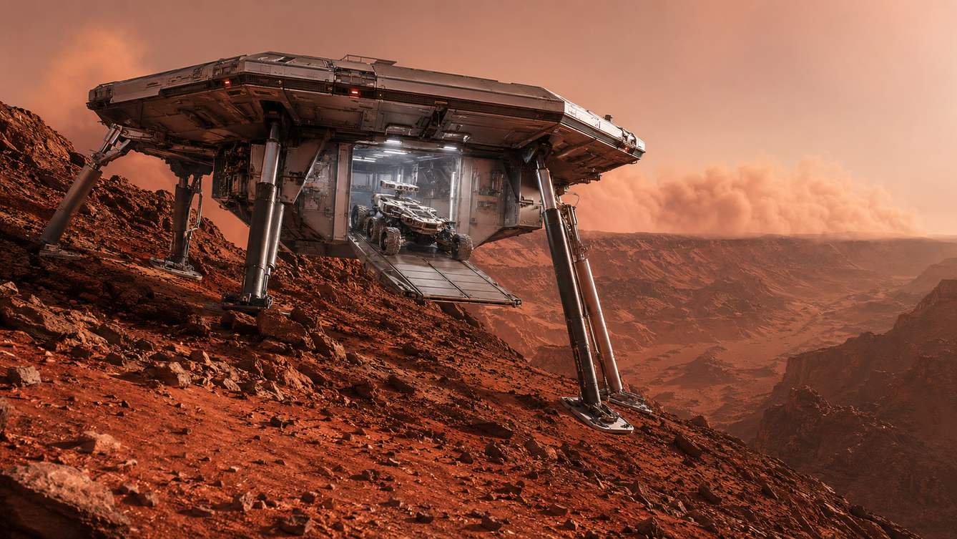
02 | Self-Stabilizing Landing Platform
Problem:
Landing on uneven slopes or crater rims tilts or tips over spacecraft, causing structural damage or blocking rover release.
Need:
An active self-leveling landing system to keep the main deck perfectly horizontal on highly uneven terrains.
Solution:
Active suspension with four telescopic legs, IMU sensors, and parallel inverse kinematics to level the landing platform.
Figure 2: Concept design of the self-stabilizing lander utilizing active suspension on a steep Martian slope.
Group 5 | six gentlemen
3
Notes:
First, let us examine the Self-Stabilizing Landing Platform. Landing on uneven Martian slopes or rocky crater edges is extremely hazardous. Typical landers can easily tip over, causing structural failure or permanently trapping the rover inside. To address this need, our solution integrates active suspension with four telescopic legs and real-time IMU sensors. By applying parallel inverse kinematics, the legs dynamically adjust their lengths on touchdown to keep the main deck perfectly level, ensuring a safe rover deployment.

Slide 5
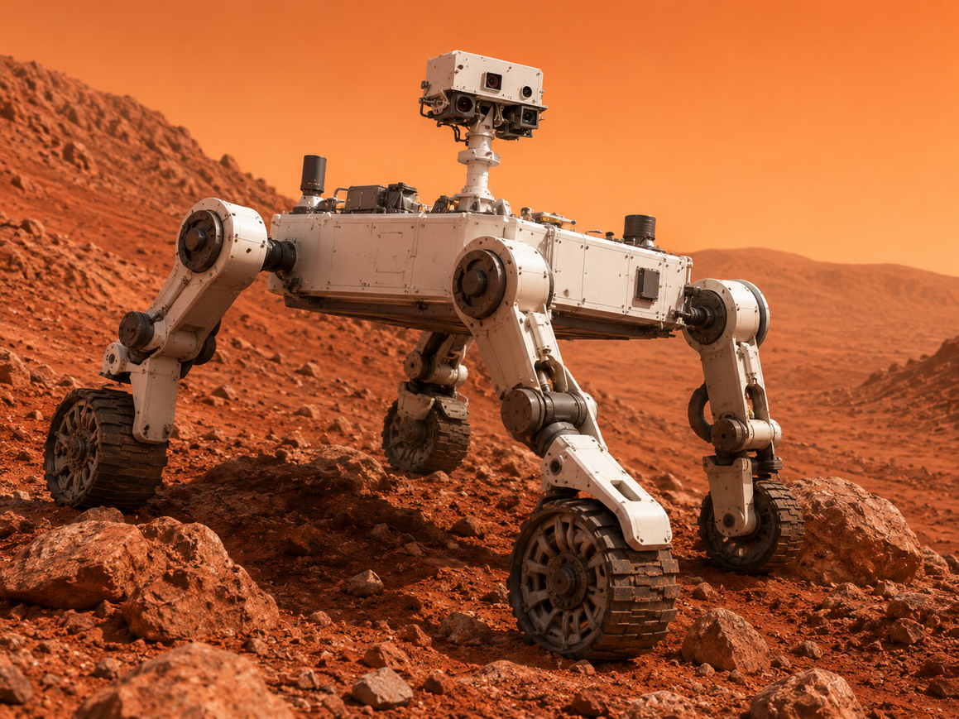
03 | Quadrupedal Wheeled Mars Rover
Problem:
Traditional rovers easily get stuck on rugged Martian terrains, while pure walking robots consume too much energy on flat ground.
Need:
Space explorers need a versatile, energy-efficient vehicle capable of maintaining absolute body stability across extreme and complex landscapes.
Solution:
We designed a quadrupedal robot equipped with wheels and gyroscope sensors that can adjust its legs to keep the main body perfectly level on any terrain.
Figure 3: Active suspension rover adjusting wheel heights to keep the main chassis level on steep terrain.
Group 5 | six gentlemen
8
Notes:
Our sixth concept is the Terrain-Adaptive Quadruped Rover with Active Suspension. Current planetary rovers utilize passive suspensions that are limited to low speeds and shallow slopes, and cannot react dynamically to obstacles. We need a mobility platform that can cross steep rocky terrain at high speed while keeping the chassis perfectly level. Our solution is a four-wheeled rover with independently actuated suspension hubs controlled by IMU feedback and cascade PID, allowing dynamic height adjustments.

Slide 6
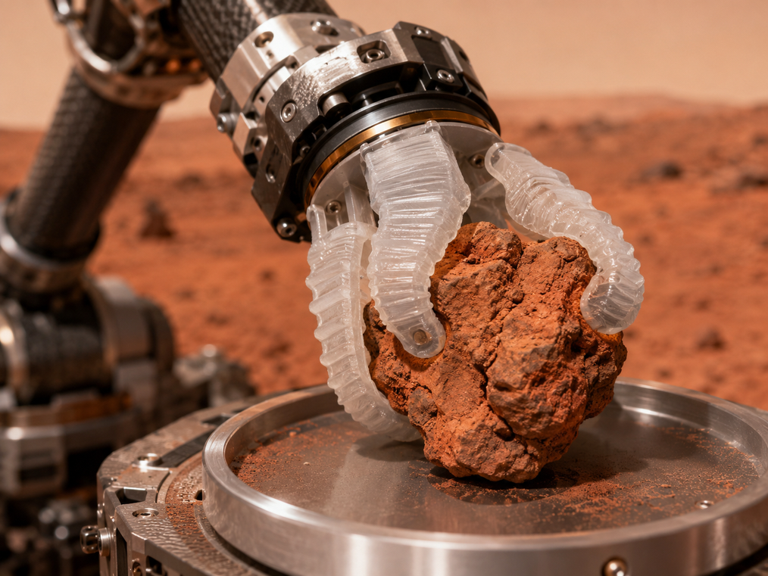
04 | Adaptive Robotic Arm Gripper
Problem:
Rigid metallic grippers crush fragile geological samples or slip when grasping irregular and smooth minerals.
Need:
A versatile, non-destructive gripping mechanism that conforms to various irregular shapes and sizes of geologic specimens.
Solution:
A 3D-printed flexible soft gripper that uses elastomeric finger deformation to adaptively conform and securely grasp irregular samples.
Figure 4: Soft robotic gripper utilizing the Fin-Ray structure to grasp irregular rock formations safely.
Group 5 | six gentlemen
4
Notes:
Next is the Adaptive Robotic Arm Gripper. Traditional rigid metal clamps often crush delicate scientific samples, such as loose clay or crystals, and easily slip when grasping rounded rocks. We need a versatile, non-destructive grasping mechanism. Our solution is a 3D-printed soft robotic gripper using elastomeric fingers. Inspired by the Fin-Ray structure, the fingers adaptively bend and wrap around irregular geology specimens, maximizing contact area and ensuring a secure, gentle hold.

Slide 7

05 | Deployable Communication Relays
Problem:
Martian terrain obstacles like craters, hills, and canyons block line-of-sight RF signals, causing rover communication blackouts.
Need:
A rapid-deployment method to establish temporary signal bridges over large obstacles or challenging planetary topography.
Solution:
Rover-launched micro spherical relay nodes deployed via spring mechanism to bypass terrain barriers and restore signals.
Figure 5: Active deployment of micro relay nodes to bridge line-of-sight wireless communication.
Group 5 | six gentlemen
6
Notes:
Fourth, we introduce the Deployable Communication Relays. Planetary obstacles like steep crater walls, mountains, and canyon formations block direct line-of-sight radio signals, leading to rover blackouts. We need a rapid way to bypass these obstacles. Our solution uses a pneumatic spring launcher to shoot micro spherical communication nodes onto high ground. These shock-absorbing spheres deploy antennas to form a multi-hop wireless bridge, restoring contact with the base.

Slide 8
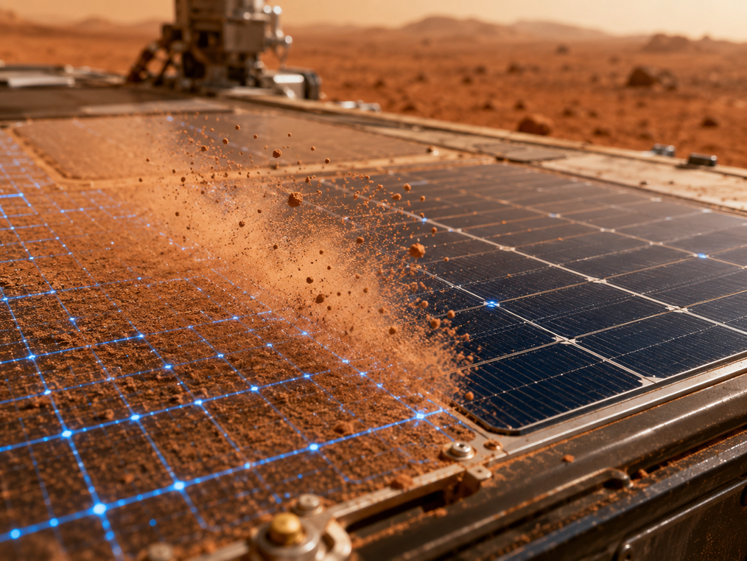
06 | Electrostatic Solar Dust Remover
Problem:
Fine Martian atmospheric dust deposits on solar panels, blocking sunlight and reducing power output over time.
Need:
A non-contact, wear-free cleaning system to remove dust without scratching panel surfaces or consuming limited fluids.
Solution:
High-voltage electrostatic electrodes generating dynamic electric fields to lift and sweep away fine dust particles.
Figure 6: Electrostatic dust removal showing particles levitated and removed by a traveling electric field.
Group 5 | six gentlemen
7
Notes:
Finally, let us look at the Electrostatic Solar Dust Remover. Dry, static-charged Martian dust particles cling to solar panels, blocking solar energy and depleting battery power over time. Mechanical wipers can scratch the glass cover. We need a non-contact cleaning system. Our solution embeds transparent electrodes inside the cover glass, applying high-voltage multi-phase voltage. This creates a traveling electric wave that levitates and sweeps dust off the panel edges with zero wear.

Slide 9
Thank You!
Questions & Comments
Course: ENGR1000J
Instructor: Prof Shen & Prof Wei
Presenter: Group 5
Group Name: six gentlemen
SJTU Global College — Technical Communication Pitch
8
Notes:
That concludes our presentation. On behalf of Group Five, thank you very much for your time and attention. We would be happy to answer any questions or receive comments you may have regarding these Mars exploration subsystems. Thank you.

Slide 10
Six Innovative Space Exploration Concepts
Overview: Five specialized subsystems engineered to address critical environmental challenges on Mars
01 | Deep Space Thermal Control System
04 | Adaptive Robotic Arm Gripper
Closed-loop PID loops maintaining internal instrumentation.
Soft-robotic claw conforming to irregular minerals.
02 | Self-Stabilizing Landing Platform
05 | Deployable Communication Relays
Active-leveling landing legs to prevent spacecraft tipping.
Micro launcher bridging signals over steep canyons.
03 | Quadrupedal Wheeled Mars Rover
06 | Electrostatic Solar Dust Remover
A wheeled quadruped robot that keeps its body level on any terrain.
Dynamic traveling electric fields clearing panel dust.
Group 5 | six gentlemen
2
Notes:
On this slide, you can see an overview of the five specialized subsystems we have developed. We will first discuss our self-stabilizing landing platform, which uses active suspension. Next, we will cover our adaptive robotic arm gripper for specimen collection. Then, we will look at high-precision deep space thermal control. After that, we will introduce deployable micro communication relays, and finally, we will present our electrostatic dust removal device for solar panels. Each system solves a critical threat to mission success.

