Slide 1
Project 1 · ODE IVP · 10 min
Numerical Solution of the
Robertson Kinetics IVP
Chuyang Wang · 2363591 · Team 15
Stiffness, implicit Euler + Newton, and a cost–accuracy check
that did not go the way I first expected.

Slide 2
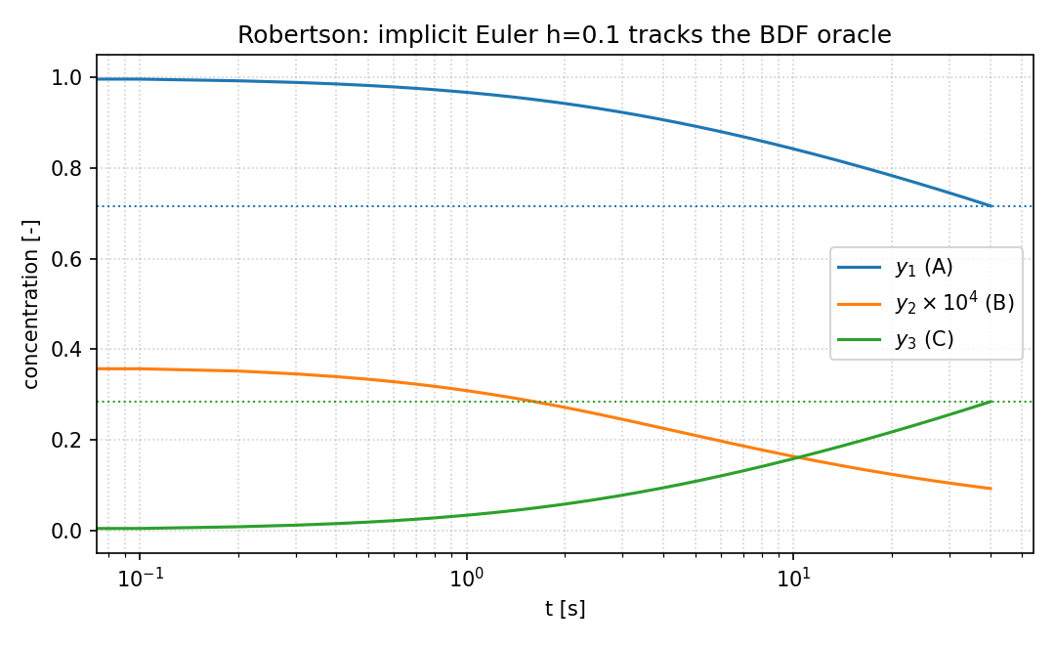
The problem
Robertson 1966 · stiff chemical kinetics on [0, 40]
y(0) = (1, 0, 0), three species A, B, C.
Rates span eight orders: 0.04 vs 10^4 vs 3×10^7.
Mass is an invariant: y1 + y2 + y3 = 1.
J_f always has a structural zero eigenvalue.
Stiffness from the two nonzero eigenvalues:
S(40) = 1.58×10^5, λ_fast ≈ −3.39×10^3.
Question: can implicit Euler be trusted here,
and is adaptivity cheaper at the same error?
Implicit Euler, h = 0.1, tracks the slow drift.
Takeaway | This is a stability problem, not a missing-order problem.
Project 1 | Robertson kinetics | Chuyang Wang 2363591
2 / 11

Slide 3
Three one-step methods + Newton
I implemented the time-steppers; SciPy BDF/Radau is only the oracle.
Explicit Euler: y_{n+1} = y_n + h f(t_n, y_n). Order 1. R(z) = 1 + z.
Classical RK4: four stages. Order 4. Bounded stability region.
Implicit Euler: y_{n+1} = y_n + h f(t_{n+1}, y_{n+1}). Order 1, A-stable and L-stable. R(z) = 1/(1−z).
Newton solves F(w) = w − y_n − h f(t_{n+1}, w) = 0, with J_F = I − h J_f, stop at ||F||_∞ < 10^{−12}.
Adaptivity: step-doubling. Accept y_fine if e = ||y_fine − y_coarse||_∞ ≤ tol; else halve h.
First Robertson step: residual rises 4×10^{−3} → 48 before quadratic decay. That is y2(0)=0, not a wrong Jacobian.
Takeaway | A-stability, a small Newton residual, and accuracy are three different claims.
Project 1 | Robertson kinetics | Chuyang Wang 2363591
3 / 11

Slide 4
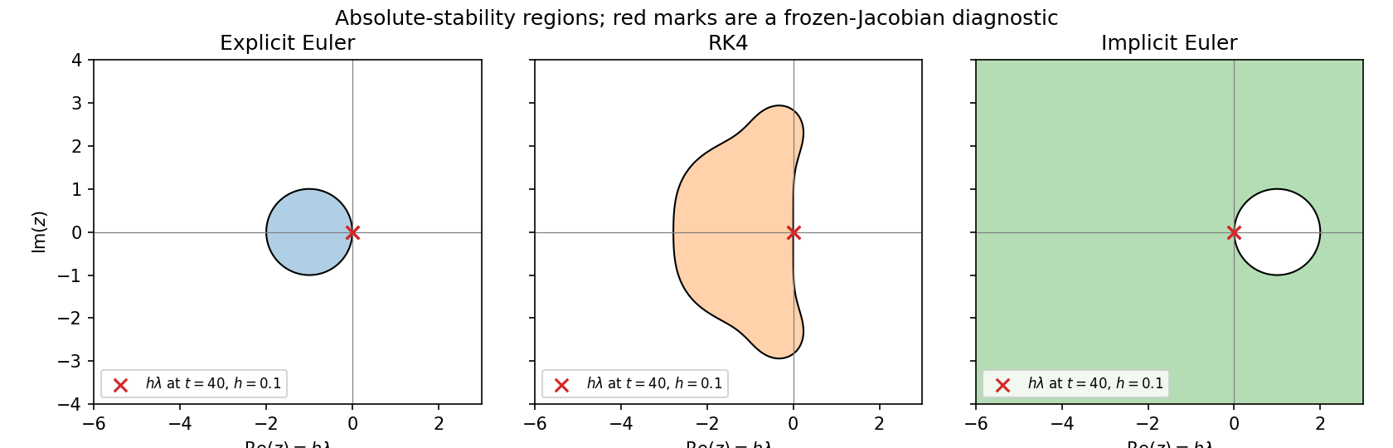
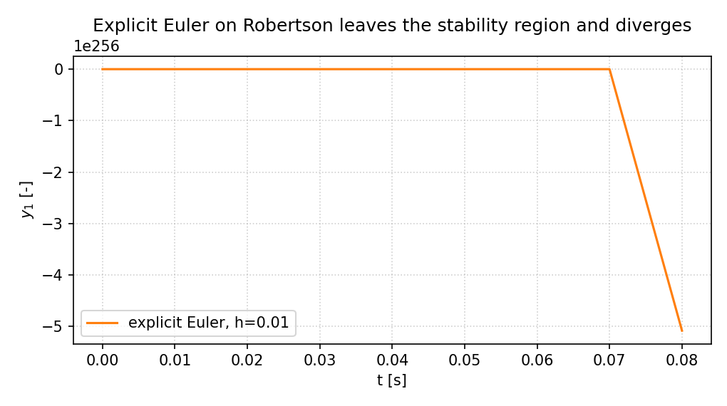
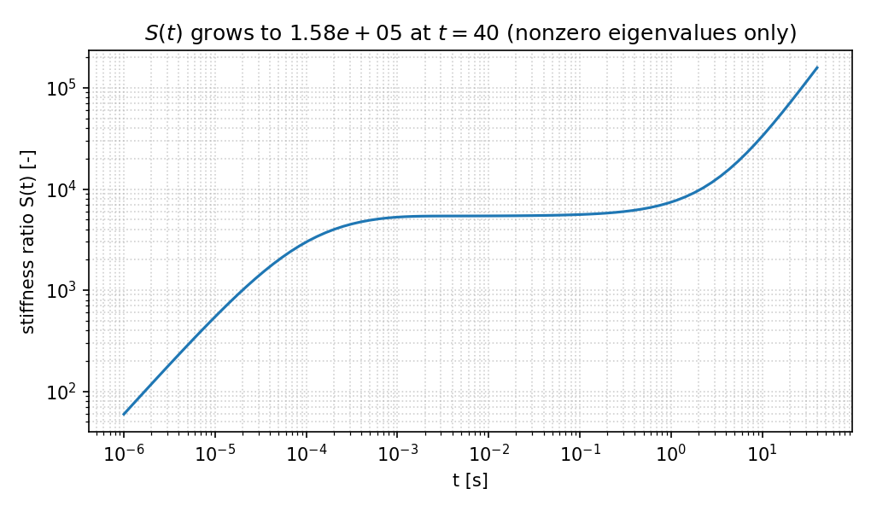
Stability: prediction, then the experiment
hλ overlay is a frozen-Jacobian diagnostic, not a nonlinear proof.
Explicit Euler needs h < 5.90×10^{−4}.
h = 0.01 already blows up (NaN).
Working implicit step h = 0.1 puts
the fast mode at z ≈ −339, inside IE,
far outside both explicit regions.
Takeaway | Divergence at h = 0.01 is a stability failure. The true solution stays on the mass simplex.
Project 1 | Robertson kinetics | Chuyang Wang 2363591
4 / 11

Slide 5
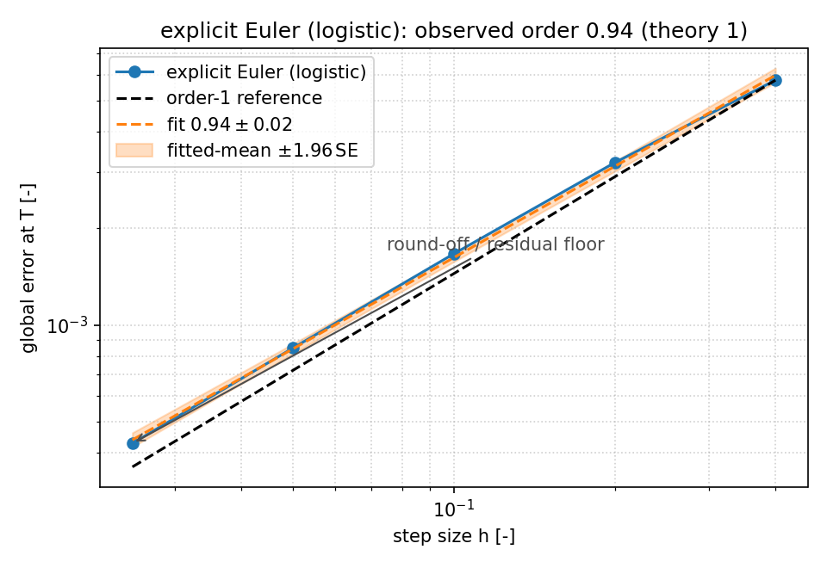
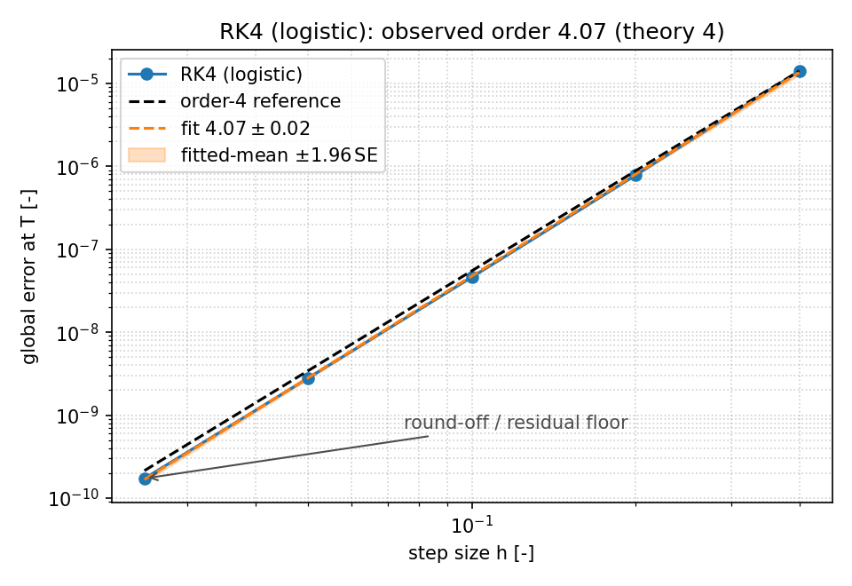
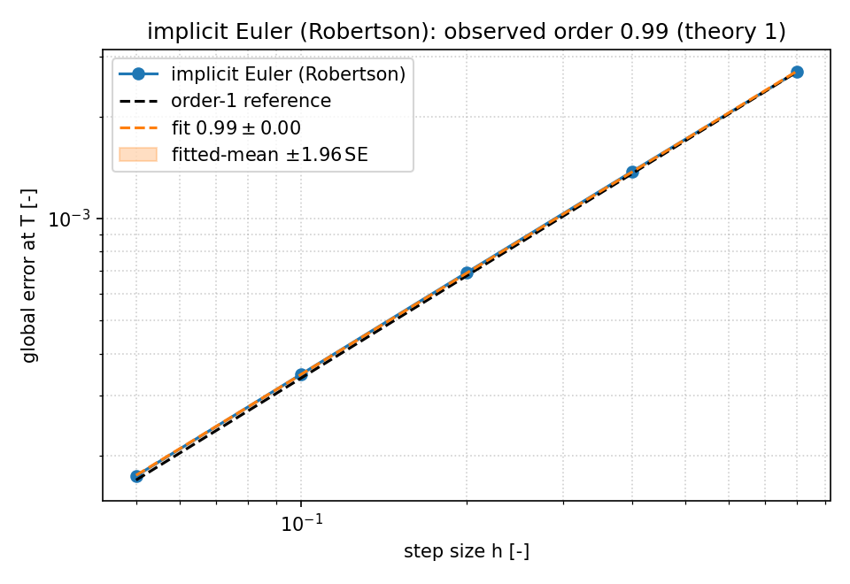
Orders against an oracle I built
p ± SE is one standard error, not a 95% CI for p.
Logistic (exact): Euler 0.943 ± 0.015 (theory 1), RK4 4.075 ± 0.018 (theory 4).
Robertson vs BDF/Radau oracle: implicit Euler 0.990 ± 0.002. |BDF − Radau|_∞ = 1.4×10^{−11}.
At h = 0.1, componentwise relative errors are all < 1%.
Takeaway | Observed slopes match theory once h is in the asymptotic regime.
Project 1 | Robertson kinetics | Chuyang Wang 2363591
5 / 11

Slide 6
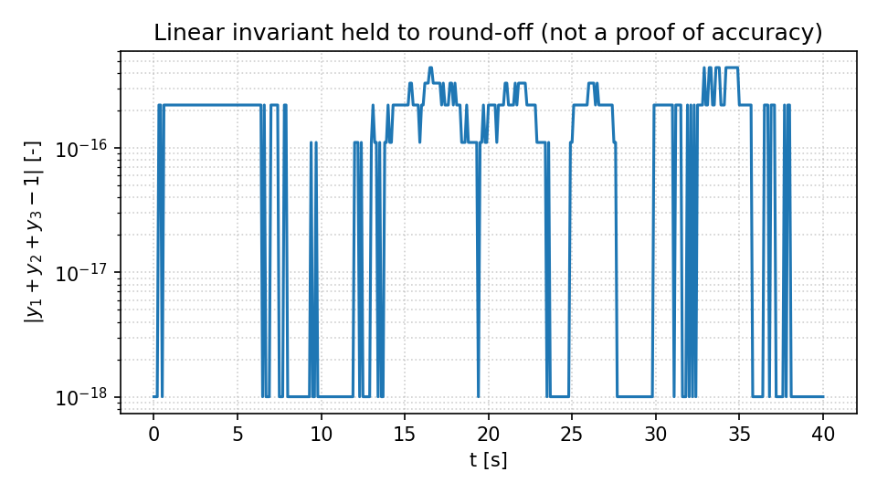
Conservation, positivity, and E(h) are separate
An inaccurate or even negative vector can still sum to one.
Mass defect at h = 0.1: 4.4×10^{−16} (round-off).
After t = 0, min y2 stays positive for every tabulated h, including h = 10.
Clip / reject never fired. Observation, not a positivity theorem.
Newton sweep at fixed h = 0.1:
||y(40; 10^{−8}) − y(40; 10^{−12})||_∞ = 2.21×10^{−7}.
Time-discretisation error E(0.1) = 3.48×10^{−4}.
Iteration error is ~ 6×10^{−4} of the discrete error.
Takeaway | Accuracy is the oracle comparison E(h), not mass, not ||F||, not y2 ≥ 0.
Project 1 | Robertson kinetics | Chuyang Wang 2363591
6 / 11

Slide 7
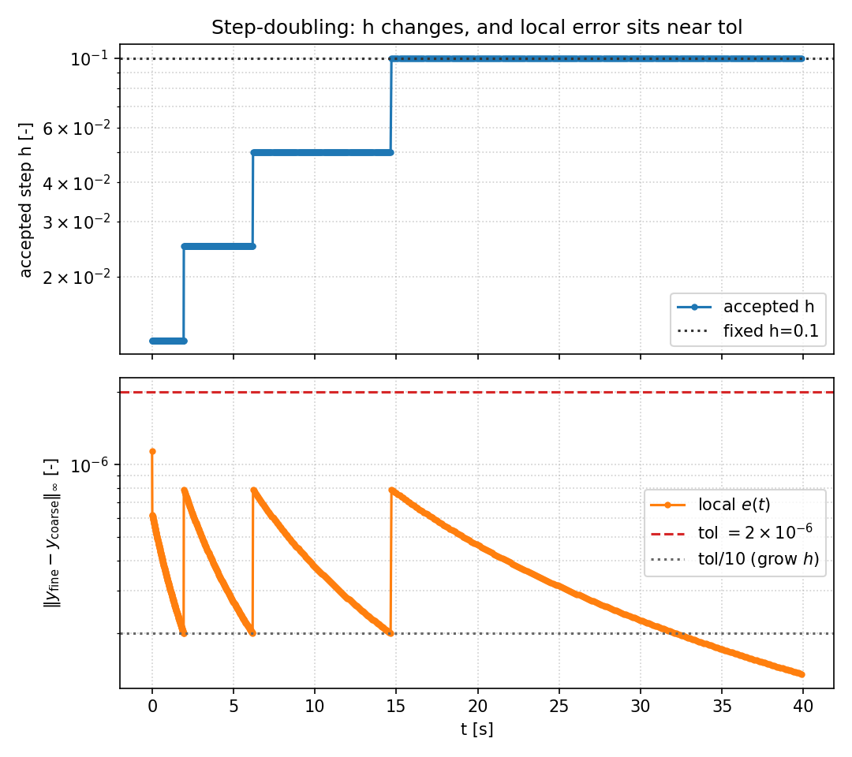
Adaptivity: h changes, and e(t) sits near tol
h0 = 0.1, tol = 2×10^{−6}, step-doubling.
749 accepted steps.
3 rejected steps.
h shrinks to 1.25×10^{−2}, then grows back to h0.
max local e = 1.13×10^{−6} < tol.
89% of accepted e in [tol/10, tol].
Terminal e_∞ = 8.90×10^{−5},
smaller than fixed h = 0.1.
Takeaway | A relabelled fixed grid would not produce this h(t), and the estimator tracks the tolerance.
Project 1 | Robertson kinetics | Chuyang Wang 2363591
7 / 11

Slide 8
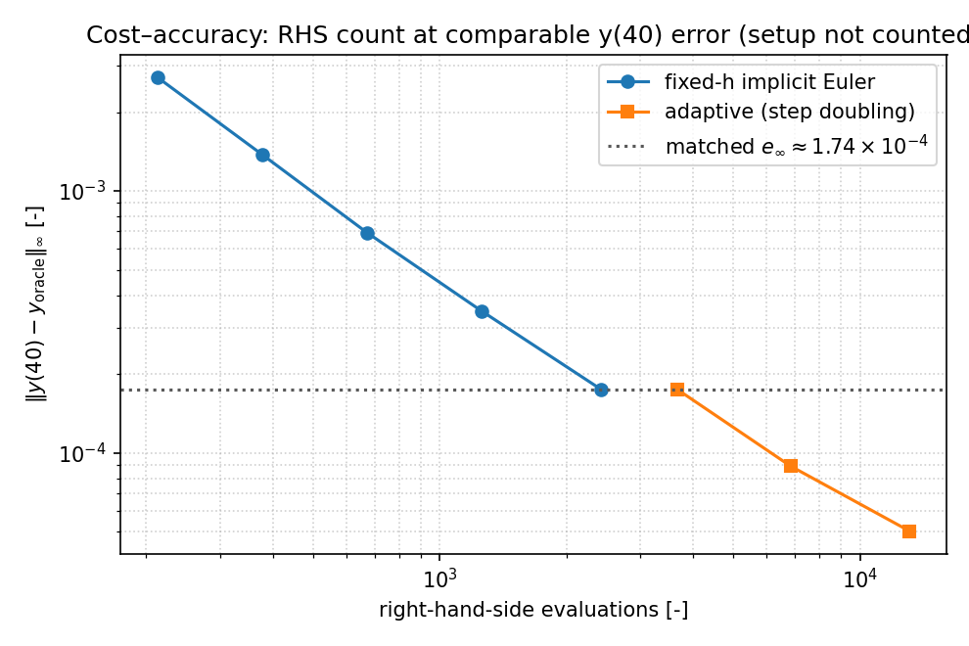
Cost–accuracy at a matched y(40) error
Cost = RHS evaluations during Newton. Jacobian factorisation is not counted.
Fixed h = 0.05: e_∞ = 1.74×10^{−4} with 2424 RHS.
Adaptive tol = 5×10^{−5}: same error, 3680 RHS.
Each accepted adaptive step costs three implicit Euler solves.
Step-doubling is a reliability tool, not a cheaper integrator, once a good fixed h is known.
I report this because the measurement went that way.
Takeaway | At matched accuracy, adaptive step-doubling spent more RHS evaluations than a tuned fixed step.
Project 1 | Robertson kinetics | Chuyang Wang 2363591
8 / 11

Slide 9
What I trust, and what I do not
Limitations stated in the same sentence as the claim.
Trust: orders vs logistic exact + tightened BDF/Radau oracle; explicit blow-up matches 2/|λ|_max; Newton error ≪ E(h).
Do not treat hλ overlays as a nonlinear stability theorem. J_f varies; the overlay is local.
Do not treat clip/reject as a positivity-preserving scheme. They never fired; there is no convergence guarantee.
Step-doubling assumes a smooth O(h^2) error expansion. Fine here; would fail on a non-smooth right-hand side.
I did not implement a positivity-preserving high-order method or an embedded implicit pair.
Takeaway | The evidence for accuracy is the refined oracle, not A-stability or a conserved sum.
Project 1 | Robertson kinetics | Chuyang Wang 2363591
9 / 11

Slide 10
Conclusions
Implicit Euler + analytic Newton Jacobian solves Robertson on [0, 40] with observed order 0.990 ± 0.002.
Explicit Euler at h = 0.01 diverges, as the frozen-Jacobian bound predicted.
Mass, positivity, and E(h) answer different questions; I reported all three.
Adaptive stepping really moves h, and local error stays near tol — but it is more expensive in RHS counts.
Reproducible: python code/run_all.py; git history is iterative, submitted with the code zip.
Takeaway | A stable first-order method is the right tool here; adaptivity bought reliability, not cheaper work.
Project 1 | Robertson kinetics | Chuyang Wang 2363591
10 / 11

Slide 11
Backup: numbers I may be asked
Viva / Q&A
Oracle y(40) ≈ (0.715827, 9.186×10^{−6}, 0.284164). Implicit Euler h=0.1: relative errors 0.049%, 0.147%, 0.122%.
Newton first-step ||F||_∞: 4.00×10^{−3}, 47.6, 11.9, …, 5.55×10^{−17} (12 iterations).
Jacobian FD check: max |J_an − J_FD| = 3.2×10^{−12}; every column of J_f sums to 0.
Table 2 min_{t>0} y2 at h = 0.8 … 0.05: all ~ 9.2×10^{−6} > 0.
Adaptive vs fixed at matched e_∞ ≈ 1.74×10^{−4}: 3680 RHS vs 2424 RHS.
SciPy Radau in the oracle is 3-stage Radau IIA (order 5). I did not implement it as a method under test.
Project 1 | Robertson kinetics | Chuyang Wang 2363591
11 / 11

