Slide 1
Project 2 · PDE BVP · 10 min + 3 min Q&A
Numerical Solution of a
Variable-Diffusion Elliptic BVP
READ | Direction 3 from the problem pack: steady heat conduction, -div(a grad u)=f on the unit square. I discretise with a conservative face-averaged five-point FDM, not FEM. Smooth manufactured P4 is second order. On a jump a=1|10, the harmonic face mean is nodally exact; the arithmetic mean keeps a symmetric M-matrix but the flux is wrong. Cost is CG iterations versus one sparse factorisation; at n=31 there is no runtime crossover with spsolve.
Start on the next slide. Do not introduce name or ID.

Slide 2
Why this problem
Problem pack Direction 3 · FDM path · not a curved-disk Poisson
READ | A layered composite is the model in which conductivity a(x,y) can jump. The physically correct operator is divergence form: normal flux a du/dn is continuous. Expanding a Delta u + grad a · grad u is the wrong starting point once a is discontinuous — it loses conservation, symmetry, and the M-matrix sign pattern.
Domain Omega = (0,1)^2, Dirichlet on the whole boundary (Gamma_N empty).
PDE: -div(a grad u) = f in Omega, u = g on dOmega, a_min > 0.
I chose Direction 3 so the Tutorial 5 five-point machinery stays intact, while the jump forces a modelling choice (harmonic vs arithmetic faces) that smooth Poisson never sees.
Method: FDM only as the project method. scikit-fem P1 is an independent oracle, not a second scheme under test.
Story of this talk: stencil and Dirichlet shift → P4 order 2 → algebraic vs discretisation → harmonic vs arithmetic → cost.
Takeaway | The brief asked for a real elliptic BVP with evidence. The jump is the numerical content, not decoration.
Project 2 | Variable-diffusion elliptic BVP | Chuyang Wang 2363591
2 / 12

Slide 3
Two benchmarks, one operator
Smooth P4 checks order · layered jump checks flux
READ | P4: a=1+x, u*=sin(pi x)sin(pi y), g=0. The extra -pi cos(pi x)sin(pi y) in f is grad a · grad u* — a constant-coefficient Laplacian cannot capture it. Layered: a=1 for x<1/2 and a=10 for x>1/2, f=0, g=u*. Exact profile is piecewise linear, u*(0)=0, u*(1)=1, flux a u_x* = 20/11 continuous.
P4 regularity: u in C^4, a in C^2 → theory says order 2 in discrete L2 and L-infinity.
Layered regularity: u* is only Lipschitz, a not C^2 → the order-2 theorem does not apply.
Well-posed: uniform ellipticity + nonempty Dirichlet boundary; no compatibility condition.
Expected signs: layered u* in [0,1] with extrema on the boundary (maximum principle).
Discrete L2 means h ||U||_2. L-infinity is the max nodal |error|. Residual ||b-AU||_infinity is algebraic, not discretisation.
Takeaway | P4 answers “is the stencil second order?”. The jump answers “does symmetry imply correct physics?”.
Project 2 | Variable-diffusion elliptic BVP | Chuyang Wang 2363591
3 / 12

Slide 4
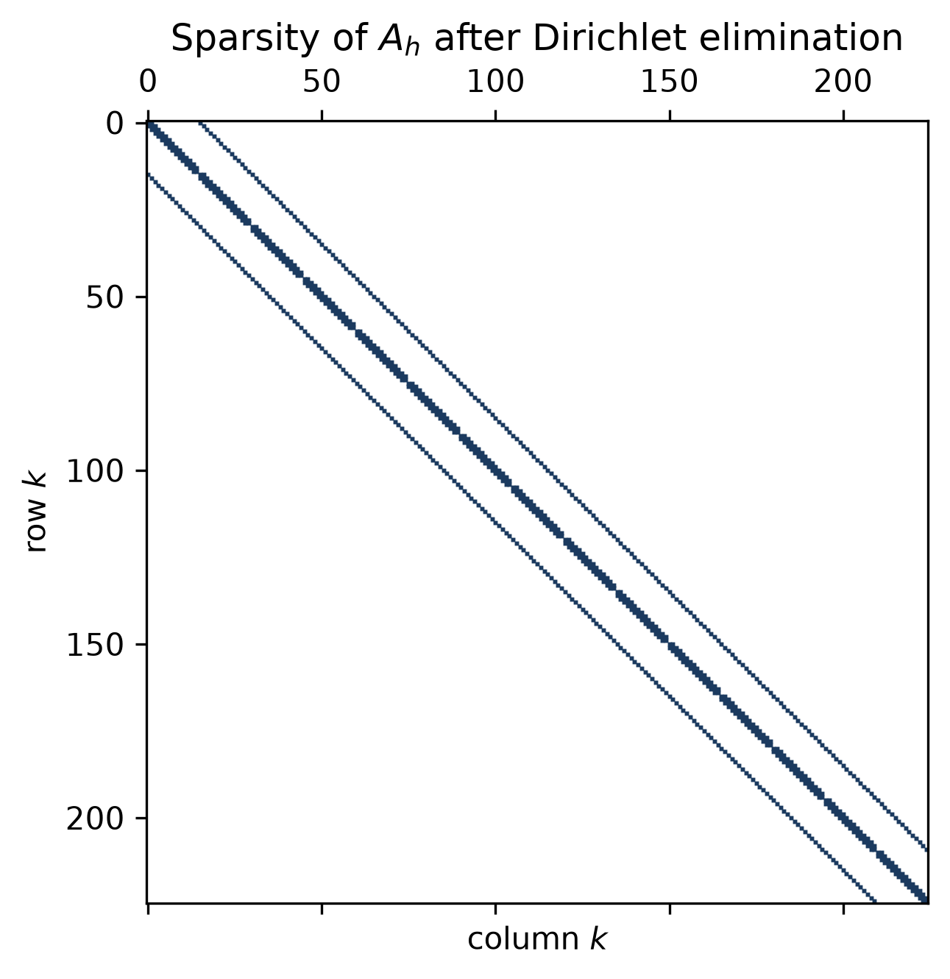
Discretisation: shared faces, Dirichlet in b
n interior nodes/direction, h=1/(n+1), k=i n+j
READ | Conservative five-point: (A_h U)_ij = h^{-2} [ a_E(U-U_E)+a_W(U-U_W)+a_N(U-U_N)+a_S(U-U_S) ]. The east coefficient of (i,j) is the west coefficient of (i+1,j). That sharing, not the particular average, makes A_h symmetric after elimination. Boundary nodes are not unknowns: b_k += a_face g / h^2. Replacing a Dirichlet row by e_k and leaving the column destroys symmetry.
Smooth a: evaluate at the half-point. For a=1+x this is second-order.
Jump: harmonic (resistance) mean 2 a_L a_R/(a_L+a_R).
Why harmonic: integrate u_x=q/a across two half-edges → series resistors.
Arithmetic (a_L+a_R)/2 is a different resistance unless a_L=a_R.
Odd interval counts so x=1/2 bisects a grid edge.
Spy (n=15, 225×225): five-point bandwidth after Dirichlet elimination.
Energy: U^T A U = sum_faces a_face (delta U)^2 / h^2 ≥ a_min |U|_{H^1_h}^2.
Takeaway | Symmetry comes from shared faces. Harmonic averaging is forced by flux continuity, not by taste.
Project 2 | Variable-diffusion elliptic BVP | Chuyang Wang 2363591
4 / 12

Slide 5
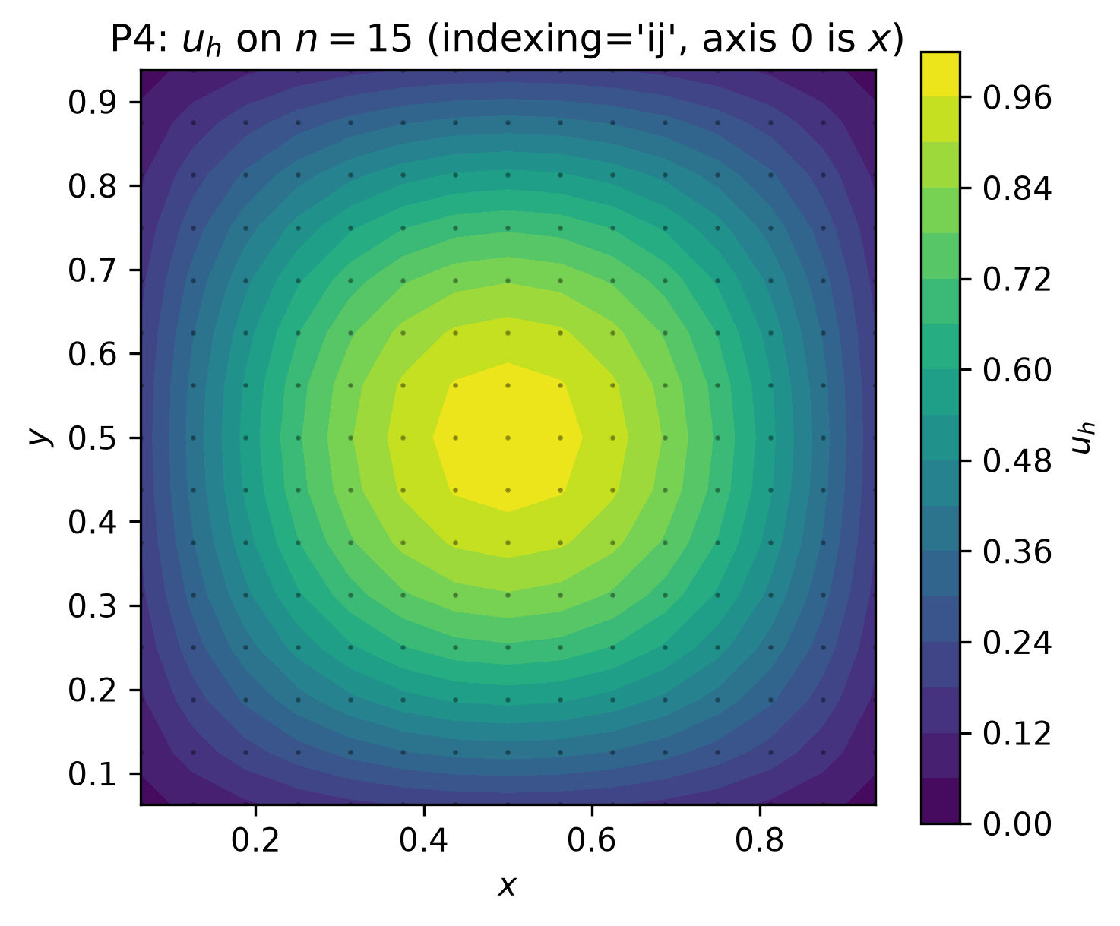
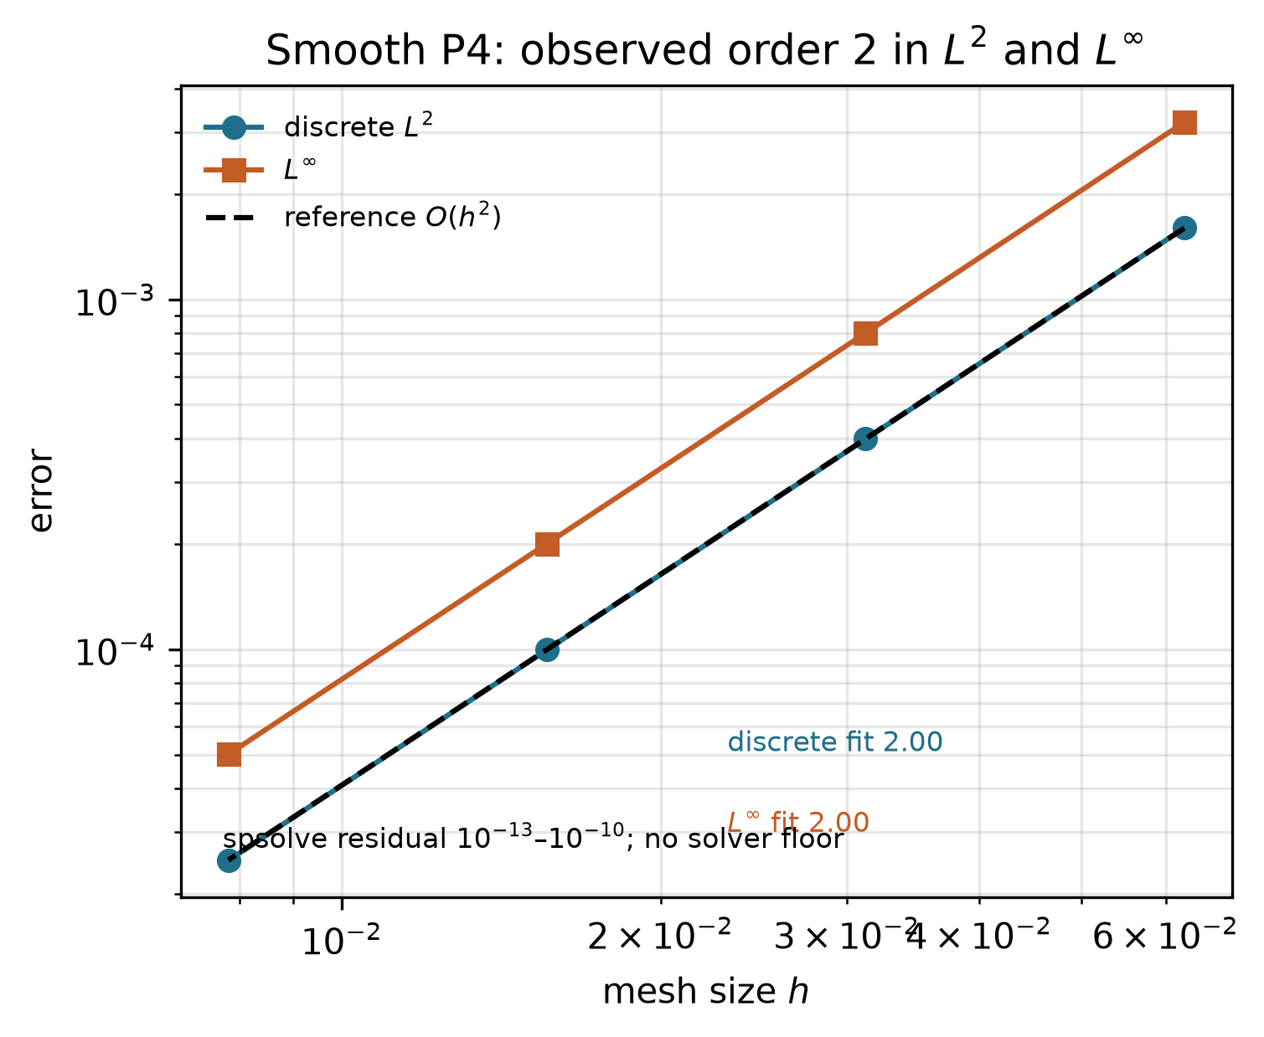
Verification: P4 manufactured solution
Named norms · four meshes · no round-off floor
READ | n=15,31,63,127. Discrete L2 and L-infinity both fit order 2.00 (SE of the fit < 10^{-3}). P5 centre u_h(0.5,0.5)=1.652 checks the Dirichlet sign. P2 (quadratic) is exact to 3.3×10^{-16}. A 2D P1 FEM oracle on different triangles is only an order-of-magnitude cross-check, not a digit match.
Contour: indexing='ij', axis 0 is x; nodes plotted.
n=15 L2=1.598e-3.
n=31 L2=3.988e-4, p=2.00.
n=127 L2=2.491e-5, p=2.00.
Truncation quarters each doubling.
||A-A^T||_max = 0, λ_min=28.61.
Takeaway | On smooth data the face-averaged stencil is second order in both named norms.
Project 2 | Variable-diffusion elliptic BVP | Chuyang Wang 2363591
5 / 12

Slide 6
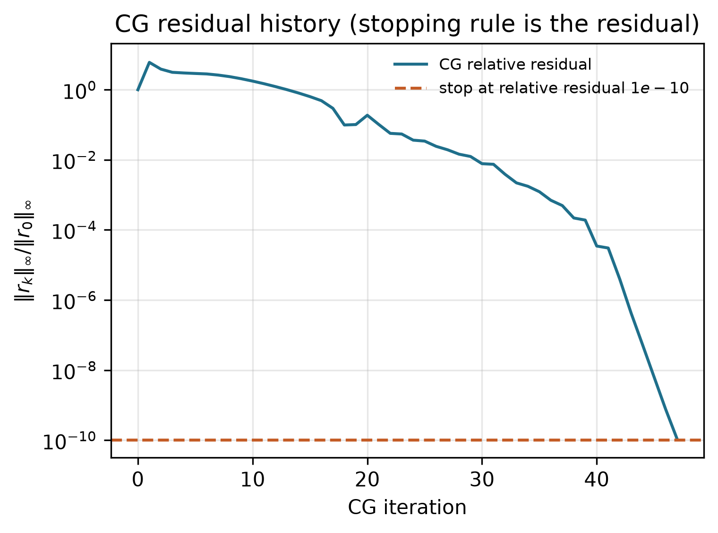
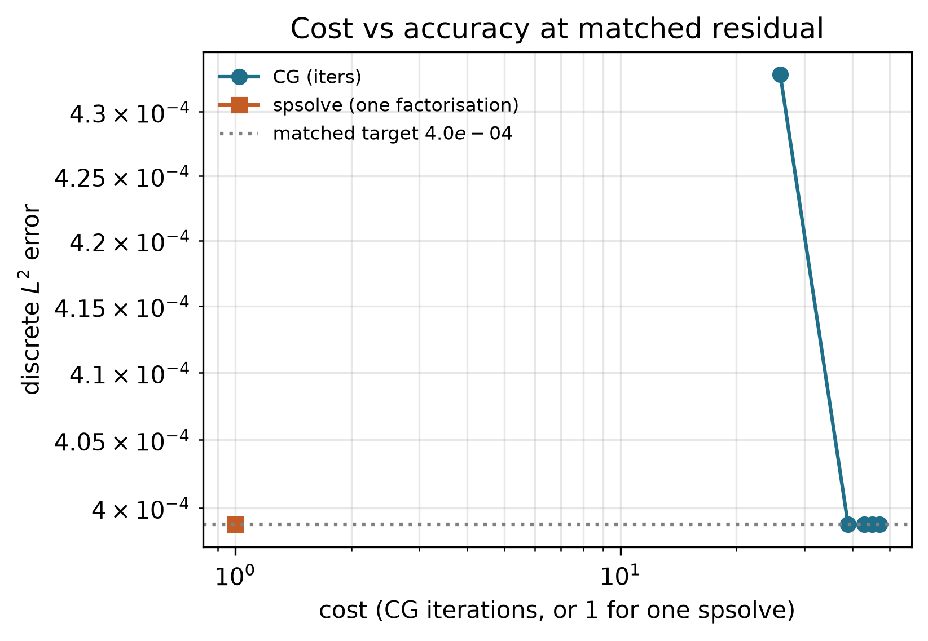
Algebraic error is not discretisation error
Stop CG on the residual, never on ||x^{k+1}-x^k||
READ | spsolve has no tolerance: treat it as the exact discrete solution and report ||b-Au||_∞. On P4, n=31 that residual is 3×10^{-12} while discrete L2 is 3.99×10^{-4}. CG at relative 10^{-2} still sits above the direct L2; from 10^{-4} the L2 locks. Tightening further does not change the reported order.
Takeaway | Relative residual 10^{-4} is the loosest CG stop that reproduces the direct L2. The slope is discretisation.
Project 2 | Variable-diffusion elliptic BVP | Chuyang Wang 2363591
6 / 12

Slide 7
Cost: CG iterations vs one factorisation
Matched target = spsolve L2 = 3.988×10^{-4} on n=31
READ | Cost named first: CG iteration count to a stated relative residual, versus one sparse factorisation. Not counted: assembly, eigsh, plotting. At this mesh both finishes are about 2 ms — a negative result for unpreconditioned CG. On the finest P4 mesh n=127, dropping CG from 10^{-3} to 10^{-4} (one order) locks L2 onto 2.491×10^{-5}.
CG rel. 10^{-2}: 26 iters, residual 7.5×10^{-1}, L2=4.329×10^{-4} (still algebraic contamination).
CG rel. 10^{-4}: 39 iters, residual 5.9×10^{-3}, L2=3.988×10^{-4} (matches spsolve).
CG rel. 10^{-6} … 10^{-10}: L2 unchanged. Floor = discretisation.
spsolve: one factorisation, residual ~10^{-12}, L2=3.988×10^{-4}, wall ≈ 2 ms.
n=127: CG 10^{-3} → L2=2.504×10^{-5}; CG 10^{-4} → L2=2.491×10^{-5} = direct.
This is not an FDM-versus-FEM cost plot. FEM is only the P4 oracle.
Takeaway | At matched discretisation accuracy there is no CG–direct crossover for n≤31.
Project 2 | Variable-diffusion elliptic BVP | Chuyang Wang 2363591
7 / 12

Slide 8
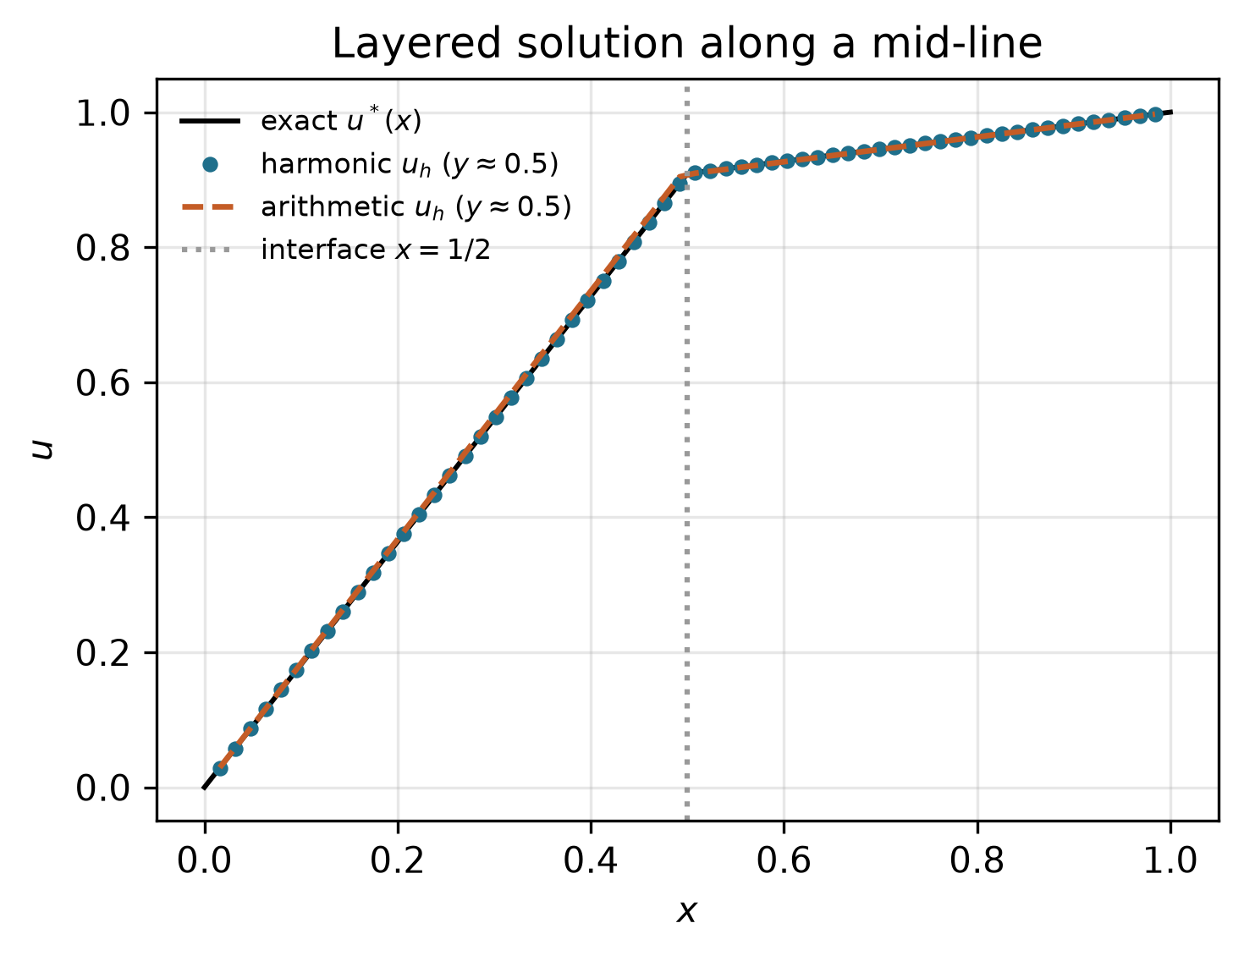
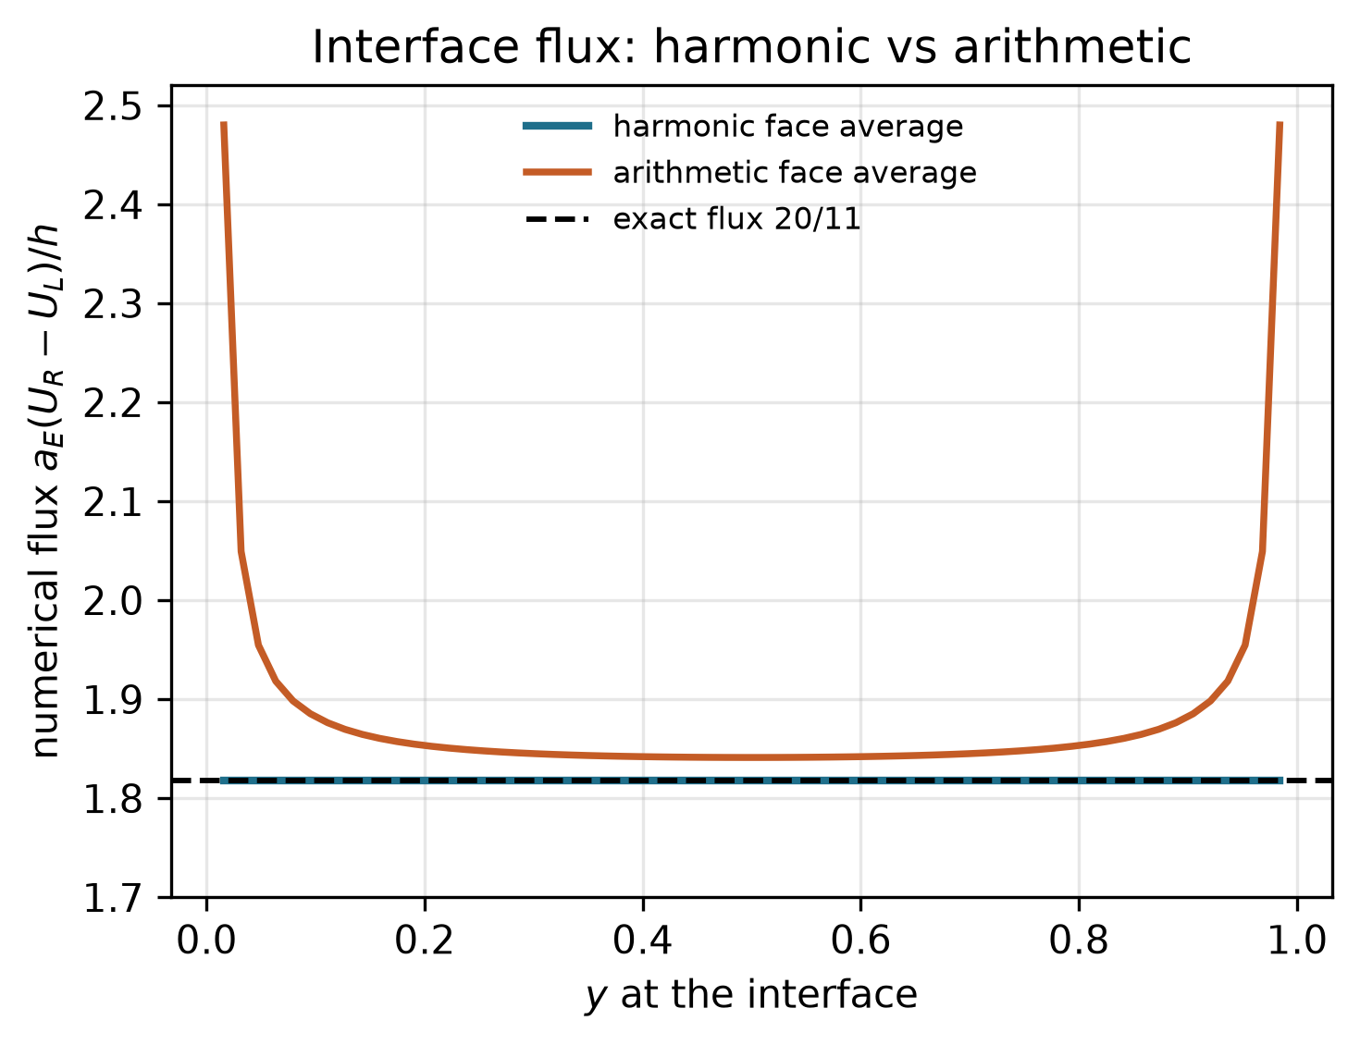
Depth comparison: harmonic vs arithmetic
Same jump, same odd-N grids, same Dirichlet data, same spsolve
READ | Hypothesis under test: any positive face average that keeps A symmetric is an acceptable interface scheme. Harmonic averaging is nodally exact (L-infinity ≤ 3×10^{-14}) and the numerical flux equals 20/11. Arithmetic averaging is still an M-matrix — and the flux jump stays 0.66 under refinement.
Takeaway | Symmetry is necessary and not sufficient. Flux continuity selects the harmonic mean.
Project 2 | Variable-diffusion elliptic BVP | Chuyang Wang 2363591
8 / 12

Slide 9
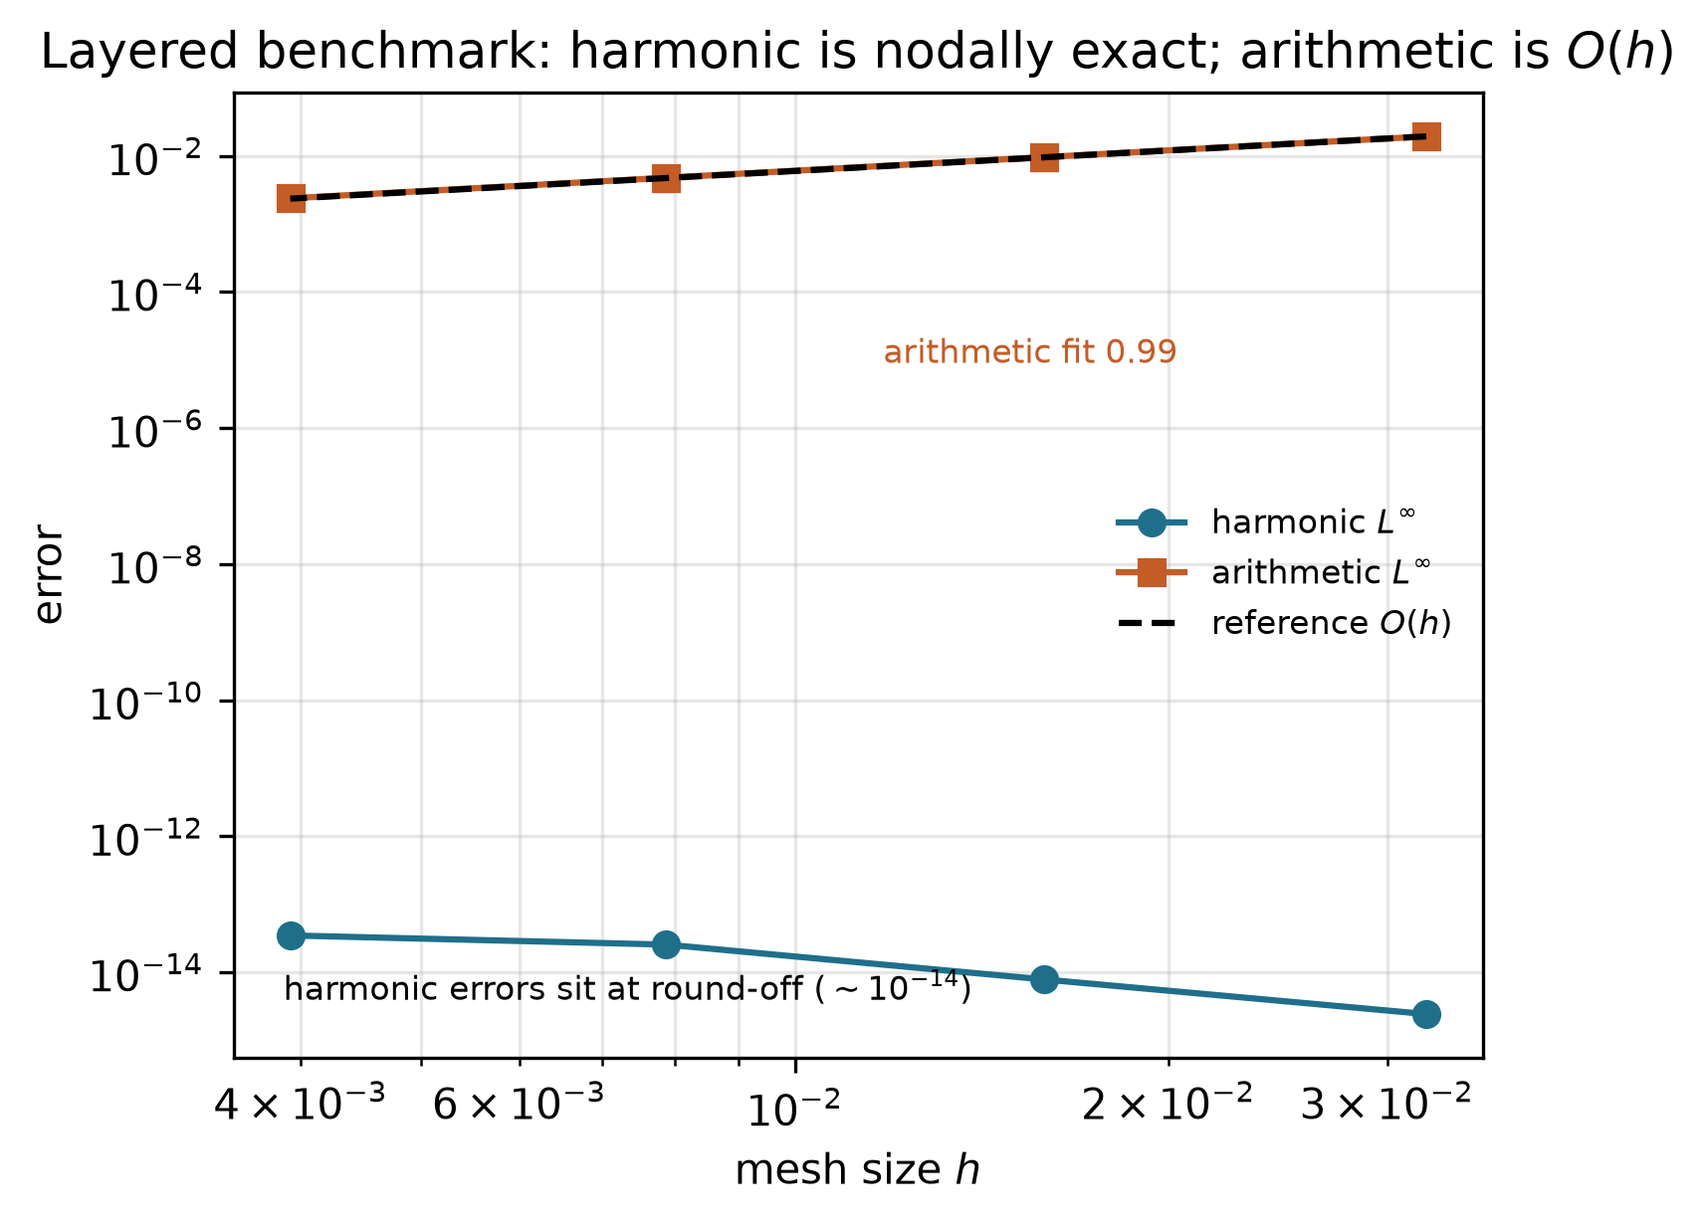
The jump predicted the order drop
Deviation from order 2 is theory, not a bug in the table
READ | On smooth P4, consistency plus M-matrix / energy stability imply order 2. Across the jump that regularity fails. Harmonic averaging restores the 1D transmission identity, so nodal error sits at round-off. Arithmetic tracks first-order L-infinity (1.94×10^{-2} down to 2.38×10^{-3} as N=31…255). Both solutions stay in [0,1]: DMP does not pick the physics.
Harmonic L-infinity ~ 10^{-14} on four meshes.
Harmonic flux jump ≤ 5×10^{-13}.
Arithmetic flux jump ≈ 0.66 = O(1), not O(h).
1D P1 FEM with x=1/2 a node: L-infinity 6.7×10^{-16}.
Two methods, neither stencil nor mesh shared, agree on nodal values.
Takeaway | A colour plot of the arithmetic solution still looks stable. The flux plot is the falsifier.
Project 2 | Variable-diffusion elliptic BVP | Chuyang Wang 2363591
9 / 12

Slide 10
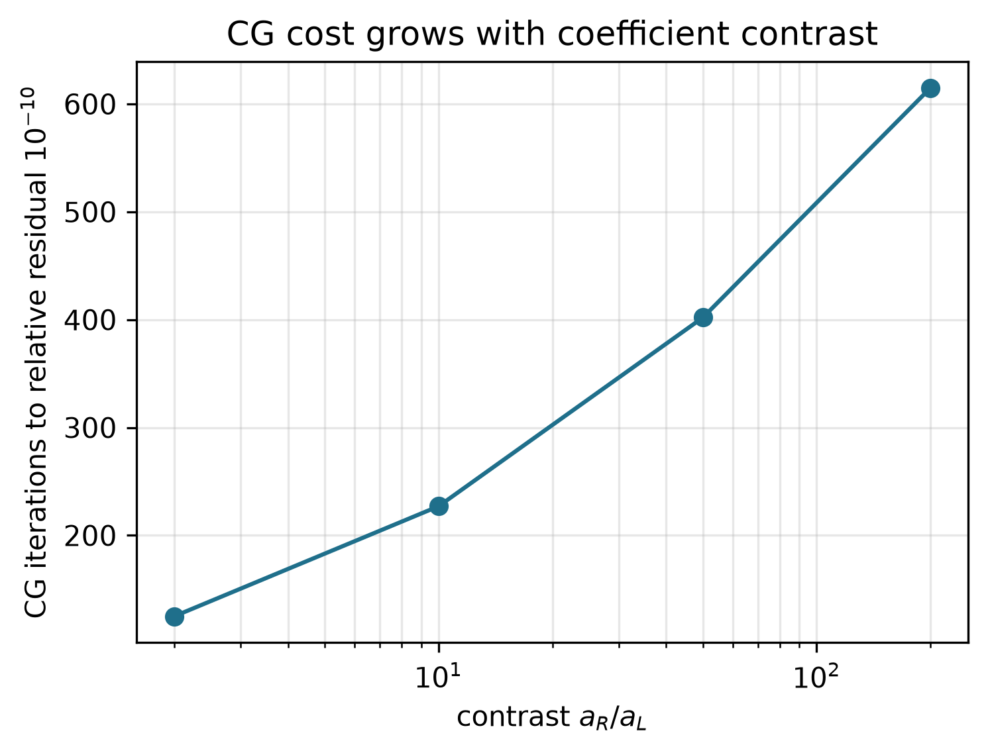
Contrast raises CG cost; it does not break DMP
Limitations are part of the grade, not an apology
READ | Layered harmonic matrix, n=30, residual stop 10^{-10}: CG iterations 125, 227, 401, 615 at contrasts 2, 10, 50, 200. On P4, kappa_2(A) tracks h^{-2}. Second-order is for smooth a. Harmonic exactness here is a 1D aligned-grid identity, not a theorem for cuts through cells. AMG-CG is the next solver, not a result of this talk.
Cost here = iterations, not wall time.
Contrast is expensive for unpreconditioned CG.
Not a reason to switch to arithmetic faces.
Not implemented: AMG on the FDM matrix.
Not implemented: 2D interface-fitted FEM beyond the P4 oracle.
Cartesian Dirichlet only; a cut-cell disk needs another boundary row.
Takeaway | Unpreconditioned CG will not be the iterative method of choice on finer 2D meshes.
Project 2 | Variable-diffusion elliptic BVP | Chuyang Wang 2363591
10 / 12

Slide 11
Conclusions (end here; backup is Q&A only)
READ | A conservative face-averaged five-point scheme for -div(a grad u), Dirichlet data in b, is second order on smooth P4. On the jump, harmonic faces are nodally exact and keep flux 20/11; arithmetic faces give first-order error and an O(1) flux jump. CG matches spsolve L2 once the relative residual is 10^{-4}; no runtime crossover at n=31. Thank you.
P4: fitted order 2.00 in discrete L2 and L-infinity on four meshes; ||A-A^T||=0; λ_min>0.
Gates: P5 centre 1.652; P2 L-infinity 3.3×10^{-16}; bank self-check 5.8×10^{-6}.
CG n=31: L2 locks at 3.988×10^{-4} from rel. 10^{-4}; spsolve residual ~10^{-12}.
Layered: harmonic L-infinity ~10^{-14}, flux 20/11; arithmetic p≈1, flux jump 0.66.
Reproduce: python code/run_all.py and python code/validation_tests.py in cyw1971/pde-bvp-variable-diffusion.
Takeaway | Trust the order on smooth data and the flux on the jump. Do not trust symmetry alone.
Project 2 | Variable-diffusion elliptic BVP | Chuyang Wang 2363591
11 / 12

Slide 12
Backup / Q&A (do not present this slide)
Q: FDM or FEM? A: Project method is FDM. FEM P1 is an oracle (P4 L2=5.18e-3 on a different mesh). No matched FDM–FEM cost table.
Q: bounded / monotone ⇒ accurate? A: No. Arithmetic is an M-matrix and stays in [0,1], but flux jump is 0.66. Accuracy is named-norm error + flux.
Q: why not pin Dirichlet rows? A: Leaves columns in place, destroys symmetry, kills CG/energy. Boundary nodes are absent from A.
Q: why odd N? A: So x=1/2 bisects an edge; harmonic mean is then exact for piecewise-constant a.
Q: residual vs iterate difference? A: Course rule. ||x^{k+1}-x^k|| can stall while ||b-Ax|| is large.
Q: is 10^{-4} residual ≪ discretisation? A: Forward L2 no longer changes. Residual 5.9e-3 is not itself the algebraic error in the solution; the locked L2 is the evidence.
Q: modelling vs discretisation vs algebraic? A: ||u-u*|| model; ||u*-A^{-1}b|| grid; ||A^{-1}b - û|| solver. Fix by better PDE / finer h / tighter tol.
Project 2 | Variable-diffusion elliptic BVP | Chuyang Wang 2363591
12 / 12

