Slide 1


Sagar Vikani 05IT025
Abhishek Sakhpariya 05IT037
Viral Munjpara 05IT009

Slide 2
Purpose
INTRANET provides cost effective and innovative services to internal to share company information, computing resources among employees, conferencing etc.
Small and medium-sized businesses can benefit most from intranets, which offer better productivity, knowledge sharing and money-saving resources.

Slide 3
Benefits
Staff members to be able to perform their tasks with the most common forms faster and more efficiently.
Reduce paper work and useless documentation.
Providing more information easily available to employees.
Providing best communication way between staff members.
Improve team work.
Increasing employees' ability to perform their jobs faster, more accurately, and with confidence

Slide 4
Business Objectives
Effective means of communication to users working in organization with audio visual capabilities.
Effective means of communication to user working in organization with audio visual capabilities.
Share resources and save them at server if necessary according to user’s group.
Bulletin board that would show latest news and announcement common to every user.
Web based email for commutation with outer network
Opinion polls, forum and canteen menu.

Slide 5
Technical Objectives
Provide internal network application based on all Internet technologies, including the Internet Protocol (IP), the World Wide Web.
System has to be up 24x7, and will be subjected to the traffic that generates as many issues of work orders, inspection.
System should have efficient and intuitive user interface so that user of all categories (from office staffers to field workers) find it easy to use
System will include a web based application product that supports text messaging, emailing, sharing etc capabilities.

Slide 6
Technology & Tools
ASP.NET 2.0
AJAX ( Asynchronous Javascript and XML)
Microsoft Visual Source Safe 2005
SQL Server 2005
Telerik RAD Controls for AJAX (Third Party Control)
Log4Net Controls ( Third Party Control)

Slide 7
List of Modules
Document Manager
Scheduler
Data Manager
Intranet Contact Manager
Opinion Polls
Intranet Import/Export
Web Based Email
Intranet Bulletin Board
Online Help
Company Memos
Intranet Application Administration
Instant messaging
Bulletin board(will cover news and announcements)

Slide 8
Sending / Receiving Documents
Grouping all users according to their designations
Providing sharing of doc on server by group(Cabinet - group and personal)
Forum
Progress Report of Employees
Timesheet/Expenses
Meeting Room/Resource Booking
Canteen Menus
Shared Links
Full Text Search(like Search Engine)
Auto Notification(by email)

Slide 9
Prepared Modules
Data Manager
Scheduler
Progress Report of Employees
Opinion Polls
Bulletin board
Intranet Based Mail

Slide 10


Slide 11
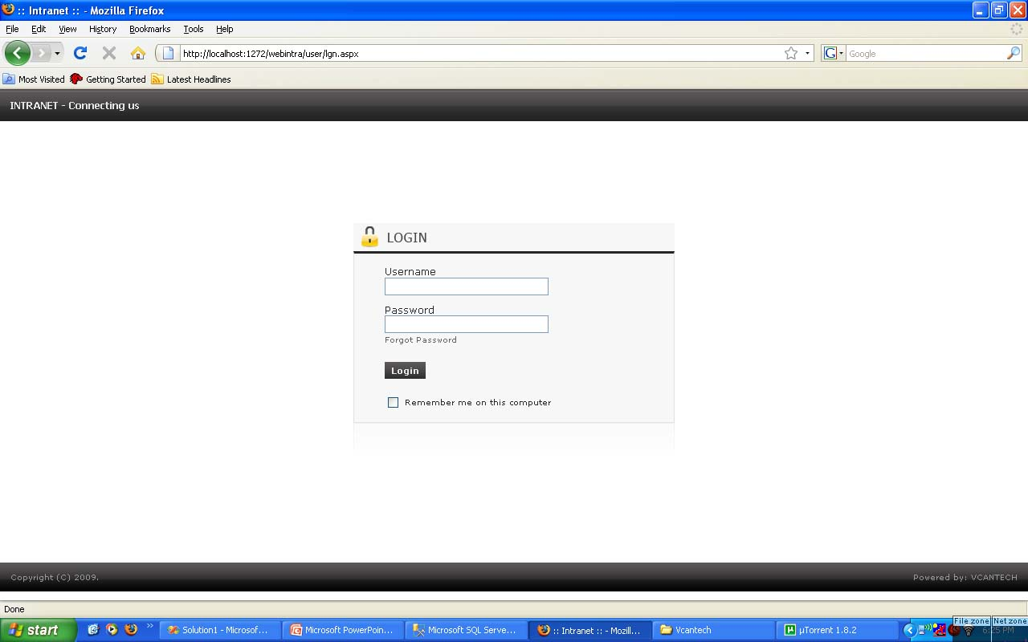

Slide 12
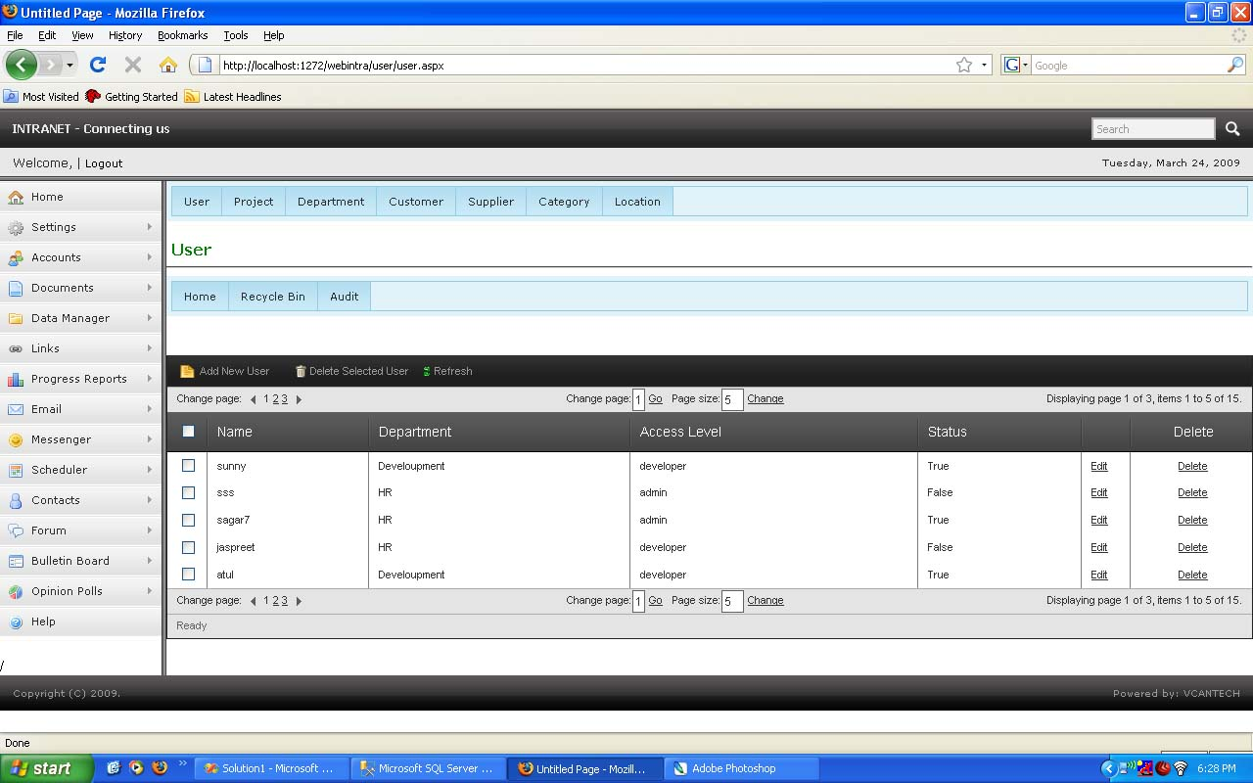

Slide 13
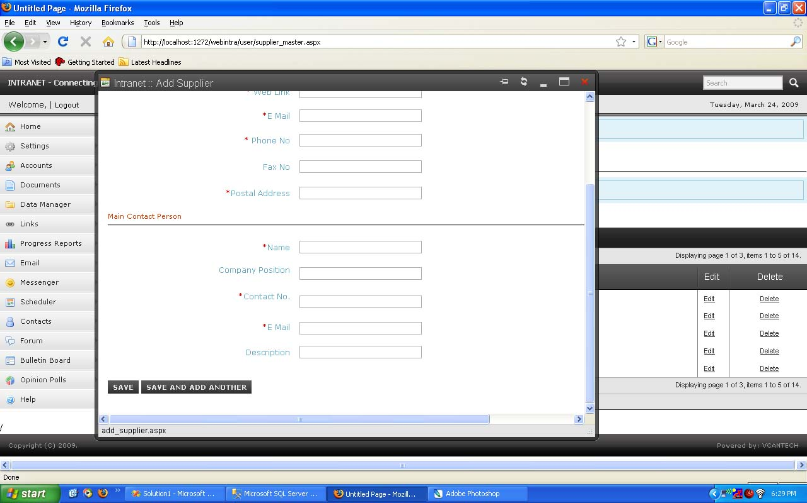

Slide 14
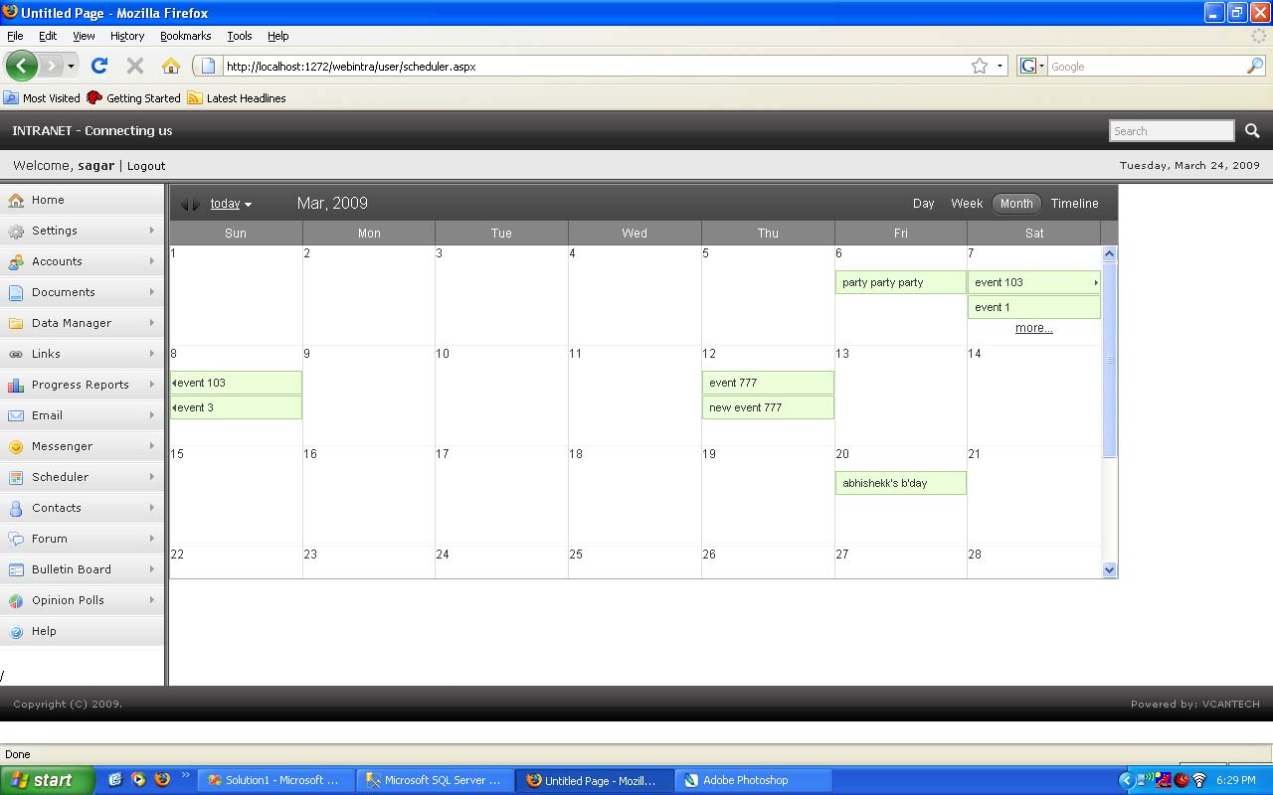

Slide 15
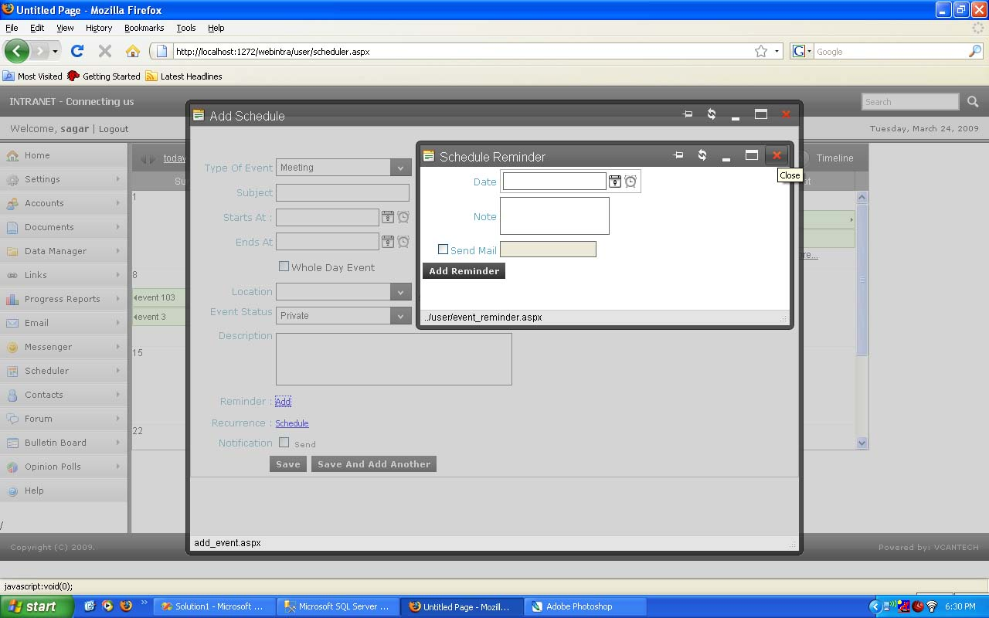

Slide 16
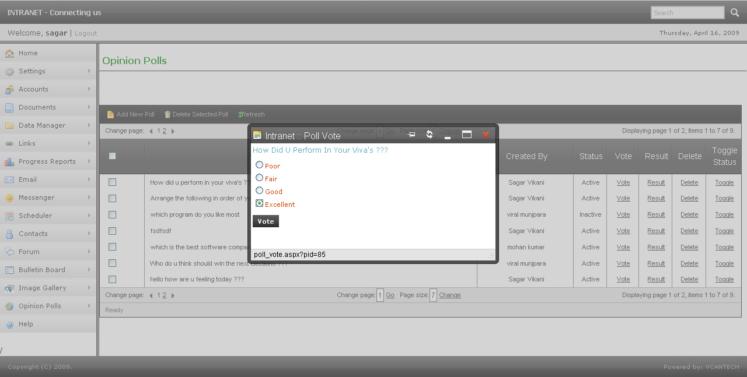

Slide 17
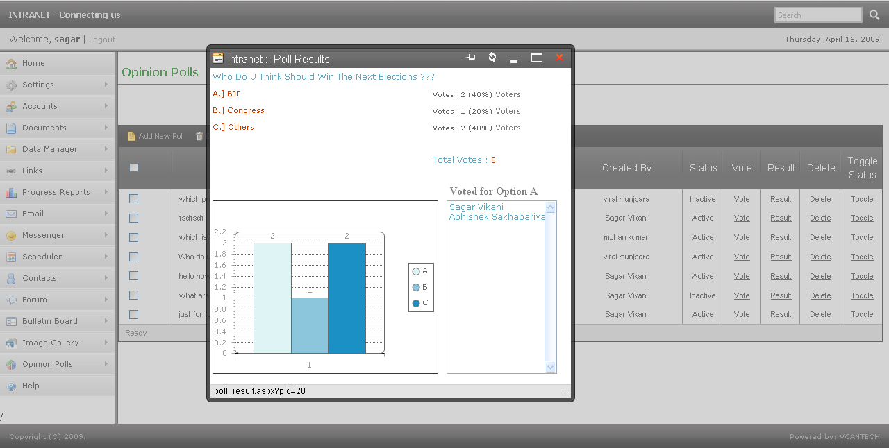

Slide 18
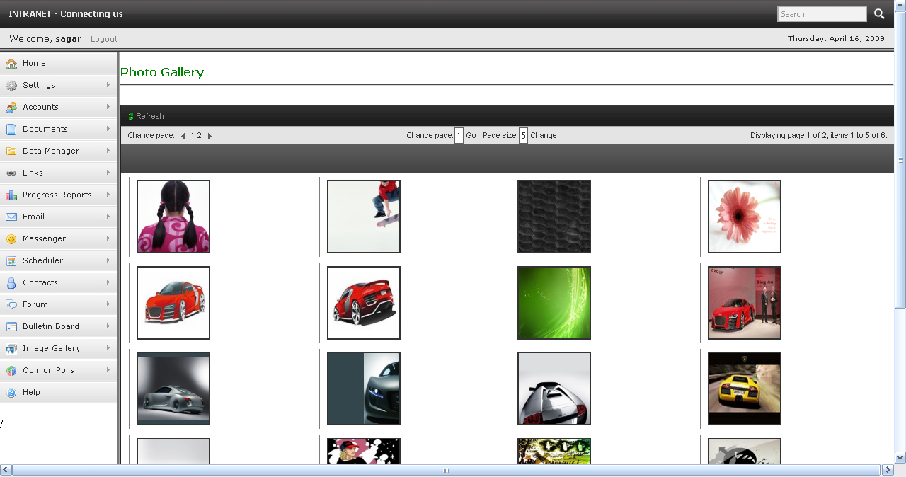

Slide 19


Slide 20
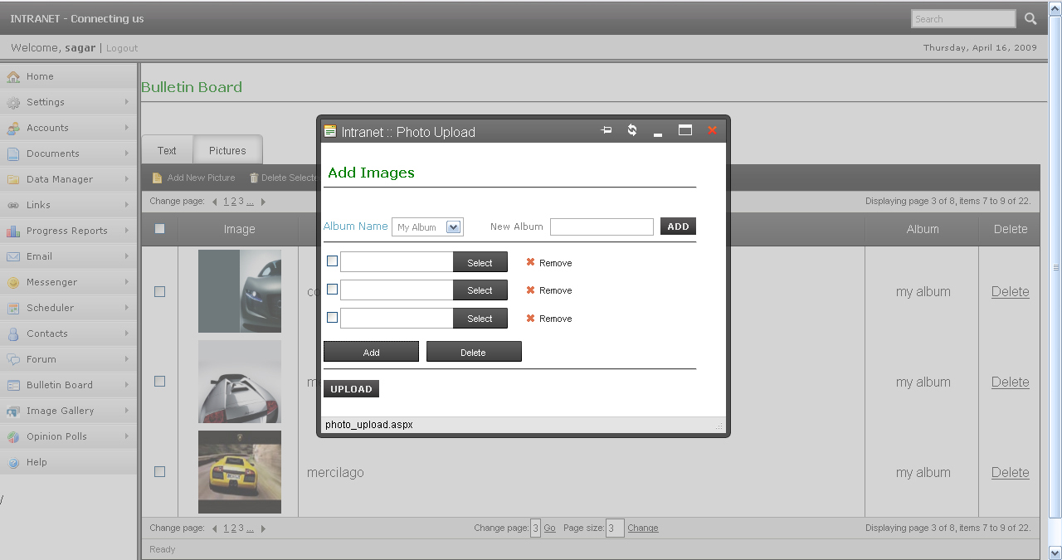

Slide 21
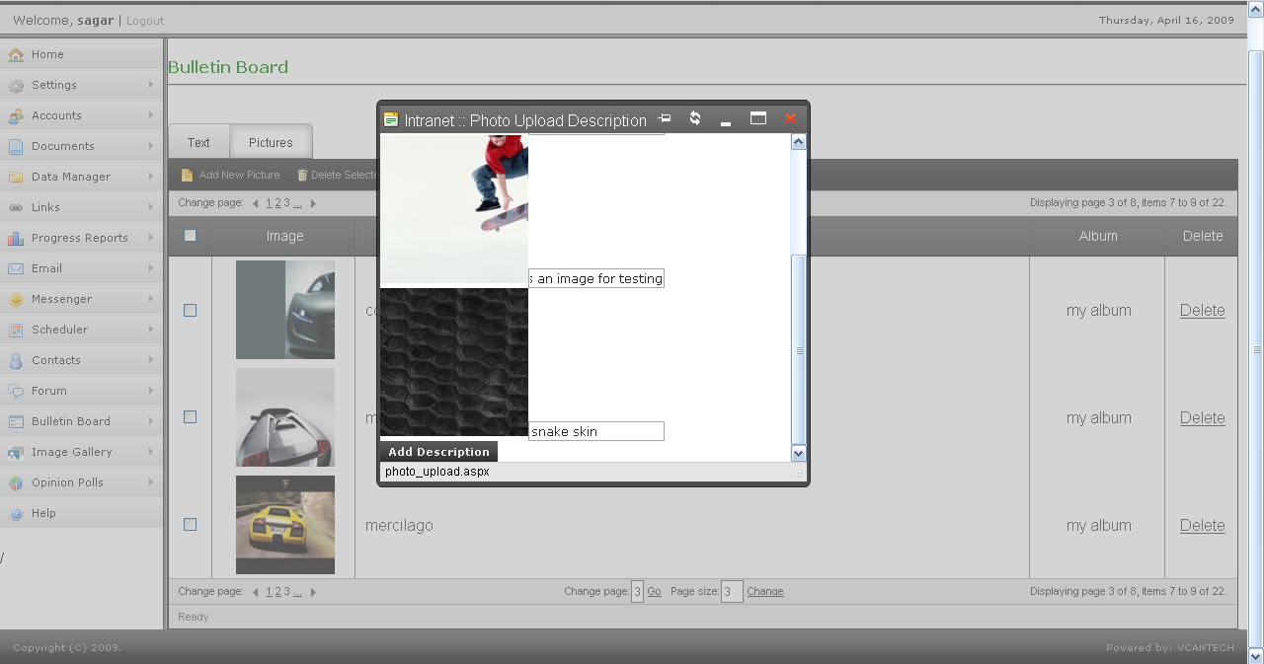

Slide 22
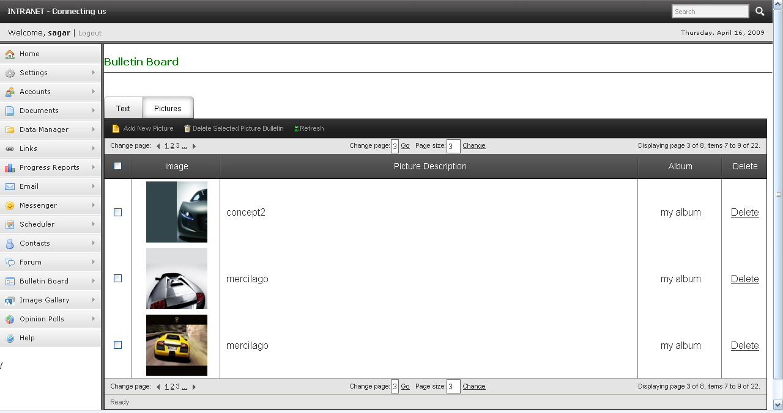

Slide 23
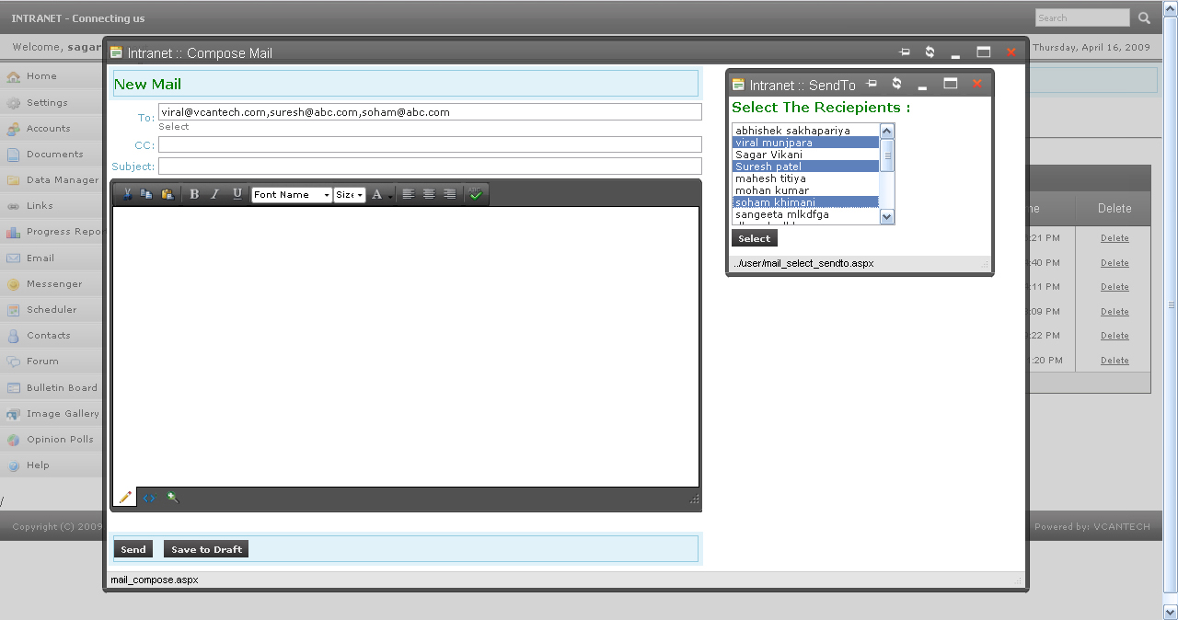

Slide 24
