Slide 1
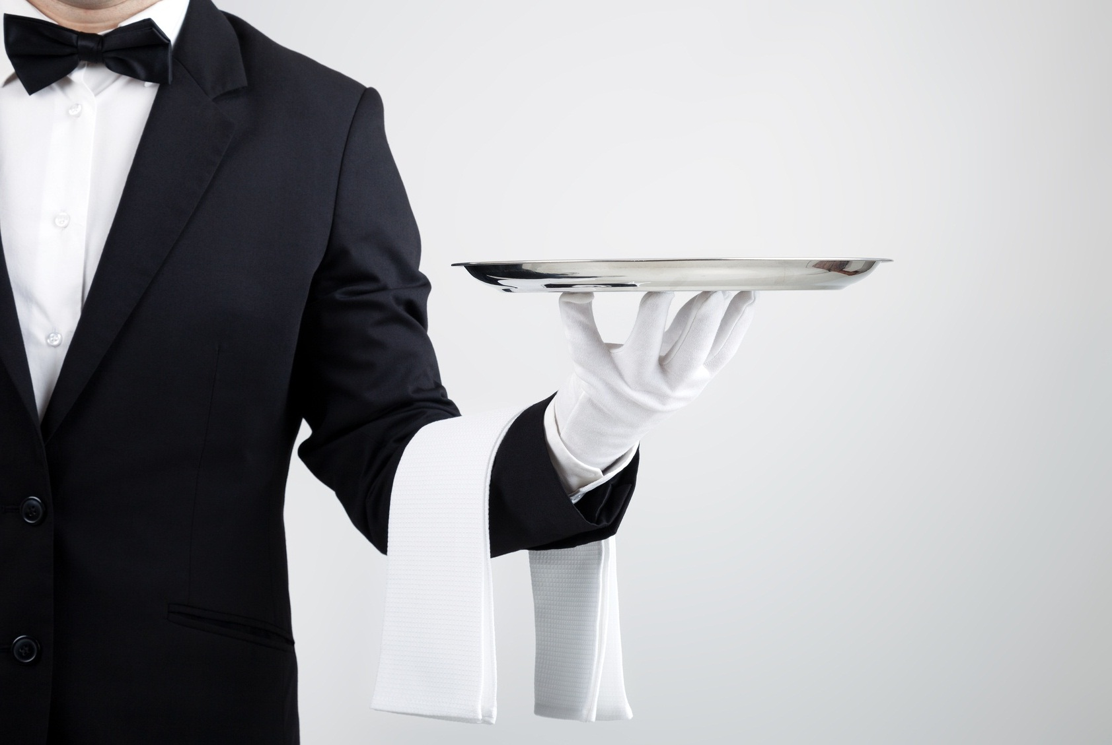
Tipping and Etiquette in United States
Name: Yingxu.Chen
Stu No:18
2018/10/30

Slide 2
While tipping is not mandatory in most of the United States, it is customary in many circumstances for service, especially at almost all sit-down restaurants which offer table service and many food servers depend on tips as an essential part of their wage.

Slide 3
Some states allow a "tip credit" to count as part of the Federal Minimum Wage of $7.25/hour so tipped employees may be paid as low as $2.00 an hour plus tips. Generally, the average tip is 15% to 20% of the total meal cost.

Slide 4
Tipping practices can vary depending upon the location in the U.S., and even published guidance can vary greatly depending upon the source. For example, some Americans don't tip at a buffet restaurant, but it's generally good form to tip $1-2/person for wait staff just clearing several rounds of plates, to as much as 10 percent if the wait staff is refilling drinks and providing other services. The general rule is to tip in proportion to the service, and the quality of service being delivered.

Slide 5
Tip jars at carry-out restaurants are a recent innovation, and one resisted by many Americans. While one guide below advises to tip 10 percent at carry-out restaurants, many Americans do not tip for carry-out, even when a tip jar is present, and tipping at most chain restaurants, such as McDonald's, is not common. Some who do contribute to tip jars, put in change or only $1, depending upon the size of the order.

Slide 6
Keep in mind that those who provide service are often dependent on tip income and generally are grateful for any tips received, especially when prompt and exceptional service has been provided. Tipping is the means by which to acknolwedge good service.
The tipping guides that follow are listed in alphabetical order. None is more authoritative than the other:

Slide 7
Many visitors to the U.S. feel pressured to tip even when they do not feel it is fair or reasonable to do so. Customers are REQUIRED to pay 'mandatory gratuities (tips)' if these are disclosed (on the menu or elsewhere) prior to being served. Mandatory gratuities are charged by many restaurants when large groups (6 or more; sometimes, 8 or more) are being served. Mandatory gratuities also are used by some restaurants with large numbers of foreign customers who may not be familiar with American tipping customs, often in tourist centers such as New York City.

Slide 8
here some suggest(1):
$1-2/bag for skycaps, bellhops, doormen, and parking valets if they handle bags, $1 per coat for coatroom attendants, $1 per diner to 10 percent of the pre-tax bill at buffets, $2-5 per night for housekeeper, $5-10 for concierge (only if they arranged tickets or reservations), $1-3 per bag for grocery loaders (not in all areas of the US). Doormen who merely open doors are not tipped, unless they call a cab or provide another service. Parking valets are paid upon pick-up $3-5, depending upon much effort is required to retrieve a vehicle.

Slide 9
here some suggest(1):
percentage of your total bill as follows: 10% usually means you aren't totally happy, 15% usually means all was acceptable, 20% for excellent, over 20% for outstanding. 15-20 percent is considered standard in most communities.
For ski instructors, tipping 15 percent for adult groups and 10 percent for private clients is pretty standard.

Slide 10
Note(1):
Tipping percentages will vary in different parts of the country, and even in different parts of a state. Reportedly, tips of 25 percent may be expected at higher-quality restaurants in New York City. In Colorado a tip of 20% is considered normal.

Slide 11
Note(2):
Ignore sales tax when calculating tips or not, it's not set in stone.
Note that if you have more than one person serving you at these establishments, the percentage represents the total tip and your server will split it between the group.

Slide 12
Note(3):
Tips should only go to people who are helpful. If they don't help you, don't tip them. If you receive bad service, you should speak to management, not just ignore the tip as the server is unaware of the situation. Perhaps they think you overlooked the tip or another person picked up the tip and pocketed it themselves.
In some places a clearly displayed "Service Charge" or "Gratuity" might be automatically added to a bill, especially for party sizes of 8 or more. Check your bill for these charges before tipping. If the word "Gratuity" is used and you're not happy, check with the manager. A gratuity by definition is an amount you don't have to pay but choose to.

