Slide 1
Innovate
Innovate
618寝室组
作业：618组
包高翔
陈煜暄
金家俊
娄必辉

Slide 2
Innovate
Innovate
618寝室组
包高翔
陈煜暄
金家俊
娄必辉
作业：618组

Slide 3
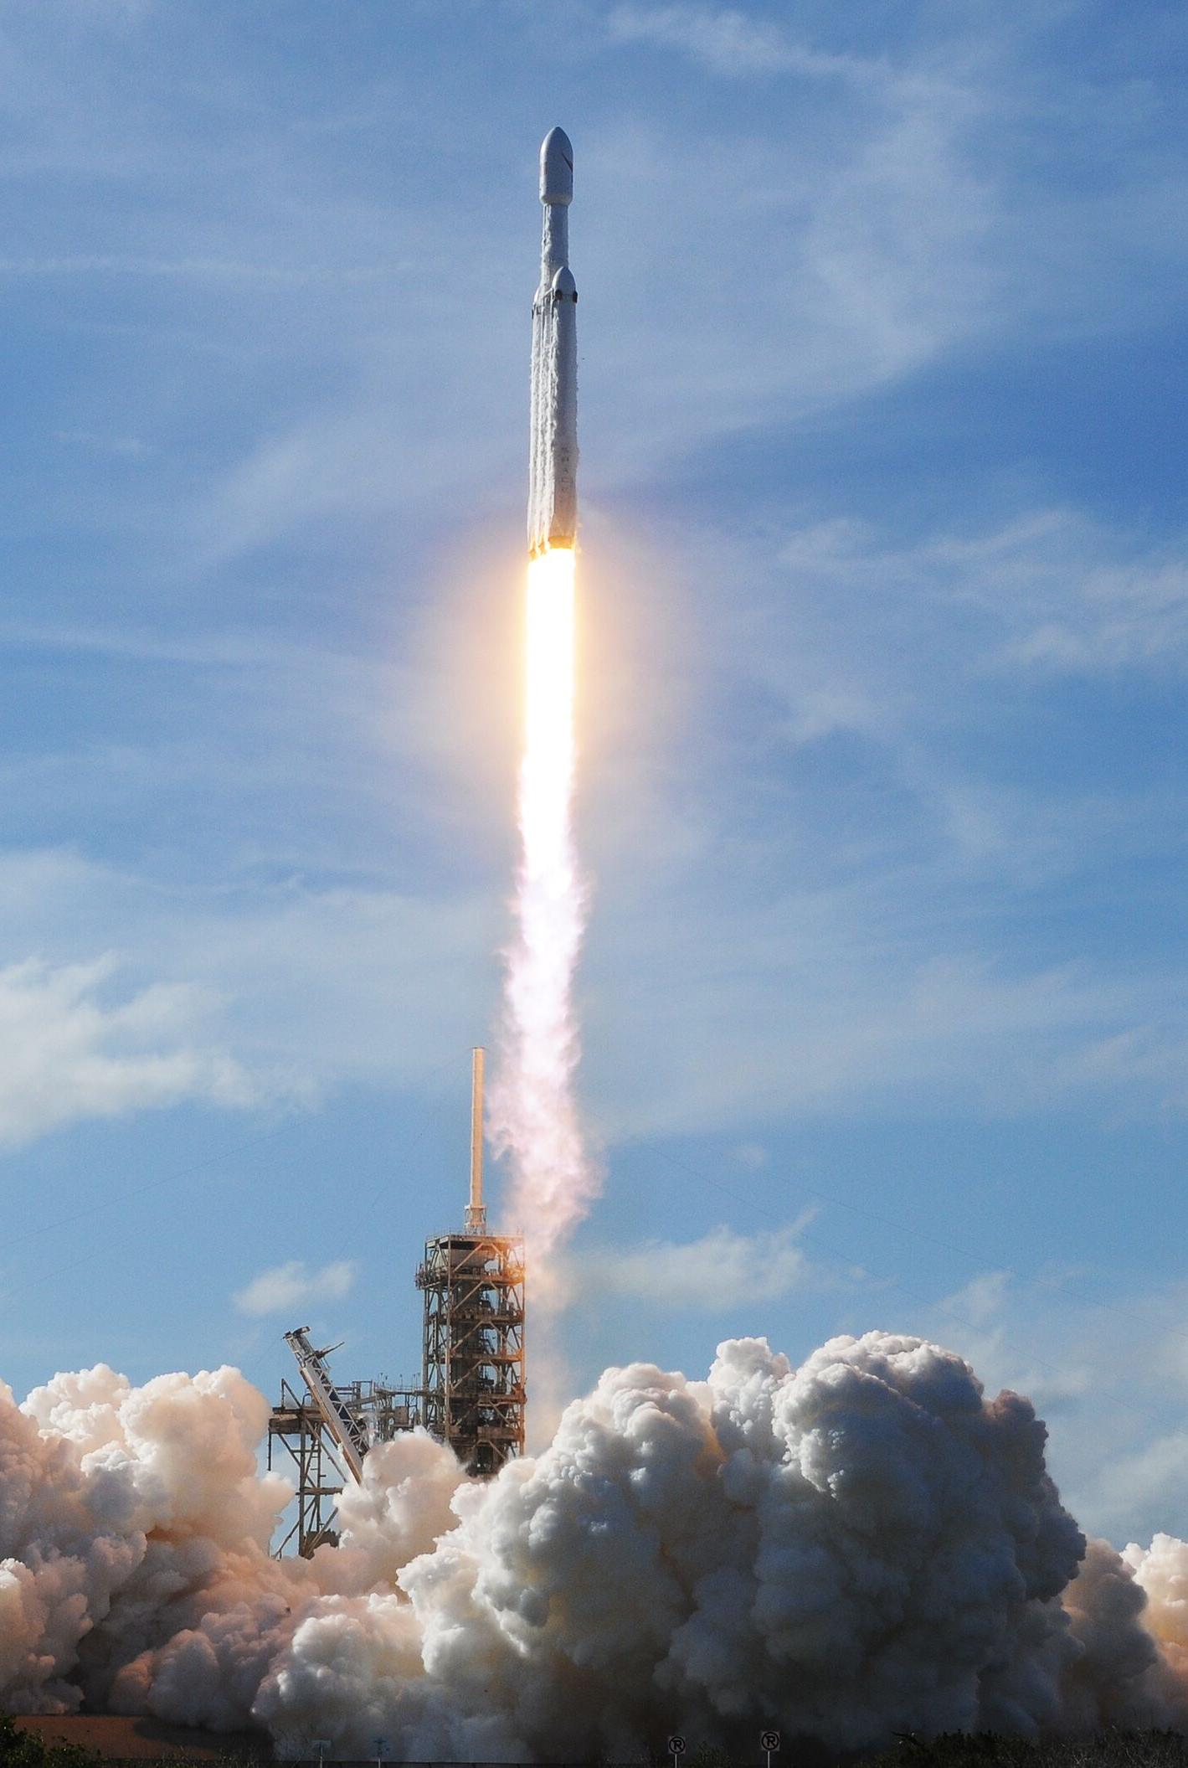
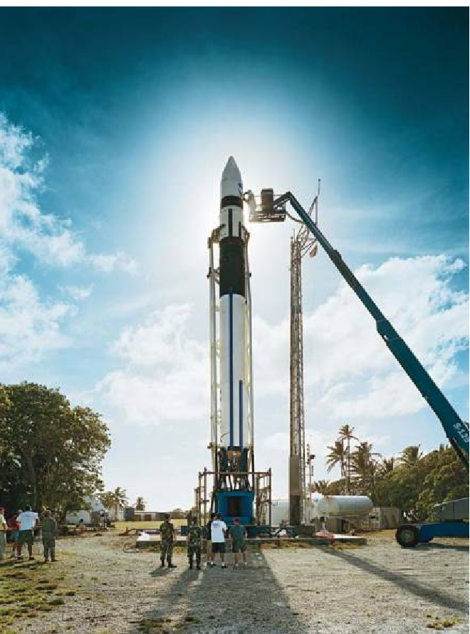
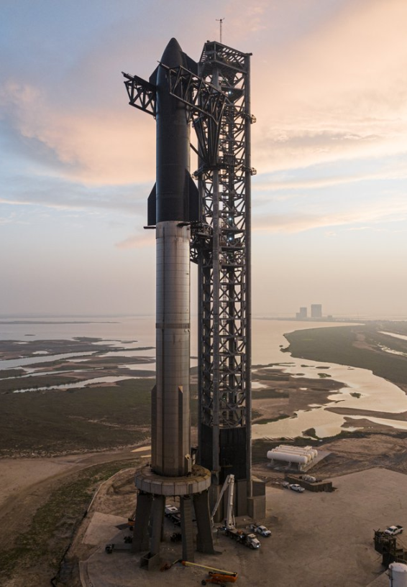

Past present and future
Past
Past
future

Slide 4
Table of Contents
Past
present
future

Slide 5
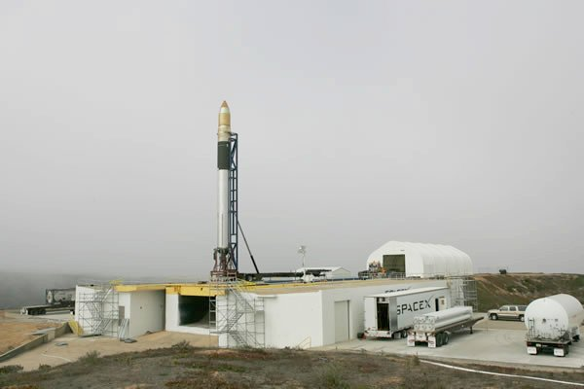
past

Slide 6
Past Falcon 1
Disruptive
guts
sweat blood
2006.3.24
2007.3.21
2008.8.3
2008.9.28
2009.7.14
fail
fail
fail
succeed
succeed
After many failures, Falcon 1 finally succeeded.

Slide 7
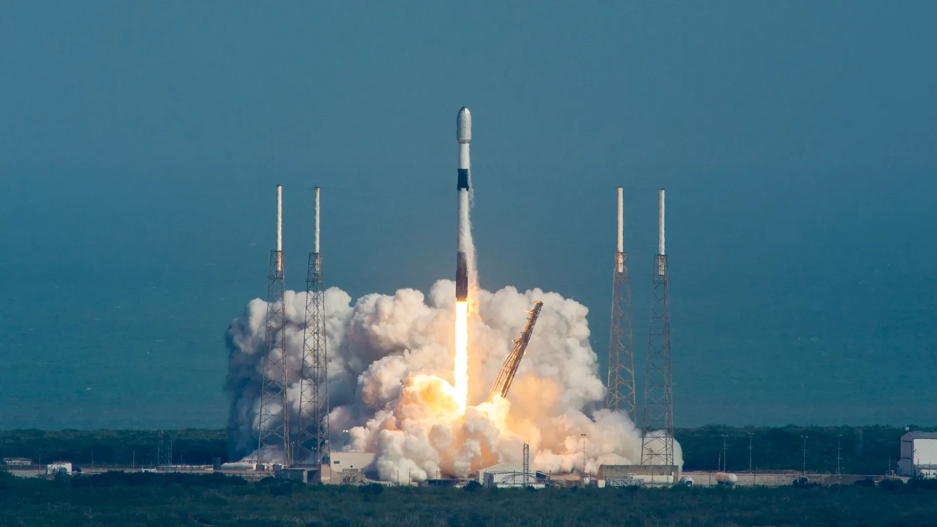
present

Slide 8
present Falcon 9
Falcon 9 is a reusable rocket by SpaceX, known for its cost-efficient and reliable launches of satellites and space missions
recyclable
High efficiency
Cheap

Slide 9
present Falcon 9
The Falcon 9 is one of the cheapest rockets in the world.
2720
Falcon-9

Slide 10
present Falcon 9
The Falcon 9 is the most efficient rocket in the world
Number of rocket launches in 2024
36
32
11
9
Soyuz
Electronic number
CZ series
Other
92

Slide 11
present Falcon 9
92
The Falcon 9 is the most efficient rocket in the world
Number of rocket launches in 2024
36
32
9
11
Soyuz
Electronic number
CZ series
Other
Falcon-9

Slide 12
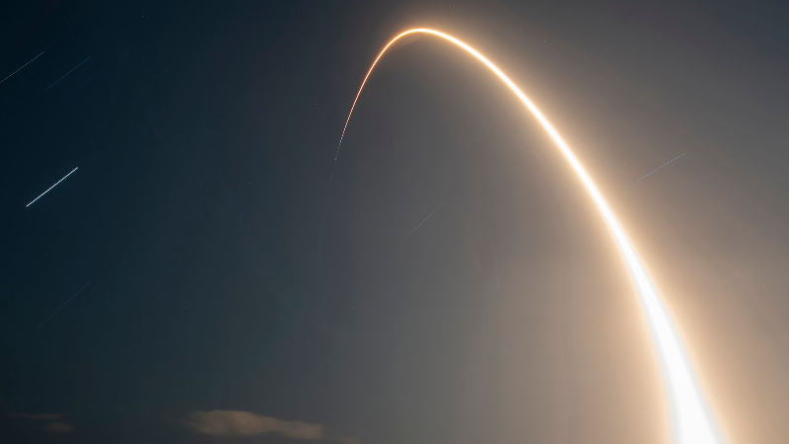
present Falcon 9
others
Falcon9
More than 70 percent

Slide 13
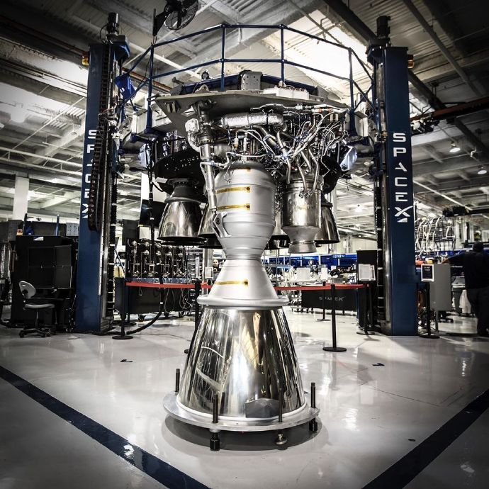
present Merlin 1d
推力（真空） | 934.1 Kn （梅林1DV+）
推力（海平面） | 903.0 kN （梅林1D++）
比冲（真空） | 348 s （梅林1DV+）
比冲（海平面） | 290 s （梅林1D++）
燃烧室压力 | 10.8 Mpa （梅林1D+）

Slide 14
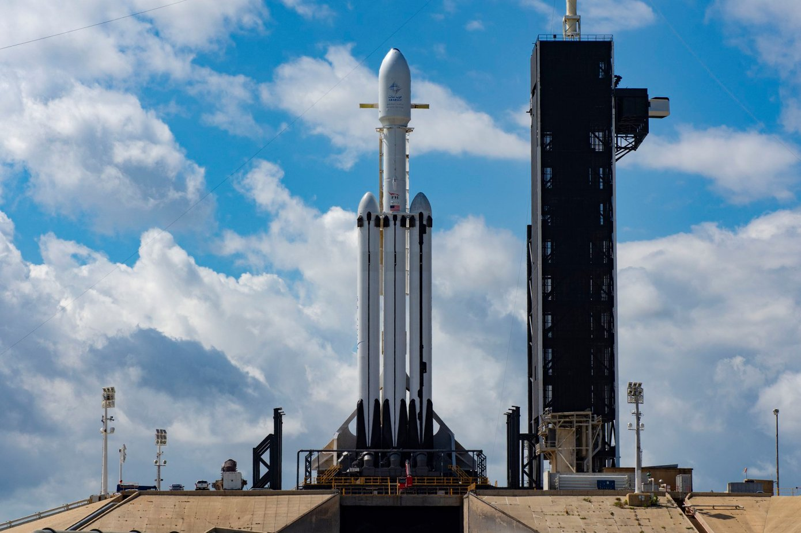
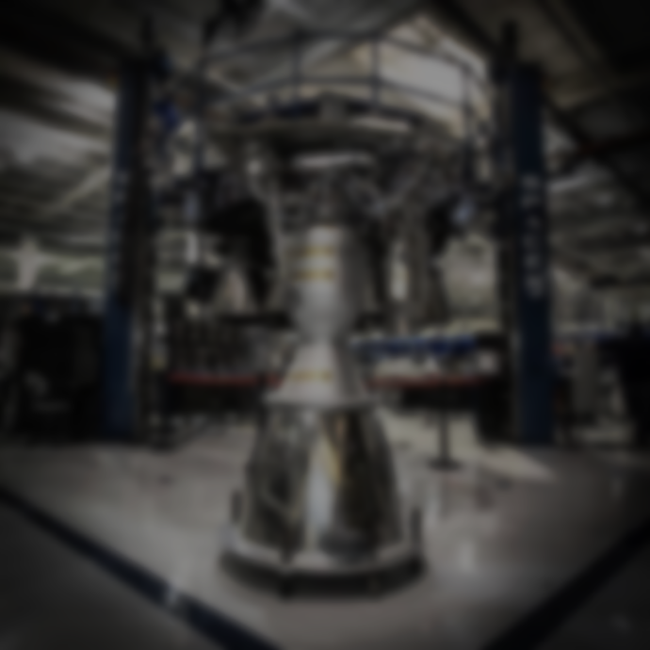
Heavy Falcon

Slide 15
present Heavy Falcon
The Falcon Heavy is the cheapest heavy rocket
LEO capacity
25778
25784
23038
CZ-5
63200
130000
Angara
Ariana 5

Slide 16
present Heavy Falcon
130000
The Falcon Heavy is the cheapest heavy rocket
LEO capacity
63200
23038
25778
25784
9500
CZ-5
Angara
Ariana 5
Falcon Heavy
SLS

Slide 17
present Heavy Falcon
130000
The Falcon Heavy is the cheapest heavy rocket
>100000
LEO capacity
Price
63200
Too expensive
26300
18200
11600
23038
25778
25784
9500
CZ-5
Angara
Ariana 5
Falcon Heavy
SLS

Slide 18
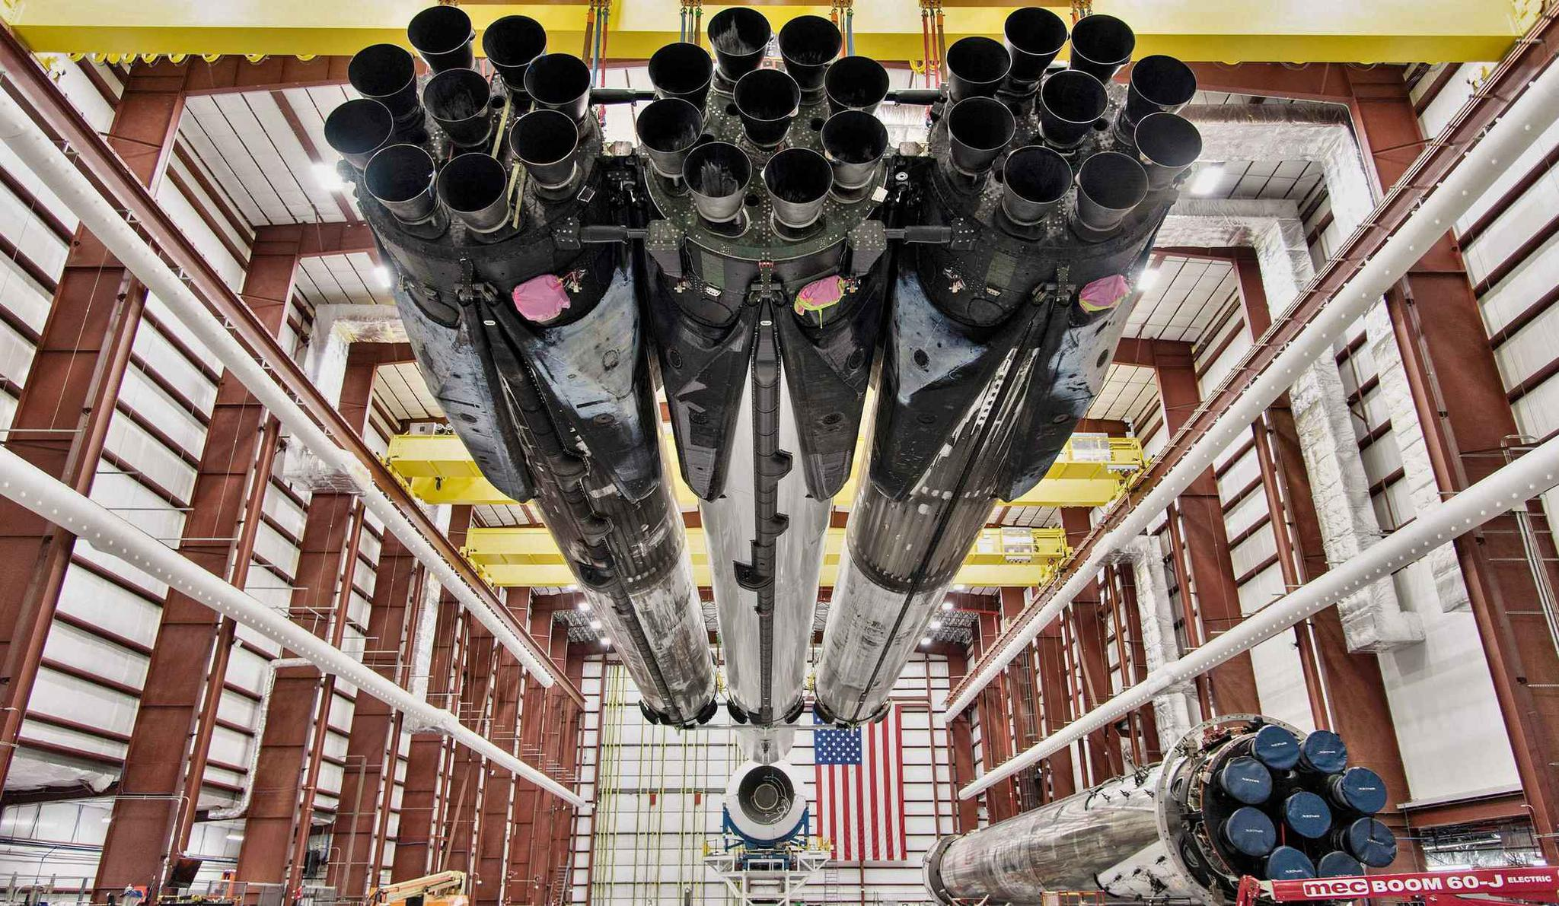
27 Merlin engines in parallel
for increased reliability
and extreme efficiency

Slide 19
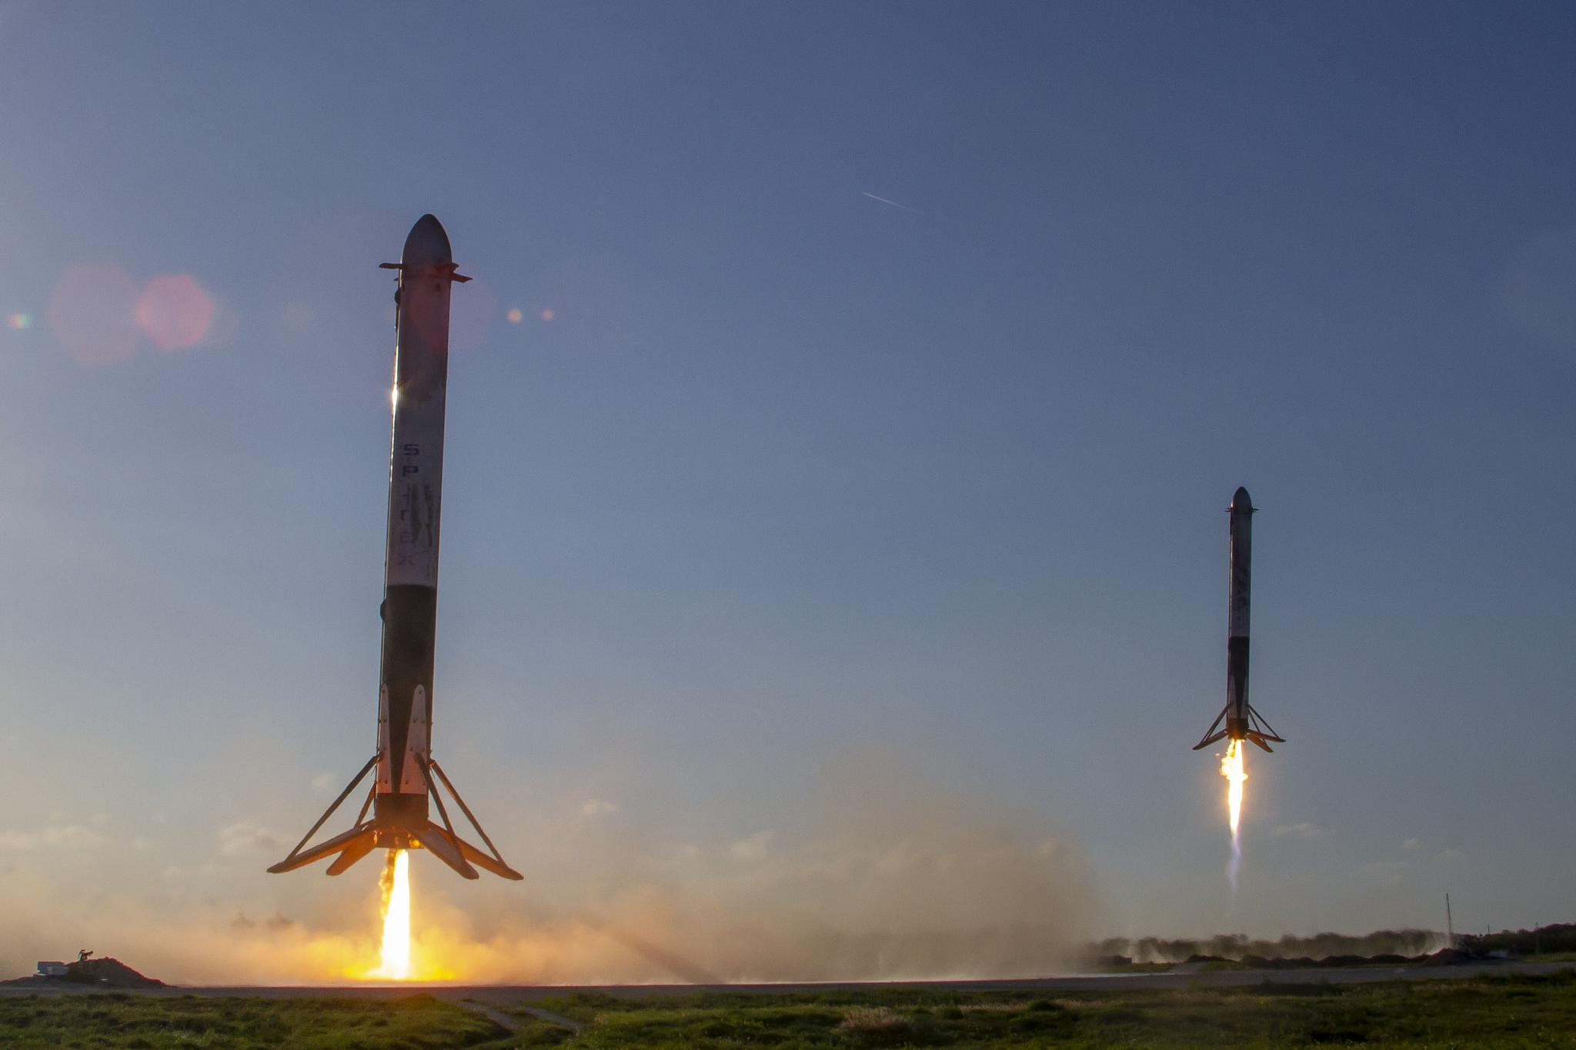
More than two-thirds
of the recyclable portion is recyclable

Slide 20
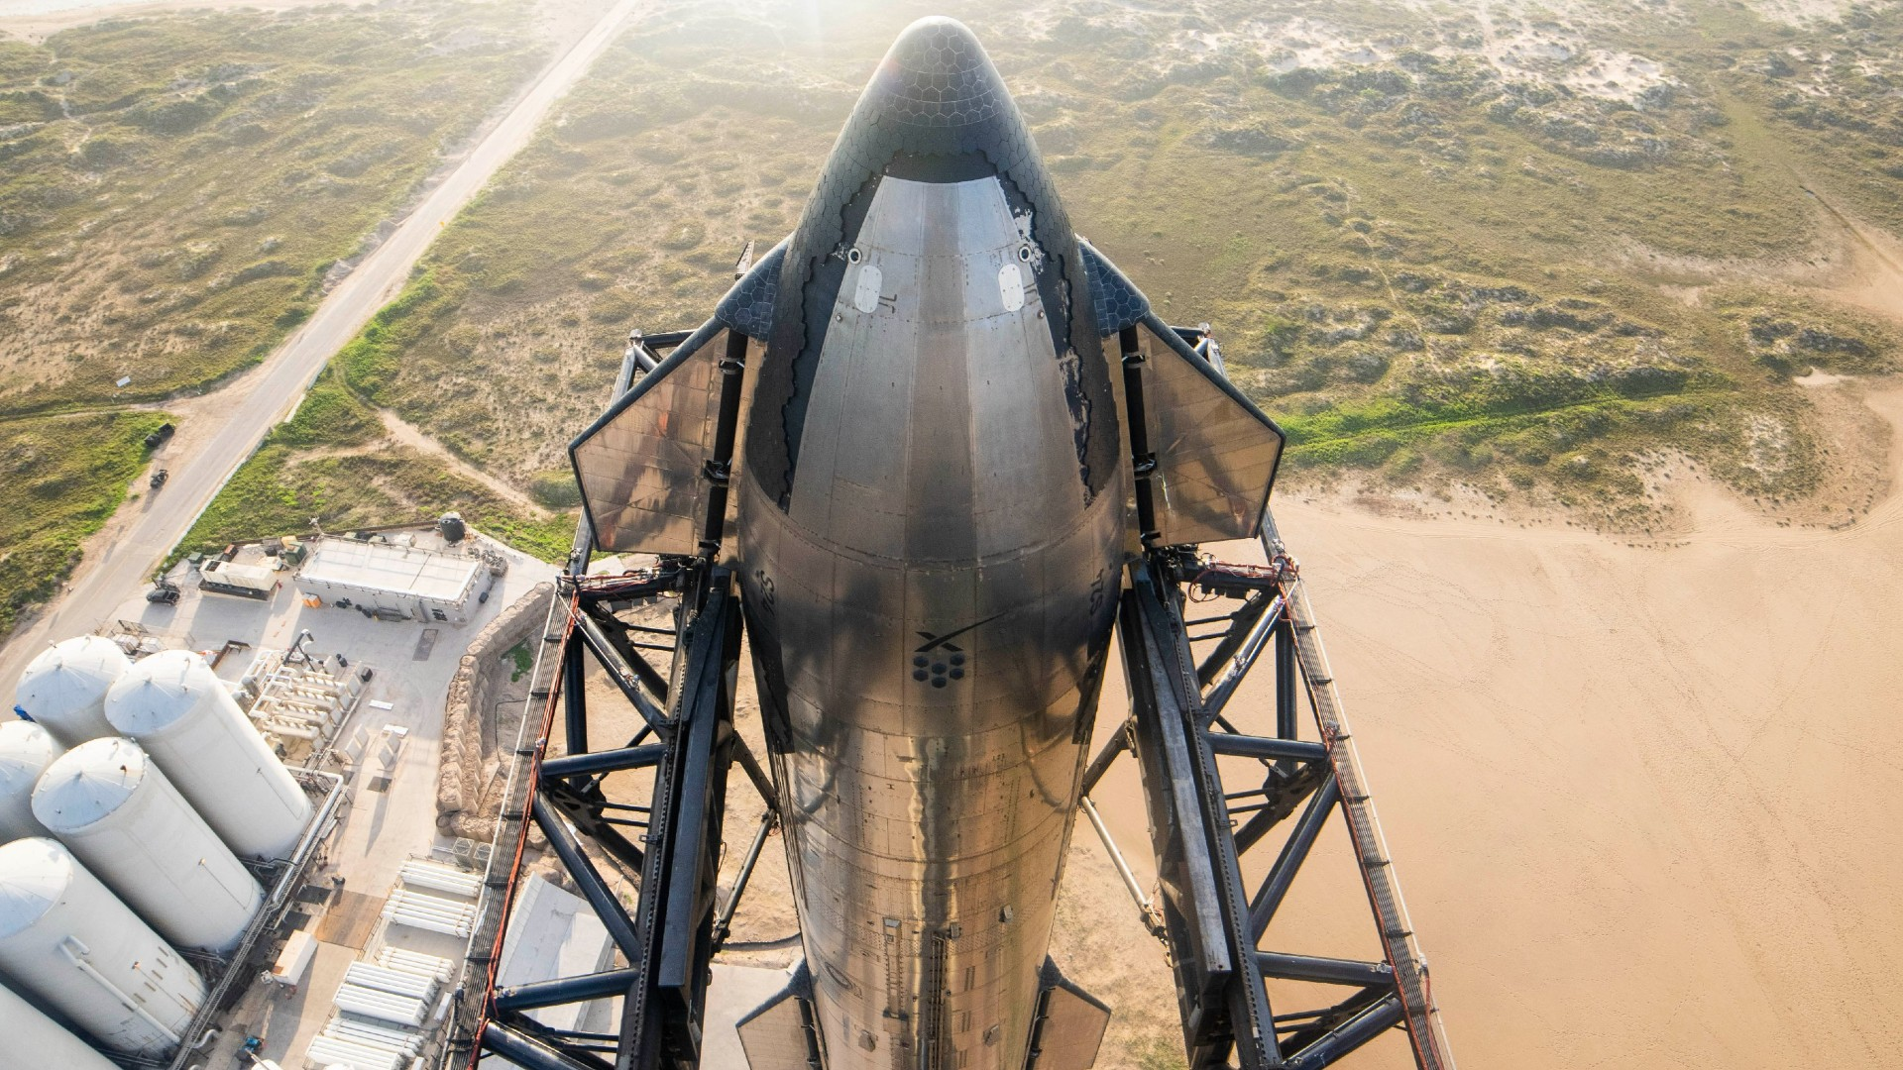
Greater carrying capacity
Sustainable development
Lower cost
Intelligentization
Harmless to the environment
future

Slide 21
Future major trend
Greater carrying capacity
Sustainable development
Lower cost
Intelligentization
Harmless to the environment

Slide 22
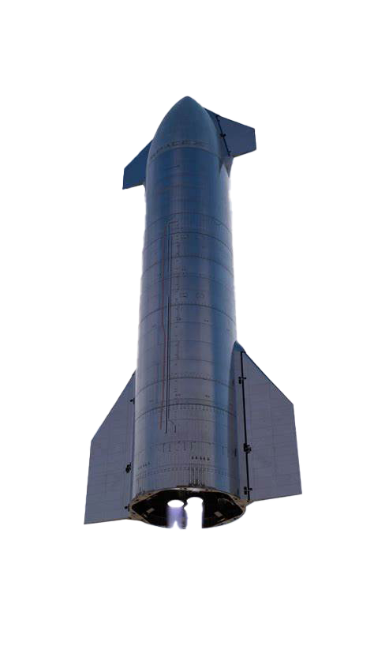
Future starship
Big Falcon Rocket (BFR)
Commercial application of Starship will start in 2025
Preparation for Mars exploration from 2026 to 2030

Slide 23
Future starship
Super large carrying capacity
Fully reusable
Adopt stainless steel material
Equipped with aerodynamic control device

Slide 24
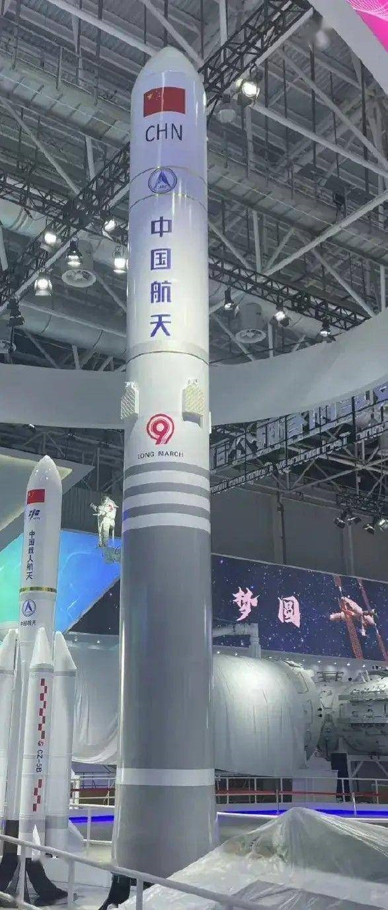
Future cz-9
Technological Advancements and Maturation
Accelerated Development Process

Slide 25
Future cz-9
Superb carrying capacity
Advanced propulsion system
High degree of modular design
Possessing reusable potential

Slide 26
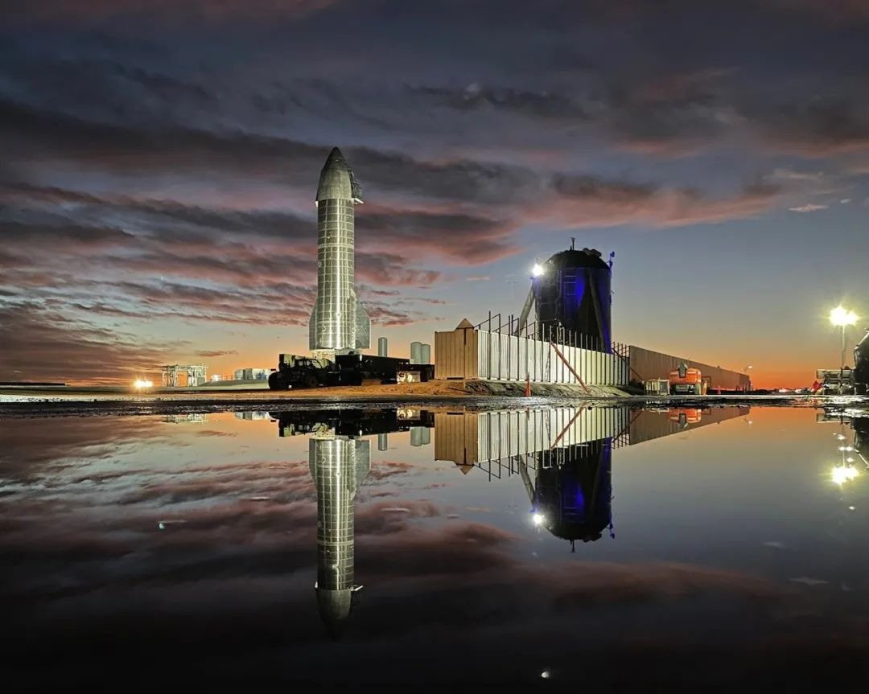
Future COMPARISON
In terms of recycling
innovation and launch
cost, Starship has more
advantages.

Slide 27
Future COMPARISON
At present, Starship greatly reduces the launch cost by adopting the reusable mode. In this regard, it has more advantages than CZ-9

Slide 28
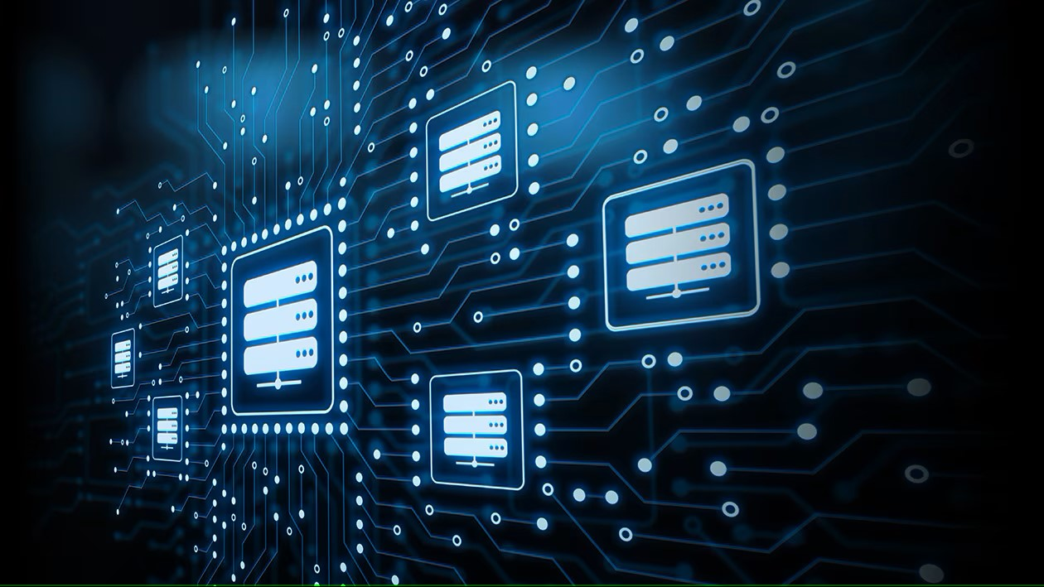

disruptive INNOVATION

Slide 29
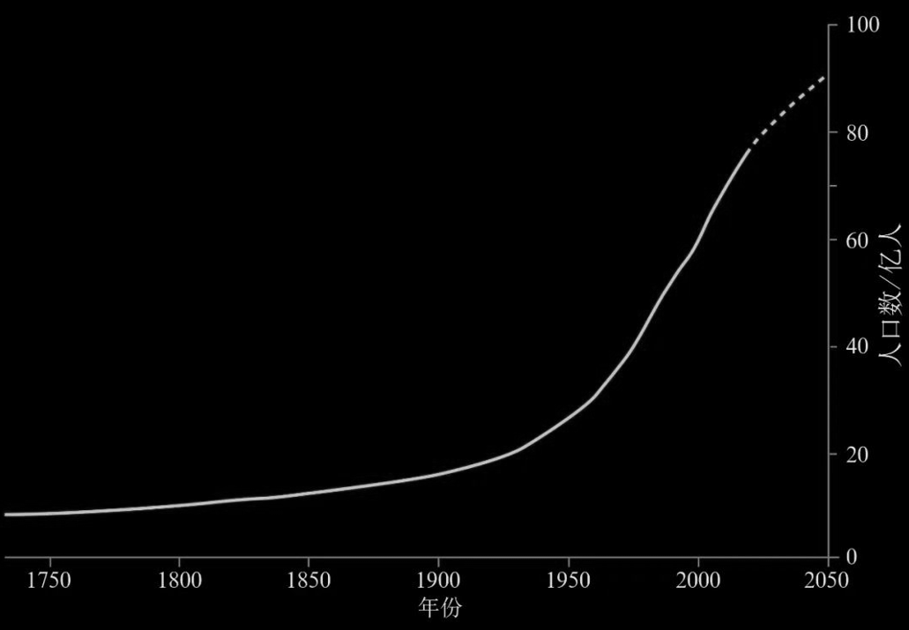
INNOVATION chemical fertilizer
controllable nutrients
concentrated nutrients
high content
easy to use.
这里使用金克拉是玩梗

Slide 30
INNOVATION chemical fertilizer
Be coordinated with the level of economic and social development
Adapted to the carrying capacity of resources and environment

Slide 31
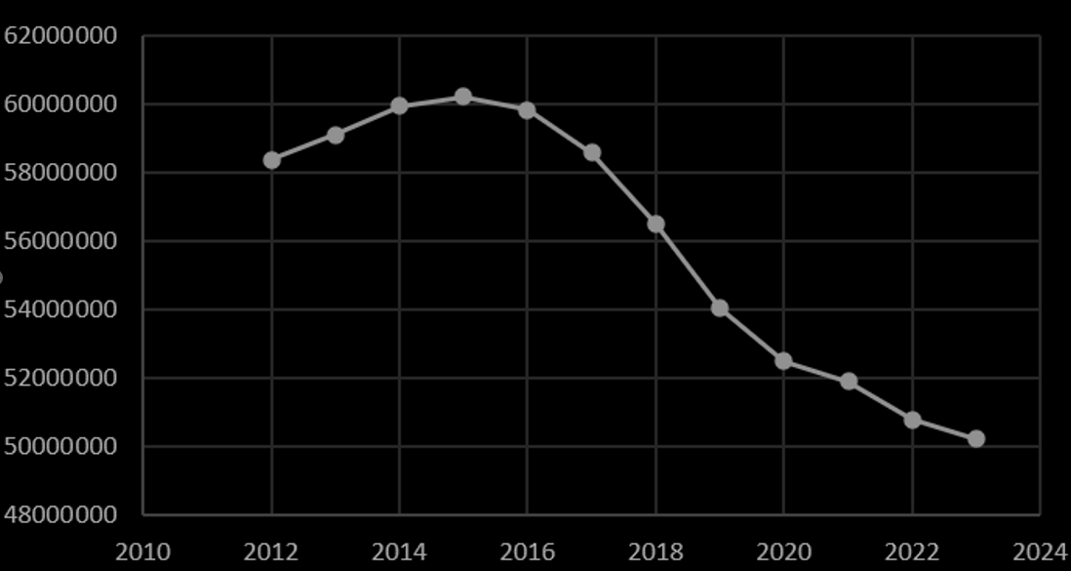
INNOVATION chemical fertilizer
First in the world
one-third of the world
sum of United States and India
Breaking restrictions
Adhere to green development

Slide 32
Adhere to green development
INNOVATION
chemical fertilizer
First in the world
one-third of the world
sum of United States and India

Slide 33
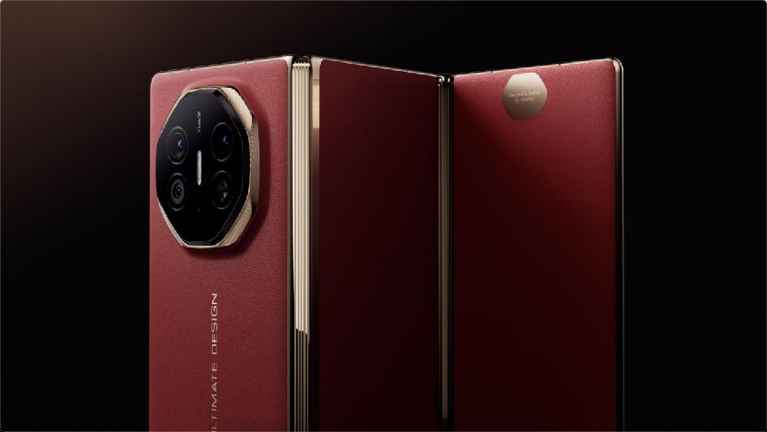
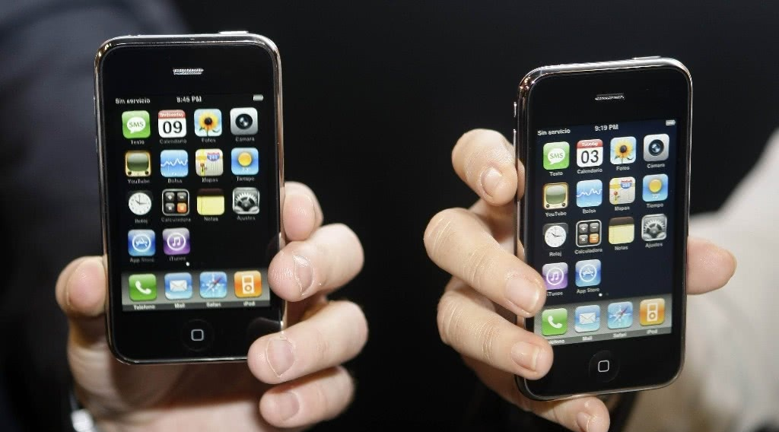
INNOVATION Smartphone

Slide 34
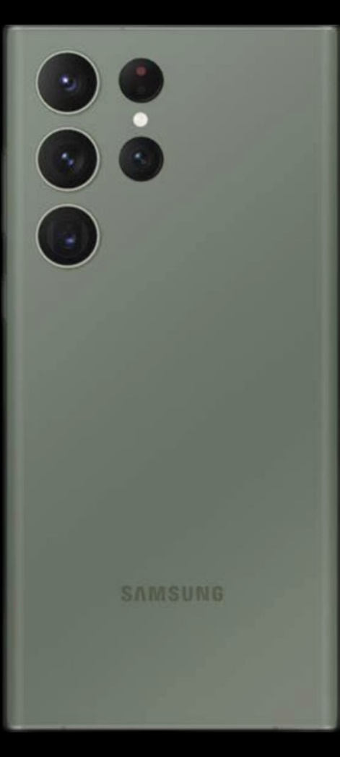
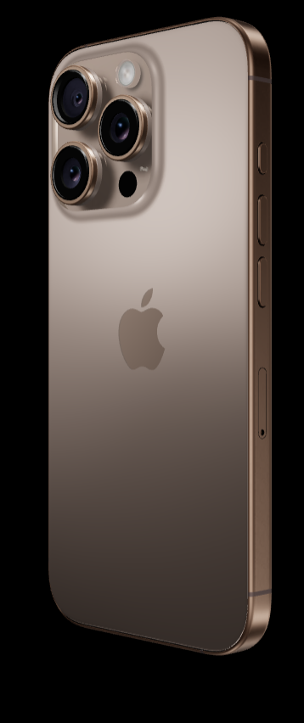
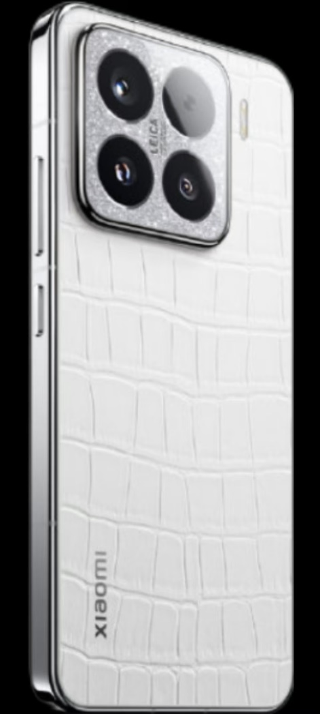
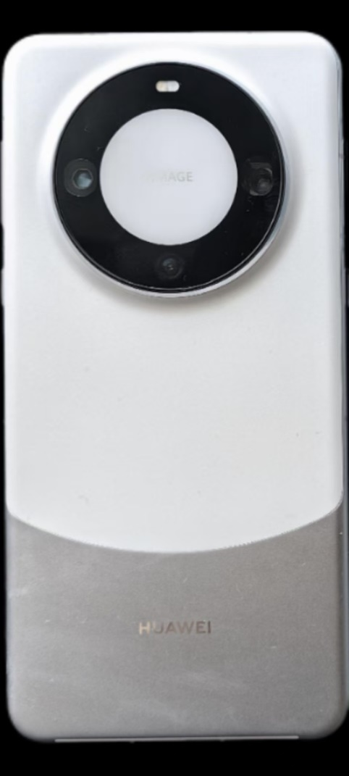
INNOVATION Smartphone
No Phycial keyboard
Multi-touch
Self-developed system
Trend-setting industrial design

Slide 35
INNOVATION
Smartphone

Slide 36
summary
Meet the demand
Economic value
Uncertain result

