Slide 1
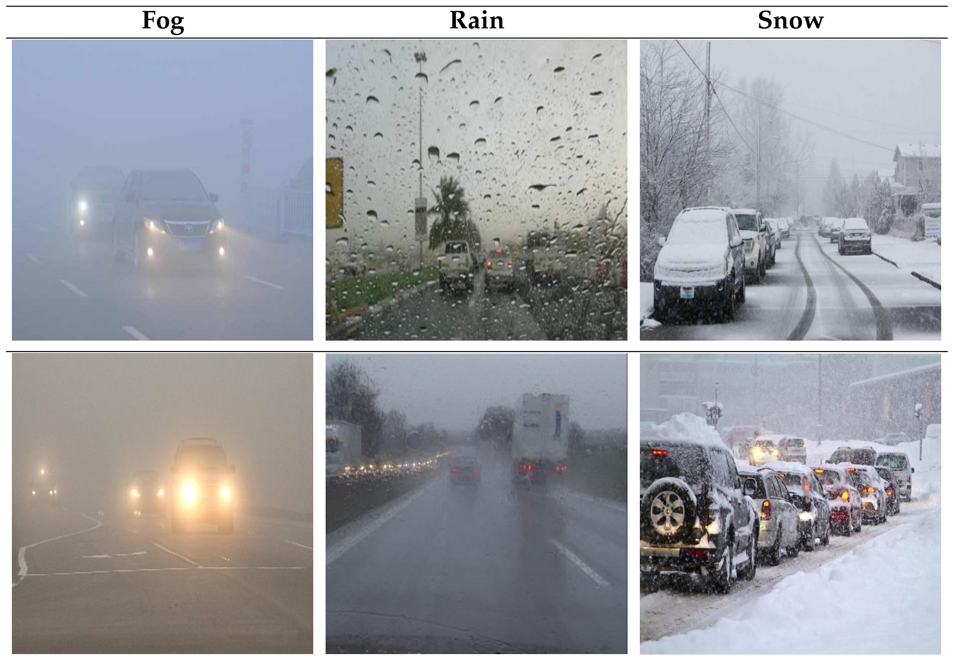
Laborprojekt Servicerobotik / Bildverarbeitung für Robotik 2026 Zwischenpräsentation
Projekt 10: Enhance Robustness in Adverse Weather Conditions
Bearbeiter: Sihan Chen (3872154), Yuxuan Chen (3619935)

Slide 2
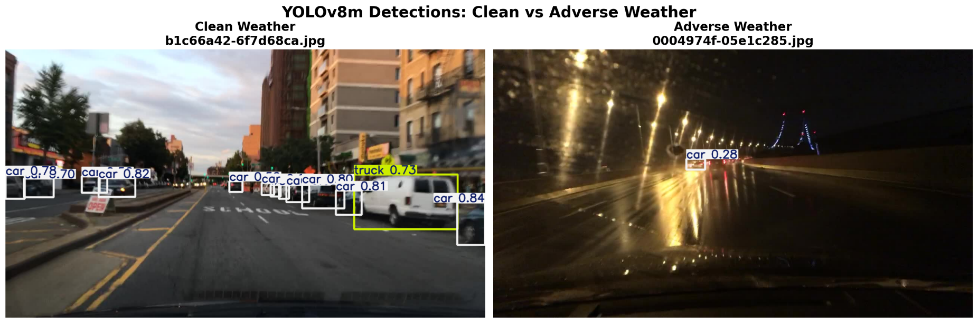
Motivation
Clean Weather
Problem: Camera Perception Failure
Adverse weather (rain, snow, fog) severely degrades image quality.
Leads to detection failures and real-world safety risks.
Why It Matters: The "Clear-Weather" Gap
Models are biased toward ideal clear-weather training data.
Systematic degradation under adverse conditions remains underexplored.
Our Contribution: Retraining-Free Accuracy Recovery
Quantify YOLOv8m performance loss on BDD100K under adverse weather.
Apply lightweight preprocessing (MSRCR, CLAHE) to recover lost accuracy.
Adverse Weather

Slide 3
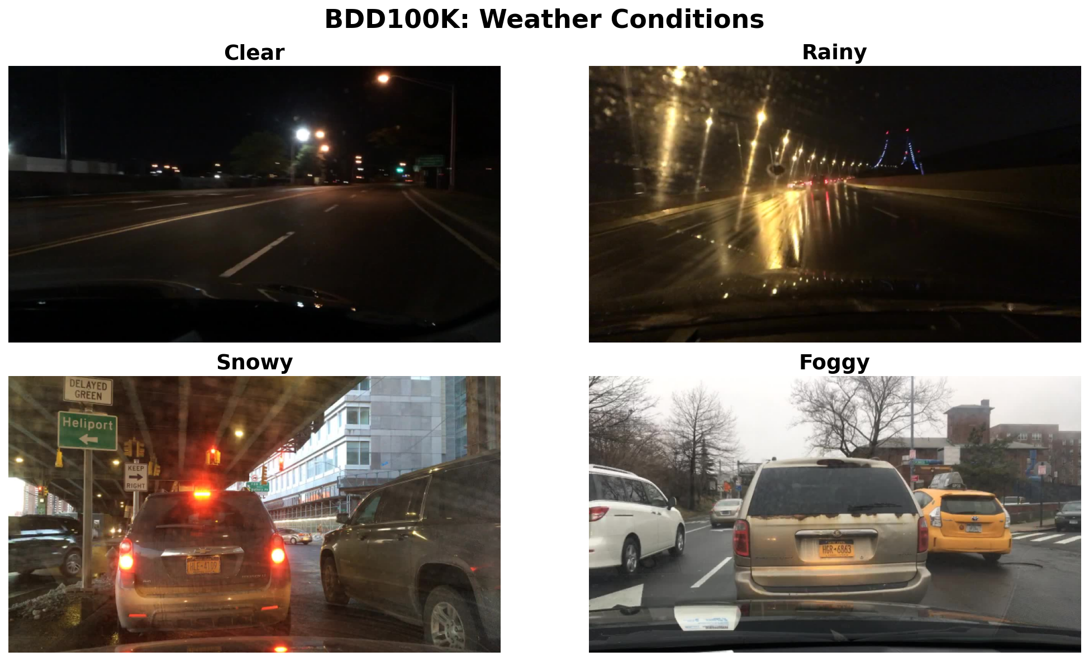
Konzept: BDD100K Dataset
Property | Value
Dataset | BDD100K (Berkeley DeepDrive 100K)
Total Images | 100K: 70K train + 10K val + 20K test
Resolution | 1280 × 720 pixels
Classes Used | 7: person, bicycle, car, motorcycle, bus, train, truck
Clean Split | clear + overcast + partly cloudy + sunny (~54K images)
Adverse Split | rainy + snowy + foggy (~12K images)
Evaluation Subset | 2000 clean + 2000 adverse (balanced across weather types)
Weather distribution: clear (37K) | overcast (8.8K) | undefined (8.1K) | snowy (5.5K) | rainy (5.1K) | partly cloudy (4.9K) | foggy (130)
Note: foggy has only 130 samples: severely underrepresented, results on fog are anecdotal.

Slide 4
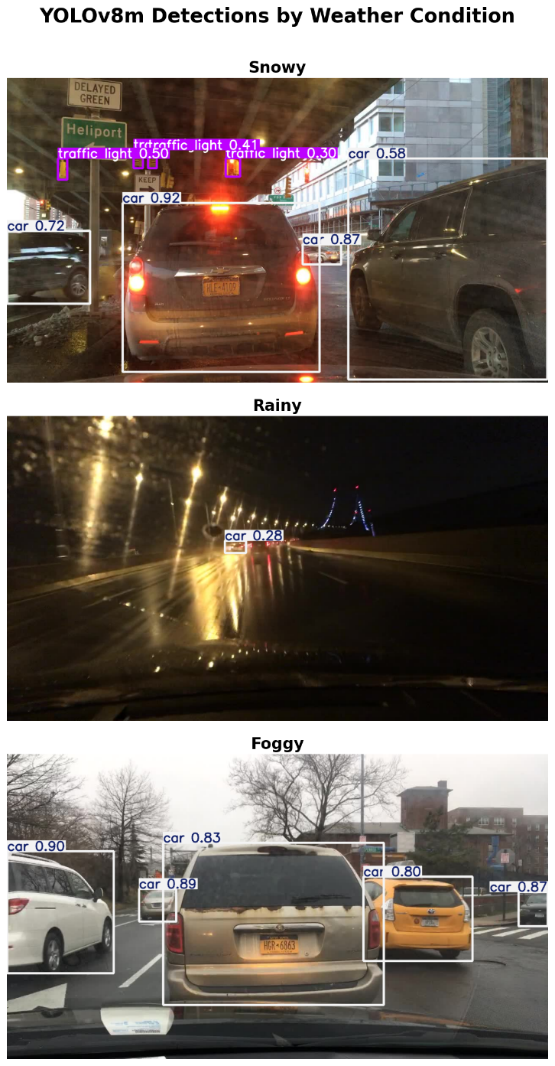
Konzept: Two-Phase Methodology
Phase 1: Baseline Quantification
YOLOv8m evaluated on 2,000 clean vs 2,000 adverse BDD100K images
Per-class AP@0.5 comparison → measure weather-induced degradation
Per-weather breakdown: snowy, rainy, foggy
Phase 2: Preprocessing Recovery
Apply MSRCR & CLAHE to adverse images before inference
Compare mAP against raw adverse → measure recovery rate
No model retraining required: lightweight, deployable solution
Evaluation Pipeline
BDD100K DSDL → YOLO label format + weather-condition split
YOLOv8m batch inference (stream=True, conf=0.25) → JSON predictions
IoU-based matching (gt ↔ pred @ 0.5) → Per-class AP computation
Chart generation

Slide 5
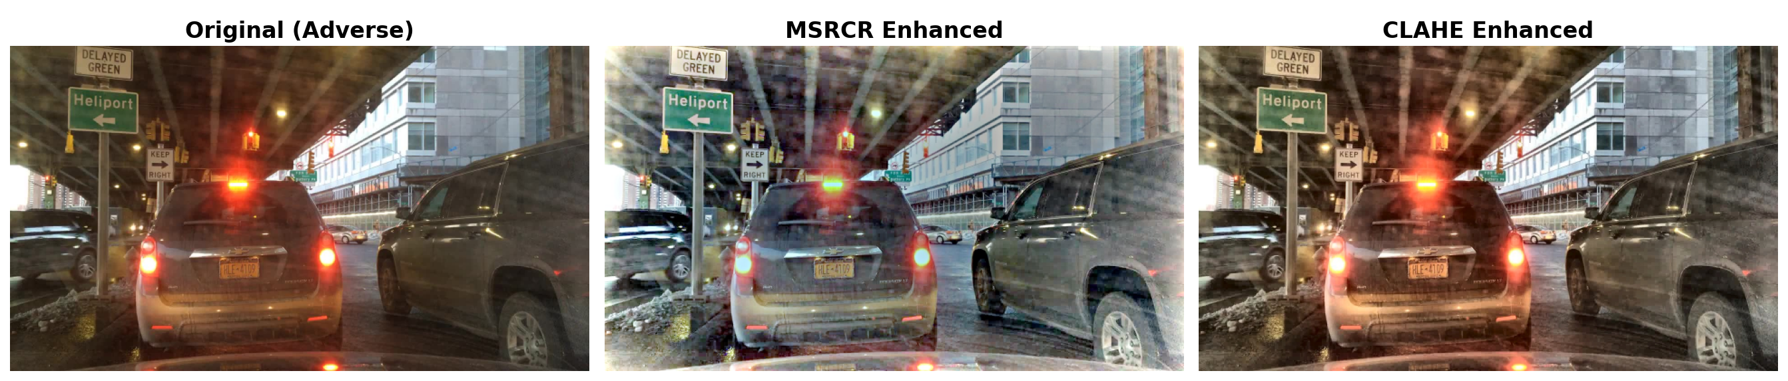
Konzept: Preprocessing Methods
MSRCR: Multi-Scale Retinex with Color Restoration
Retinex theory: image = illumination × reflectance
3-scale Gaussian surround (σ = 15, 80, 250)
Color restoration to prevent graying
GPU-accelerated via PyTorch separable convolution
Parameters: α = 125, β = 46
CLAHE: Contrast Limited Adaptive Histogram Equalization
Operates on L-channel of LAB color space
Adaptive histogram equalization in 8×8 tiles
Contrast clip limit = 2.0 (prevents noise amplification)
Preserves color: only luminance is enhanced
OpenCV implementation: fast & deterministic
Both methods operate on input images only: no model retraining or architecture changes needed. This makes them practical for real-time autonomous driving pipelines where model updates are expensive and safety-critical.

Slide 6
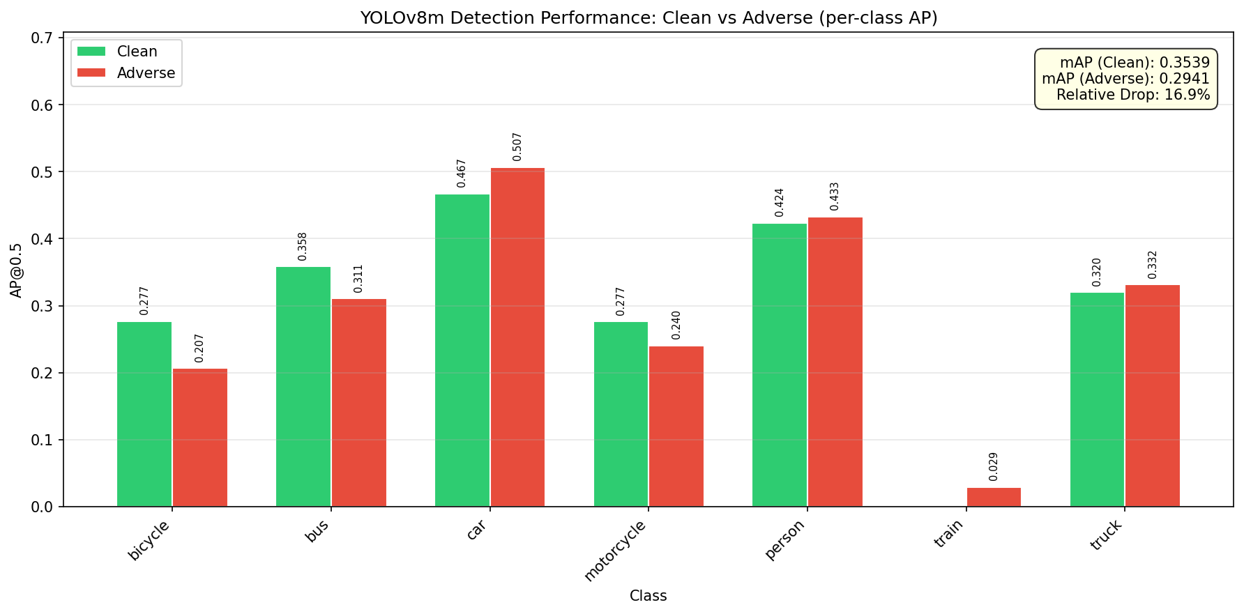
Stand der Implementierung
Clean mAP@0.5
Adverse mAP@0.5
Absolute Drop
Relative Drop
0.3539
0.2941
0.0598↓
16.9% ↓
Class | Clean AP | Adverse AP | Δ Drop | Drop %
person | 0.4237 | 0.4330 | -0.0093 | -2.2%
bicycle | 0.2771 | 0.2067 | +0.0704 | +25.4%
car | 0.4674 | 0.5069 | -0.0395 | -8.5%
motorcycle | 0.2767 | 0.2405 | +0.0362 | +13.1%
bus | 0.3583 | 0.3106 | +0.0477 | +13.3%
train | 0.0000 | 0.0294 | -0.0294 | +0.0%
truck | 0.3203 | 0.3317 | -0.0114 | -3.6%
mAP | 0.3539 | 0.2941 | 0.0598 | 16.9%
Per-class AP: Clean vs Adverse (YOLOv8m)

Slide 7
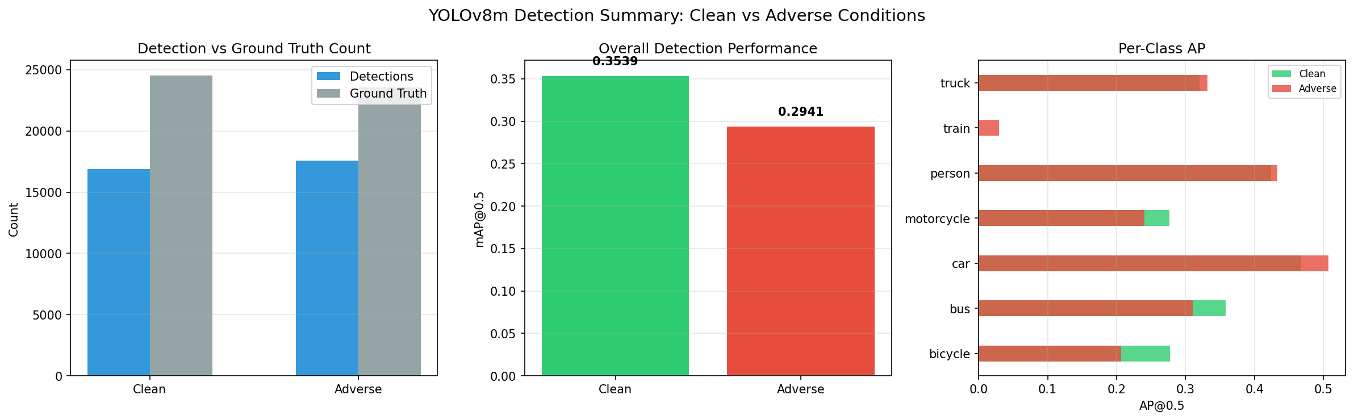
Stand der Implementierung
Clean mAP@0.5
Adverse mAP@0.5
Absolute Drop
Relative Drop
0.3539
0.2941
0.0598↓
16.9% ↓
Class-specific degradation: large objects (car, person) robust; small/detailed objects (bicycle -25%, motorcycle -13%) suffer most.

Slide 8
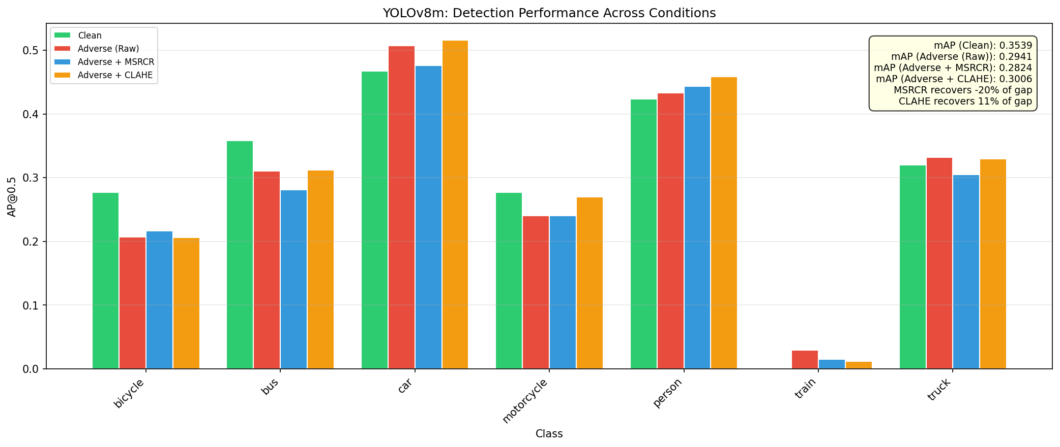
Stand der Implementierung
Adverse Raw
+ MSRCR
+ CLAHE
0.2941
0.2824
0.3006
MSRCR recovery: -19.6% of gap (slight decrease) | CLAHE recovery: +10.9% of gap (modest improvement)
Class | Clean | Adv Raw | +MSRCR | +CLAHE
person | 0.4237 | 0.4330 | 0.4435 | 0.4586
bicycle | 0.2771 | 0.2067 | 0.2163 | 0.2065
car | 0.4674 | 0.5069 | 0.4759 | 0.5162
motorcycle | 0.2767 | 0.2405 | 0.2405 | 0.2695
bus | 0.3583 | 0.3106 | 0.2808 | 0.3117
train | 0.0000 | 0.0294 | 0.0150 | 0.0115
truck | 0.3203 | 0.3317 | 0.3046 | 0.3299
4-way per-class AP comparison

Slide 9
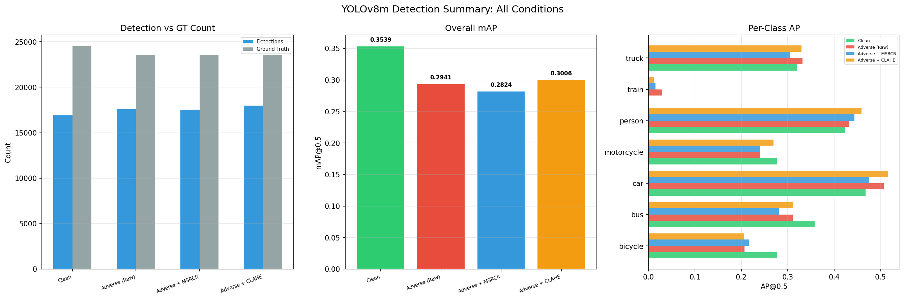
Stand der Implementierung
Adverse Raw
+ MSRCR
+ CLAHE
0.2941
0.2824
0.3006
MSRCR recovery: -19.6% of gap (slight decrease) | CLAHE recovery: +10.9% of gap (modest improvement)

Slide 10
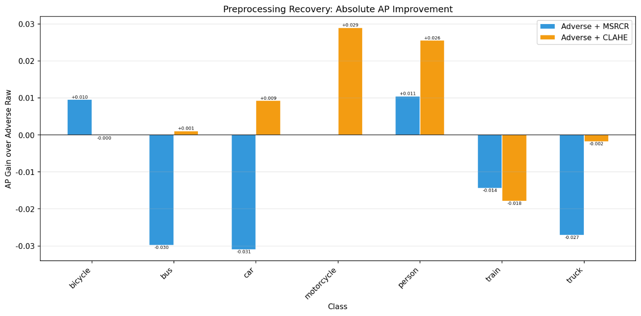
Stand der Implementierung
Weather | Images | mAP@0.5 | Note
snowy | 992 | 0.315 | Largest adverse subset
rainy | 991 | 0.344 | Less degradation than snow
foggy | 17 | 0.371* | *Only 17 images — not reliable
Snowy: the extreme bottleneck, the fine texture and high reflective profile of snow blocks object boundaries severely.
Rainy: moderately handled, YOLOv8m CNN maps have learned enough rainy texture filters to bypass surface reflections.
Foggy: split warning, only 17 images are present in the foggy validation split. Results are highly anecdotal.
Per-class AP gain from preprocessing over raw adverse
CLAHE is most effective in snowy conditions: improving local contrast helps the detector distinguish objects from snow-covered backgrounds.
MSRCR occasionally helps in rainy scenes but over-enhances in foggy/snowy conditions.

Slide 11
Geplante Experimente: Phase 3
RT-DETR: Cross-Architecture Comparison
Real-Time Detection Transformer — ViT backbone vs YOLO's CNN
Hypothesis: global self-attention may be more robust to localized weather artifacts
Same BDD100K split, identical evaluation protocol (mAP@0.5 per-class)
Compare absolute performance AND relative degradation ratios
Grad-CAM: Explainability Analysis
Visualize which image regions drive detection in clean vs adverse
Compare activation maps: YOLOv8m vs RT-DETR vs preprocessed variants
Goal: understand why detectors fail in adverse weather at the feature level
Potential to guide architectural improvements or preprocessing strategies

Slide 12
Fragen & Diskussion
Thank you for your attention!
Projekt 10: Enhance Robustness in Adverse Weather Conditions

