Slide 1
Single-cell RNA Similarity Search Tool
Test Datasets
Yixin Chen

Slide 2
Simulation Datasets

Slide 3
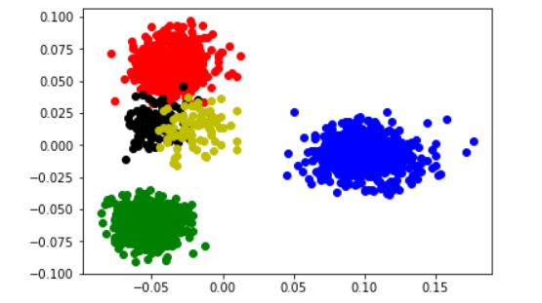
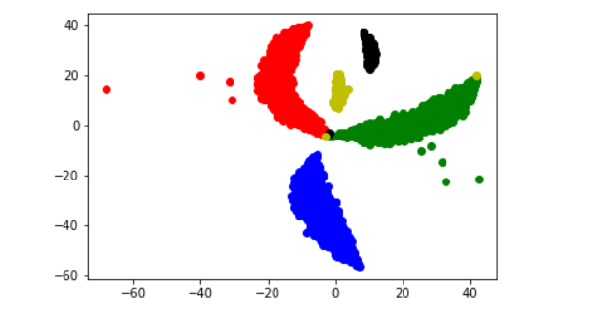
Toy_Data
Location: stocky: /home/chenyx/LSH_Data/Toy_Data/Toy_Data.txt
Size: 2000 samples * (10000Genes + 1 label dimension)
Clusters: 1 batch with 5 clusters (0.3, 0.3, 0.3, 0.05, 0.05)
Accession: generated by splatter with the script: Toy_Data.R
Explanation: the toy data (simplest) without dropout and batch effect
Usage: to check the feasibility of a method
PCA
tsne

Slide 4
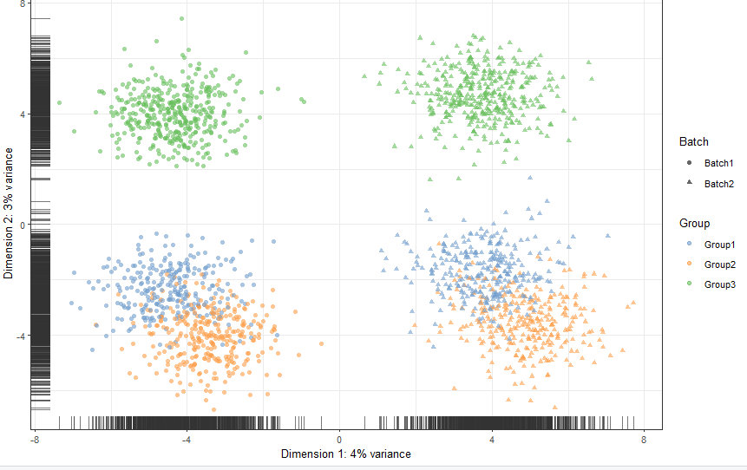
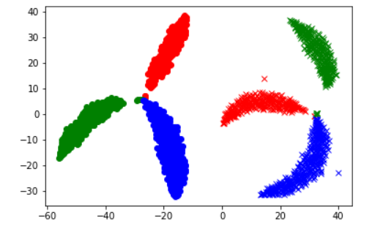
Batch_Data
Location: stocky: /home/chenyx/LSH_Data/Batch_Data/Batch_Data.txt
Size: (1k + 1k) samples * (10000Genes + 2 label dimensions)
Clusters: 2 batches each 3 clusters (0.3, 0.3, 0.4)
Accession: generated by splatter with the script: Batch_Data.R
Explanation: the toy data with batch effect
Usage: to study the robust of batch effect
PCA
tsne

Slide 5
Dropout_Data
Location: stocky: /home/chenyx/LSH_Data/Dropout_X_Data/Dropout_X_Data.txt
Size: 2000 samples * (10000Genes + 1 label dimension)
Clusters: 1 batch with 5 clusters (0.3, 0.3, 0.3, 0.05, 0.05)
Accession: generated by splatter with the script: Dropout_Data.R
Explanation: the toy data with dropout
Usage: to study the robust of dropout
Dataset Num. | 0 | 1 | 2 | 3 | 4 | 5
Dropout rate | 0 | 0.1544 | 0.2515 | 0.3528 | 0.4341 | 0.5360
P.S: The initial dataset(without dropout) has about 45% zero counts.

Slide 6
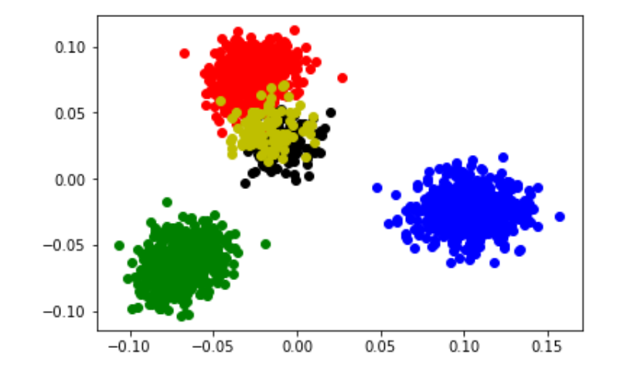
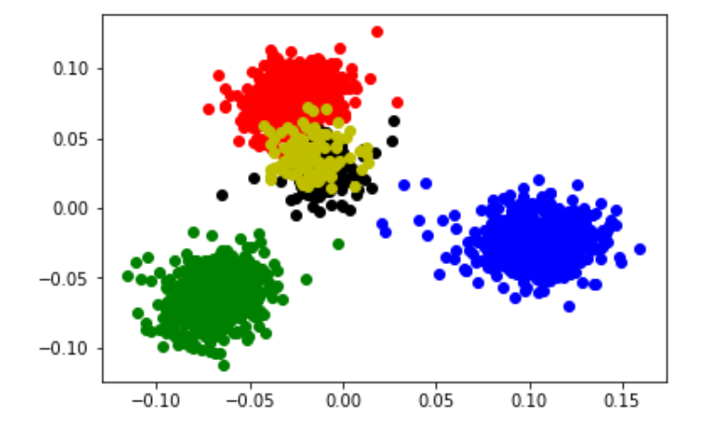
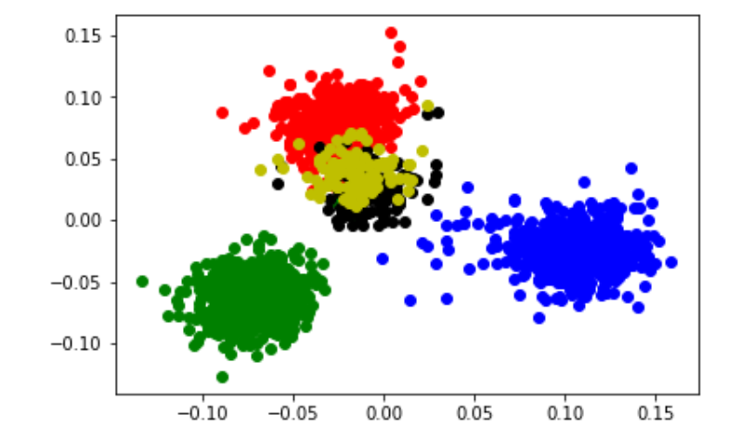
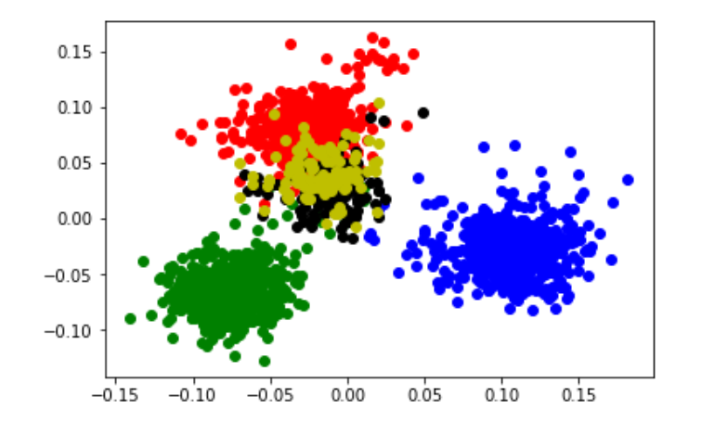
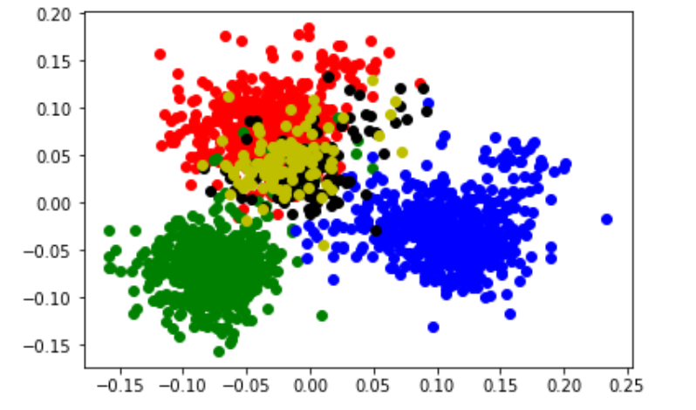
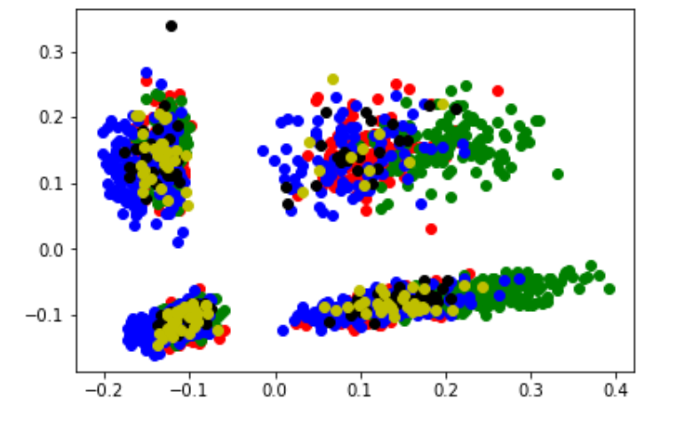
PCA_dataset0
PCA_dataset1
PCA_dataset2
PCA_dataset3
PCA_dataset4
PCA_dataset5

