Slide 1
•••
A CIVILIZATION OF THE NILE
Ancient Egypt
古 埃 及 · 文 明 史 诗
◆
Cradle of Civilization along the Nile River · c. 3150 BC – 30 BC
Source: Wikipedia · Wikimedia Commons
❖ ❖ ❖

Slide 2
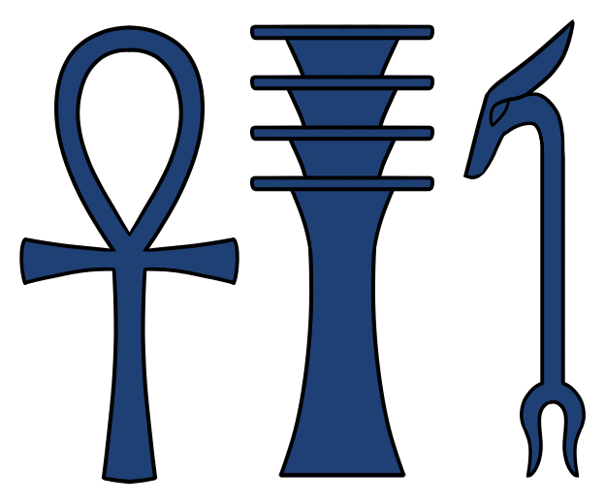
CONTENTS
目 录
01
Overview · 文明概述
02
Timeline of Kingdoms · 王朝年代表
03
Geography & the Nile · 地理与尼罗河
04
Predynastic Period · 前王朝时期
05
Old Kingdom · 古王国 — 金字塔时代
The Three Sacred Symbols
生命 · 稳定 · 力量
06
Middle & New Kingdoms · 中王国与新王国
07
Religion & Gods · 宗教与诸神
08
Writing & Mathematics · 文字与数学
09
Architecture & Art · 建筑与艺术
10
Achievements & Legacy · 成就与遗产
CONTENTS · 目录
2 / 12

Slide 3
01 · OVERVIEW
文 明 概 述
古埃及是沿尼罗河下游兴起的伟大文明，是人类早期最重要的文明摇篮之一。从公元前约3150年由美尼斯统一上下埃及，到公元前30年托勒密王朝被罗马吞并，古埃及延续了逾三千年的辉煌历史。
"
The success of ancient Egyptian civilization came partly from its ability to adapt to the conditions of the Nile.
Ancient Egypt emerged as one of the world's earliest and most enduring civilizations, flourishing for more than three millennia along the fertile banks of the Nile River. It unified Upper and Lower Egypt under the first pharaoh and gave rise to monumental architecture, sophisticated writing, advanced mathematics, and a complex religious worldview.
— Encyclopedia · Wikipedia
3000+
30+
1M+
Years of Civilization
文明存续年数
Dynasties
王朝数量
Pyramids & Tombs
金字塔与墓葬
OVERVIEW · 文明概述
3 / 12

Slide 4
02 · TIMELINE
古 埃 及 王 朝 年 表
Three Kingdoms & Their Intermediate Periods
Period · 时期 | Dates · 年代 | Dynasties · 王朝 | Highlights · 亮点
Early Dynastic Period 早期王朝 | c. 3150 – 2686 BC | 1st – 2nd | Unification by Menes/Narmer; founding of Memphis. 美尼斯统一上下埃及；建立孟菲斯城。
Old Kingdom 古王国 | 2686 – 2181 BC | 3rd – 6th | Age of Pyramids — Giza, Saqqara; solar cult of Ra. 金字塔时代——吉萨、萨卡拉；太阳神拉崇拜。
1st Intermediate 第一中间期 | 2181 – 2055 BC | 7th – 11th | Collapse of central authority; regional rulers. 中央集权崩溃，地方统治者割据。
Middle Kingdom 中王国 | 2055 – 1650 BC | 11th – 14th | Reunification; literary classic; Faiyum irrigation. 再度统一；文学经典；法尤姆绿洲灌溉。
2nd Intermediate 第二中间期 | 1650 – 1550 BC | 15th – 17th | Hyksos rule in the Delta; horse & chariot introduced. 喜克索斯人在三角洲建都；引入马与战车。
New Kingdom 新王国 | 1550 – 1069 BC | 18th – 20th | Imperial Egypt — Hatshepsut, Akhenaten, Tutankhamun, Ramesses II. 帝国时代——哈特谢普苏特、埃赫那顿、图坦卡蒙、拉美西斯二世。
Late Period 后期王朝 | 664 – 332 BC | 26th – 31st | Persian invasions; last native dynasty. 波斯入侵；最后本土王朝。
Ptolemaic 托勒密时期 | 332 – 30 BC | Ptolemaic | Greek rule after Alexander; Cleopatra VII ends dynasty. 亚历山大之后的希腊统治；克娄巴特拉七世终结王朝。
TIMELINE · 王朝年表
4 / 12

Slide 5
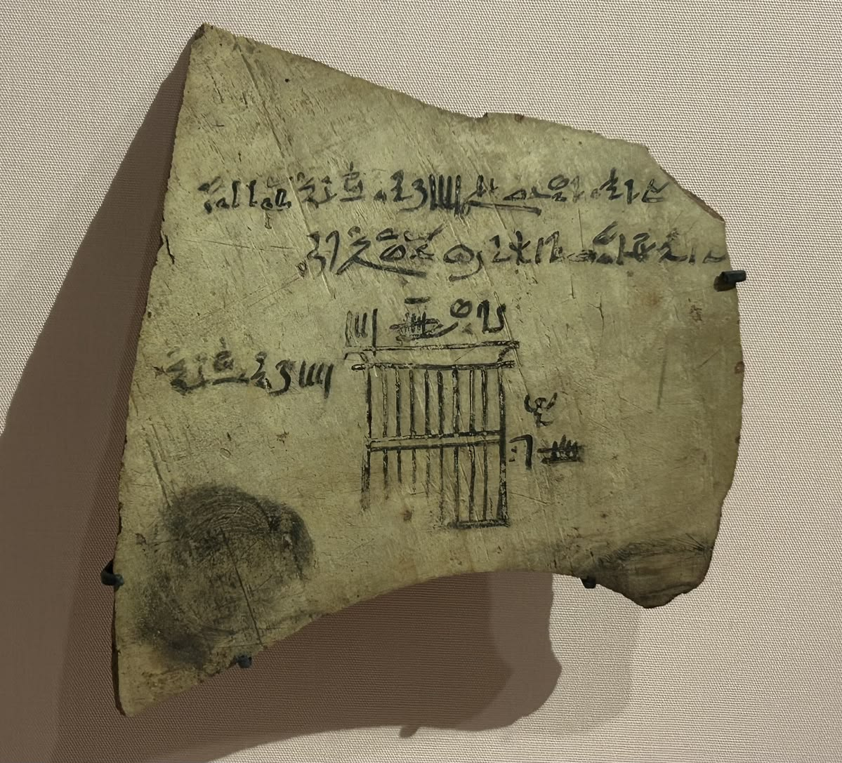
03 · GEOGRAPHY
地 理 与 尼 罗 河
A civilization born of the world's longest river — stretching from the First Cataract to the Mediterranean Delta, the Nile's predictable flooding shaped agriculture, trade, religion, and the very concept of Egyptian kingship.
Administrative Record
管理文书样本
Feature · 特征 | Detail · 详情
Region 地理范围 | Lower Nile, NE Africa 尼罗河下游 · 东北非
Climate 气候 | Hot arid desert, fertile floodplain 炎热干旱沙漠 · 肥沃河谷
Economy 经济基础 | Irrigated agriculture + Nile trade 灌溉农业 + 尼罗河贸易
Capital Capitals 首都 | Memphis · Thebes · Alexandria 孟菲斯 · 底比斯 · 亚历山大
Reach 领土 | Nubia to Levant (New Kingdom peak) 努比亚至黎凡特（新王国鼎盛期）
Limestone ostracon with hieratic inscription on a window order
1295 – 1186 BCE · Louvre
"The Nile has been the lifeline of its region for much of human history. The fertile floodplain gave humans the opportunity to develop a settled agricultural economy and a more sophisticated, centralized society."
GEOGRAPHY · 地理
5 / 12

Slide 6
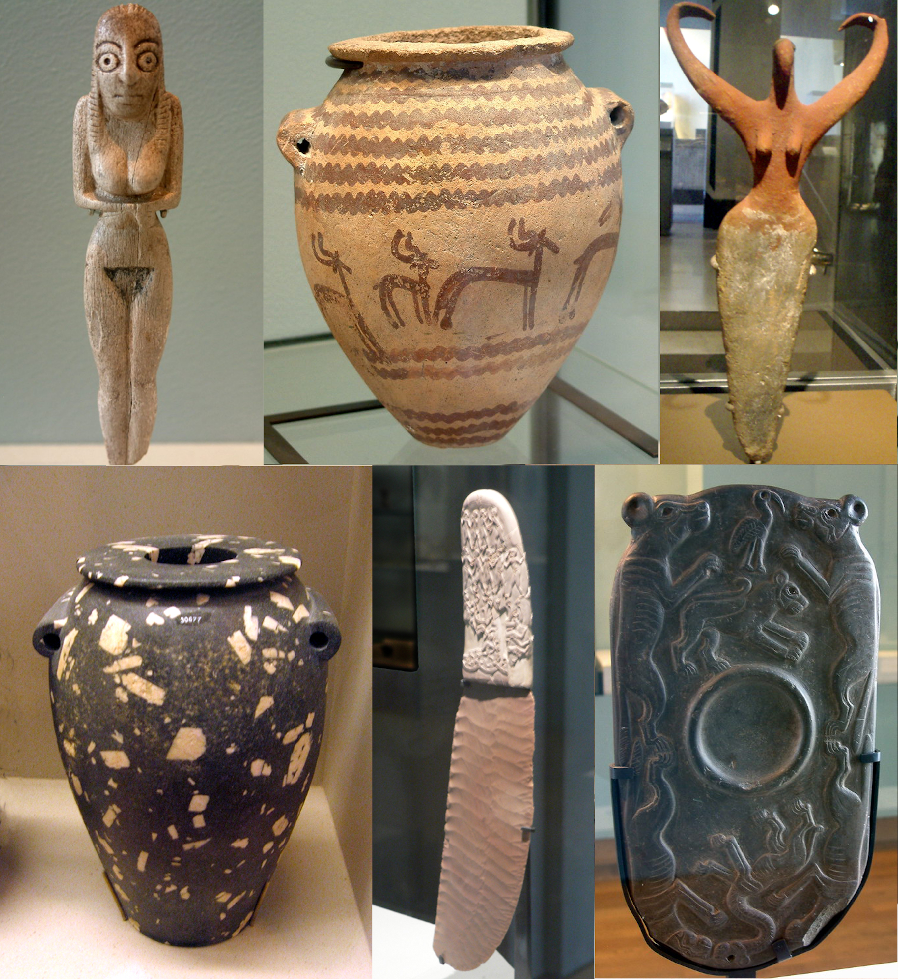
04 · PREDYNASTIC PERIOD
前 王 朝 时 期
c. 5000 – 3100 BCE
Predynastic Egypt
The formative era when scattered farming settlements along the Nile gradually coalesced into larger political units. Key developments included copper metallurgy, the rise of Upper Egyptian kingdoms (Naqada culture), early hieroglyphic writing, and the emergence of divine kingship.
前王朝阶段
尼罗河沿岸的史前聚落逐步发展为更大规模的政治实体。这一时期出现了铜器冶炼、上埃及那伽达文化、早期象形文字雏形以及神权王权的萌芽。陶俑、调色板、化妆石板等遗物显示出独特的艺术风格。
Phase · 阶段 | Period · 年代 | Significance · 意义
Naqada I 巴达里文化 | c. 5000 – 4000 BC | Agriculture, pottery, early settlements 农业 · 制陶 · 早期定居
Naqada II 那伽达二期 | c. 4000 – 3500 BC | Long-distance trade, chiefdoms 远程贸易 · 部族联盟
Naqada III 那伽达三期 | c. 3500 – 3100 BC | Prototype kingship, writing emerges 王权雏形 · 文字萌芽
Predynastic Artefacts Collage · 前王朝文物精选
PREDYNASTIC · 前王朝
6 / 12

Slide 7
05 · OLD KINGDOM
古 王 国 · 金 字 塔 时 代
Age of the Pyramid Builders · 2686 – 2181 BC
☥
神 圣 王 权
△
纪 念 碑 建 筑
☉
太 阳 神 信 仰
Divine Kingship
Monumental Architecture
Solar Religion
The pharaoh was worshipped as a living god, the intermediary between the gods and the people. The pyramid was both tomb and stairway to the eternal stars.
The Great Pyramid of Giza (Khufu), the Sphinx, and the sun temples of Abu Gurab define this era of stone. Engineering, mathematics, and labor organization reached new heights.
The cult of Ra dominated. Pharaohs took the title "Son of Ra", and the Pyramid Texts inscribed on tomb walls ensured safe passage through the afterlife.
法老被视为活神，是神人之间的中介。金字塔既是陵墓，也是通往永恒星辰的天梯。
吉萨大金字塔（胡夫）、狮身人面像、阿布古拉布太阳神庙——石造建筑的巅峰。工程、数学与组织能力达到空前高度。
太阳神拉信仰占据主导。法老自称"拉之子"，金字塔铭文确保来世之旅的顺利。
Dynasties 3 – 6 · Memphis as capital · Birth of monumental funerary architecture
OLD KINGDOM · 古王国
7 / 12

Slide 8
06 · CLASSICAL & IMPERIAL AGES
中 王 国 与 新 王 国
Classical Literature · Imperial Expansion
MIDDLE KINGDOM
NEW KINGDOM
中 王 国
新 王 国
2055 – 1650 BC · Dynasty 11 – 14 · Capital: Thebes
1550 – 1069 BC · Dynasty 18 – 20 · Imperial Egypt
Reunification after 1st Intermediate
Expulsion of the Hyksos; reunification
第一中间期后再度统一
驱逐喜克索斯人 · 重新统一
Classical literature: Tale of Sinuhe, Story of the Shipwrecked Sailor
Hatshepsut — female pharaoh, Punt expedition
经典文学：《辛努赫的故事》《遇难水手》
哈特谢普苏特女王 · 蓬特远征
Faiyum irrigation project; large scale agricultural expansion
Akhenaten's monotheistic Aten cult
埃赫那顿一神教改革
法尤姆水利工程 · 农业大扩张
Tutankhamun restores traditional religion
Nubia campaigns; trade with the Levant
图坦卡蒙恢复传统宗教
努比亚战事 · 黎凡特贸易
Ramesses II — Battle of Kadesh, first peace treaty
Cataract forts along the Nile
拉美西斯二世 · 卡迭石战役 · 世界上最早的和约
尼罗河沿线的要塞
Tomb of the Kings in the Valley of the Kings
Democratization of the afterlife — Coffin Texts
帝王谷王陵
来世观念普及——《棺文》
Temples of Karnak & Luxor; Abu Simbel
卡纳克、卢克索神庙；阿布辛贝
MIDDLE & NEW KINGDOMS
8 / 12

Slide 9
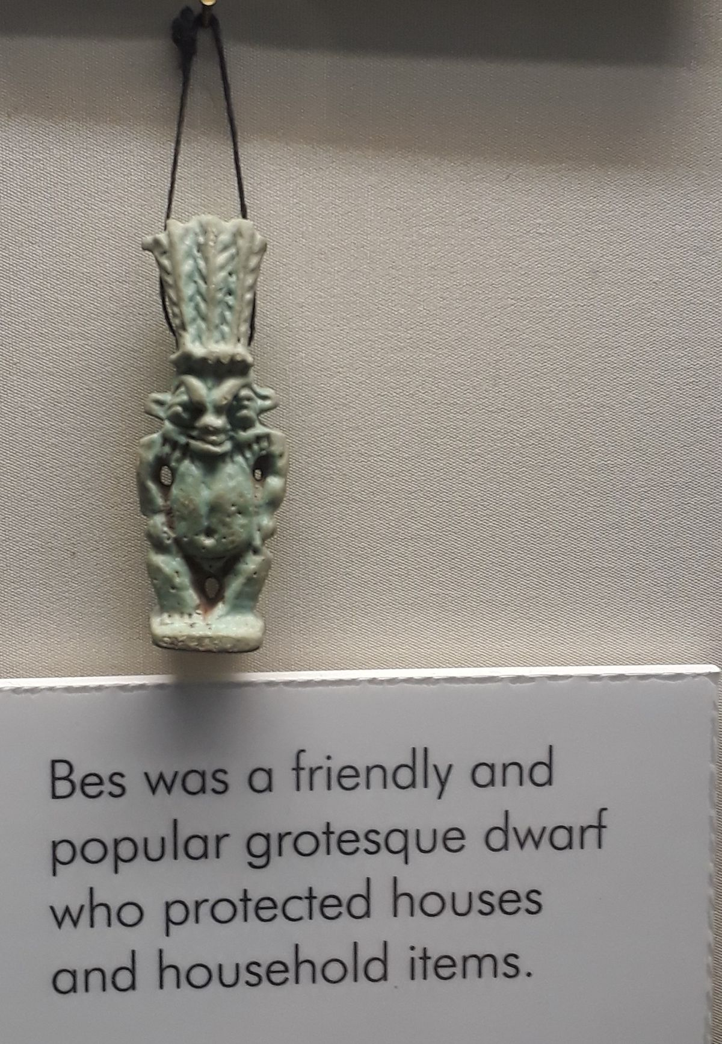
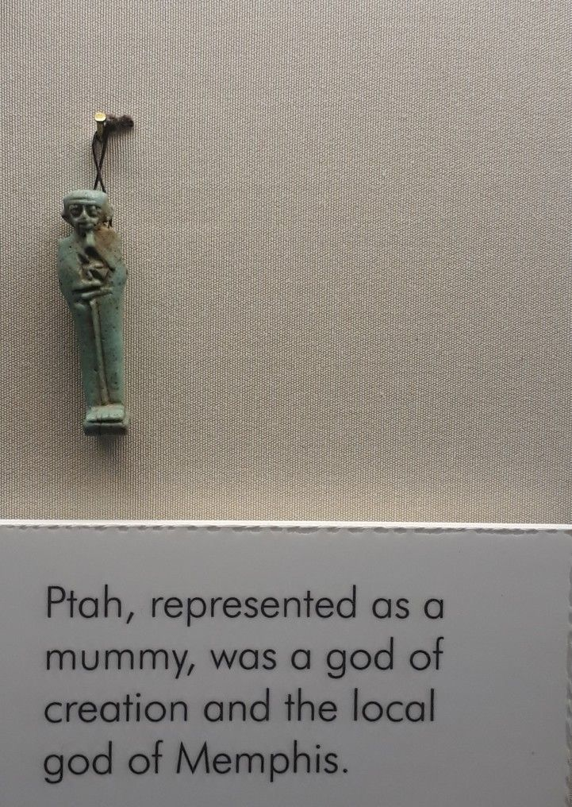
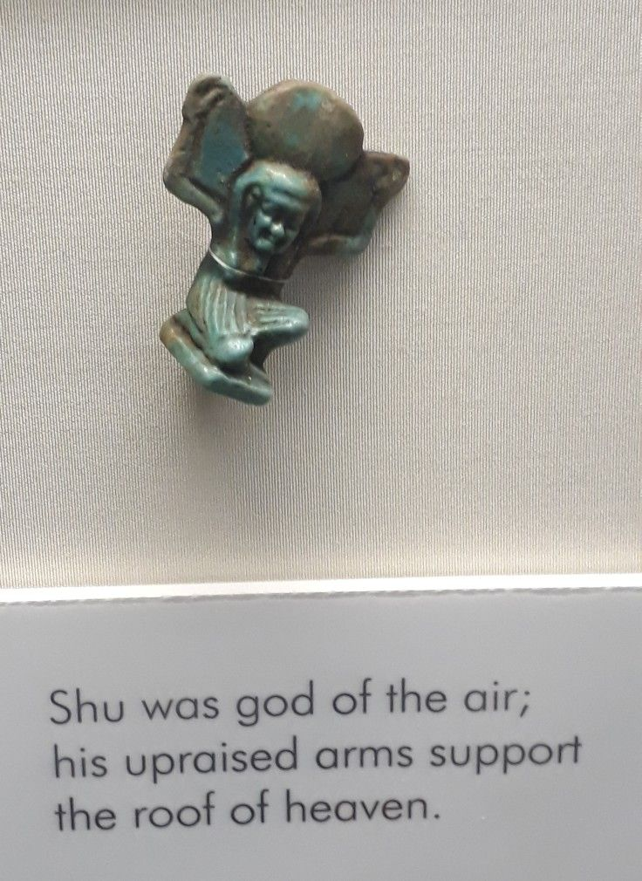
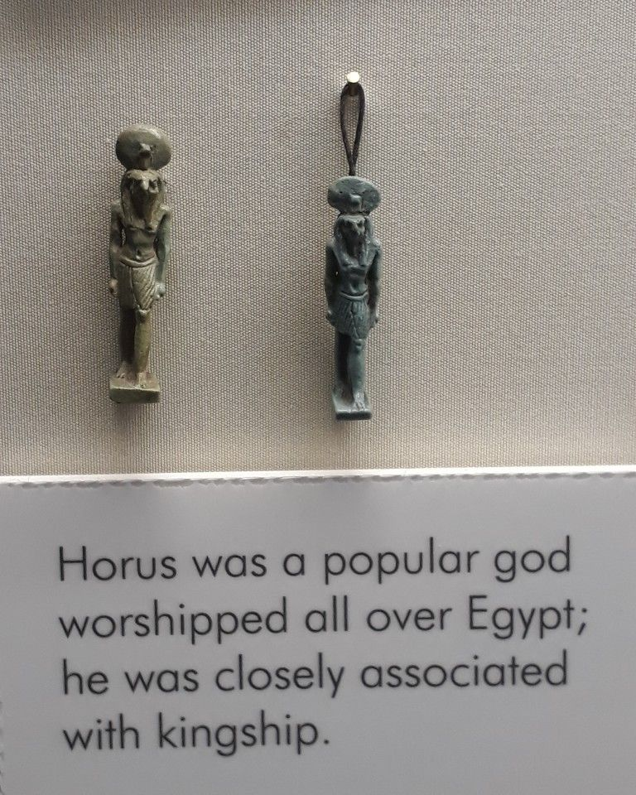
07 · RELIGION & GODS
宗 教 与 诸 神
From household amulets to cosmic theology
BES
PTAH
SHU
HORUS
Protector of Households
家庭守护神 · 驱邪避凶
God of Memphis & Creation
孟菲斯主神 · 创造之神
God of Air · 空气之神
Sky God of Kingship
天空之神 · 王权象征
A friendly grotesque dwarf deity who warded off evil spirits and protected mothers, children, and homes. Often shown with a leonine mane, protruding tongue, and bow-legged stance.
Dressed as a mummified man with a tight cap and a staff combining the ankh, djed and was. Patron of craftsmen and architects; "Nefertum" and "Imhotep" were associated with him.
His upraised arms hold up the sky, separating it from the earth. Son of Atum/Ra; with his sister Tefnut (moisture) he began the world's order.
Falcon-headed son of Osiris and Isis. The living pharaoh was the earthly embodiment of Horus; his eye (the wedjat) became a powerful protective symbol.
Amulets, Birmingham Museum & Art Gallery · 伯明翰博物馆与艺术馆馆藏
RELIGION & GODS · 宗教与神祇
9 / 12

Slide 10
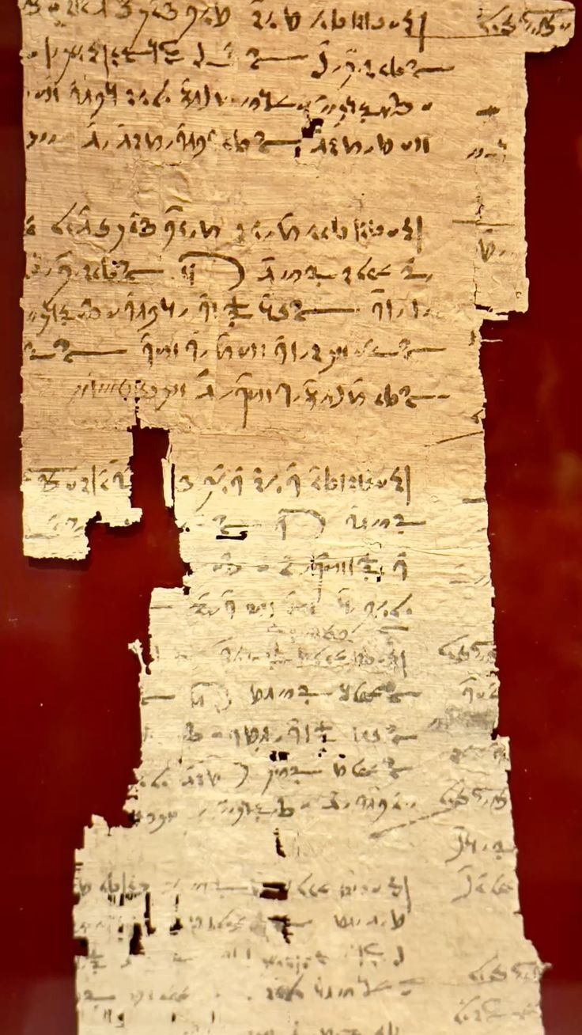
08 · LANGUAGE & MATHEMATICS
语 言 · 文 字 · 数 学
WRITING SYSTEMS
MATHEMATICS
文 字 系 统
古 埃 及 数 学
Script · 字体 | Use · 用途 | Notes · 备注
Hieroglyphic 象形文字 | Monuments, tombs 纪念碑 · 陵墓 | 800+ symbols 800+ 符号
Hieratic 僧侣体 | Administrative, literary 行政 · 文学 | Cursive shorthand 简化的草书体
Demotic 世俗体 | Daily business 日常商务 | From 7th c. BC 公元前7世纪起
Coptic 科普特文 | Late Egyptian 晚期埃及 | Greek-based alphabet 希腊字母改造
Egyptian mathematics — visible on the Rhind Mathematical Papyrus (~1650 BC) — used hieratic numerals and fractions. Scribes solved problems of surveying, grain storage, and pyramid construction.
Three Sacred Symbols
三 大 神 圣 符 号
☥ Ankh · 生命之符 | Life & immortality 生命与永生
𓊽 Djed · 稳定之柱 | Stability · 稳定
𓌀 Was · 权 杖 之 神 | Power & dominion 权力与统辖
Mathematical ostracon, c. 50 BCE – 10 CE · Ashmolean Museum
"The earliest mathematical texts demonstrate sophisticated multiplication, division, and geometric methods."
WRITING & MATH · 文字与数学
10 / 12

Slide 11
09 · ARCHITECTURE & ART
建 筑 与 艺 术
Stone, Symbol, and Story
ARCHITECTURAL MARVELS
建 筑 奇 迹
Monument · 建筑 | Era · 年代 | Note · 描述
Pyramid of Djoser 乔塞尔金字塔 | 27th c. BC | First stone pyramid; Imhotep 首座石造金字塔 · 印何阗设计
Great Pyramid of Giza 吉萨大金字塔 | c. 2560 BC | 146 m; ancient wonder 146米 · 古代世界七大奇迹之一
Karnak Temple Complex 卡纳克神庙群 | Middle – Late | Largest religious complex 最大宗教建筑群
Abu Simbel 阿布辛贝神庙 | 13th c. BC | Ramesses II rock-cut temple 拉美西斯二世岩凿神庙
Valley of the Kings 帝王谷 | New Kingdom | Royal tombs including Tutankhamun 图坦卡蒙陵墓所在地
Predynastic Egyptian artefacts · Idols, pottery, palettes, maceheads
ARCHITECTURE & ART · 建筑与艺术
11 / 12

Slide 12
10 · ACHIEVEMENTS & LEGACY
文 明 成 就 与 千 载 遗 产
◆
SCIENCE & TECHNOLOGY
CULTURE & WRITING
LEGACY · 千载影响
科学与技术
文化与文字
跨时代影响
✦
Quarrying, surveying, construction
✦
Earliest peace treaty with Hittites
✦
Inspired Greek & Roman art
✦
Mathematical system & geometry
✦
Rich literary tradition
✦
Influence on Coptic Christianity
✦
Effective medicine & surgery
✦
Hieroglyphic writing system
✦
Modern Egyptology (since 1822)
✦
First known planked boats
✦
Calendar of 365 days
✦
Universal symbol of antiquity
✦
Faience and glass technology
✦
Monumental art & architecture
✦
UNESCO world heritage sites
"Its art and architecture were widely copied and its antiquities carried off to be studied, admired, or coveted in the far corners of the world."
THANK YOU

